Slide 1





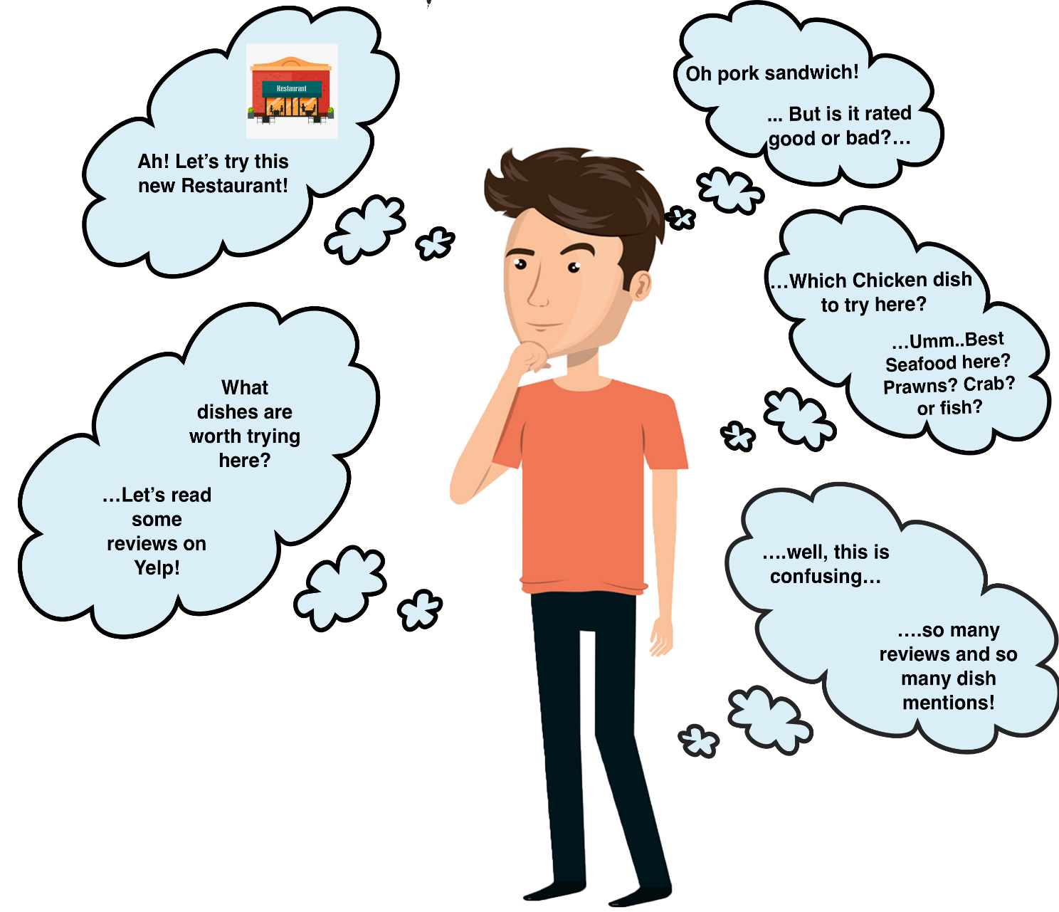




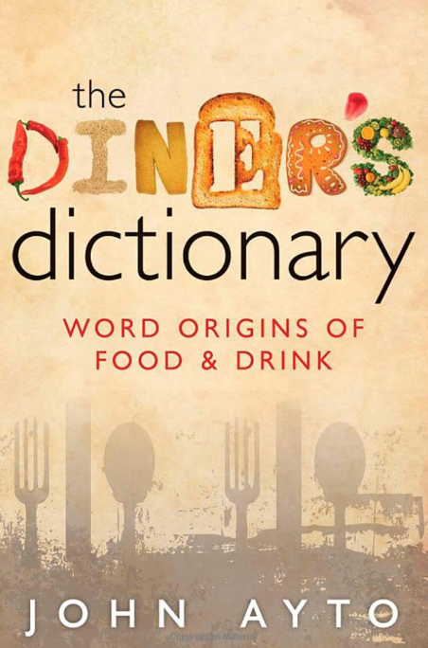
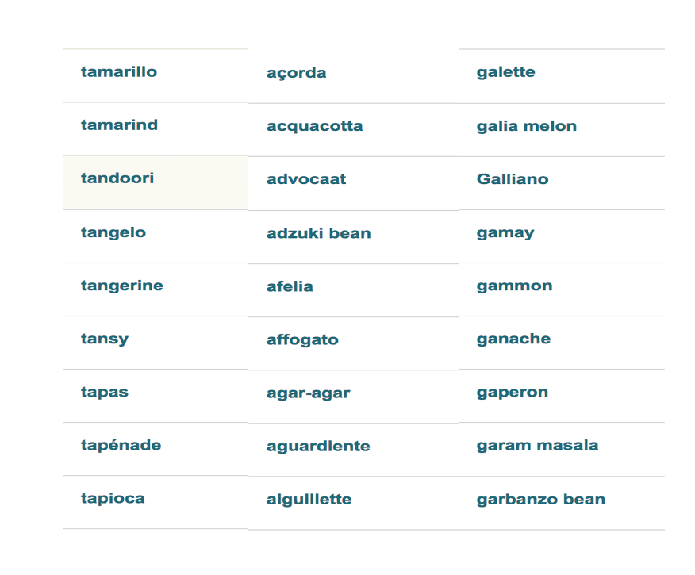

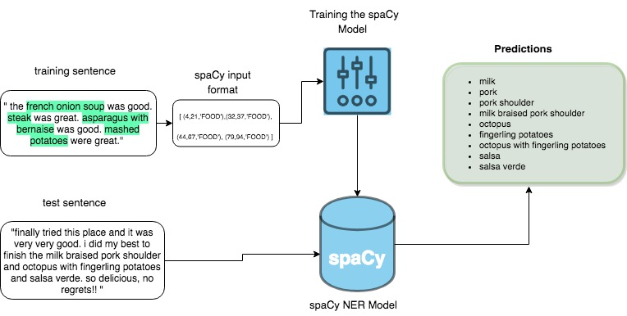

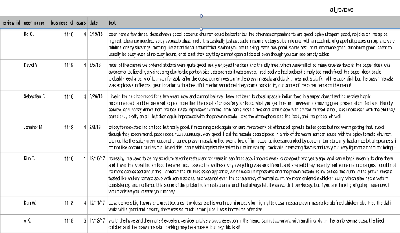



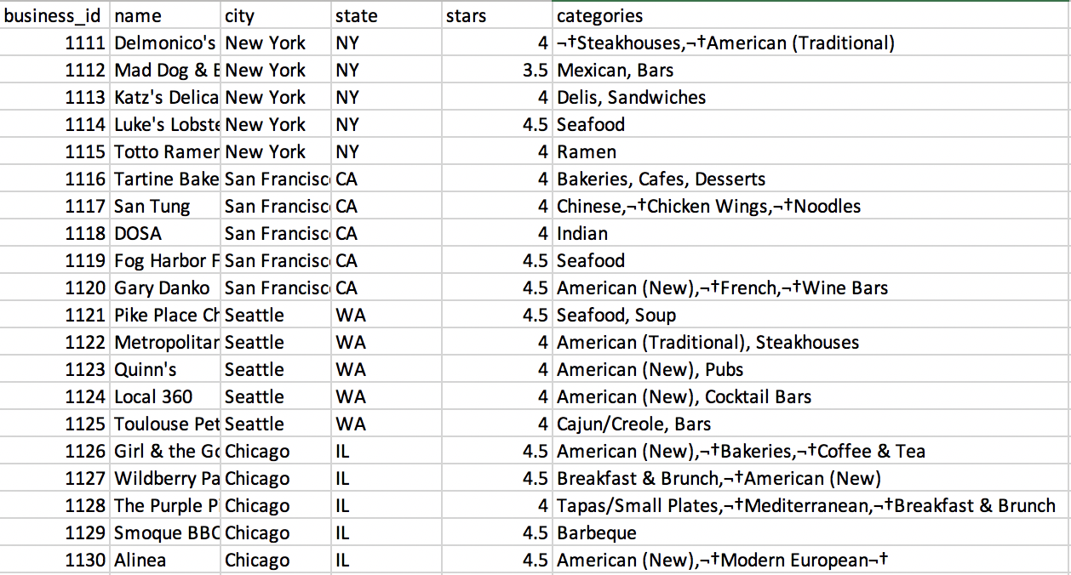

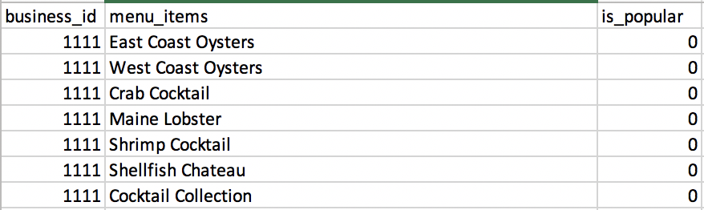
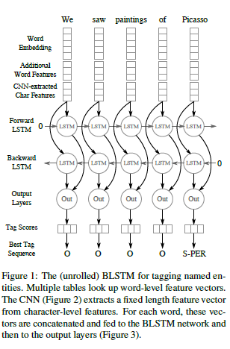
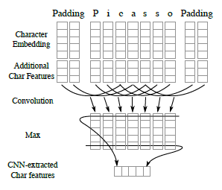
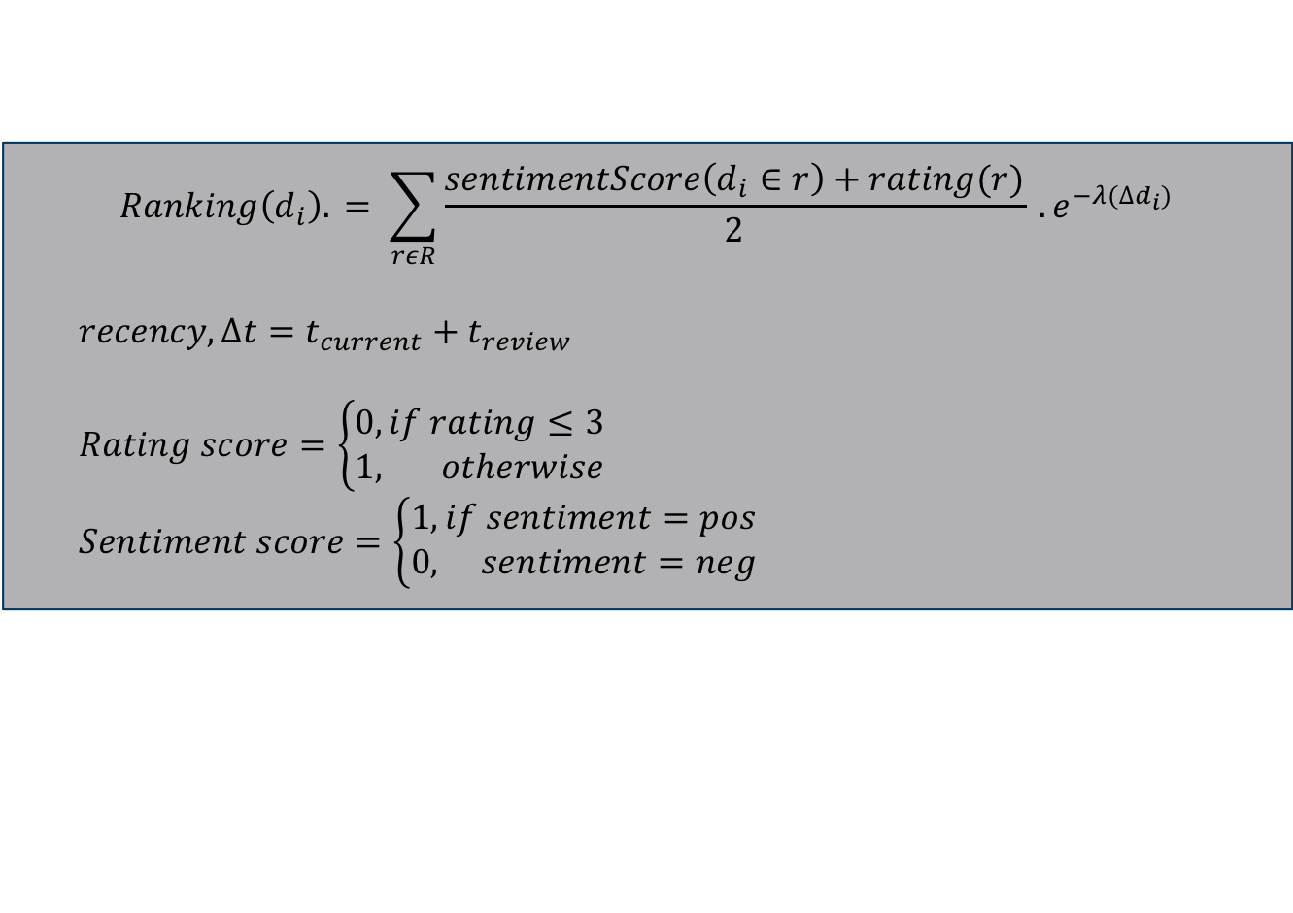
Word2Mouth: A Top Dish Recommender System
Abhirup Mukherjee, Mithra Muthukrishnan, Aditya Narula, Aishwarya Turuvekere
¹University of Massachusetts Amherst
The problem
Reviews
List of Menu Items
Eliminate duplicates using similarity measure
Annotate
Split into Train and Test
Named Entity Recognition
SpaCy
BiLSTM
Final list of Dishes
Validate against scraped menus
Analysis
Customers visiting a new restaurant are often faced with the dilemma of which dishes to try out. The most convenient way is to go to Yelp and to browse through customer reviews and find dishes rated best by others.
But the amount of data available is both overwhelming and _ for one to find the restaurant’s most popular dishes quickly.
Reviews
Aggregate
Final Top Dishes
Validate against scraped top dishes
Tag all reviews with sentiment
Sentiment Analysis
Stanford Core NLP
Logistic Regression
Top items on Yelp | Top items retrieved by model
dungeness crab roll | chowder
market chowder | crab
new england clam chowder | seafood bisque
seafood bisque | bread
seared scallop chowder | clam chowder
smoked salmon chowder | new england clam chowder
southwestern chicken & corn chowder | dungeness crab roll
vegan chowder | smoked salmon chowder
 | lobster
 | england clam chowder
Baseline
NER using spaCy
The spaCy approach involves training the NER model using the annotated training data. Once trained, we use it to extract food entities from unannotated reviews. Gives a list of food/menu items. A similarity metric is applied to the predictions list to eliminate redundant menu items.
Top 10 items based on the dishes retrieved by spaCy
Precision and Recall
 | Precision | Recall
Absolute Match | 40% | 50%
Substring Match | 80% | 100%
The Data
 | Baseline (with stemming) | Baseline (without stemming)
Precision | 11% | 6.85%
Recall | 25% | 10%
Which performs better?
Data scraped from yelp.com for 22 most popular restaurants located in Seattle, San Francisco, New York, and Chicago.
Raw data scraped for each restaurant
menu list
reviews to annotate
Cookie cooki
Chocolate chocol
Evaluation
NER using BiLSTM
The (unrolled) BiLSTM for tagging named entities. Multiple tables look up word-level feature vectors.
The CNN extracts fixed length feature vector from character level features. For each word, these vectors are concatenated and fed to BiLSTM network and then to output layers.
The Future Direction
$$Ranking\left(d_{i}\right). = \sum_{rεR}{\frac{sentimentScore\left(d_{i}∈r\right)+rating(r)}{2}} . e^{−λ(∆d_{i})}$$
$recency, ∆t=t_{current}+t_{review}$
$Rating score=\left\{\begin{aligned}0, if rating≤3 \\ 1, otherwise\end{aligned}\right.$
$Sentiment score=\left\{\begin{aligned}1, if sentiment=pos \\ 0, sentiment=neg\end{aligned}\right.$
Click here to insert your Conclusions text. Type it in or copy and paste from your Word document or other source.
To change the font style of this text box: Click on the border once to highlight the entire text box, then select a different font or font size that suits you. This text is Calibri 20pt and is easily read up to 3 feet away on a 24x36 poster, and up to 6 feet away on a 48x72 poster.
Zoom out to 100% (for 24x36) or 200% (for 48x72) to preview what this will look like on your printed poster.

