Slide 1
Data Fusion
Eyüp Serdar AYAZ
İlker Nadi BOZKURT
Hayrettin GÜRKÖK

Slide 2
Outline
What is data fusion?
Why use data fusion?
Previous work
Components of data fusion
  System selection
  Bias concept
  Data fusion methods
Experiments
Conclusion

Slide 3
Data Fusion
Merging the retrieval results of multiple systems.
A data fusion algorithm accepts two or more ranked lists and merges these lists into a single ranked list with the aim of providing better effectiveness than all systems used for data fusion.

Slide 4
Why use data fusion?
Combining evidence from different systems leads to performance improvement
  Use data fusion to achieve better performance than the individual systems involved in the process.
Example metasearch systems
  www.dogpile.com
  www.copernic.com

Slide 5
Why use data fusion?
Same idea is also used for different query representations
  Fuse the results of different query representations for the same request and obtain better results
Measuring relative performance of IR systems such as web search engines is essential
  Use data fusion for finding pseudo relevant documents and use these for automatic ranking of retrieval systems

Slide 6
Previous work
Borda Count method in IR
  Models for Metasearch, Aslam & Montague, ‘01
Random Selection, Soboroff et.al., ‘01
Condorcet method in IR
  Condorcet Fusion in Information Retrieval, Aslam & Montague, ’02
Reference Count method for automatic ranking, Wu & Crestani, ‘02

Slide 7
Previous work
Logistic Regression and SVM model
  Learning a ranking from Pairwise preferences, Carterette & Petkova, ’06
Fusion in automatic ranking of IR systems
  Automatic ranking of information retrieval systems using data fusion, Nuray & Can ’06

Slide 8
Components of data fusion
DB/search engine selector
Select systems to fuse
Query dispatcher
Submit queries to selected search engines
Document selector
Select documents to fuse
Result merger
Merge selected document results

Slide 9
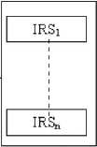
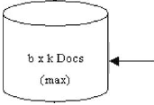
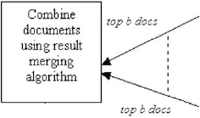
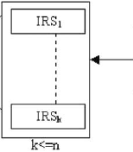

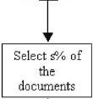
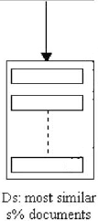
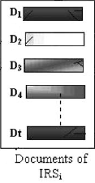
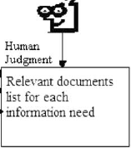
Ranking retrieval systems

Slide 10
System selection methods
Best: certain percentage of top performing systems used
Normal: all systems to be ranked are used
Bias: certain percentage of systems that behave differently from the norm (majority of all systems) are used

Slide 11
More on bias concept
A system is defined to be biased if its query responses are different from the norm, i.e., the majority of the documents returned by all systems.
Biased systems improve data fusion
  Eliminate ordinary systems from fusion
  Better discrimination among documents and systems

Slide 12
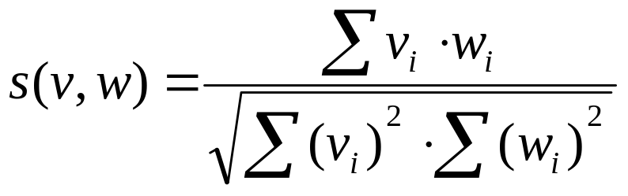
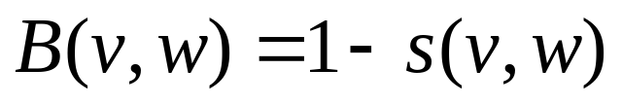
Calculating bias of a system
Similarity value
Bias of a system
 | v: vector of norm w: vector of retrieval system

Slide 13
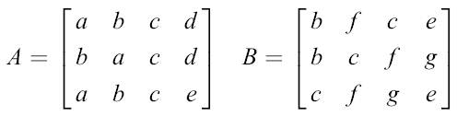
Example of calculating bias
norm vector → X = X_{A}+X_{B} = (3, 5, 6, 2, 3, 3, 2)
s(X_{A},X)=49/[32][96]^{1/2} = 0.8841
Bias(A)=1-0.8841=0.1159
s(X_{B},X)=47/[30][96]^{1/2} = 0.8758
Bias(B)=1-0.8758=0.1242
X_{A}=(3, 3, 3, 2, 1, 0, 0) X_{B}=(0, 2, 3, 0, 2, 3, 2) | 2 systems: A and B 7 documents: a, b, c, d, e, f, g i^{th} row is the result for i^{th} query

Slide 14
Bias calculation with order
Order is important because users usually just look at the documents of higher rank.
Increment the frequency count of a document by m/i instead of 1 where m is number of positions and i position of the document.
m=4
X_{A}=(10, 8, 4, 2, 1, 0, 0); X_{B}=(0, 8, 22/3, 0, 2, 8/3, 7/3)
Bias(A)=0.0087; Bias(B)=0.1226
 | 2 systems: A and B 7 documents: a, b, c, d, e, f, g i^{th} row is the result for i^{th} query

Slide 15
Data fusion methods
Similarity value models
  CombMIN, CombMAX, CombMED,
  CombSUM, CombANZ, CombMNZ
Rank based models
  Rank position (reciprocal rank) method
  Borda count method
  Condorcet method
  Logistic regression model

Slide 16
Similarity value methods
CombMIN – choose min of similarity values
CombMAX – choose max of similarity values
CombMED – take median of similarity values
CombSUM – sum of similarity values
CombANZ - CombSUM / # non-zero similarity values
CombMNZ - CombSUM * # non-zero similarity values

Slide 17
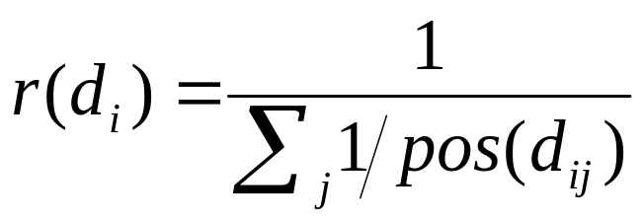
Rank position method
Merge documents using only rank positions
Rank score of document i (j: system index)
If a system j has not ranked document i at all, skip it.

Slide 18
Rank position example
4 systems: A, B, C, D
documents: a, b, c, d, e, f, g
Query results:
A={a,b,c,d}, B={a,d,b,e},
C={c,a,f,e}, D={b,g,e,f}
r(a)=1/(1+1+1/2)=0.4
r(b)=1/(1/2+1/3+1)=0.52
Final ranking of documents:
(most relev) a > b > c > d > e > f > g (least relev)

Slide 19
Borda Count method
Based on democratic election strategies.
The highest ranked document in a system gets n Borda points and each subsequent gets one point less where n is the number of total retrieved documents by all systems.

Slide 20
Borda Count example
3 systems: A, B, C
Query results:
A={a,c,b,d}, B={b,c,a,e}, C={c,a,b,e}
  5 distinct docs retrieved: a, b, c, d, e. So, n=5.
BC(a)=BC_{A}(a)+BC_{B}(a)+BC_{C}(a)=5+3+4=12
BC(b)=BC_{A}(b)+BC_{B}(b)+BC_{C}(b)=3+5+3=11
Final ranking of documents:
(most relevant) c > a > b > e > d (least relevant)

Slide 21
Condorcet method
Also, based on democratic election strategies.
Majoritarian method
  The winner is the document which beats each of the other documents in a pair wise comparison.

Slide 22
Condorcet example
3 candidate documents: a, b, c
5 systems: A, B, C, D, E
A: a>b>c - B:a>c>b - C:a>b=c - D:b>a - E:c>a
Final ranking of documents
a > b = c
Pairwise comparison | Pairwise winners
 | a | b | c
a | - | 4, 1, 0 | 4, 1, 0
b | 1, 4, 0 | - | 2, 2, 1
c | 1, 4, 0 | 2, 2, 1 | -
 | Win | Lose | Tie
a | 2 | 0 | 0
b | 0 | 1 | 1
c | 0 | 1 | 1

Slide 23
Experiments
Turkish Text Retrieval System will be used
  All Milliyet articles from 2001 to 2005
  80 different system ranked results
    8 matching methods
    10 stemming functions
  72 queries for each system
4 approaches for on the experiments

Slide 24
Experiments
First Approach
  Mean average precision values of merged system is significantly greater than al the individual systems
Second Approach
  Find the data fusion method that gives the highest mean average precision value

Slide 25
Experiments
Third Approach
  Find the best stemming method in terms of mean average precision values
Fourth Approach
  See the effect of system selection methods

Slide 26
Conclusion
Data Fusion is an active research area
We will use several data fusion techniques on the now famous Milliyet database and compare their relative merits
We will also use TREC data for testing if possible
We will hopefully find some novel approaches in addition to existing methods

Slide 27
References
Automatic Ranking of Retrieval Systems using Data Fusion (Nuray,R & Can,F, IPM 2006)
Fusion of Effective Retrieval Strategies in the same Information Retrieval System (Beitzel et.al., JASIST 2004)
Learning a Ranking from Pairwise Preferences (Carterette et.al., SIGIR 2006)

Slide 28
Thanks for your patience.
Questions?

