Slide 1

EFFECTIVE WATER QUALITY MONITORING USING DATA FUSION
Department of Information Technology
SSN College of Engineering, Kalavakkam - 603 110
Academic Year 2015 - 2016

Slide 2
STUDENT PROJECT BY
1. AISHWARYA A.
Reg No. : 312212205002
2. ARUN SHUNMUGAM J.
Reg No. : 312212205014
3. DEEPAK S.
Reg No. : 312212205023
PROJECT GUIDES
Ms. S. Mohanavalli
Assistant Professor
Ms. Srividya
Assistant Professor

Slide 3
INTRODUCTION
A robust Real-Time Water Quality Monitoring System to detect and identify the quality of water dynamically
A combination of Data Analytics, Data Fusion and Machine Learning techniques
Real-time Data from Water and surroundings obtained and processed to alert the user when water detected non-potable or non-usable
System classifies water usage according to different needs
Affordable by a common man
Suited to Indian circumstances

Slide 4
Overall System Design
Water Local Fusion
Water
Source
Soil Local Fusion
Central Fusion
Quality and Class of usage
Dataset
Air Local Fusion
Machine Learning
Data Analytics

Slide 5
ORIGIN AND IMPORTANCE
Despite already developed sophisticated systems, neither affordable nor suitable
Water, a depleting resource
Cost-effective systems are essential
Classify water, rather waste it (Know your water)
High correlation between water quality and human health
Water-borne diseases, Improper discharge of Industrial Wastes, Domestic sewage
Only preliminary research is being done regarding application of Data Fusion in Environmental Science
Contribution to Environment

Slide 6
BACKGROUND
Major pollutants: Asbestos, Lead, Mercury, Nitrates, Phosphates, Sulphur, Oils, Petrochemicals
Industries involved: complex organic chemical industries, electric power plants, food industry, iron and steel industry, mines and quarries, nuclear industry, pulp and paper industry, water treatment
Causes: chemicals, pathogens, solids and emulsions, hydraulic fracturing, unregulated industrial waste discharge, lacks sufficient treatment capacity in India, growing population, unrelenting urbanization
Effects: elevated temperature, discoloration, increased turbidity, toxic wastes increase, oxygen depletion, affecting plants, fishes' gills, waterborne diseases in humans

Slide 7
OBJECTIVE
To identify the quality of water
To classify the usage of water according to the various domestic uses
To alert the user whenever desired
To plan and prioritize of pollution control strategies
To assess the nature and extent of pollution control needed in different water bodies
To evaluate effectiveness of pollution control measures already in existence
To evaluate water quality trend over a period of time
To understand the environmental fate
To assess the fitness of water for different uses

Slide 8
DESIGN
System to alert an user if the water being consumed becomes not safe.
The entire system can be divided into local fusion modules and a central fusion module, each observing values from water, air and soil
Feature reduction or attribute selection can be done in order to reduce time consumption

Slide 9
METHODOLOGY
To gather readings of various parameters of water, soil and surrounding air in real-time
To clean and fuse the parameters of every resource individually
To provide a local decision at every local fusion node
To fuse and process the local decisions to provide one final decision at the central node
To alert the user with a prompt regarding when the water is detected non-potable or non-usable

Slide 10
LOCAL FUSION MODULE
Parameter readings are obtained
Readings flood in after every 30 minutes
Sensors readings cleaned for false negative values
With the resultant readings, mean values are determined
Mean Reading of every parameter is compared with Indian Government Standards
According to deviation from the standards of reasonable usage, levels or labels of parameters are assigned
Labels fused and processed to provide a local decision
Three local fusion nodes for water, soil and air

Slide 11
LOCAL FUSION ALGORITHMS
Preprocessing and Cleaning of input data and Normalization
Mean values are obtained using K-Means Clustering Algorithm
Labels such as 'Very Safe', 'Safe', 'Below Safe' are fused and processed using Bayesian Classification to provide a Local Decision

Slide 12
Local
Fusion
Module
pH
Conductivity
Dissolved Oxygen
Safe
Very Safe
Below Safe
Local Decision

Slide 13
CENTRAL FUSION MODULE
Local decisions or labels are obtained from the local modules
Fused and synthesized using Decision Tree Methods to provide a Final Decision
Based on the Final Decision, priorities are retrieved whether the water can be used for drinking, washing or other purposes

Slide 14
Water Local Decision
Air Local Decision
Soil Local Decision
Final Decision

Slide 15
WORK IN PROGRESS
S.No | Name of the dataset | Number of Attributes | Number of reduced attributes | Number of clusters | Number of classes of water
1 | UCI Wastewater Dataset | 37 |  |  | 13
2 | CPCB Basin wise Water Quality Data 2011 | 8 |  |  | 2
3 | CPCB Ganga 2003 | 8 |  |  | 2
4 | CPCB Krishna 2003 | 8 |  |  | 2
5 | CPCB Krishna 2004 | 8 |  |  | 2
Water datasets containing values of various parameters acquired
Preliminary preprocessing of data and Normalization
Determining the number of clusters using Elbow method
K-Means Cluster Analysis and Ward Hierarchical Clustering
Feature Reduction

Slide 16
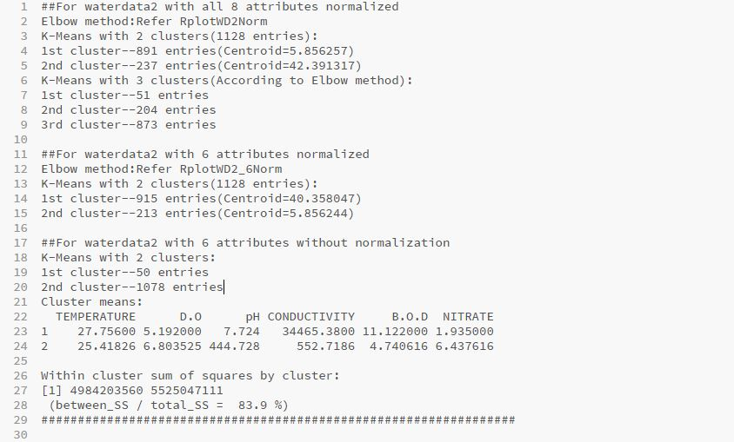
RESULTS

Slide 17
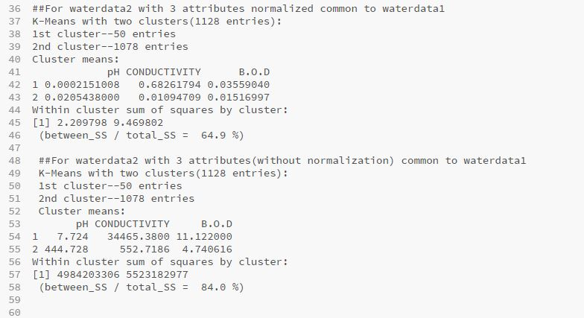

Slide 18
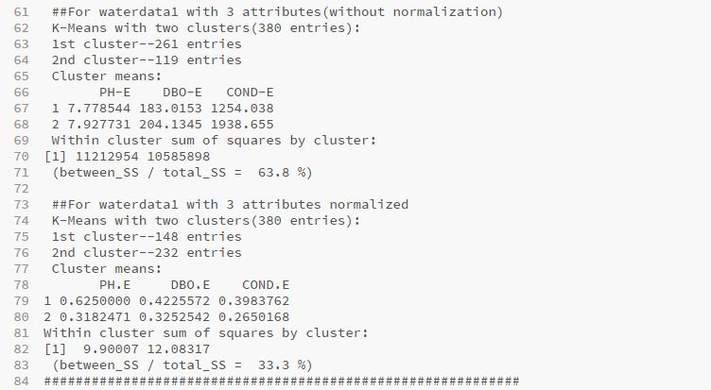

Slide 19
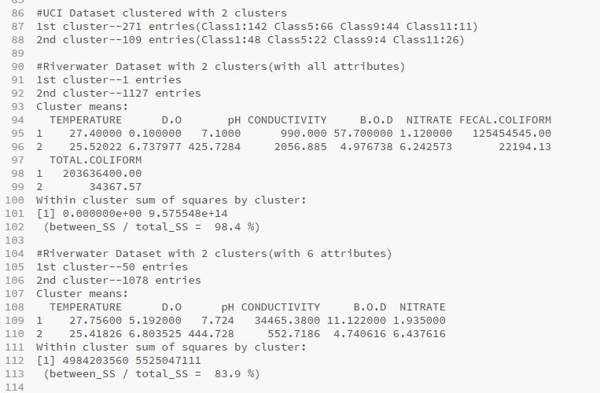

Slide 20
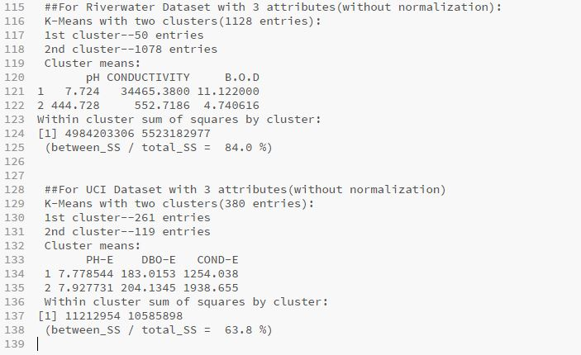

Slide 21
FEATURE EXTRACTION
Real-time data flows in at regular intervals
Lesser control over data
Clustering similarity between different number of attributes
Currently using brute force method to extract the core attributes from all others
Core attributes vary with data. Dataset 1 core attribute is pH but for dataset 2 core attribute is different. Difference due to diverse water sources
When control over horizontal loading of data cannot be achieved, vertical control can be done
Greatly reduces time & space and also improves processing efficiency
Regression technique to select features

Slide 22
FUTURE WORK
Attribute Selection using Regression
Processing of Air and Soil Data
Deciding the classifiers
Identifying the classes of water and their criteria
Developing the training dataset and test dataset
Local Fusion mechanism
Central Fusion mechanism

Slide 23
LITERATURE SURVEY
Jiawei Han and Micheline Kamber, “Data Mining Concepts and Techniques”, Second Edition, Elsevier, 2007
R. A. Smith, G. E. Schwarz, and R. B. Alexander, “Regional interpretation of water quality monitoring data,” Water Resources Research, vol. 33, no. 12, pp. 2781–2798, 1997.
I. Stoianov, L. Nachman, A. Whittle, S. Madden, and R. Kling, “Sensor Network for Monitoring Water Supply and Sewer Systems: Lessons from Boston,” in Proceedings of ASCE Conference, 2003
D. Byer and K. Carlson, “Realtime detection of intentional chemical contamination in the distribution systems,” American Water Works Association Journal, vol. 97, no. 7, pp. 130–141, 2005
Ebrahim Karami, Francis M. Bui, and Ha H. Nguyen, “Multisensor Data Fusion for Water Quality Monitoring Using Wireless Sensor Networks”, 2012, IEEE
Bureau Of Indian Standards, "Indian Standard Drinking Water Specification (Second Edition) ICS" 13.060.20
Department of Science and Technology, India : Big Data Initiative http://www.dst.gov.in/scientificprogramme/ bigdatainitiative.html
Eduardo F. Nakamura, Antonio A.F. Loureiro, and Alejandro C. Frery, “Information Fusion for Wireless Sensor Networks: Methods, Models and Classifications”, 2007
http://cgwb.gov.in/CR/achi_hydroche_stu.html

Slide 24
Wikipedia
World Health Organization (WHO)
Central Pollution Control Board (CPCB)
American Public Health Association (APHA)
Indian Public Health Association (IPHA)
India - WRIS
Indian Association of Hydrologists (IAH)

Slide 25
Thank You!

