Slide 1

EFFECTIVE WATER QUALITY MONITORING USING DATA FUSION
Department of Information Technology
SSN College of Engineering, Kalavakkam - 603 110
Academic Year 2015 - 2016
Notes:
‹#›

Slide 2
STUDENT PROJECT BY
1. AISHWARYA A.
Reg No. : 312212205002
2. ARUN SHUNMUGAM J.
Reg No. : 312212205014
3. DEEPAK S.
Reg No. : 312212205023
PROJECT GUIDES
Ms. S. Mohanavalli
Assistant Professor
Ms. Srividya
Assistant Professor
Notes:
‹#›

Slide 3
INTRODUCTION
A robust Real-Time Water Quality Monitoring System to detect and identify the quality of water dynamically
A combination of Data Analytics, Data Fusion and Machine Learning techniques
Real-time Data from Water and surroundings obtained and processed to alert the user when water detected non-potable or non-usable
System classifies water usage according to different needs
Affordable by a common man
Suited to Indian circumstances
Notes:
‹#›

Slide 4
Overall System Design
Water Local Fusion
Water
Source
Soil Local Fusion
Central Fusion
Quality and Class of usage
Dataset
Air Local Fusion
Machine Learning
Data Analytics
Notes:
‹#›

Slide 5
ORIGIN AND IMPORTANCE
Despite already developed sophisticated systems, neither affordable nor suitable
Water, a depleting resource
Cost-effective systems are essential
Classify water, rather waste it (Know your water)
High correlation between water quality and human health
Water-borne diseases, Improper discharge of Industrial Wastes, Domestic sewage
Only preliminary research is being done regarding application of Data Fusion in Environmental Science
Contribution to Environment
Notes:
‹#›

Slide 6
BACKGROUND
Major pollutants: Asbestos, Lead, Mercury, Nitrates, Phosphates, Sulphur, Oils, Petrochemicals
Industries involved: complex organic chemical industries, electric power plants, food industry, iron and steel industry, mines and quarries, nuclear industry, pulp and paper industry, water treatment
Causes: chemicals, pathogens, solids and emulsions, hydraulic fracturing, unregulated industrial waste discharge, lacks sufficient treatment capacity in India, growing population, unrelenting urbanization
Effects: elevated temperature, discoloration, increased turbidity, toxic wastes increase, oxygen depletion, affecting plants, fishes' gills, waterborne diseases in humans
Notes:
‹#›

Slide 7
OBJECTIVE
To identify the quality of water
To classify the usage of water according to the various domestic uses
To alert the user whenever desired
To plan and prioritize of pollution control strategies
To assess the nature and extent of pollution control needed in different water bodies
To evaluate effectiveness of pollution control measures already in existence
To evaluate water quality trend over a period of time
To understand the environmental fate
To assess the fitness of water for different uses
Notes:
‹#›

Slide 8
DESIGN
System to alert an user if the water being consumed becomes not safe.
The entire system can be divided into local fusion modules and a central fusion module, each observing values from water, air and soil
Feature reduction or attribute selection can be done in order to reduce time consumption
Notes:
‹#›

Slide 9
METHODOLOGY
To gather readings of various parameters of water, soil and surrounding air in real-time
To clean and fuse the parameters of every resource individually
To provide a local decision at every local fusion node
To fuse and process the local decisions to provide one final decision at the central node
To alert the user with a prompt regarding when the water is detected non-potable or non-usable
Notes:
‹#›

Slide 10
LOCAL FUSION MODULE
Parameter readings are obtained
Sensors readings cleaned for false negative values
With the resultant readings, mean values are determined
Mean Reading of every parameter is compared with Indian Government Standards
According to deviation from the standards of reasonable usage, levels or labels of parameters are assigned
Labels fused and processed to provide a local decision
Three local fusion nodes for water, soil and air
Notes:
‹#›

Slide 11
Local Fusion
Module
pH
Conductivity
Dissolved Oxygen
Preprocessing and Normalization
K-Means Clustering
Feature Extraction
Important
Unimportant
Important
Classification
Local Decision
Notes:
‹#›

Slide 12
PREPROCESSING AND CLUSTERING
Records with missing values identified and omitted
Normalization done for every value
Elbow Method used to determine optimal number of clusters for dataset
K-Means Clustering used to categorize the datapoints
Cluster labels are appended to the dataset

Slide 13
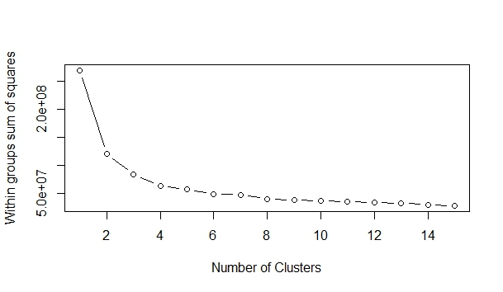
Elbow Method Optimal Clusters = 2 for UCI Water Dataset

Slide 14
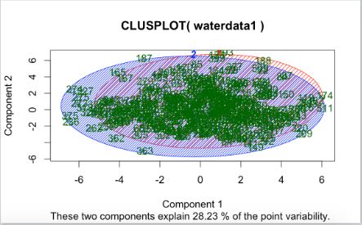
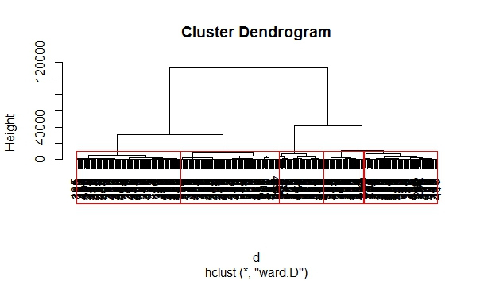
Plot graph of the clusters formed for UCI Water Dataset
Hierarchical Clustering for UCI Water Dataset

Slide 15
S.No | Name of the dataset | Number of Attributes | Number of clusters | Cluster means (For instance)
1 | UCI Water Dataset | 37 | 2 clusters Cluster1 - 271 entries Cluster2 – 109 entries | Cluster 1-pH(7.778544) Cluster 2-pH(7.927731)
 | UCI Water Dataset | 3 (pH,Conductivity,B.O.D) | 2 clusters Cluster1 – 261 entries Cluster2 – 119 entries | Cluster 1-pH(7.778544) Cluster 2-pH(7.927731)
2 | CPCB Basin wise Water Quality Data 2011 | 6 | 2 clusters Cluster1 – 50 entries Cluster2 – 1078 entries | Cluster 1-B.O.D(11.122000) Cluster2- B.O.D(4.740616)
 | CPCB Basin wise Water Quality Data 2011 | 3 (pH,Conductivity,B.O.D) | 2 clusters Cluster1 – 50 entries Cluster2 – 1078 entries | Cluster 1-B.O.D(11.122000) Cluster2- B.O.D(4.740616)

Slide 16
S.No | Name of the dataset | Number of Attributes | Number of clusters | Cluster means (For instance)
3 | CPCB Ganga 2003 | 11 | 2 clusters Cluster1 – 2 entries Cluster2 – 25 entries | Cluster 1-pH(7.650) Cluster 2-pH(7.864)
 | CPCB Ganga 2003 | 3 (pH,Conductivity,B.O.D) | 2 clusters Cluster1 – 2 entries Cluster2 – 25 entries | Cluster 1-pH(7.650) Cluster 2-pH(7.864)
4 | CPCB Krishna 2003 | 11 | 2 clusters Cluster1 – 9 entries Cluster2 – 4 entries | Cluster 1-B.O.D(5.288889) Cluster2- B.O.D(1.800000)
 | CPCB Krishna 2003 | 5 (pH,Conductivity,B.O.D, Faecal Coliform,Total Coliform) | 2 clusters Cluster1 – 9 entries Cluster2 – 4 entries | Cluster 1-B.O.D(5.288889) Cluster2- B.O.D(1.800000)

Slide 17
S.No | Name of the dataset | Number of Attributes | Number of clusters | Cluster means (For instance)
5 | CPCB Krishna 2004 | 11 | 2 clusters Cluster1 – 13 entries Cluster2 – 7 entries | Cluster 1-pH(7.730769) Cluster 2-pH(8.300000)
 | CPCB Krishna 2004 | 5 (pH,Conductivity,B.O.D,Faecal Coliform,Total Coliform) | 2 clusters Cluster1 – 13 entries Cluster2 – 7 entries | Cluster 1-pH(7.730769) Cluster 2-pH(8.300000)

Slide 18
FEATURE EXTRACTION
Real-time data flows in at regular intervals
Lesser control over data
Clustering similarity between different number of attributes
Currently using brute force method to extract the core attributes from all others
Core attributes vary with data. Dataset 1 core attribute is pH but for dataset 2 core attribute is different. Difference due to diverse water sources
When control over horizontal loading of data cannot be achieved, vertical control can be done
Greatly reduces time & space and also improves processing efficiency
Notes:
‹#›

Slide 19
SELECTION METHODS
Brute Force
Chi-Squared
Neural Networks with Feature Extraction
Removal of Redundant Features by Correlation
Recursive Feature Extraction with Random Forest
Random Forest
Boruta
Partial Least Squares Discriminant Analysis (PLSDA)
CLASSIFICATION METHODS
Naive Bayes Classification
Support Vector Machine (SVM)

Slide 20
RESULTS - WATER
Classifier used : Naive Bayes
S.NO | FE METHODS | NO. OF PARAMETERS | ACCURACY | PRECISION | RECALL | F-SCORE
1 | None | 37 | 0.9532 | 0.9824 | 0.9654 | 0.9484
2 | Union (RandomForest +ChiSquared) | 25 | 0.9636 | 0.9818 | 0.9759 | 0.9581
3 | ChiSquared | 20 | 0.9662 | 0.9967 | 0.9627 | 0.9595
4 | RandomForest | 20 | 0.9558 | 0.9849 | 0.9646 | 0.9500
5 | RFE with RandomForest | 20 | 0.9480 | 0.9702 | 0.9702 | 0.9412
6 | Intersection (RF + Chi) | 16 | 0.9558 | 0.9967 | 0.9504 | 0.9472

Slide 21
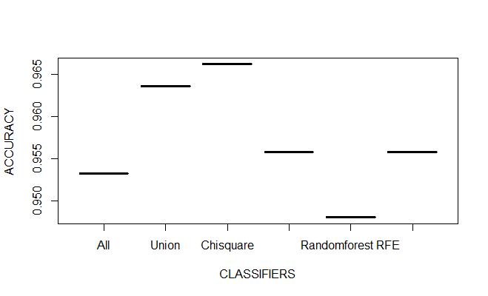

Slide 22
Classifier used : Support Vector Machine (SVM)
S.NO | FE METHODS | NO. OF PARAMETERS | ACCURACY | PRECISION | RECALL | F-SCORE
1 | None | 37 | 0.9844 | 0.9883 | 0.9941 | 0.9824
2 | Union (RandomForest +ChiSquared) | 25 | 0.9844 | 0.9883 | 0.9941 | 0.9824
3 | ChiSquared | 20 | 0.9818 | 0.9826 | 0.9970 | 0.9796
4 | RandomForest | 20 | 0.9818 | 0.9854 | 0.9941 | 0.9795
5 | RFE with RandomForest | 20 | 0.9844 | 0.9883 | 0.9941 | 0.9824
6 | Intersection (RF + Chi) | 16 | 0.9740 | 0.9768 | 0.9941 | 0.9710

Slide 23
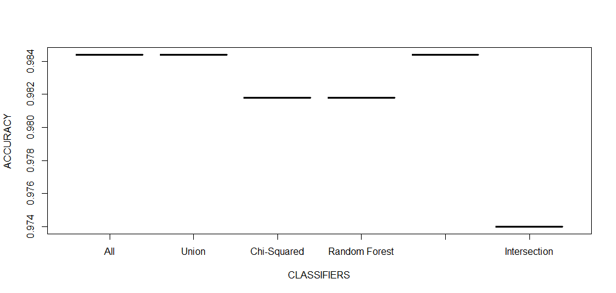

Slide 24
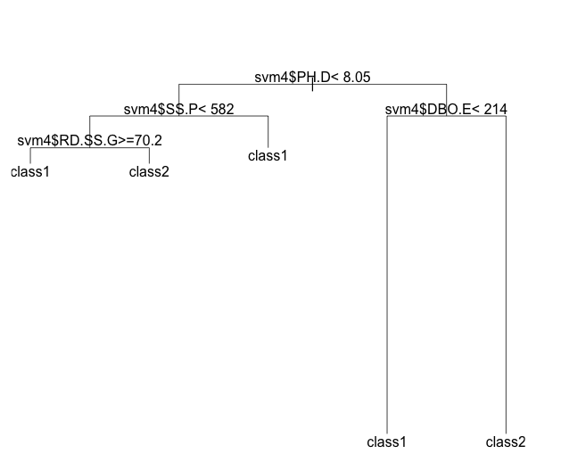
After Feature Selection and classification, Decision Trees are used to derive the decision
Decision Tree Learning gives the quality of water from the results of Classification

Slide 25
OTHER FUSION MODULES - AIR AND WATER
Similar to Water, cleaning and feature extraction done for Air and Soil
Once cleaning done same feature extraction models are executed for air and soil
Best methods out of those are used
Voting System is used for Air and Soil parameters to attain the Ground Truth for Classification

Slide 26
RESULTS - AIR
Classifier used : Naive Bayes
S.NO | FE METHODS | NO. OF PARAMETERS | ACCURACY | PRECISION | RECALL | F-SCORE
1 | None | 6 | 0.7589 | 0.8493 | 0.5254 | 0.4462
2 | Union (RandomForest +ChiSquared) | 6 | 0.7589 | 0.8493 | 0.5254 | 0.4462
3 | ChiSquared | 5 | 0.7841 | 0.8630 | 0.5575 | 0.4811
4 | RandomForest | 6 | 0.7589 | 0.8493 | 0.5254 | 0.4462
5 | RFE with RandomForest | 5 | 0.7841 | 0.8630 | 0.5575 | 0.4811
6 | Intersection (RF + Chi) | 5 | 0.7841 | 0.8630 | 0.5575 | 0.4811

Slide 27
Classifier used : Support Vector Machine (SVM)
S.NO | FE METHODS | NO. OF PARAMETERS | ACCURACY | PRECISION | RECALL | F-SCORE
1 | None | 6 | 0.9352 | 0.8082 | 0.9365 | 0.7568
2 | Union (RandomForest +ChiSquared) | 6 | 0.9352 | 0.8082 | 0.9365 | 0.7568
3 | ChiSquared | 5 | 0.9388 | 0.8219 | 0.9375 | 0.7705
4 | RandomForest | 6 | 0.9352 | 0.8082 | 0.9365 | 0.7568
5 | RFE with RandomForest | 5 | 0.9388 | 0.8219 | 0.9375 | 0.7705
6 | Intersection (RF + Chi) | 5 | 0.9388 | 0.8219 | 0.9375 | 0.7705

Slide 28
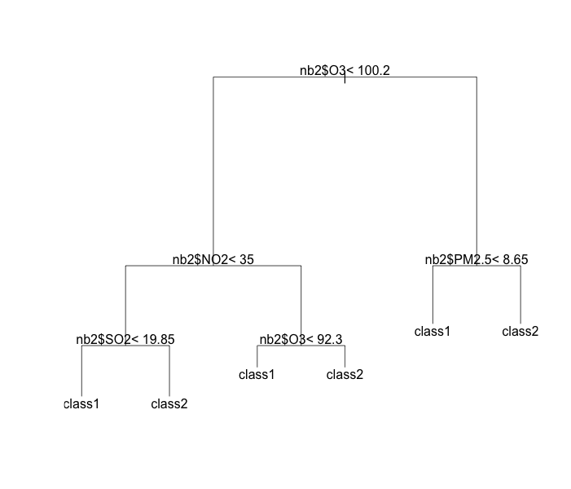
DECISION TREE - AIR

Slide 29
RESULTS - SOIL
Classifier used : Naive Bayes
S.NO | FE METHODS | NO. OF PARAMETERS | ACCURACY | PRECISION | RECALL | F-SCORE
1 | None | 6 | 0.7589 | 0.8493 | 0.5254 | 0.4462
2 | Union (RandomForest +ChiSquared) | 6 | 0.7589 | 0.8493 | 0.5254 | 0.4462
3 | ChiSquared | 5 | 0.7841 | 0.8630 | 0.5575 | 0.4811
4 | RandomForest | 6 | 0.7589 | 0.8493 | 0.5254 | 0.4462
5 | RFE with RandomForest | 5 | 0.7841 | 0.8630 | 0.5575 | 0.4811
6 | Intersection (RF + Chi) | 5 | 0.7841 | 0.8630 | 0.5575 | 0.4811

Slide 30
Classifier used : Support Vector Machine (SVM)
S.NO | FE METHODS | NO. OF PARAMETERS | ACCURACY | PRECISION | RECALL | F-SCORE
1 | None | 6 | 0.9352 | 0.8082 | 0.9365 | 0.7568
2 | Union (RandomForest +ChiSquared) | 6 | 0.9352 | 0.8082 | 0.9365 | 0.7568
3 | ChiSquared | 5 | 0.9388 | 0.8219 | 0.9375 | 0.7705
4 | RandomForest | 6 | 0.9352 | 0.8082 | 0.9365 | 0.7568
5 | RFE with RandomForest | 5 | 0.9388 | 0.8219 | 0.9375 | 0.7705
6 | Intersection (RF + Chi) | 5 | 0.9388 | 0.8219 | 0.9375 | 0.7705

Slide 31
DECISION TREE - SOIL

Slide 32
CENTRAL FUSION MODULE
Local decisions or labels are obtained from the local modules after their respective Decision Trees
Fused and synthesized using Decision Tree Methods to provide a Final Decision
Based on the Final Decision, priorities are retrieved whether the water can be used for drinking or not
Two labels are given for water : Potable (Good) and Non-Potable (Bad)
Notes:
‹#›

Slide 33
Water Local Decision
Air Local Decision
Soil Local Decision
Final Decision
Notes:
‹#›

Slide 34
COMBINATION OF LOCAL DECISIONS FOR FINAL DECISION
S.No | WATER | AIR | SOIL | FINAL
1
2
3
4

Slide 35
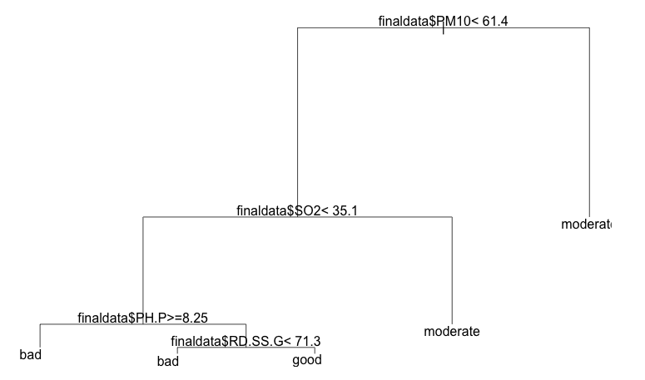
DECISION TREE - FINAL

Slide 36
Outcomes or inferences or something to include!!

Slide 37
REFERENCES
Jiawei Han and Micheline Kamber, “Data Mining Concepts and Techniques”, Second Edition, Elsevier, 2007
R. A. Smith, G. E. Schwarz, and R. B. Alexander, “Regional interpretation of water quality monitoring data,” Water Resources Research, vol. 33, no. 12, pp. 2781–2798, 1997.
I. Stoianov, L. Nachman, A. Whittle, S. Madden, and R. Kling, “Sensor Network for Monitoring Water Supply and Sewer Systems: Lessons from Boston,” in Proceedings of ASCE Conference, 2003
D. Byer and K. Carlson, “Realtime detection of intentional chemical contamination in the distribution systems,” American Water Works Association Journal, vol. 97, no. 7, pp. 130–141, 2005
Ebrahim Karami, Francis M. Bui, and Ha H. Nguyen, “Multisensor Data Fusion for Water Quality Monitoring Using Wireless Sensor Networks”, 2012, IEEE
Bureau Of Indian Standards, "Indian Standard Drinking Water Specification (Second Edition) ICS" 13.060.20
Department of Science and Technology, India : Big Data Initiative http://www.dst.gov.in/scientificprogramme/
bigdatainitiative.html
Eduardo F. Nakamura, Antonio A.F. Loureiro, and Alejandro C. Frery, “Information Fusion for Wireless Sensor Networks: Methods, Models and Classifications”, 2007
http://cgwb.gov.in/CR/achi_hydroche_stu.html
Notes:
‹#›

Slide 38
Wikipedia
World Health Organization (WHO)
Central Pollution Control Board (CPCB)
American Public Health Association (APHA)
Indian Public Health Association (IPHA)
India - WRIS
Indian Association of Hydrologists (IAH)
Notes:
‹#›

Slide 39
Thank You!
Notes:
‹#›

