Slide 1

EFFECTIVE WATER QUALITY MONITORING USING DATA FUSION
Department of Information Technology
SSN College of Engineering, Kalavakkam - 603 110
Academic Year 2015 - 2016
Notes:
‹#›

Slide 2
STUDENT PROJECT BY
1. AISHWARYA A.
Reg No. : 312212205002
2. ARUN SHUNMUGAM J.
Reg No. : 312212205014
3. DEEPAK S.
Reg No. : 312212205023
PROJECT GUIDES
Ms. S. Mohanavalli
Assistant Professor
Ms. Srividya
Assistant Professor
Notes:
‹#›

Slide 3
INTRODUCTION
A robust Real-Time Water Quality Monitoring System to detect and identify the quality of river water dynamically
A combination of Data Analytics, Data Fusion and Machine Learning techniques
Real-time Data from river water and surroundings obtained and processed to alert the user when water detected non-potable or non-usable
System classifies water usage according to different needs
Affordable by a common man
Suited to Indian circumstances
Notes:
‹#›

Slide 4
ORIGIN AND IMPORTANCE
Water - depleting resource
Classify water, rather waste it (Know your water)
High correlation between water quality and human health
Water-borne diseases due to improper discharge of industrial wastes, Domestic sewage
Water is polluted. already existing systems - not suitable, not affordable, not real time
Only preliminary research is being done regarding application of Data Fusion in Environmental Science
Contribution to Environment
Notes:
‹#›

Slide 5
BACKGROUND
Major pollutants: Asbestos, Lead, Mercury, Nitrates, Phosphates, Sulphur, Oils, Petrochemicals
Industries involved: complex organic chemical industries, electric power plants, food industry, iron and steel industry, mines and quarries, nuclear industry, pulp and paper industry, water treatment
Causes: chemicals, pathogens, solids and emulsions, hydraulic fracturing, unregulated industrial waste discharge, lacks sufficient treatment capacity in India, growing population, unrelenting urbanization
Effects: elevated temperature, discoloration, increased turbidity, toxic wastes increase, oxygen depletion, affecting plants, fishes' gills, waterborne diseases in humans
Notes:
‹#›

Slide 6
OBJECTIVE
To identify the quality of water
To classify the usage of water according to the various uses
To alert the user whenever quality deteriorated
To assess the nature and extent of pollution control needed in different water bodies
To evaluate water quality trend over a period of time
To understand the environmental fate
To assess the fitness of water for different uses
Notes:
‹#›

Slide 7
LITERATURE SURVEY
CPCB’s system NWMP monitors around 54 parameters but in a static manner
CPCB tests waters on a yearly or a half yearly basis
It plans to bring in a real-time feature to its system in the near future
9 core parameters and 5 different classes of usage - Drinking, Outdoor bathing, Irrigation, Industrial cooling, Controlled Waste Disposal
Air and soil quality parameters not included in existing systems
Prevalent systems use multi sensor data fusion for monitoring using wireless sensor networks
Existing architectures use local and central fusion modules for same quality parameter

Slide 8
Feature Extraction is used for Dimensionality Reduction
It is a predecessor step to classification
Decision Support System integrates feature extraction and classification processes
Feature extraction helps get desired results with parameters reduced
Machine learning helps achieve automation
It also helps achieve dynamic performance
There is only preliminary research done using data analytics and machine learning in water quality monitoring
This is an initiative to smart water use accustomed to Indian circumstances

Slide 9


SOFTWARE REQUIREMENTS
RStudio Desktop 0.99.893
Powerful and productive IDE for R
https://www.rstudio.com/products/rstudio/download/
R-3.2.4 for Windows (32/64 bit)
https://cran.r-project.org/bin/windows/base/
R Packages needed :
stats
cluster
caret
e1071
FSelector
mlbench
randomForest
rpart

Slide 10
Overall System Design
Water Local Fusion
Water
Source
Soil Local Fusion
Central Fusion
Quality and Class of usage
Dataset
Air Local Fusion
Machine Learning
Data Analytics
Notes:
‹#›

Slide 11
OVERALL SYSTEM DESIGN
Water, air and soil quality parameters acquired from river water
Acquired data is split and sent to individual Local fusion modules
Each local fusion module observes values from water, air and soil, processes this data and gives individual decisions of the quality
Each local module decides the quality of their data individually
Individual decisions are sent to Central Fusion module
This module decides the final overall quality of water
This module suggests the appropriate class of usage
Notes:
‹#›

Slide 12
SYSTEM ARCHITECTURE
Level 1 : Data Acquisition
Level 2 : Local Fusion Module
Level 2.1 : Preprocessing and Normalization
Level 2.2 : Ground Truth Check
Level 2.3 : Feature Extraction
Level 2.4 : Classification and Decision Making
Level 3 : Central Fusion Module
Output : Quality of water and Class of Usage
Notes:
‹#›

Slide 13
Water Source
Data Acquisition
Datasets
Air
Water
Soil
Preprocessing and Normalization
Preprocessing and Normalization
Preprocessing and Normalization
Ground Truth Check
Ground Truth Check
Ground Truth Check
Feature Extraction
Feature Extraction
Feature Extraction
Classification and Decision Making
Classification and Decision Making
Classification and Decision Making
Central Fusion Module
Quality and Class of Usage

Slide 14
LOCAL FUSION MODULE
Parameter readings are obtained via datasets
Records cleaned for missing or erroneous values using Preprocessing and Normalization
Next, mean values determined using K-Means Clustering in water dataset to check with ground truth
Voting system is used for air and soil parameters
Feature Extraction used to cut down irrelevant features - Dimension Reduction - different methods for every dataset
Refined dataset used to classify records using Naive Bayes and Support Vector Machine
Local decision given by Decision Tree method
Notes:
‹#›

Slide 15
Local Fusion
Module
pH
Conductivity
Dissolved Oxygen
Preprocessing and Normalization
Ground Truth Check
Feature Extraction
Important
Unimportant
Important
Classification
Local Decision
Notes:
‹#›

Slide 16
PREPROCESSING AND NORMALIZATION
Records with missing or erroneous values identified and omitted
Normalization done for every value
GROUND TRUTH CHECK - CLUSTERING
Elbow Method used to determine optimal number of clusters for dataset
K-Means Clustering used to categorize the data points
Cluster labels are appended to the dataset

Slide 17
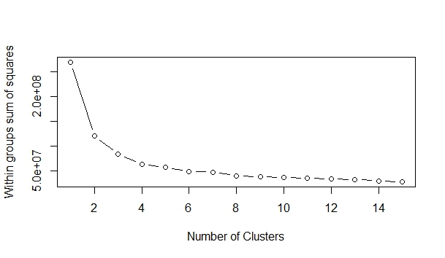
Elbow Method Optimal Clusters = 2 for UCI Water Dataset

Slide 18
CLUSTERING RESULTS FOR WATER DATASET
S.No | Name of the dataset | Number of Attributes | Number of clusters | Cluster means (For instance)
1 | UCI Water Dataset | 37 | 2 clusters Cluster1 - 271 entries Cluster2 – 109 entries | Cluster 1-pH(7.778544) Cluster 2-pH(7.927731)

Slide 19
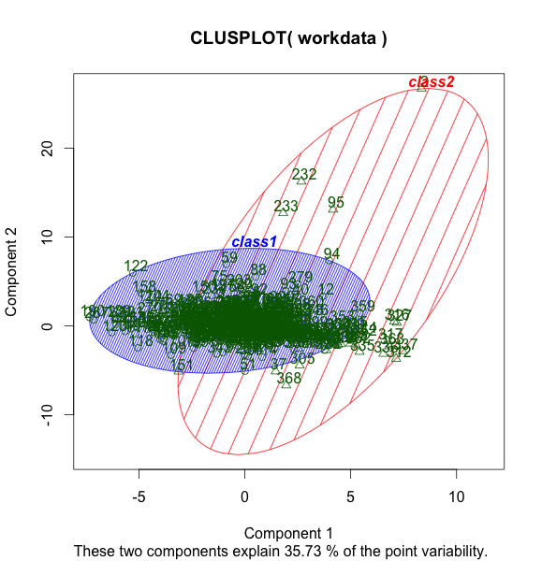

Slide 20
FEATURE EXTRACTION
Real-time data flows in at regular intervals
Lesser control over data
Clustering similarity between different number of attributes
Currently using brute force method to extract the core attributes from all others
Core attributes vary with data. Dataset 1 core attribute is pH but for dataset 2 core attribute is different. Difference due to diverse water sources
When control over horizontal loading of data cannot be achieved, vertical control can be done
Greatly reduces time & space and also improves processing efficiency
Notes:
‹#›

Slide 21
SELECTION METHODS
Brute Force
Chi-Squared
Neural Networks with Feature Extraction
Removal of Redundant Features by Correlation
Recursive Feature Extraction (RFE) with Random Forest
Random Forest
Boruta
Linear Vector Quantization (LVQ)
Partial Least Squares Discriminant Analysis (PLSDA)
CLASSIFICATION METHODS
Naive Bayes Classification
Support Vector Machine (SVM)

Slide 22
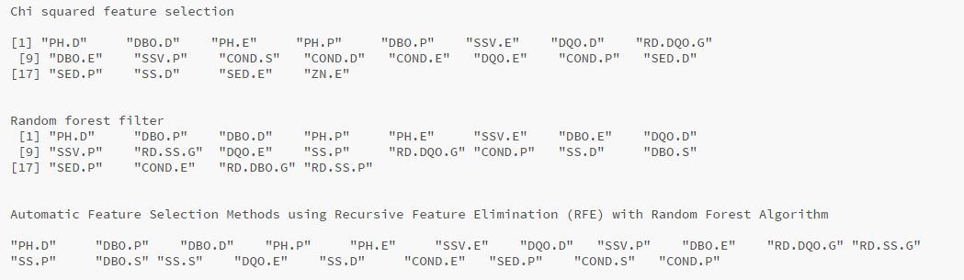
EXTRACTED FEATURES - WATER

Slide 23
PERFORMANCE METRICS
Accuracy: a description of systematic errors given by the formula (True Positives + True Negatives ) / (Positives + Negatives)
Precision: proportion of instances that are truly of a class divided by the total instances classified as that class
Recall: proportion of instances classified as a given class divided by the actual total in that class (equivalent to TP rate)
F-Measure: A combined measure for precision and recall calculated as 2 * Precision * Recall / (Precision + Recall)

Slide 24
RESULTS - WATER
Classifier used : Naive Bayes
S.NO | FE METHODS | NO. OF PARAMETERS | ACCURACY | PRECISION | RECALL | F-SCORE
1 | None | 37 | 0.9532 | 0.9824 | 0.9654 | 0.9484
2 | Union (RandomForest +ChiSquared) | 25 | 0.9636 | 0.9818 | 0.9759 | 0.9581
3 | ChiSquared | 20 | 0.9662 | 0.9967 | 0.9627 | 0.9595
4 | RandomForest | 20 | 0.9558 | 0.9849 | 0.9646 | 0.9500
5 | RFE with RandomForest | 20 | 0.9480 | 0.9702 | 0.9702 | 0.9412
6 | Intersection (RF + Chi) | 16 | 0.9558 | 0.9967 | 0.9504 | 0.9472

Slide 25
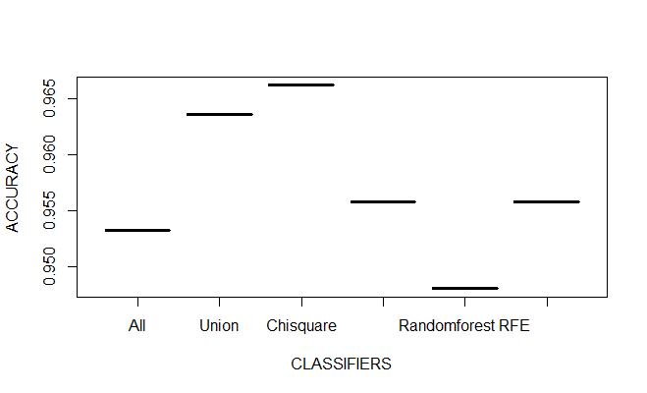

Slide 26
Classifier used : Support Vector Machine (SVM)
S.NO | FE METHODS | NO. OF PARAMETERS | ACCURACY | PRECISION | RECALL | F-SCORE
1 | None | 37 | 0.9844 | 0.9883 | 0.9941 | 0.9824
2 | Union (RandomForest +ChiSquared) | 25 | 0.9844 | 0.9883 | 0.9941 | 0.9824
3 | ChiSquared | 20 | 0.9818 | 0.9826 | 0.9970 | 0.9796
4 | RandomForest | 20 | 0.9818 | 0.9854 | 0.9941 | 0.9795
5 | RFE with RandomForest | 20 | 0.9844 | 0.9883 | 0.9941 | 0.9824
6 | Intersection (RF + Chi) | 16 | 0.9740 | 0.9768 | 0.9941 | 0.9710

Slide 27
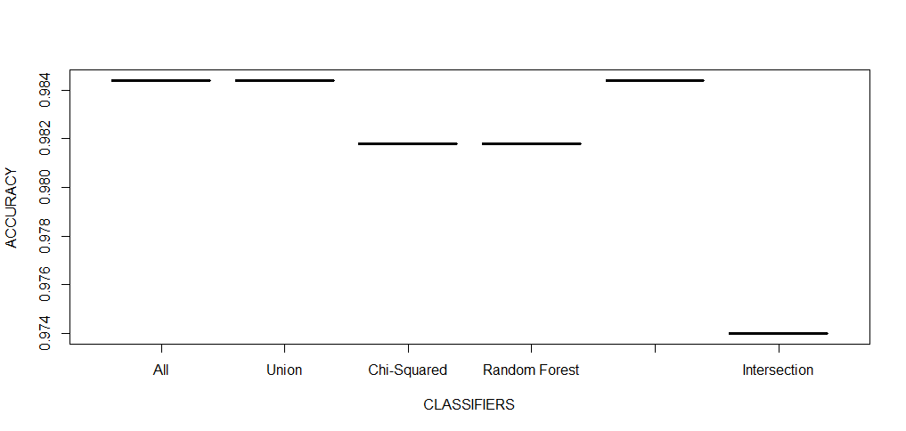

Slide 28
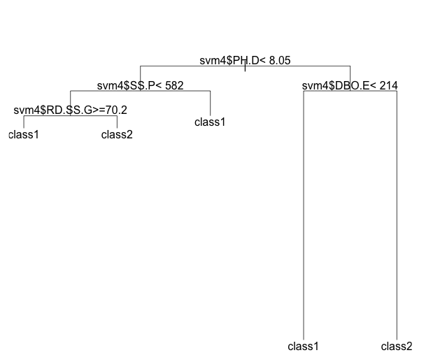
After Feature Selection and classification, Decision Trees are used to derive the decision
Decision Tree Learning gives the quality of water from the results of Classification

Slide 29
OTHER FUSION MODULES - AIR AND SOIL
Similar to Water, cleaning and feature extraction done for Air and Soil
Once cleaning done same feature extraction models are executed for air and soil
Best methods out of those are used
Voting System is used for Air and Soil parameters to attain the Ground Truth for Classification

Slide 30
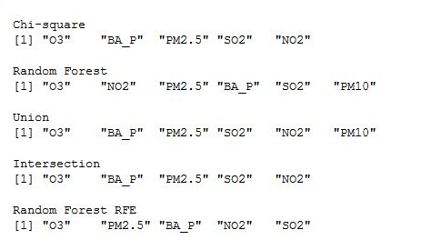
EXTRACTED FEATURES - AIR

Slide 31
RESULTS - AIR
Classifier used : Naive Bayes
S.NO | FE METHODS | NO. OF PARAMETERS | ACCURACY | PRECISION | RECALL | F-SCORE
1 | None | 6 | 0.7589 | 0.8493 | 0.5254 | 0.4462
2 | Union (RandomForest +ChiSquared) | 6 | 0.7589 | 0.8493 | 0.5254 | 0.4462
3 | ChiSquared | 5 | 0.7841 | 0.8630 | 0.5575 | 0.4811
4 | RandomForest | 6 | 0.7589 | 0.8493 | 0.5254 | 0.4462
5 | RFE with RandomForest | 5 | 0.7841 | 0.8630 | 0.5575 | 0.4811
6 | Intersection (RF + Chi) | 5 | 0.7841 | 0.8630 | 0.5575 | 0.4811

Slide 32
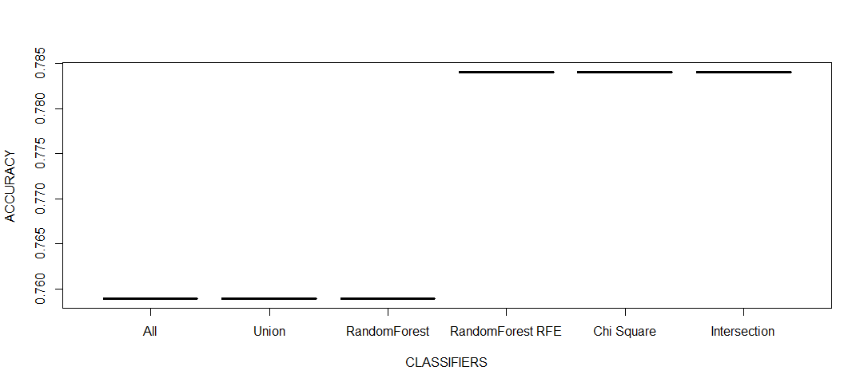

Slide 33
Classifier used : Support Vector Machine (SVM)
S.NO | FE METHODS | NO. OF PARAMETERS | ACCURACY | PRECISION | RECALL | F-SCORE
1 | None | 6 | 0.9352 | 0.8082 | 0.9365 | 0.7568
2 | Union (RandomForest +ChiSquared) | 6 | 0.9352 | 0.8082 | 0.9365 | 0.7568
3 | ChiSquared | 5 | 0.9388 | 0.8219 | 0.9375 | 0.7705
4 | RandomForest | 6 | 0.9352 | 0.8082 | 0.9365 | 0.7568
5 | RFE with RandomForest | 5 | 0.9388 | 0.8219 | 0.9375 | 0.7705
6 | Intersection (RF + Chi) | 5 | 0.9388 | 0.8219 | 0.9375 | 0.7705

Slide 34
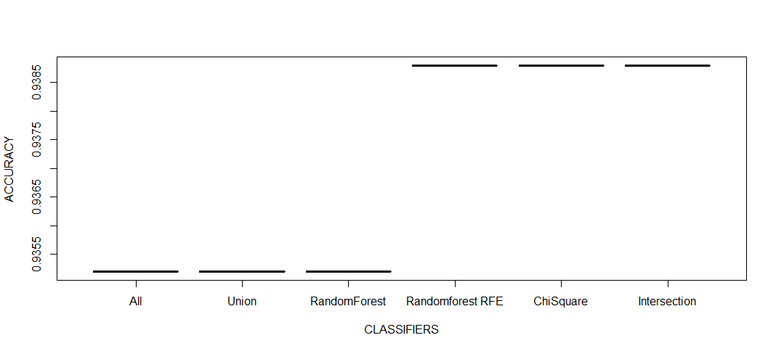

Slide 35
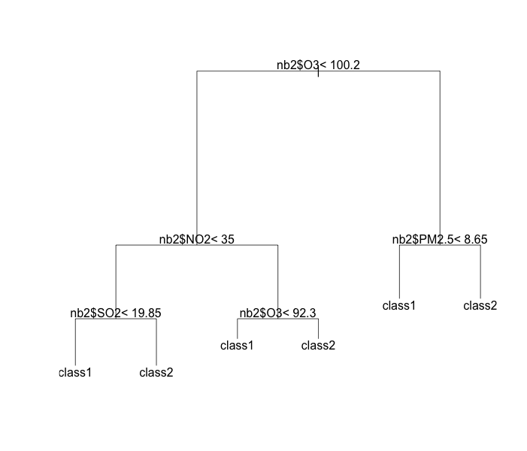
DECISION TREE - AIR

Slide 36
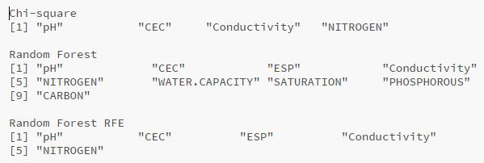
EXTRACTED FEATURES - SOIL

Slide 37
RESULTS - SOIL
Classifier used : Naive Bayes
S.NO | FE METHODS | NO. OF PARAMETERS | ACCURACY | PRECISION | RECALL | F-SCORE
1 | None | 10 | 0.7831 | 0.8229 | 0.9186 | 0.7559
2 | RandomForest | 9 | 0.7740 | 0.8166 | 0.9147 | 0.7469
3 | RFE with RandomForest | 5 | 0.7861 | 0.8191 | 0.9302 | 0.7619
4 | ChiSquared | 4 | 0.8493 | 0.8489 | 0.9806 | 0.8324

Slide 38
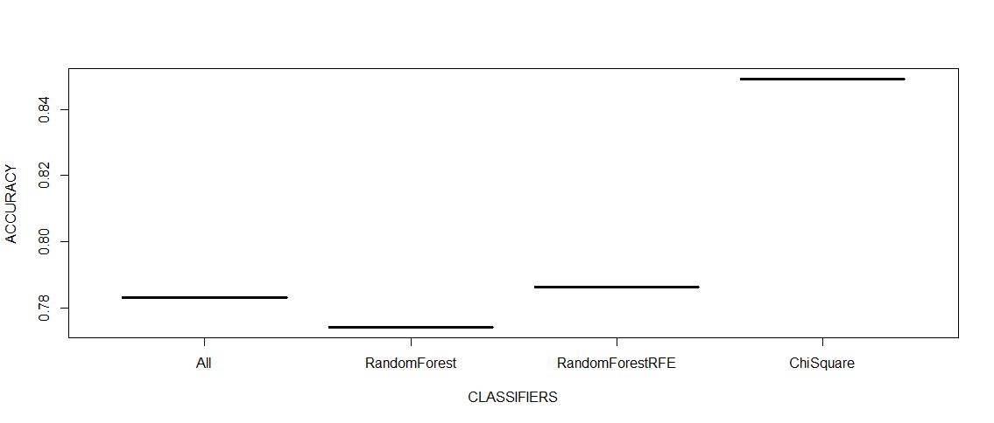

Slide 39
Classifier used : Support Vector Machine (SVM)
S.NO | FE METHODS | NO. OF PARAMETERS | ACCURACY | PRECISION | RECALL | F-SCORE
1 | None | 10 | 0.9126 | 0.8989 | 1 | 0.8989
2 | RandomForest | 9 | 0.9126 | 0.8989 | 1 | 0.8989
3 | RFE with RandomForest | 5 | 0.9246 | 0.9175 | 0.9922 | 0.9104
4 | ChiSquared | 4 | 0.8825 | 0.8711 | 0.9961 | 0.8677

Slide 40
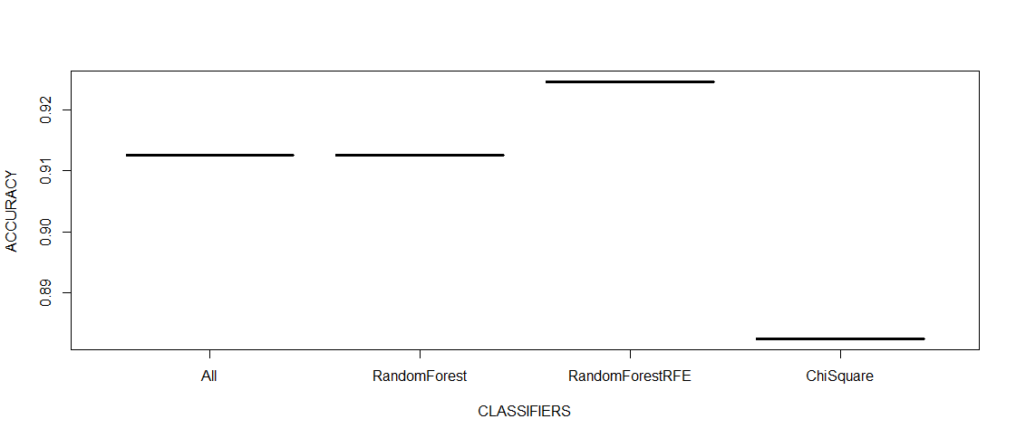

Slide 41
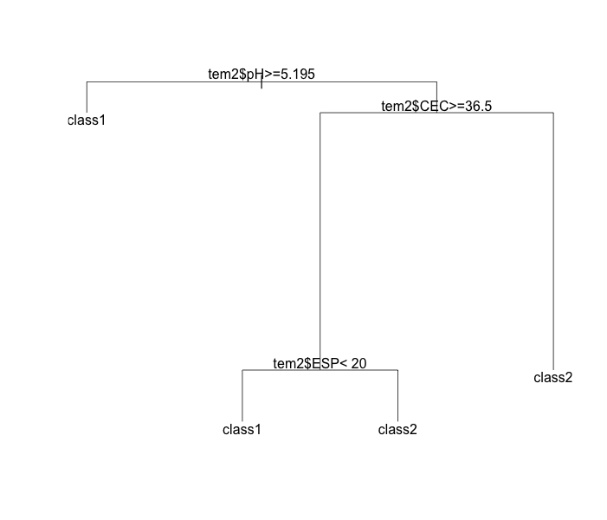
DECISION TREE - SOIL

Slide 42
CENTRAL FUSION MODULE
Local decisions or labels are obtained from the local modules after their respective Decision Trees
Fused and synthesized using Decision Tree Methods to provide a Final Decision
Based on the Final Decision, priorities are retrieved whether the water can be used for drinking or not
Four labels are given : Good, Slightly Good, Slightly Bad, Bad
Notes:
‹#›

Slide 43
Water Local Decision
Air Local Decision
Soil Local Decision
Final Decision
Notes:
‹#›

Slide 44
COMBINATION OF LOCAL DECISIONS FOR FINAL DECISION
S.No | WATER | AIR | SOIL | FINAL
1 | Bad | Bad | Bad | Bad
2 | Bad | Bad | Good | Bad
3 | Bad | Good | Bad | Bad
4 | Bad | Good | Good | Bad
5 | Good | Bad | Bad | Slightly Bad
6 | Good | Bad | Good | Slightly Good
7 | Good | Good | Bad | Slightly Good
8 | Good | Good | Good | Good

Slide 45
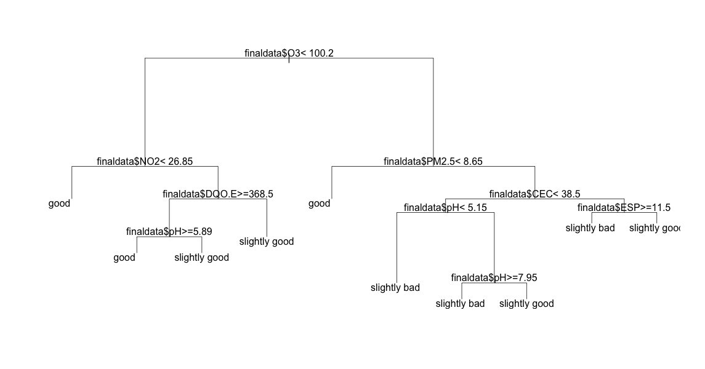
DECISION TREE - FINAL

Slide 46
SYSTEM PERFORMANCE
Accuracy of water local fusion module - 98.18%
Accuracy of air local fusion module - 93.88%
Accuracy of soil local fusion module - 92.46%
Accuracy of overall water quality monitoring system - 95.25%

Slide 47
ADVANTAGES OF SYSTEM
Includes real-time feature
Supports dynamic decision making
Data Fusion of all possible parameters that affect water quality - includes air and soil
Feature Extraction reduces dimension; hence faster processing and accurate results
cost-effective and includes real-time compared to NWMP
ensemble learning methods
more suited to Indian circumstances

Slide 48
FUTURE SCOPE
Usage of sensor network to acquire data values from river waters
Testing waters at various zones of the river
Many other feature extraction methods can be tried
Can be implemented to give more extensive classes of usage regarding water quality
Can be upgraded to support many other water resources such as lakes, oceans, etc.

Slide 49
REFERENCES
Bhardwaj, R. M. "Water quality monitoring in India—achievements and constraints." IWG-Env, International Work Session on Water Statistics, Vienna (2005): 1-12.
Byer, David, and Kenneth H. Carlson. "Expanded summary: Real-time detection of intentional chemical contamination in the distribution system."Journal (American Water Works Association) 97.7 (2005): 130-133.
Domingos, Pedro. "A few useful things to know about machine learning. "Communications of the ACM 55.10 (2012): 78-87.
Han, Jiawei, Micheline Kamber, and Jian Pei. “Data mining: concepts and techniques”. Elsevier, 2011.
Karami, Ebrahim, Francis M. Bui, and Ha H. Nguyen. "Multisensor data fusion for water quality monitoring using wireless sensor networks." Communications and Electronics (ICCE), 2012 Fourth International Conference on. IEEE, 2012.
Nakamura, Eduardo F., Antonio AF Loureiro, and Alejandro C. Frery. "Information fusion for wireless sensor networks: Methods, models, and classifications." ACM Computing Surveys (CSUR) 39.3 (2007): 9.
Pechenizkiy, M., Puuronen, S. and Tsymbal, A., 2003. “Feature extraction for classification in the data mining process.”
Smith, Richard A., Gregory E. Schwarz, and Richard B. Alexander. "Regional interpretation of water quality monitoring data." Water resources research 33.12 (1997): 2781-2798.
Notes:
‹#›

Slide 50
Standard, Indian. "Drinking water-specification." 1st Revision, IS 10500 (1991). 47
Stoianov, Ivan, et al. "Sensor networks for monitoring water supply and sewer systems: Lessons from Boston." Proceedings of the 8th Annual Water Distribution Systems Analysis Symposium. 2006.
“5 Major Causes of Water Pollution in India” - http://www.yourarticlelibrary.com/water-pollution/5-major-causes-of-water-pollution-in-india/19764
“Chi-Square Test of Independence” - http://www.stattrek.com/chi-square-test/independence.aspx?Tutorial=AP
“Data Mining - Decision Tree Induction” - http://www.tutorialspoint.com/data_mining/dm_dti.htm
“Decision Trees” - http://www.ise.bgu.ac.il/faculty/liorr/hbchap9.pdf
“Feature Extraction Models” - http://topepo.github.io/caret/Feature_Extraction.html
“Feature Selection with the Caret R Package” - http://machinelearningmastery.com/feature-selection-with-the-caret-r-package/
“Naive Bayesian” - http://www.saedsayad.com/naive_bayesian.htm
“National Water Quality Monitoring Programme” - www.cpcb.nic.in/divisionsofheadoffice/pams/NWMP.pdf
“Pearson’s Chi-Square Test for Independence” - http://www.ling.upenn.edu/~clight/chisquared.htm
“RandomForest” - https://en.wikipedia.org/wiki/Random_forest
“Random Forests:some methodological insights” - http://arxiv.org/pdf/0811.3619.pdf
“Support Vector Machines (SVM) Introductory Overview” - http://www.statsoft.com/textbook/support-vector-machines48
“Support Vector Machines” - http://scikit-learn.org/stable/modules/svm.html
“The k-means clustering algorithm” - http://cs229.stanford.edu/notes/cs229-notes7a.pdf
Notes:
‹#›

Slide 51
DATASETS
“Water Treatment Plant Dataset” - http://archive.ics.uci.edu/ml/machine-learning-databases/water-treatment/
“Air pollutant concentrations 2013” - http://www.eea.europa.eu/data-and-maps/data/air-pollutant-concentrations-at-station/pollutant-concentrations-by-city/air-pollutant-concentrations-2013-dataset-cities
“ISRIC/WDC-Soil Dataset” - http://www.isric.org/content/download-form?dataset=SOTWIS_BR.zip

Slide 52
Thank You!
Notes:
‹#›

