Slide 1
Classification and Comparison of Canopy Cover in Urban areas using satellite images
Project Guide :
Mrs R Swathika
Members :
S Anantha Natarajan
T Gokula Kannan

Slide 2
Project objective
Comparing the canopy cover of an Urban area by classifying the Urban land cover using different pixel level fusion on satellite images taken at different time periods.

Slide 3
Land Cover Classification
Land cover classification is the process of categorizing the land area into water bodies, green areas, soil covered areas and etc.
Generally classification is done on satellite images acquired from a single sensor.
To increase the effectiveness of the classification, images acquired from different sensors of satellite can be fused together and then classification can be done

Slide 4
In this project, we implement three pixel level fusion techniques
Compare the results using performance metrics
Then, we apply Bayes Classification on the fused image and calculate the canopy cover

Slide 5
Study Area
The study area covers 1500 km² around the Chennai city.
The horizontal top borderline runs across Minjur that lies below Ponneri river.
The horizontal bottom borderline runs across Kottivakam and extends upto Sriperumbadur.
The vertical left borderline runs across Thiruvallur.
The vertical right borderline runs from coastal area near Minjur to coastal area near Kottivakkam.

Slide 6
Multi sensor Fusion
Multi sensor Image fusion is the process of combining relevant information from two or more images into a single image. The resulting image will be more informative than any of the input images. Here we are using both PAN and multispectral images to fuse together to get a high resolution image.
The three techniques employed are Brovey fusion, Daubechies Wavelet based fusion and IHS fusion .

Slide 7
Pixel level Fusion
INPUT IMAGE:
-PAN Image (Panchromatic Image)
-Multispectral images
PAN:
An image collected in broad visual wavelength range but rendered in black and white.
Multispectral:
Images optically acquired in more than one spectral or wavelength interval. Each individual image is usually of same physical area and scale but of a different spectral band.

Slide 8
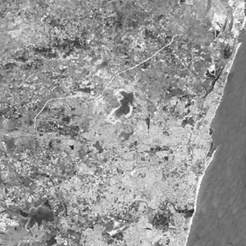
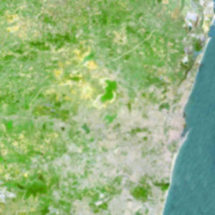
PAN and MS

Slide 9
DWB
The Daubechies wavelet transforms ( DWB )are defined by computing running averages and differences via scalar products with scaling signals and wavelets
The only difference between them consists in how these scaling signals and wavelets are defined.

Slide 10
Brovey fusion
The BT is also called the color normalization transform because it involves a red-green-blue (RGB) color transform method.
The Brovey transformation was developed to avoid the disadvantages of the multiplicative method.
It is a simple method for combining data from different sensors.

Slide 11
IHS fusion
The IHS colour transformation effectively separates spatial (I) and spectral (H, S) information from a standard RGB image. It relates to the human colour perception parameters
The IHS technique has become a standard procedure in image analysis

Slide 12
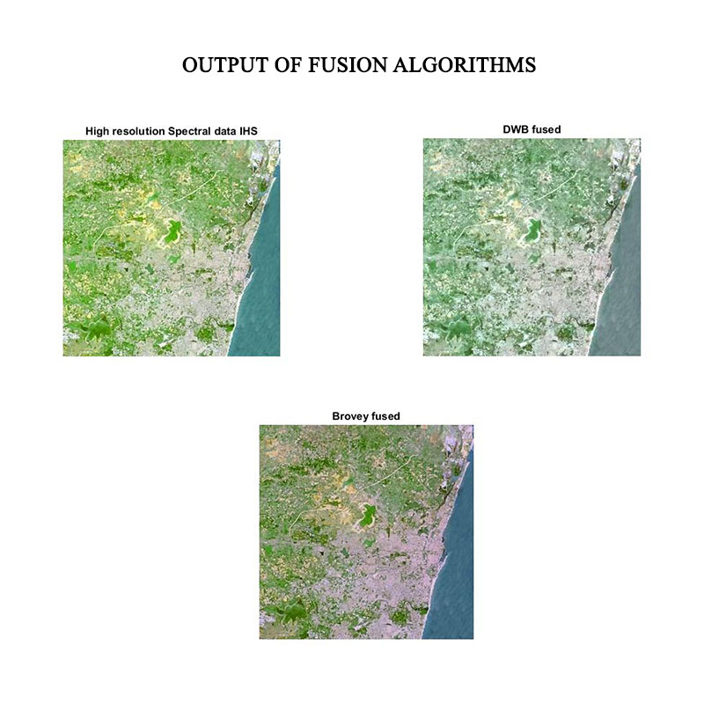

Slide 13
Performance metrics
Peak signal-to-noise ratio, often abbreviated PSNR, is an engineering term for the ratio between the maximum possible power of a signal and the power of corrupting noise that affects the fidelity of its representation.
Entropy is a statistical measure of randomness that can be used to characterize the texture of the input image.
Mutual information is a probability theory that quantify the mutual dependence between random variables.

Slide 14
Performance analysis
PERFORMANCE METRIC | BROVEY | DAUBECHIES WAVELET | IHS
PSNR (Peak Signal to Noise Ratio) | 18.2120 | 22.6896 | 23.1773
Cross Entropy | 0.6583 | 0.2547 | 0.1656
Mutual Information | 1.1216 | 1.0496 | 1.5070

Slide 15
Classification
Classification :
The classification process allows the integration of broad spectrum of different object features such as spectral values , shape or Texture for classification .
Bayesian classification is based on Bayes Theorem.
The idea behind a Bayesian classifier is that, if an agent knows the class, it can predict the values of the other features.
If it does not know the class, Bayes rule can be used to predict the class

Slide 16
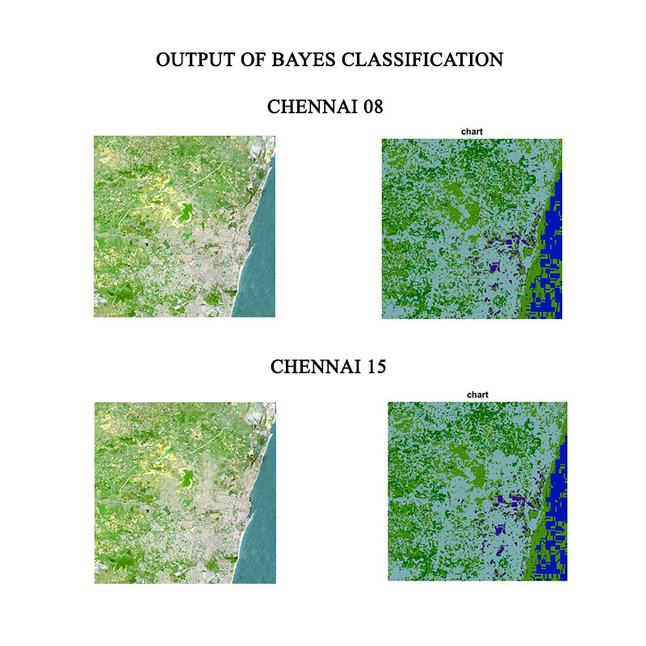
Bayes Classification

Slide 17
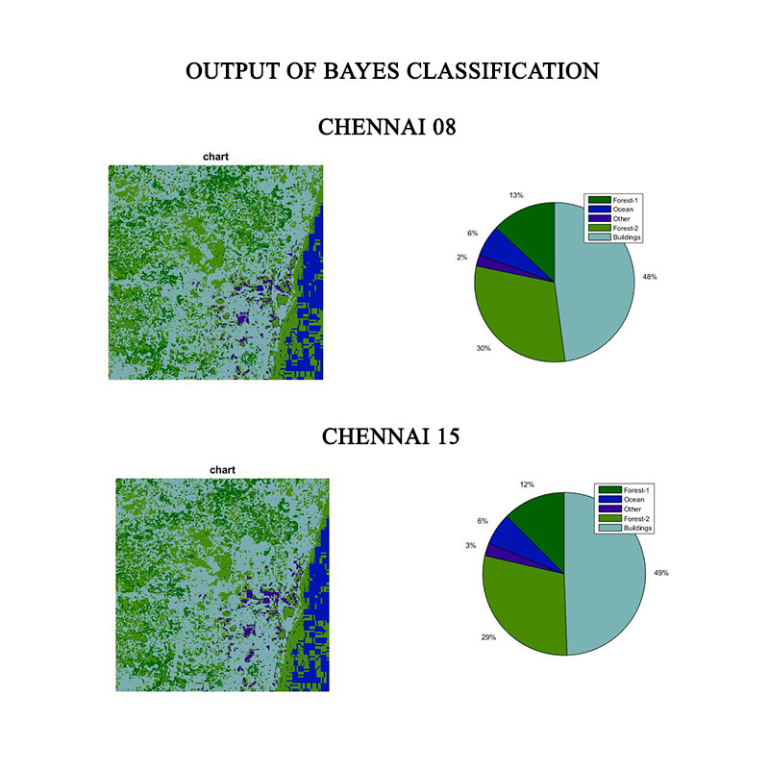
Classification graph

Slide 18
Comparison
Once the classification of urban area is done, the vegetation area is calculated from the fused and classified image . The same classification is done for the same area certain years ago and the results are compared .

Slide 19
Area measurement
AREA CALCULATION | FOREST I ( Km² ) | FOREST2 ( Km² ) | OCEAN ( Km² ) | BUILDINGS ( Km² ) | OTHER ( Km² )
CHENNAI 2008 | 214.0612 | 561.6364 | 221.417 | 358.7646 | 144.1208
CHENNAI 2015 | 200.4202 | 501.513 | 216.503 | 419.7856 | 161.7772

Slide 20
References
Boloorani, A. Darvishi, S. Erasmi, and M. Kappas. "Urban land cover mapping using object/pixel-based data fusion and ikonos images." Pan 450 (2006): 900.
Sahu, Deepak Kumar, and M. P. Parsai. "Different image fusion techniques–a critical review." International Journal of Modern Engineering Research (IJMER) 2.5 (2012): 4298-4301.
Abdikan, S., et al. "Land use/cover mapping using multisensor image fusion." Remote Sensing for a Changing Europe: Proceedings of the 28th Symposium of the European Association of Remote Sensing Laboratories, Istanbul, Turkey, 2-5 June 2008. IOS Press, 2009.
Pohl, Cle, and John L. Van Genderen. "Review article multisensor image fusion in remote sensing: concepts, methods and applications." International journal of remote sensing 19.5 (1998): 823-854.

Slide 21
References
Gougeon, François A., and Donald G. Leckie. "Individual tree crown image analysis—a step towards precision forestry." Proceedings of the First International Precision Forestry Cooperative Symposium, Seattle. 2001.
Z.azizia, A.Najafia, H.Sohrabia “Forest Canopy Density Estimating, using satellite images.”
Mas, J-F. "Monitoring land-cover changes: a comparison of change detection techniques." International journal of remote sensing 20.1 (1999): 139-152.
Farzaneh, A. "Application of image fusion (object fusion) for forest classification in Northern forests of Iran." Journal of Agricultural Science and Technology 9 (2010): 43-54.

