Slide 1
Chemotion
An Electronic Laboratory Notebook
& Repository for Research Data

Slide 2
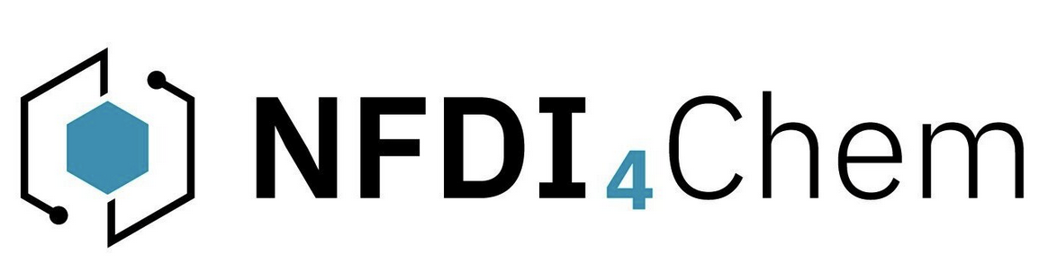
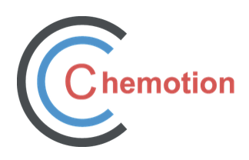
Introduction
Chemotion: Data management tool for chemistry and related sciences:
Electronic Laboratory Notebook (ELN)
Creation and management of laboratory data – directly in the lab
Can record assays, protocols, analyses, structures and reactions
Access to the working group's lists of chemicals
data can be easily shared or transferred via different access rights
Repository
-Tool for publishing research data according to the fair standards
-Automatically connected to the ELN, but can be used separately
No pre-installation required
Open source
Log in with uni-credentials

Slide 3
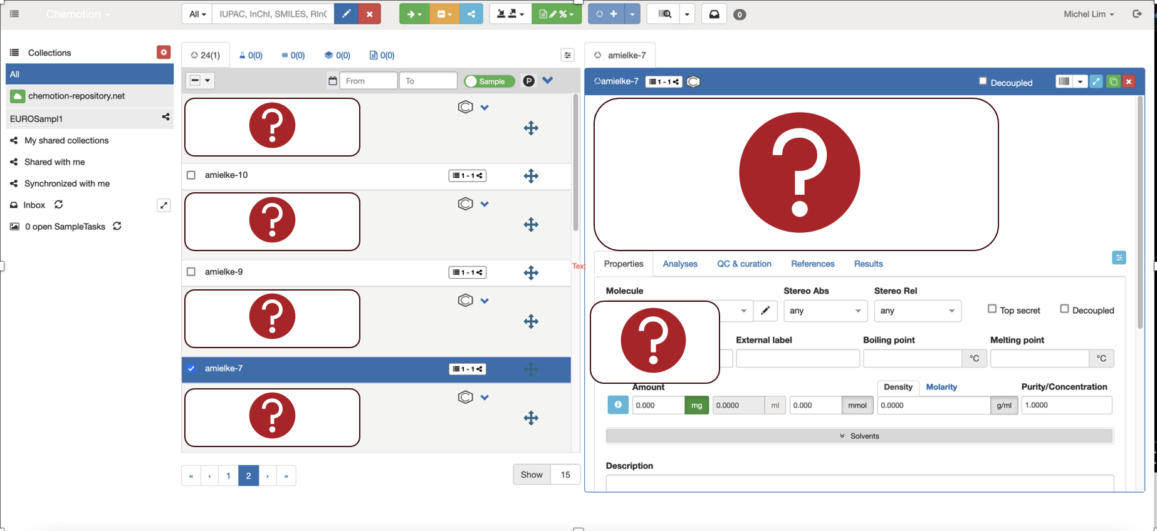
Electronic Laboratory Notebook
Add new molecules
Publish data
ELN
Collections:
-Used to structure research data
-Can be shared and published
-GHS statements are generated automatically
Add new collections
Michel Lim
28.07.23

Slide 4
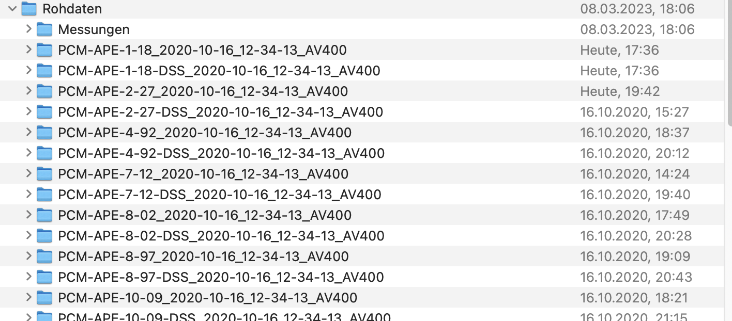
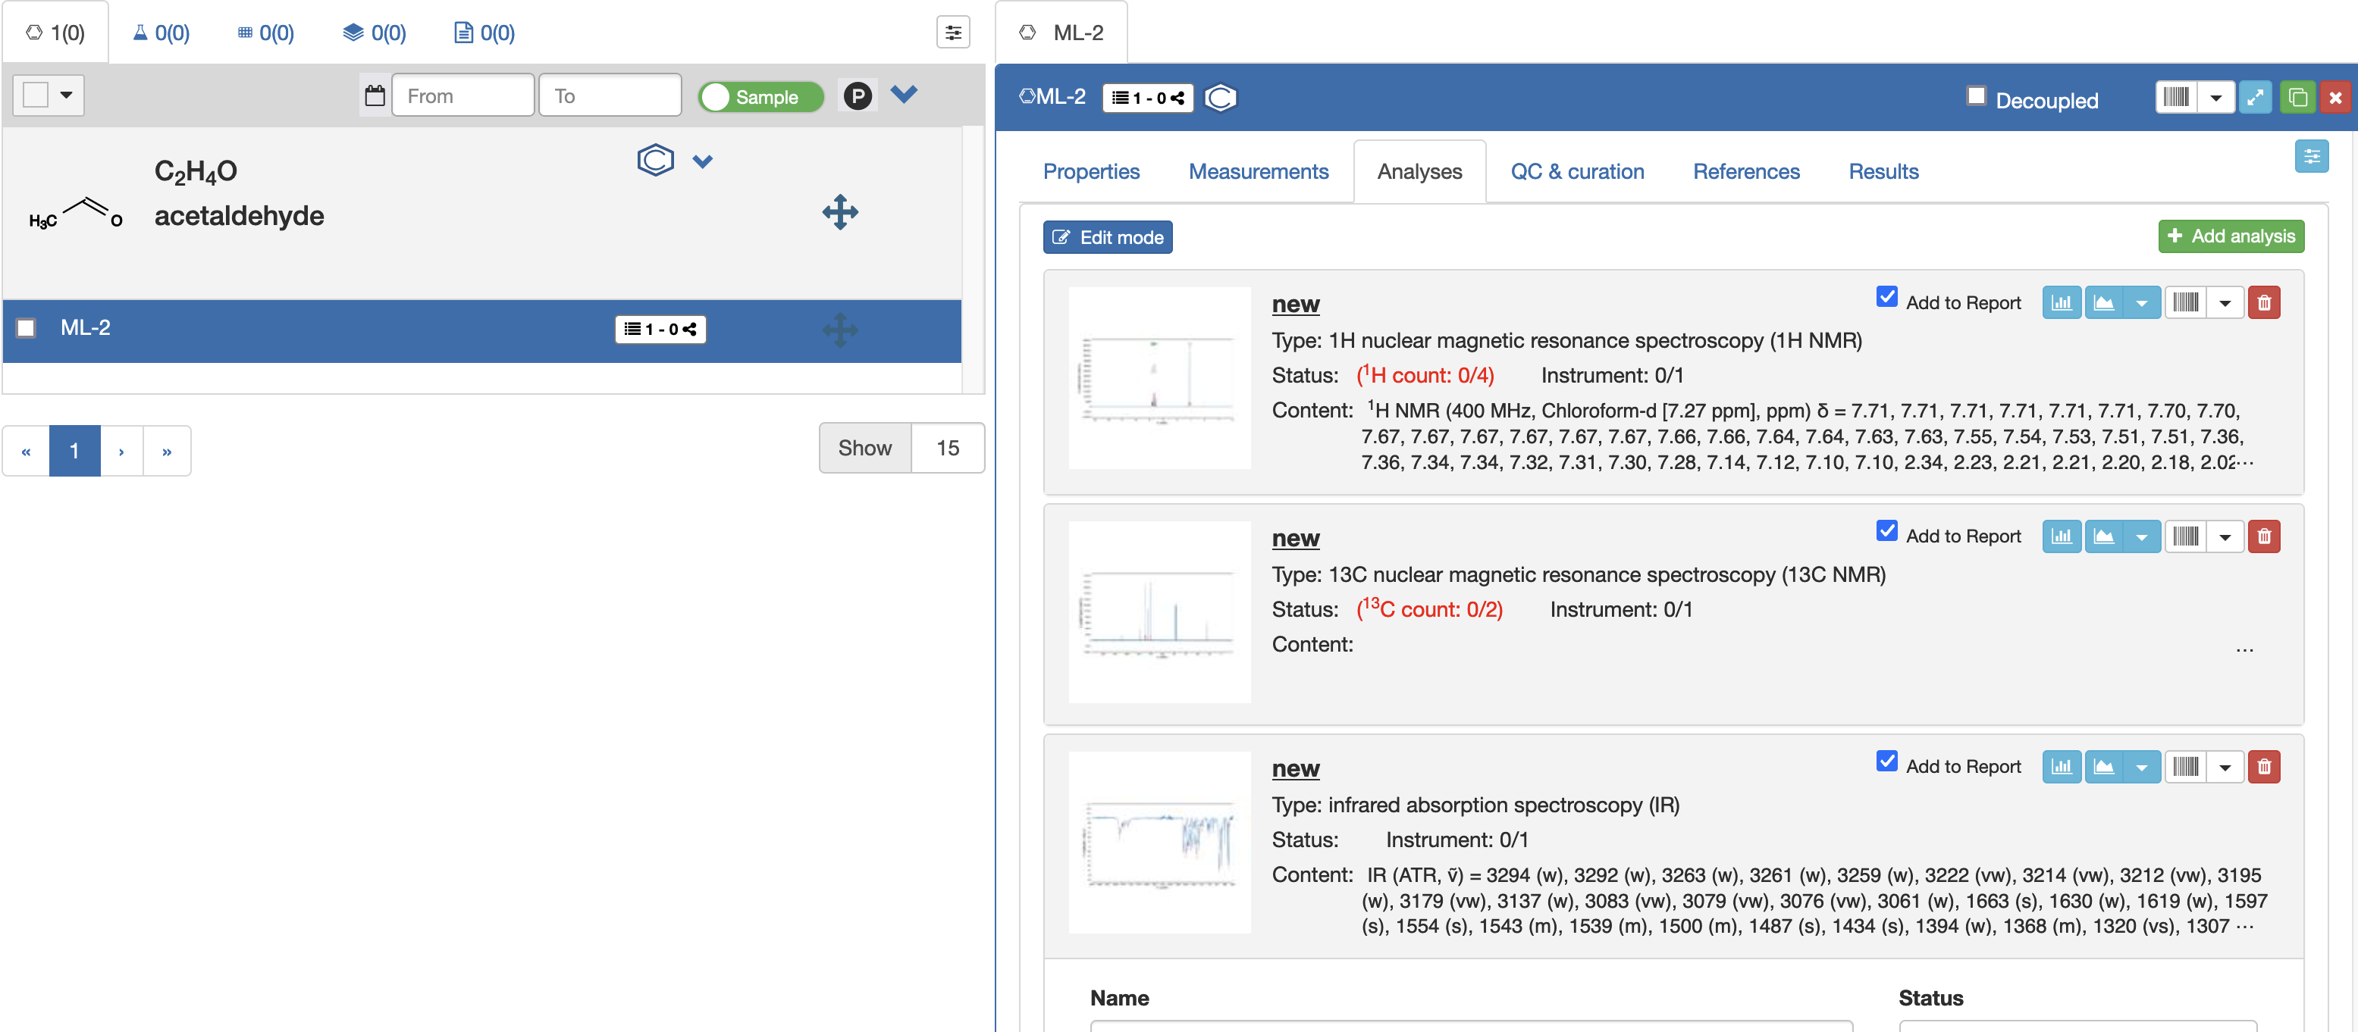

Electronic Laboratory Notebook
Manage and analyse your data in Chemotion:
-Peak picking, calculating chemical shifts possible
-Open source (contrary to MestRenova and other commercially available software)
-Still contains some bugs and can not be used in Firefox
Before
After
Michel Lim
28.07.23

Slide 5
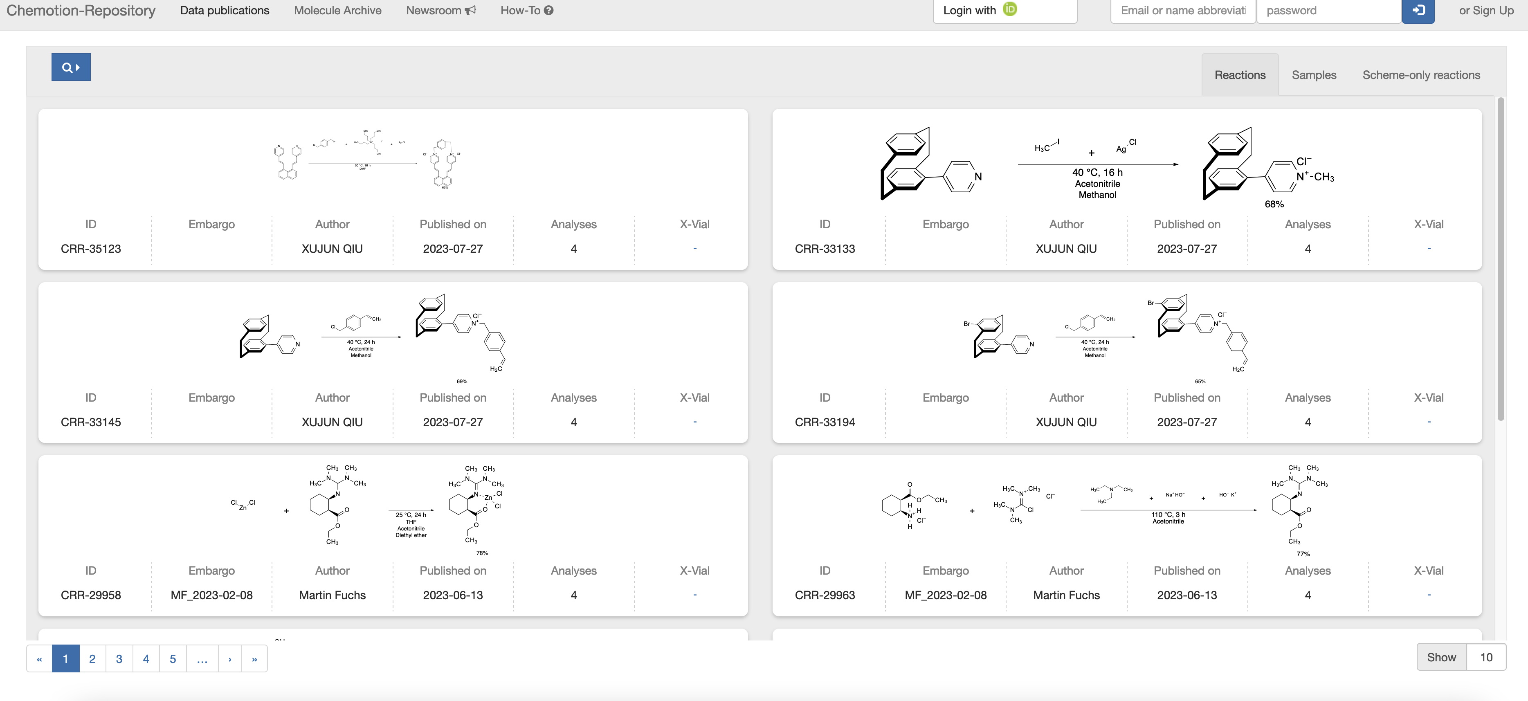
Repository
-Data is published according to FAIR (findable, accessible, interoperable, reusable) standards
-can be used to generate supporting information,
-currently: samples, reactions and schemes
-generates doi for data automatically
Michel Lim
28.07.23

