Slide 1
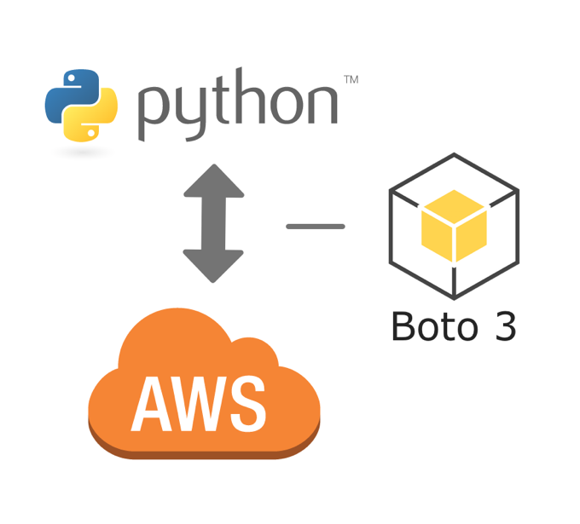
AUTOSCALING USING BOTO3
-Aishwarya Srivastava

Slide 2
BOTO3 : Introduction
BOTO is the Amazon Web Services (AWS) SDK for Python.
BOTO is a Python library supported by AWS. Each service needs to be hand coded therefore its difficult to maintain.
BOTO 3 is a new version of BOTO library based on ‘BotoCore’. JSON service descriptions are used to generate AWS services which provides
Faster updates
Consistency

Slide 3
BOTO3 : Features
Resources: a high level Python objects
Collections: a tool to iterate and manipulate groups of resources
Clients: low level service connections
Paginators: automatic paging of responses
Waiters: a way to block until a certain state has been reached

Slide 4
BOTO3 : Basics
Named arguments for functions, methods or parameters.
Response in form of dictionaries.
Naming convention for variables – Capitalized Camelcase (unlike Python)
CORRECT APPROCH
Response=client.create_subnet(CidrBlock=’10.0.1.0/24’,VpcId=’vpc-ad0014c2’)
Print(Response)
Expected Output:
'Subnet': { 'AvailabilityZone': 'us-west-2c’,
'CidrBlock': '10.0.1.0/24’,
'State': 'pending’,
'SubnetId': 'subnet-9d4a7b6c’,
'VpcId': 'vpc-a01106c2', },
'ResponseMetadata': { '...': '...', }, }
WRONG APPROACH
Response=client.create_subnet(’10.0.1.0/24’,’vpc-ad0014c2’)
OR
Response=client.create_subnet(cidr_block=’10.0.1.0/24’,vpc_id=’vpc-ad0014c2’)

Slide 5

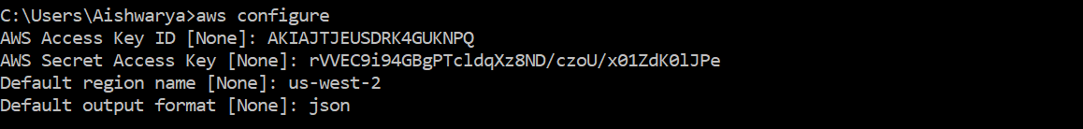
BOTO3 : Installation
Prerequisite – Python should be install
Install AWS CLI and configure AWS credentials and region.

Slide 6
Configuration files
~/.aws/credentials
~/.aws/config
[default]
aws_access_key_id=EXAMPLEkeyid
aws_secret_access_key=EXAMPLEKEYsecretsccesskey
[default]
region=us-east-1
output=json

Slide 7
Autoscaling using BOTO3
Create the basic architecture including VPC, Subnets, Internet Gateway, Security Groups, Route Tables, Instance.
Create an AMI of the instance.
Auto scaling Group - used for maintaining or scaling a set of EC2 instances
Launch Configuration: Information needed by the Auto scaling group to launch EC2 instances.
Scaling Policies and Alarms: Set of rules for determining when to scale an instance up or down in an auto scaling group.
Elastic Load Balancer – To distribute the traffic.

Slide 8
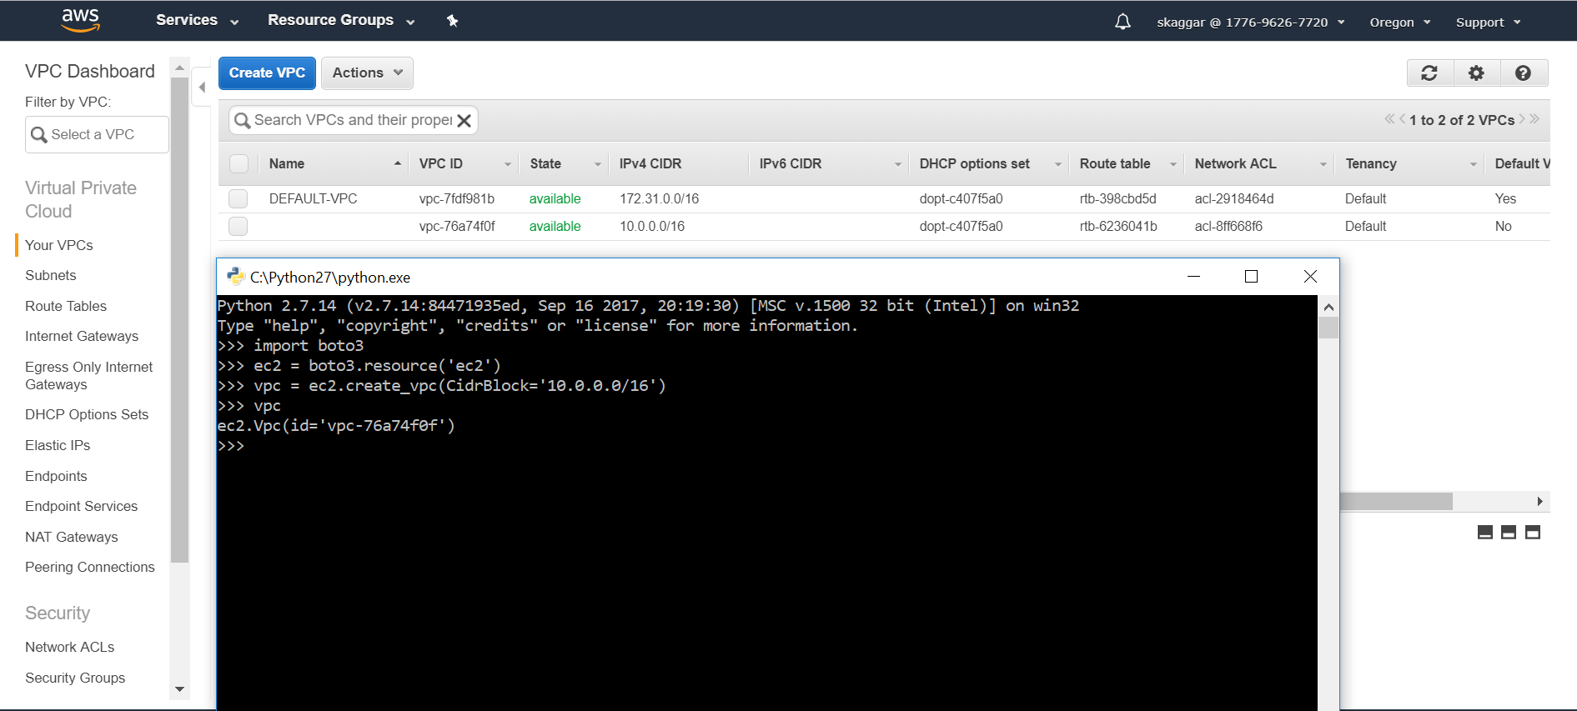
Creating a VPC

Slide 9
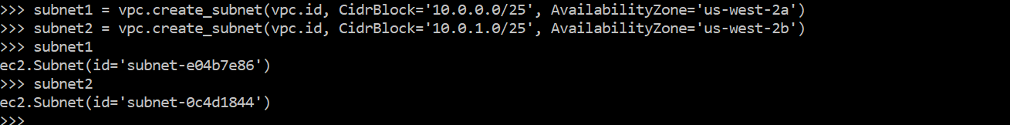
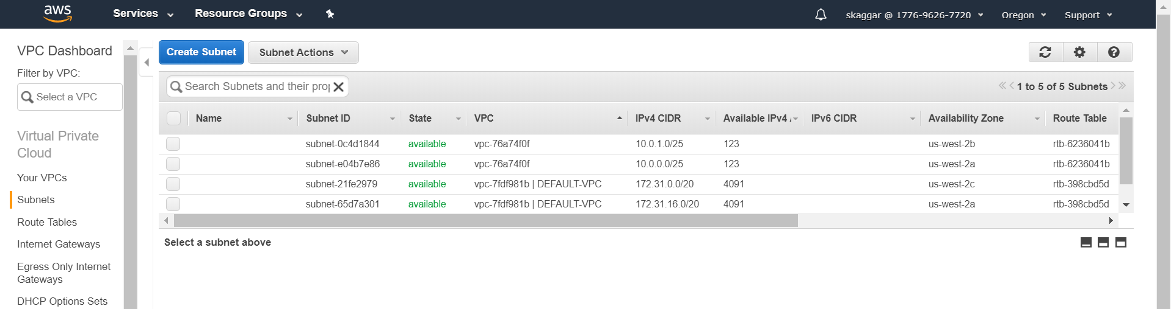
Creating Subnets

Slide 10
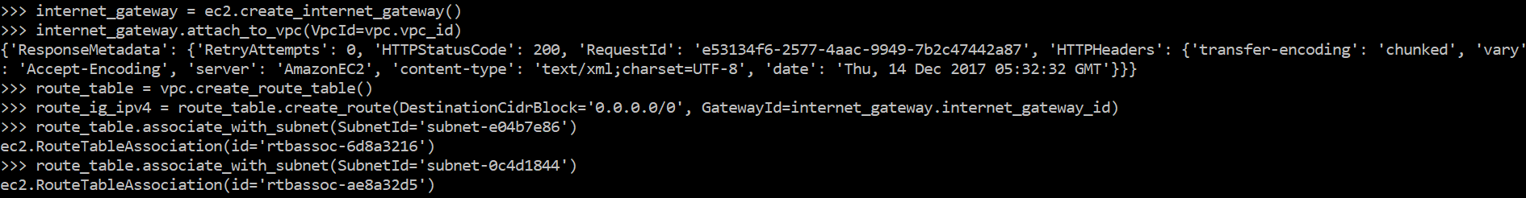
Internet Gateway and Route Tables

Slide 11
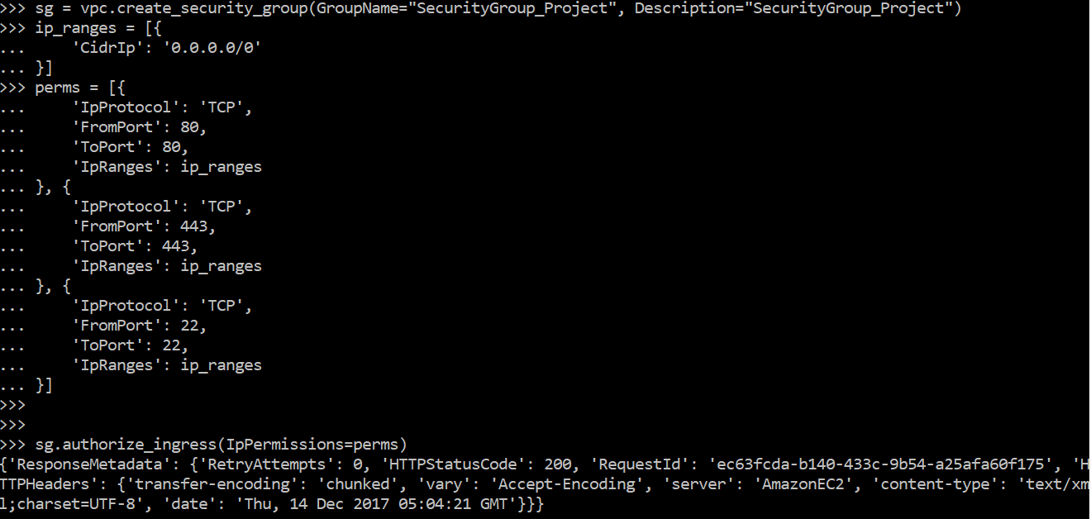
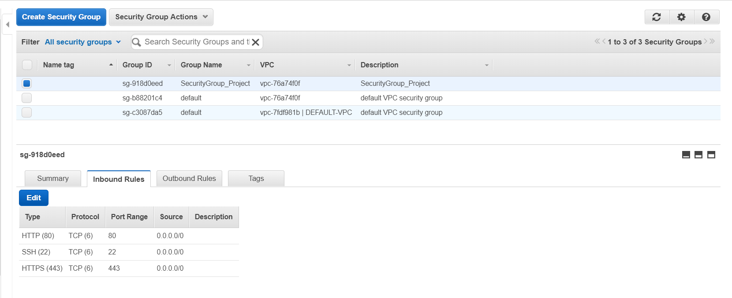
Security Groups (Ingress Rules)

Slide 12
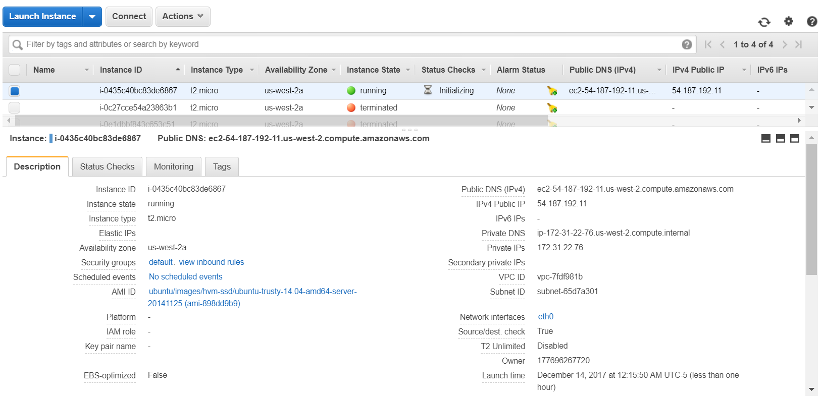
Create instances

Slide 13
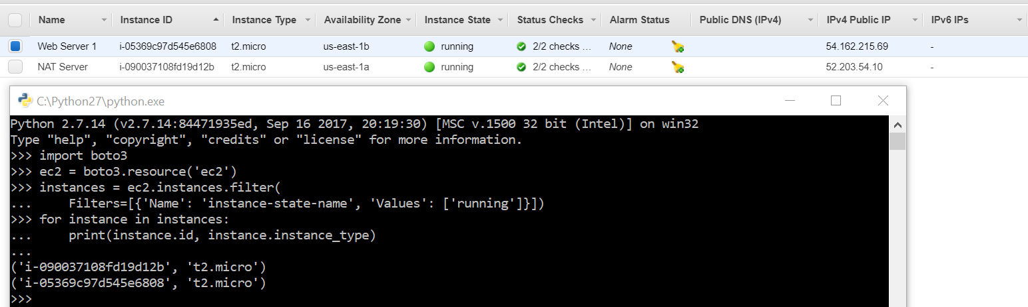
View Instances

Slide 14
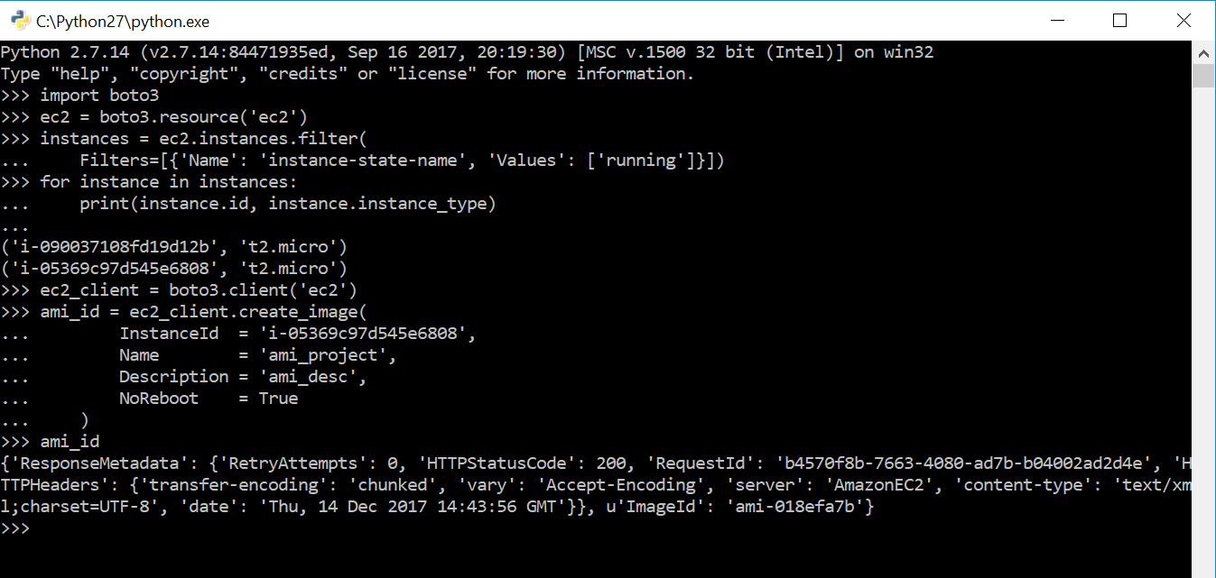
Create Amazon Machine Image (AMI)

Slide 15
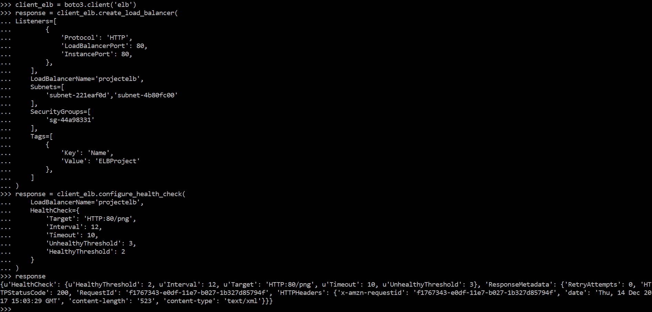
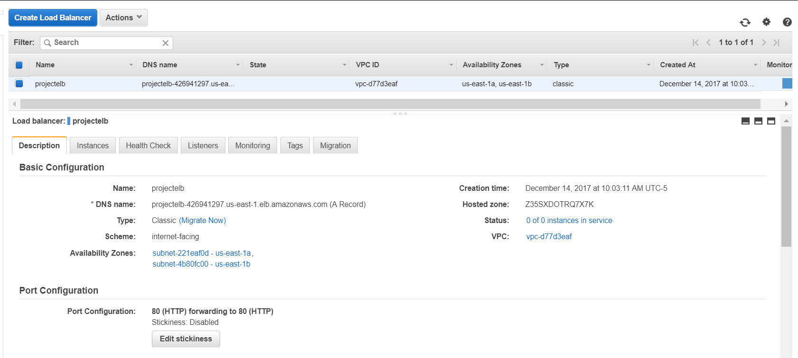
Creating Elastic Load Balancer

Slide 16
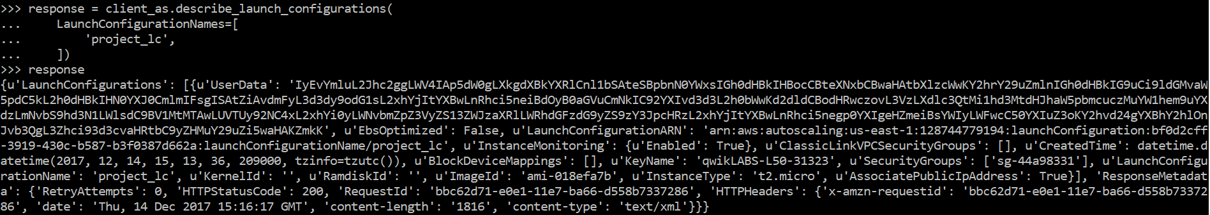
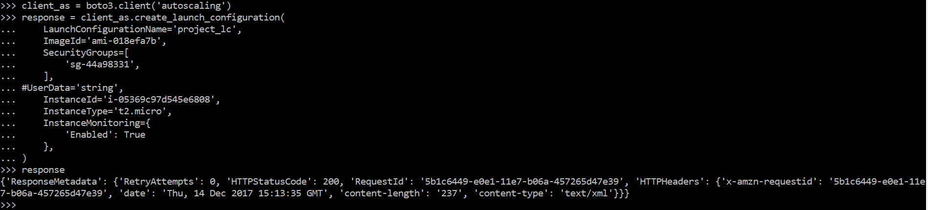
Creating Launch Configuration

Slide 17
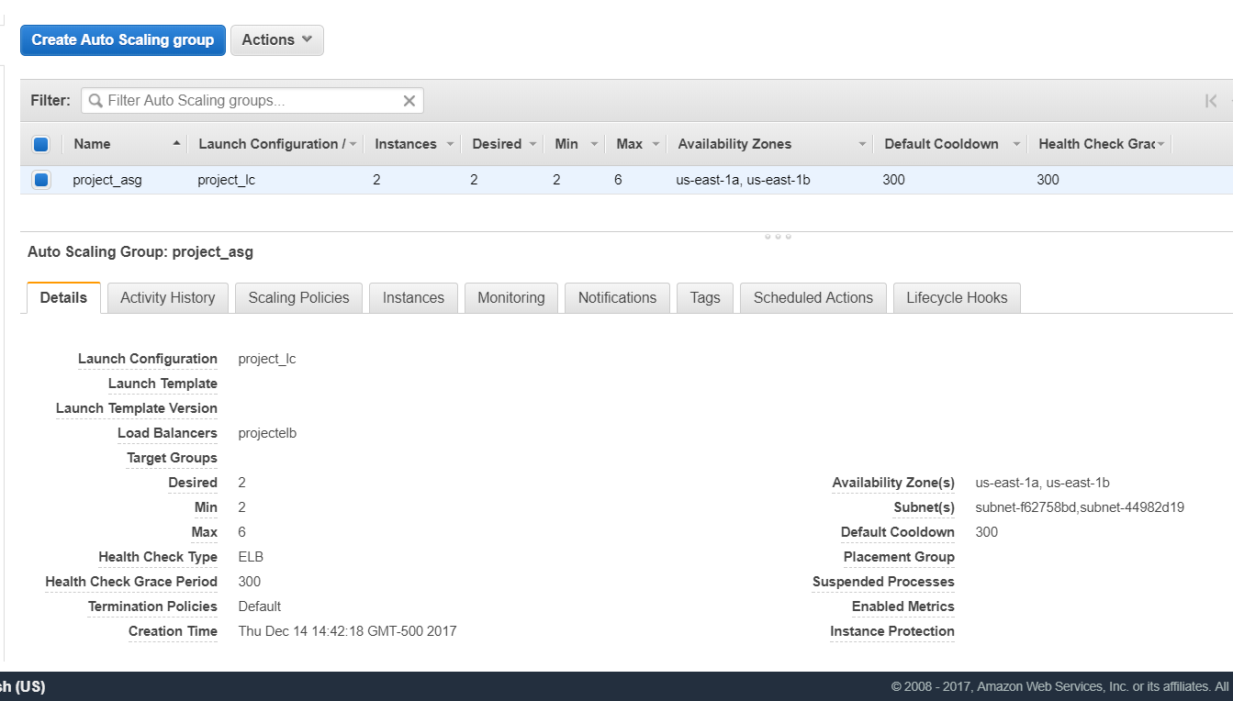
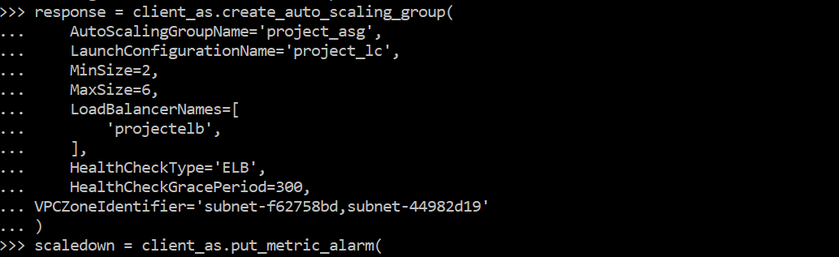
Create Auto Scaling Group

Slide 18
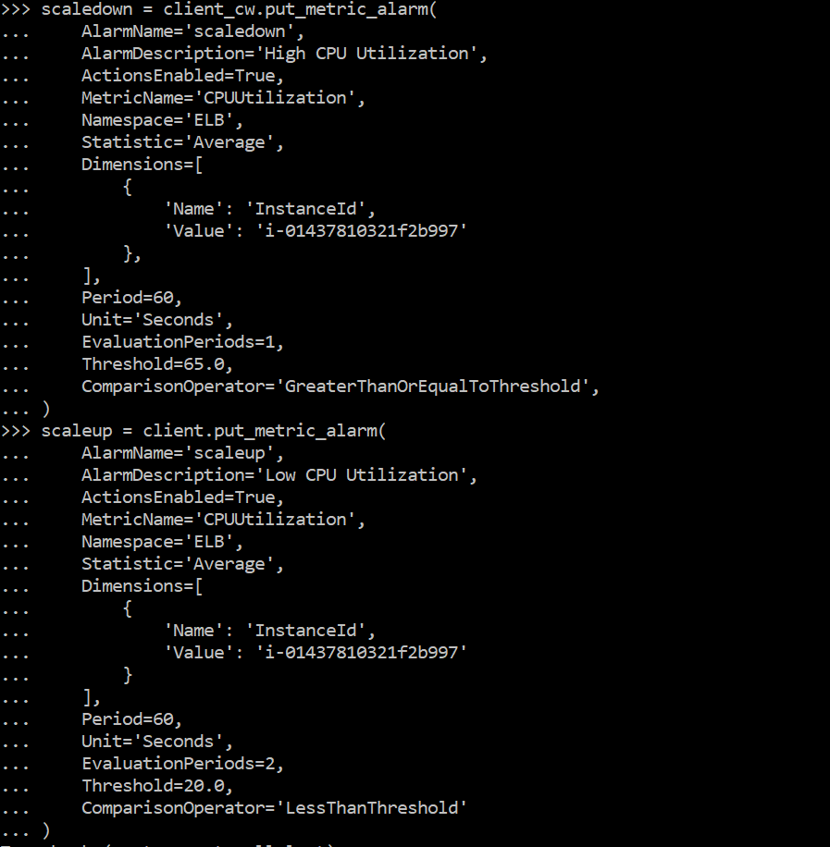
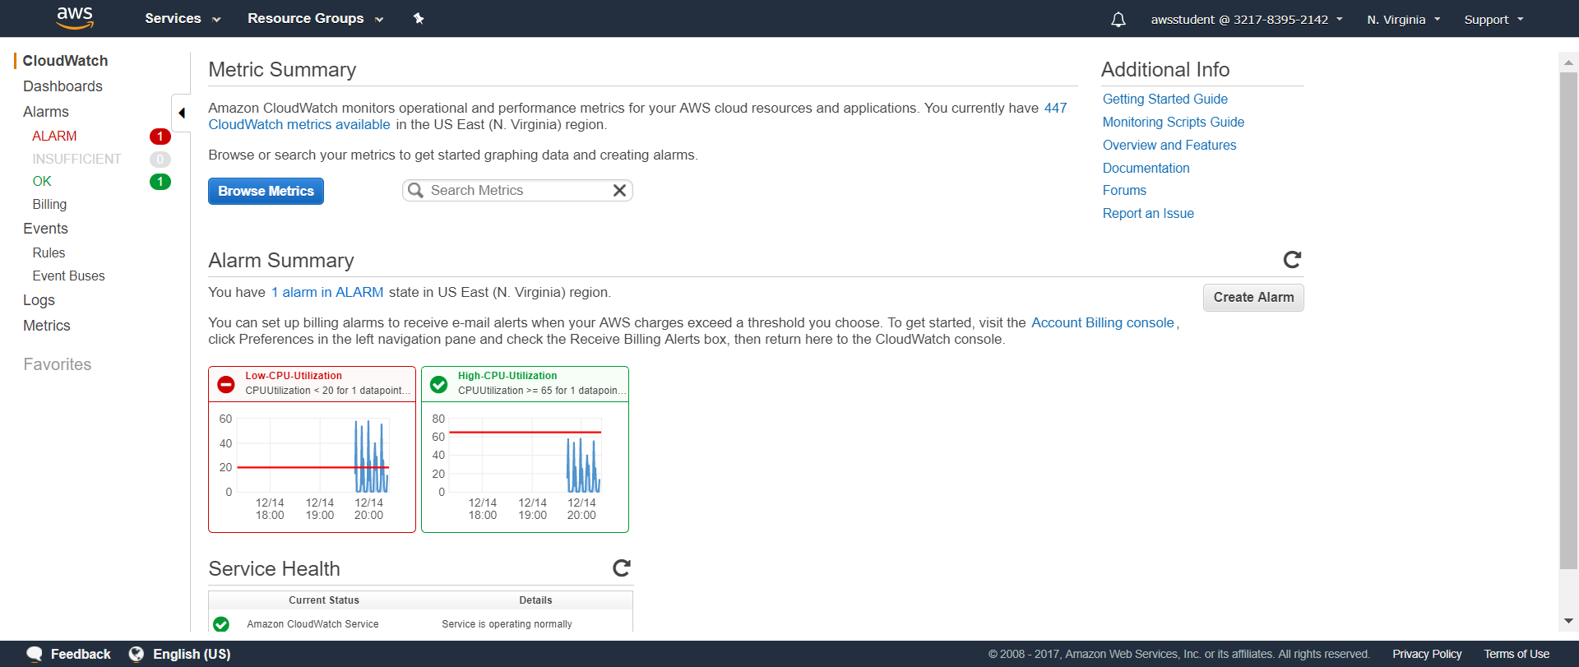
Cloud Watch Alarms

Slide 19


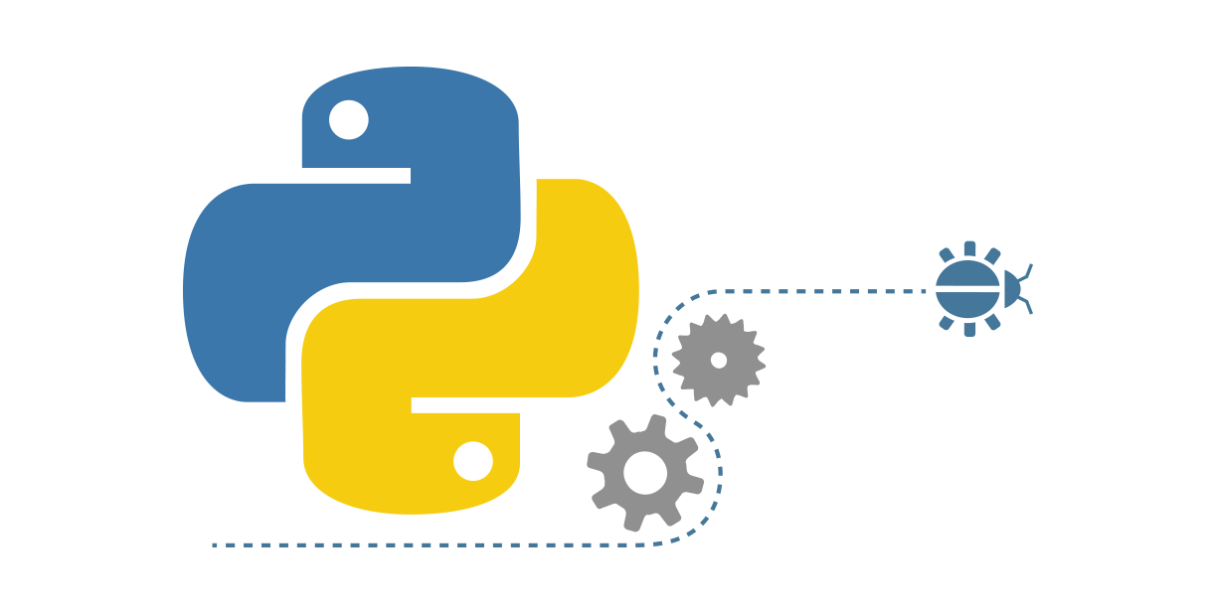

References
http://boto3.readthedocs.io
-AISHWARYA SRIVASTAVA
Graduate Student

