Slide 1


Global Programs: Applications Development
MICHAEL FRIESEN
DIRECTOR, APPLICATIONS DEVELOPMENT
MARCH 7, 2017

Slide 2

BUILDING ON STRENGTH
People focused on the development and maintenance of software to support products and services
Tools across 5 product lines
Databases tying all these products together (not including CRM, ERP or Sharepoint)
7
99+
39
500`1

Slide 3
GOING FORWARD
[E]volve – the platform for assessment organizations
[PRO]gress – assessment tools for
Everyone
StanMan – the, currently unnamed, repository for standards and assessment manuals
Currently focused on developing 3 toolsets:
[E]
[PRO]
StM
1000
1

Slide 4
[E]volve
Assessment Organizations
HSO
Surveyors
Healthcare Providers
Intended to be used by assessment organizations to efficiently automate their own program(s)
Founded on the Qmentum Licensed Program platform that was developed for NIAZ and Qatar
Currently used by NIAZ, IQG and International Accreditation
One portal used by all organizations with branding by assessment organization
Coming in 2017:
Ability to operate multiple programs
New tools to support Qmentum Global
Updated interface based on the software visual style guide

Slide 5
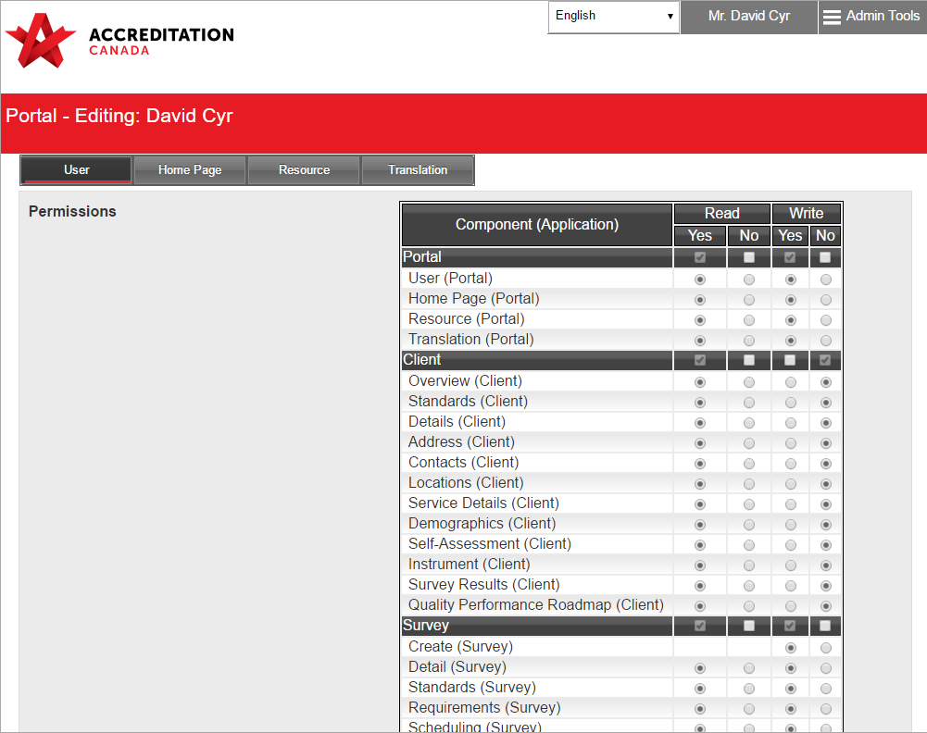
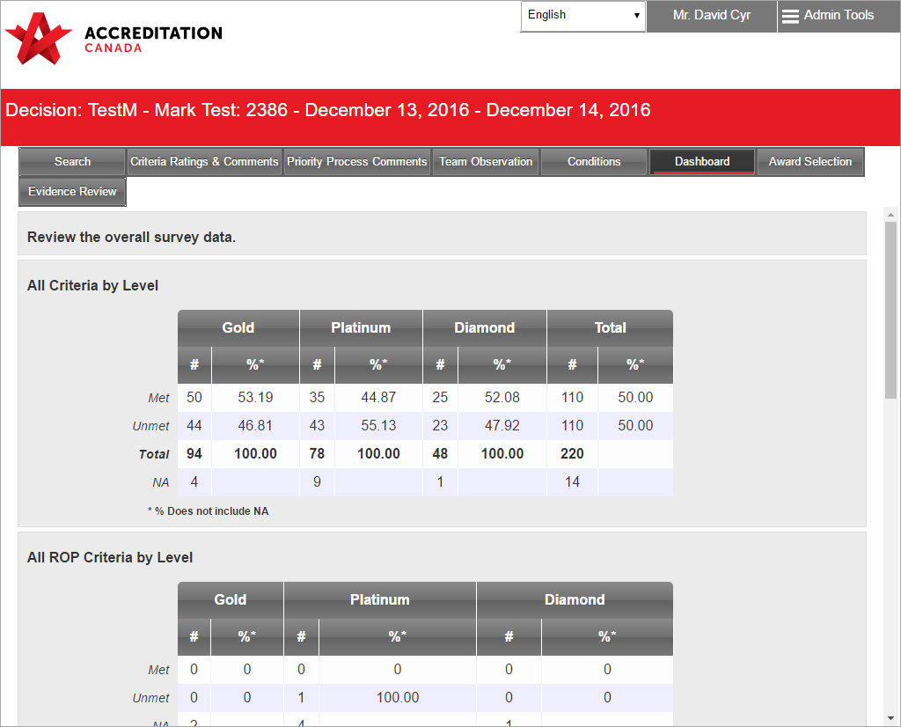
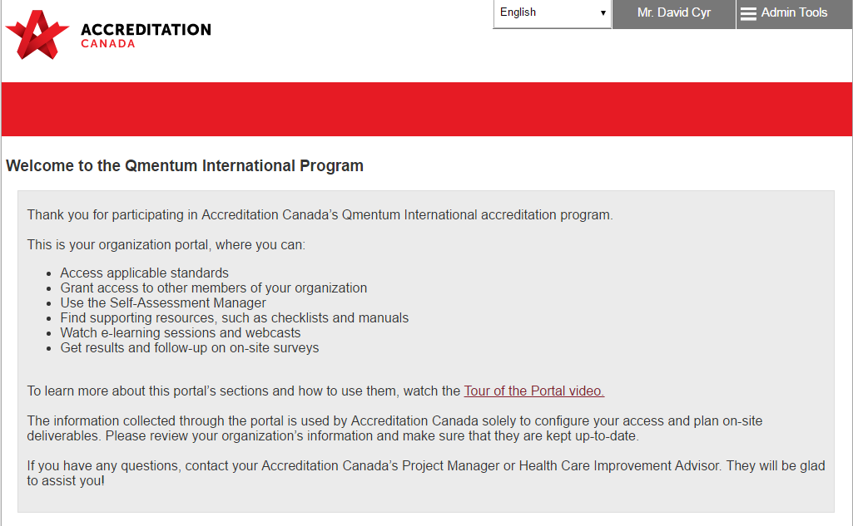
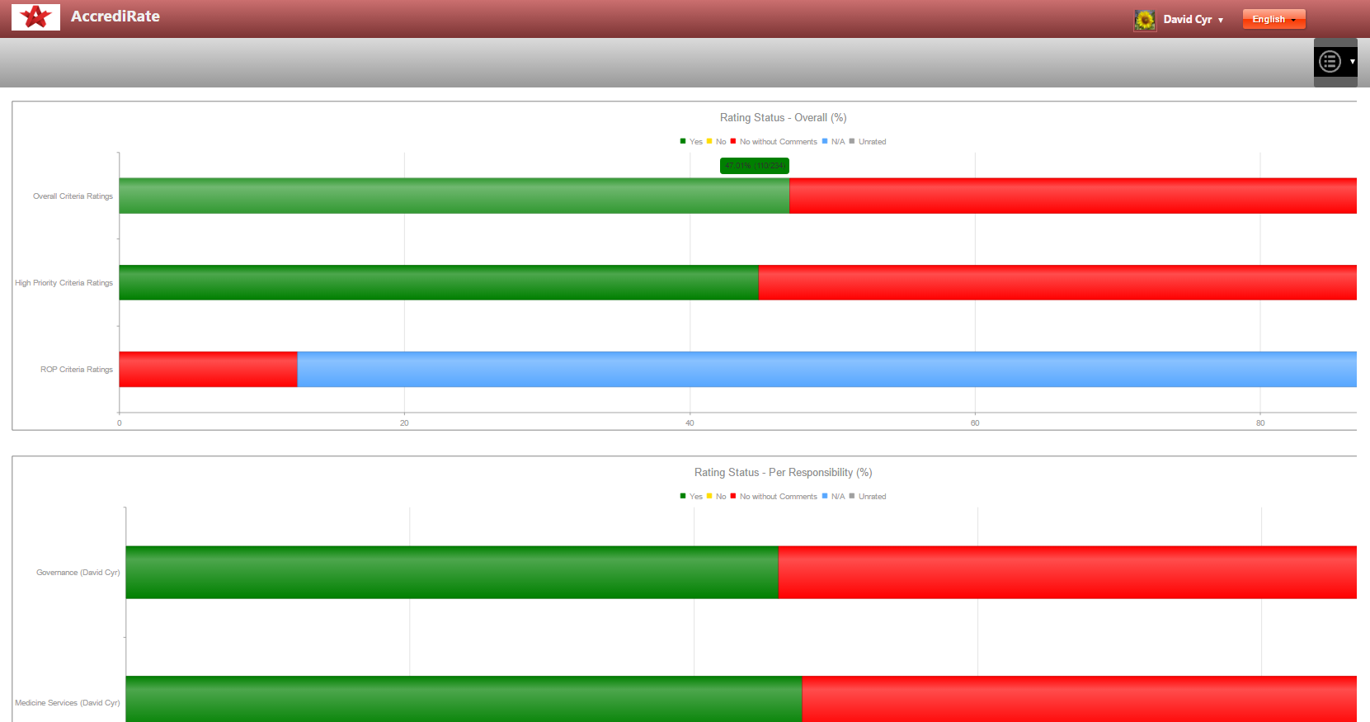
[E]volve

Slide 6

[PRO]gress
Started as an assessment tool for organizations to perform internal quality audits and then monitoring the resulting action plans
Designed around flexibility in gathering necessary information and providing relevant results
Coming in 2017:
Ability to launch multiple anonymous respondent surveys such as Self-Assessments and Instruments
Improved reporting tools and dashboards for benchmarking
Capability to perform virtual assessments with evidence review
On-site survey functionality
Early adopters:
CHUM – internal quality audit
Doctors of BC – Modified Worklife Pulse for Physicians
IWK Grace – Modified Worklife Pulse
Internal Quality Audit
Self-Assessment
Instruments
Virtual Assessment
Simulated Survey
On-site Survey
1000
1

Slide 7
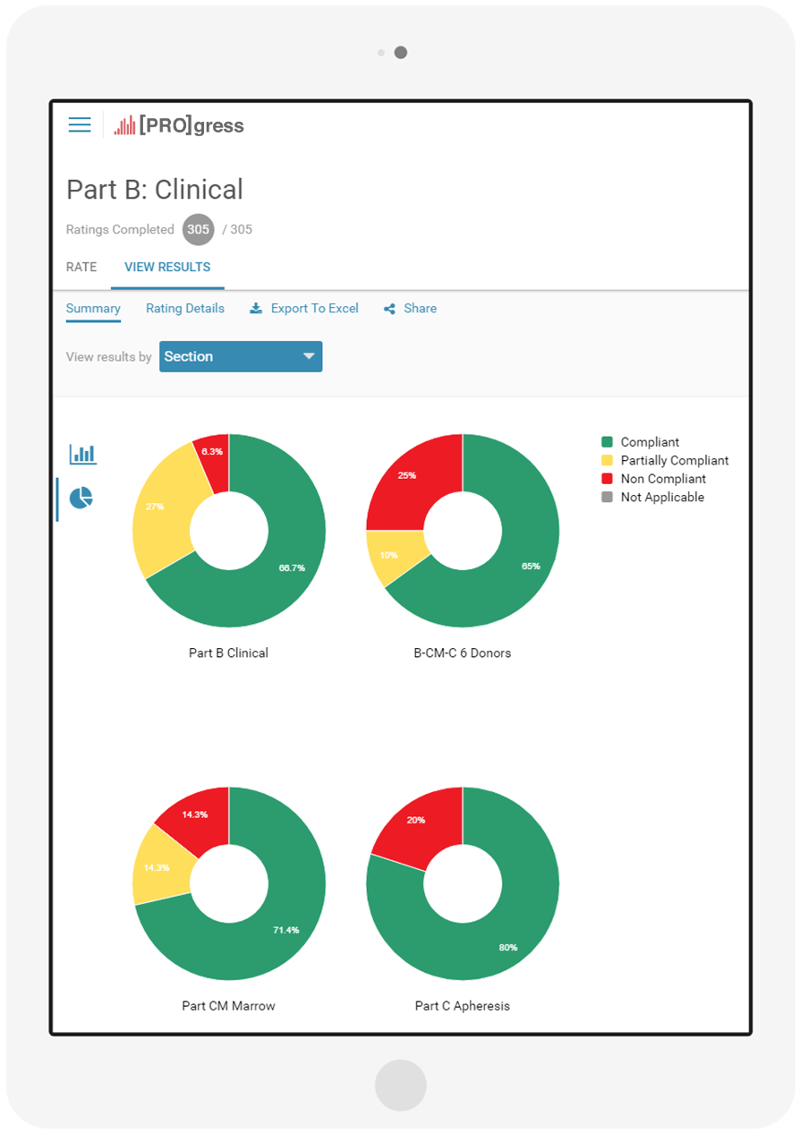
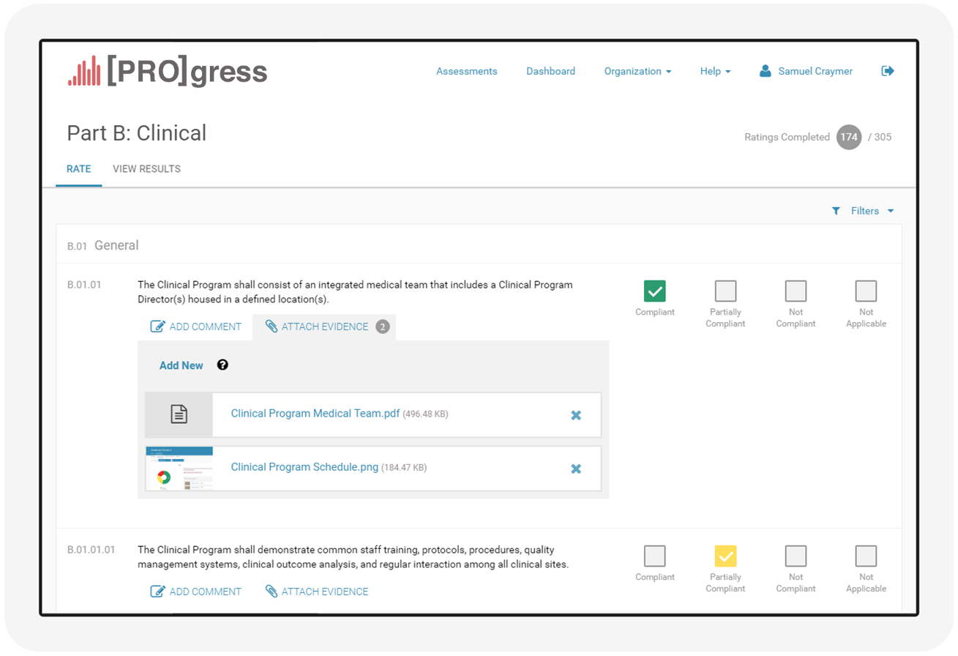
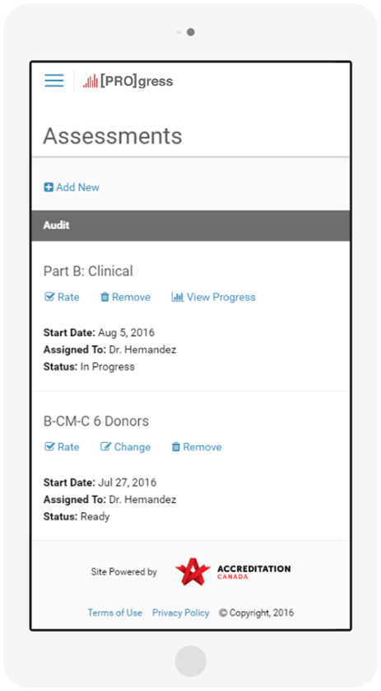
[PRO]gress
1000
1

Slide 8
StanMan (Standards Management System)
Software and repository for standards management
Multilingual capable
Multiple program frameworks (Qmentum, Allied Health, Société Santé en Français, JACIE, PhysioAlberta)
Will include tools for:
Production based on SDO workflow
E-store integration
Creation of assessment manuals
Integration with [E]volve and [PRO]gress
Generation of documents based on various templates

Slide 9
ALL TOGETHER
[E]volve
Platform for assessment organizations
Any program
StanMan
Standards and assessment manual toolset
Binds [E]volve and [PROG]gress
[PRO]gress
Assessments of different types and workflows
Potentially used by non-typical clients
Multiple perspectives
1000
1

Slide 10
OTHER PRODUCTS AND SERVICES
Software development – new tools
Software customization – configuration of existing tools
System Design
Tier 2 technical support
Maintenance of current products: Qmentum, Qmentum International, Distinction Stroke & Trauma, Corporate Applications (including ADC and Survey-Surveyor Planning)
Notes:
-Note: Early Adopter projects include small org and self-assessment tools

Slide 11

QUESTIONS?
94%

