Slide 1
Web Development Let’s Break It Down
Scott Beslow
General Assembly - Chicago
December 17, 2014

Slide 2
GENERAL ASSEMBLY
General assembly is an educational institution that transforms thinkers into creators through education in technology, business and design at twelve campuses across four continents.

Slide 3
12 Cities, 4 Continents

Slide 4

About Me
Scott Beslow
Principal Developer/Owner at Orange Wall
Email: scott@orange-wall.com
Twitter: @sbeslow
GitHub: sbeslow

Slide 5
The Plan
We are going to build a website together, demonstration style
As part of the process, we’ll discuss terms and concepts
It will be open-source
Our demo will be concept heavy and code lite
Stop me and ask questions
Notes:
What will our app do?

Slide 6
Starting Point
How do we interact with the internet?
Notes:
How do we interact with the internet?
On what devices – laptops, desktops, tablets, smartphones
What do we do on it?
Let’s pick a website.

Slide 7
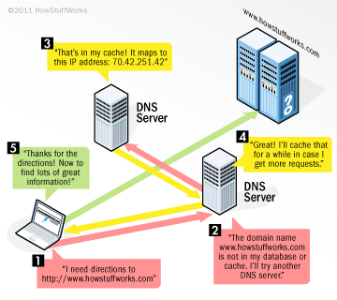
Front end, back end, & the cloud
Notes:
Server

Slide 8
Databases
An organized collection of data
We want to search through large amounts of data (you might even say big data) in a short period of time
How we want to access data determines how we want to store data

Slide 9
Comparing Databases
Name | Use Case
MySQL/Postgress | Flexible, easy, popular for set datasets. Think data tables
MongoDb | Unstructured data
Neo4j | Graph database – focuses on the relationships between data
CouchDb | Can work with frequent network unavailablity
HBase | Huge datasets

Slide 10
Back End Developers
Back end developers solve the same problem with many languages
Routing a request to a piece of coding
Talking to a database
Authenticating a user
Rendering a web page to the viewer based on the results we get back

Slide 11
Receiving Data
JSON – Javascript Object Notation
API – Application Programming Interface
Notes:
Introduce our sample dataset

Slide 12
Programming Languages
Front End
Back End
HTML
CSS
Javascript
Objective C/Swift (iOS)
Java (Android)
PHP (Wordpress)
Python
Ruby
Java
Javascript
Notes:
Front end – you’ll see that these three languages run in conjunction
Back end – small programs will usually be written in one of these. Big corporations though, have several back end servers running
Is there a best language? Depends on who you ask.

Slide 13
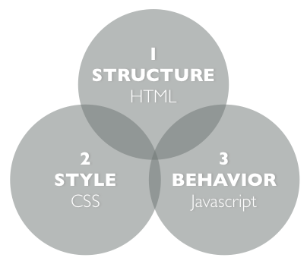

Slide 14
GitHub – Build software together
GitHub (http://www.github.com) is a web-based hosting service and repository.
A place to store the code
Developers working on the same code at the same time
Interface to see what code changes were made, who made it, and when (git)
Easy to back out code changes
Host a website for free
An account is free, but must have git
Desktop application is available
Other option is BitBucket (five free private repos)
Notes:
CREATE AN ACCOUNT HERE

Slide 15
An important definition
A software framework provides generic functionality that can be selectively changed by additional user-written code, thus providing application-specific software.

Slide 16
(Twitter) Bootstrap
A framework for developing responsive, mobile first projects on the web
http://www.getbootstrap.com
Another popular option is Zurb Foundation

Slide 17
IDE
An integrated development environment is a program that you write code in (The MS Word of coding).
Features and shortcuts to cover common scenarios and workflow efficiency
Ability to run and debug code
Color codes and displays to make code more readable
We’re going to use Brackets.io

Slide 19
The basic anatomy of HTML
<html>
<head>
<title>The title of the page</title>
</head>
<body>
<a href=“http://www.generassemb.ly.com>
Click here to visit General Assembly
</a>
<div id=“pictures”>
<img src=“/img/gaicon.png”>
<img src=https://generalassemb.ly/online/assets/ ga-lockup-logo- 9d95d5d0a1c966540edaedcb440b1963.png>
</div>
</body>
</html>

Slide 20
Let’s Build the Front-end

Slide 21
Pushing to the web
Github hosts web pages for free
http://[username].github.io/[repoName]
git checkout --orphan gh-pages

Slide 22
Our Design Pattern
Database
Languages spoken by neighborhood
Webpage rendering
Code to show webpage on client
HTML, CSS, Javascript
Web Server
Sending data through API
Parsing out per neighborhood

Slide 23
MVC Framework
Model Database
Languages spoken by neighborhood
View Webpage rendering
Code to show webpage on client
HTML, CSS, Javascript
Controller Web Server Controller
Sending data through API
Parsing out per neighborhood

Slide 24
Common MVC Frameworks
A single application that covers all three M-V-C components
Ruby On Rails (Ruby)
Nodejs (Javascript)
AngularJs (Javascript)
Django (Python)
Spring (Java)

Slide 25
Next Steps
Look at code, handouts from the repo at https://github.com/sbeslow/
Create a GitHub account
Install git or the GitHub app
https://windows.github.com
https://mac.github.com
Clone the repo on your machine and play around

Slide 26
Potential Projects
Make it look nice
Show top 3 spoken languages
Show a map
Display data from other projects from the Open Data Portal
Or look around for other APIs

Slide 27
More GA Courses
Front-End Web Development (launches March 9th) - part-time, 10 weeks, meets Mondays & Wednesdays 6–9 PM; focuses on HTML, CSS, and Javascript
Web Development Immersive (launches March 9th) - full-time, 12 weeks, meets Monday–Friday all day; is designed to give students the skills and portfolio pieces to be able to get a job as a full-stack web developer at the end of the program (and we provide job search support); focuses on Javascript, Ruby, Rails, and a ton of other topics

Slide 28
Other Places to Learn
W3 Schools
Codecademy
StackOverflow
CodePen
Dash (General Assembly)

Slide 29
Questions?

