Slide 1
Paper presentation - LTRACK: Stealthy Tracking of Mobile Phones in LTE
MartinKotuliak, SimonErni, PatrickLeu, MarcRöschlin, and SrdjanCˇapkun
Aisha Kothare
Namruth Reddy

Slide 2
Abstract
New tracking attack on LTE.
Passive localization + Stealthy tracking
Allows an attacker to stealthily extract user devices’ locations and permanent identifiers (IMSI).
Fully passive - IMSI extractor relies on uplink/ downlink sniffer : LTEprobe.
In line-of-sight conditions, the attacker can estimate the location of a phone with less than 6m error in 90% of cases.
Notes:
IMSI extractor is enhanced with surgical message overshadowing, making it the stealthiest IMSI Catcher to date
Successful testing of IMSI Extractor against a set of 17 modern smartphones.

Slide 3
Introduction
Attacks against LTE : active or passive.
Proposed attack focuses on stealthy UE tracking.
IMSI Extractor extracts a device's IMSI and binds it to its current TMSI, making it the stealthiest IMSI Catcher to date.
LTEPROBE : the first white-box uplink and downlink LTE sniffer that records both protocol level information and physical layer timings of messages.
Notes:
active attacks typically rely on fake base stations to which victim UEs connect.On the other hand, passive attacks rely on custom-built sniffers. In [8, 23], it was shown that an attacker can build a passive downlink traffic sniffer (from the eNodeB to the UE) using software-defined radios. Downlink sniffers were then used as tools for localization [32], to break the encryption of phone calls [34], and to allow traffic fingerprinting [20].
LTRACK combines passive localization and IMSI Extractor into a UE tracking system that enables simultaneous identification and localization of UEs, allowing an attacker to track users more persistently and with higher accuracy than prior attacks
Mobile phone fingerprinting is implemented using LTEPROBE, allowing the attacker to identify the make and model of the phone, further increasing the accuracy of phone localization and tracking by as much as 20 meters.
LTRACK improves on the state-of-the-art by combining Timing Advance Command sniffing and measuring the times of arrival of both LTE downlink and uplink messages. LTRACK also contains a purpose-built IMSI Catcher that does not rely on a fake base station but rather overshadows packages with surgical precision and very little energy.

Slide 4
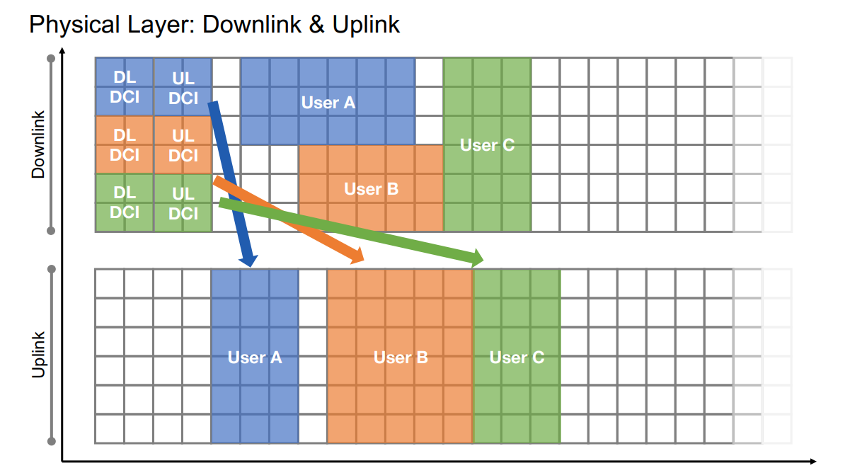
Background
Radio interface is like a 2D grid - resource vs time.
To decode data and send on uplink UE needs to look at DL DCI block.
Information sent on physical and MAC layer isn’t encrypted.
LTE probe able to sniff both uplink and downlink information exchange.
Notes:
LTE - info sent on radio interface inside 2d resource grid - resource and time. Every square res ele. Contains data
To decode data user needs to look at DL DCI block.
Mult diff dci for user ABC
Everything in LTE managed by BS
User waitas for UP DCI sent on down link
Tells user where on uplink freq user can send data
LTE nw has everything tightly synchroniosed
UL - uplink and DL - downlink DCI - downlink control information.
Resource grid -
DL DCI contains where and how the user can find and decode their data
Everything is managed by base stations. And the BS decides where and how the user can send the data Authors of the paper built a sniffer that can sniff DCIs.
Since LTE primarily operates in MAC and physical layers, data is unencrypted

Slide 5
Background
LTE has two main identifiers.
IMSI : Persistent identifier, hardcoded in SIM, sent at first connection attempt.
TMSI : Temporary (Random) Identifier, assigned by network and changes regularly, sent at every connection attempt.
To capture TMSI : using fake BS vs using overshadowing - AdaptOver
Notes:
Imsi catcher - FBS
Overshadowing: dont send something all the time, only overshadow 1 single message in protocol
Adv: send very limited message , less power needed 1.8 dB vs 30 dB - stealthy and normal detection methods dont work

Slide 6
Background
Notes:
UL - uplink and DL - downlink DCI - downlink control information.
Resource grid -
DL DCI contains where and how the user can find and decode their data
Everything is managed by base stations. And the BS decides where and how the user can send the data Authors of the paper built a sniffer that can sniff DCIs.
Since LTE primarily operates in MAC and physical layers, data is unencrypted

Slide 7
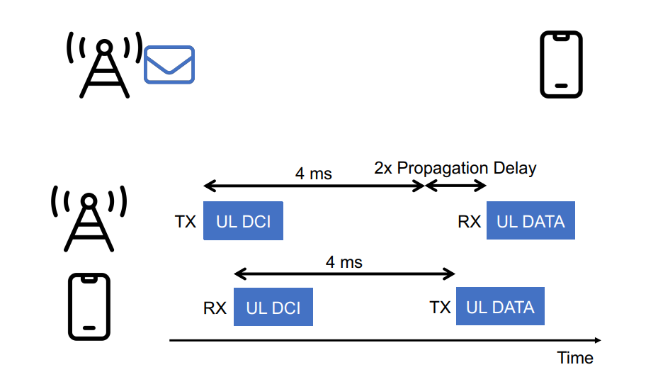
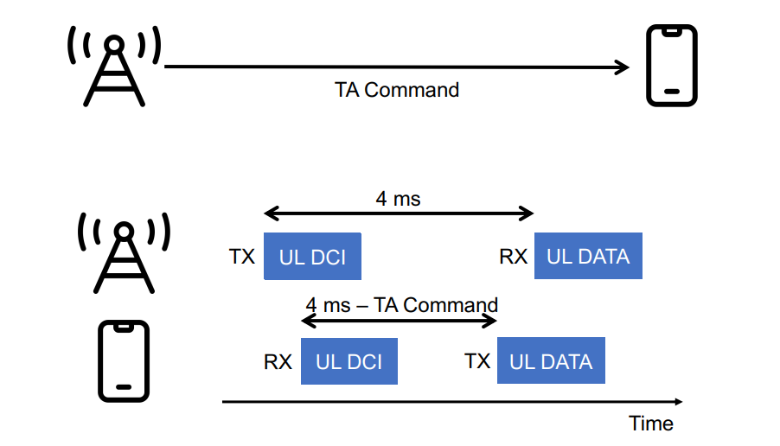
Unsynchronized mobile phones
Notes:
Timing Advancement command to account for propagation delay

Slide 8
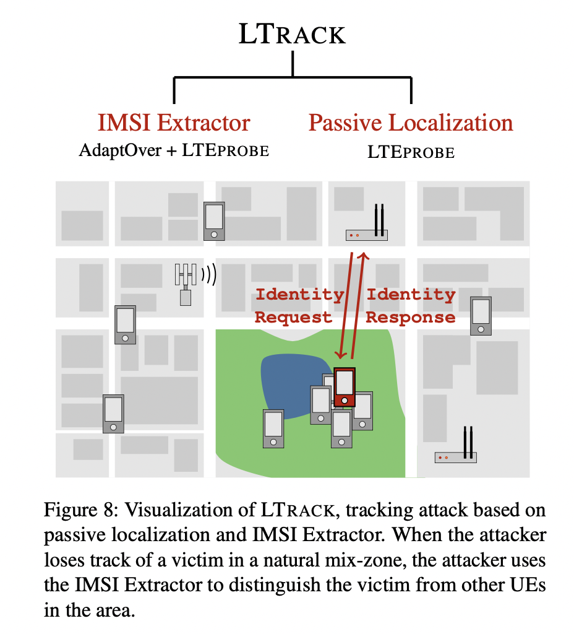
LTrack
Attack stages:
Communication Recording
IMSI Extractor
Passive Localization
Notes:
The goal of such a tracking attacks is to obtain traces of all users while staying as stealthy as possible.
Passive localization - based on TA command and propagation delay est
Sealthy identification - based on overshadowing and uplink sniffing
Issues solved by LTrack:
The attacker uses the passive localization attack to locate individual users during their connections to base stations.
without identification, all the UEs look the same, and after each reconnection, UEs might anonymize themselves with a new TMSI.
If the user moves along less frequented areas when the TMSI gets updated, the attacker could still link the two temporary identifiers based on their locations. However, as an UE enters an area with many other UEs, this area will act as a natural mix zone.
For large scale attack - 1 or atleast 2 LTEprobes near BSE - perform localization attack.
Communication Recording:
The attacker uses LTEPROBEs to record all uplink and downlink communication with arrival times from the set of base stations being monitored.
Messages during a UE's connection are addressed on the physical layer with a unique RNTI value that links them together.
Each connection of a UE to the network starts with an RRC Connection Request that contains the TMSI of the user.
The attacker stores a list of TMSIs observed during the attack and links them to corresponding connections.
To link connections of the same user whose TMSI changed during the attack, the attacker runs IMSI Extractor.
IMSI Extractor:
The IMSI Extractor extracts and stores TMSI-IMSI pairs of users
It links observed communication to the unique, persistent identifier of the UE (IMSI)
When LTEPROBE registers an RRC Connection Request, the attacker checks if it already knows the corresponding IMSI to the enclosed TMSI
If the pair exists in the database, the attacker passively records communication and links it to the stored pair
If the TMSI has not been seen before, the IMSI Extractor is run to learn the IMSI number and store the new TMSI-IMSI pair in the database
Passive Localization:
Passive localization is a method used by the attacker to locate the user.
The attacker records all the uplink and downlink communication with corresponding arrival times from all LTEPROBEs and stores them in the database.
The attacker uses recorded data to get each UE uplink message's time of arrival and Timing Advance Commands sent by the base station to locate the user.
The attacker can increase the precision of the localization attack by running a passive fingerprinting attack on the saved recordings of Attach Requests to learn the phone model.
The attacker can retroactively compensate hardware error to increase the precision of measured times of arrival of an uplink message for that user.
The attacker can visualize the movement of the victim and build a whole trace of a user's movement.
Special Cases:
Under certain conditions, a UE changes the serving cell to a cell with a stronger signal, and the attacker can observe new random access without a Service Request and match it to a connection that halted at a neighboring cell.
The attacker can observe the UE again during the next Service Request it performs, or force a reconnection using a paging message or a call.
This work does not address user deanonymization, which can be done using existing techniques based on user traces reconstructed by LTRACK, such as transportation routines, mobility traces, home addresses, who they meet, or online geo-tagged media. Even coarse spatial and temporal traces can deanonymize users based on their unique mobility patterns.

Slide 9
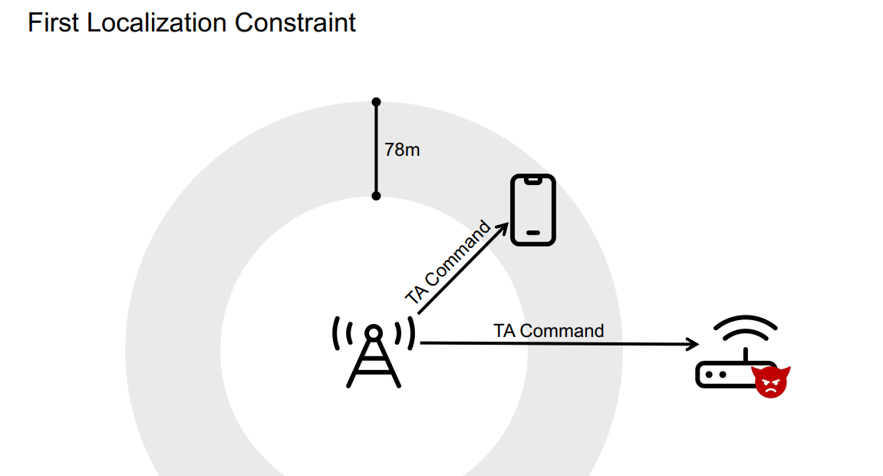
Passive Localization
Notes:
Timing advancement command sent in MAC layer unencrypted. Using sniffer to sniff the location of the phone into the ring with 78m accuracy

Slide 10
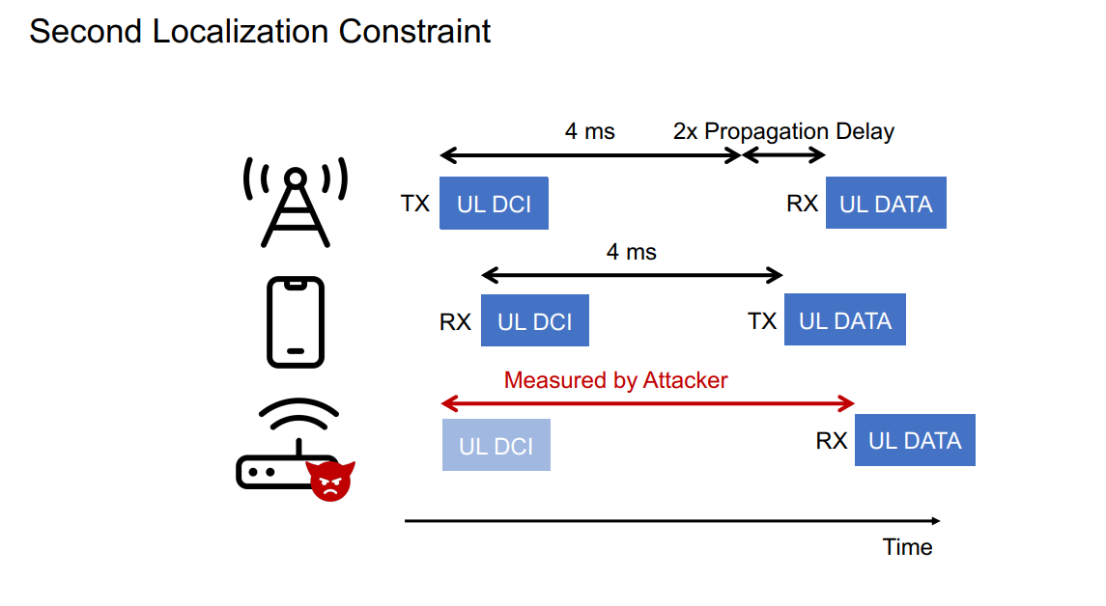
Passive Localization
Notes:
Attacker receives the UL DCI information from base station, knows the base station and its location accurately.
It also receives the UL data from the phone. Uses this two values to plot an ellipse that has base station and the sniffer as its focal points

Slide 11
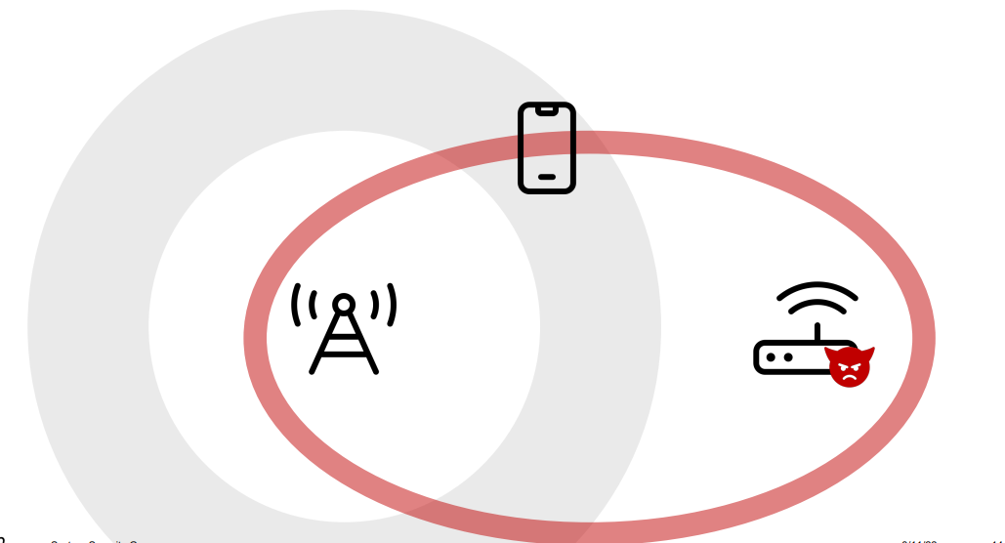
Passive Localization

Slide 12
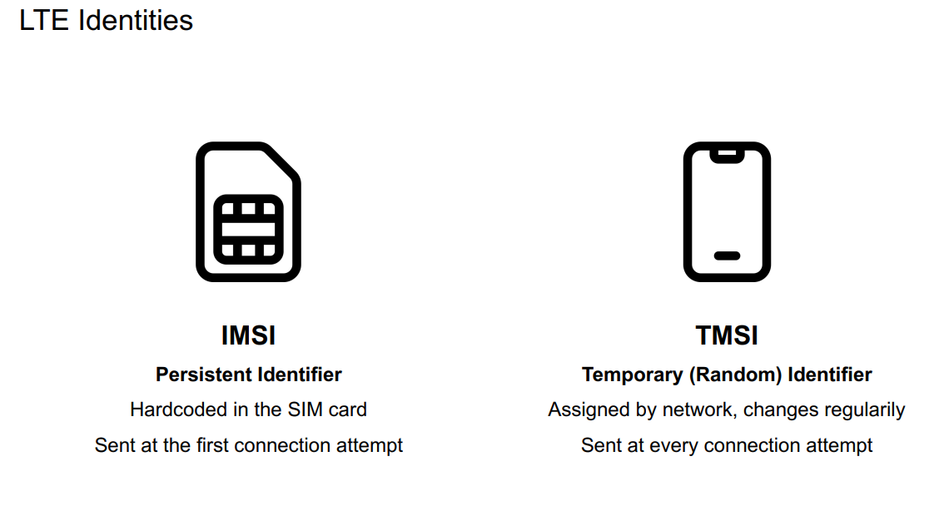
Stealthy identification
Notes:
IMSI only sent when the user connects to the network for the first time.
TMSI is used for every new connection attempts

Slide 13
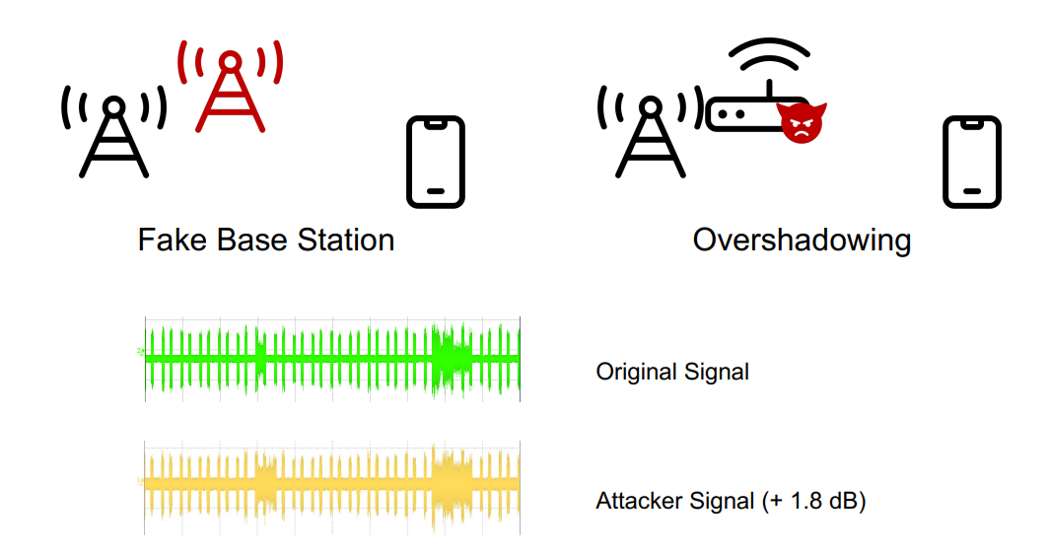
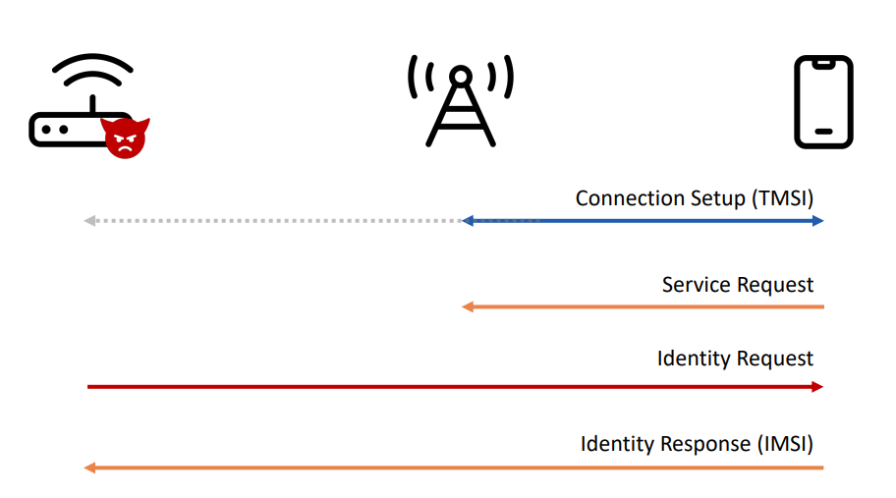
Stealthy identification
Security mode
Notes:
Usually done using IMSI catchers using fake base stations.
Selective overshadowing uses just use 1.8 dB vs 30 dB for fake base stations.

Slide 14
Evaluation of passive localization
Varied the distance of the UE from the LTEPROBE and collected measurements using different UEs.
Estimated the distance between LTEPROBE and a UE instead of the location.
Estimated the hardware error and computed the distance estimation error, translated into localization error.

Slide 15
Attack Evaluation
Varied the distance of the UE from the LTEPROBE and collected measurements using different UEs.
Estimated the distance between LTEPROBE and a UE instead of the location.
Evaluated using industry-grade base station software by Amarisoft.
The attack was conducted against 17 modern phones for Attach Request and Service Request messages.
The IMSI number was obtained as a response to the Attach Request for all 17 phones.
Response to service request didn’t work on iPhone 7.
They observed that the 90th percentile error is about 6m for all mobile phones
Notes:
The attack and the capabilities of LTEPROBE were confirmed against a live network of a national operator using a real-world Ericsson eNodeB installed inside a Faraday cage.
Amari wasnt used in localization attack becasue lower grade clock - accruacy is needed
enodeB and LTEprobe - use SDR
Octoclocks connects 2 sniffing USRPs - sync with enode b - proxy to gps acquisition in real world scenario

Slide 16
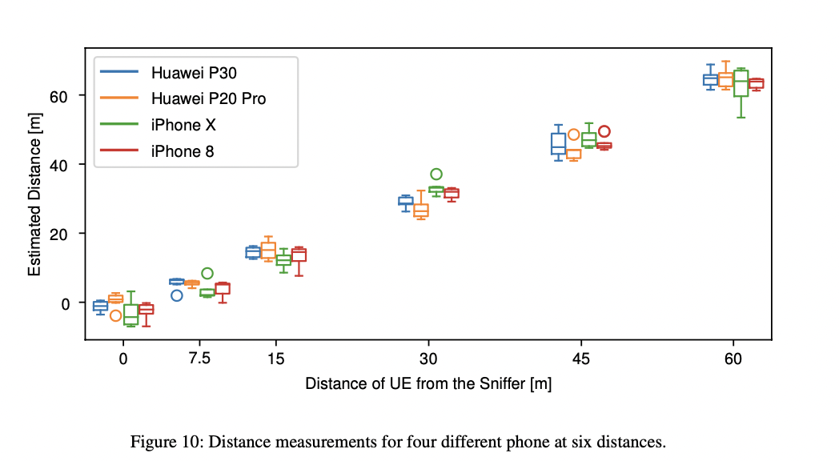
Evaluation of attacks
Notes:
five different UE brands: USRP B210 with srsUE, Huawei P20 Pro, Huawei P30, iPhone X, and iPhone 8. - 22 models
positioned the UE in line-of-sight at six different distances in a long corridor indoors: 0m, 7.5m, 15m, 30m, 45m, and 60m.
For each distance and UE, we reconnected six times to measure the distance over multiple connections.
For each distance measurement and UE, we restarted LTEPROBE at least once to reset the synchronization errors.
one data point corresponds to the median distance measurements during one connection of the UE to our eNodeB.
We do not consider connections for which we have less than ten measurements.
visualize data points with boxplots for each UE.
They observed that the 90th percentile error is about 6m for all mobile phones
They identified a problem arising from the UE not receiving the TA Command.
They removed outliers from their data. - any measure that was 10x the interquartile range away from median
All 17/17 phones used were able to extract the IMSI using stealthy identification attacks

Slide 17
Countermeasures
Use of Random offsets when UE modifies TA command before sending.
UE based and Network based countermeasures - only detect IMSI extractor attacks
Protocol based countermeasures - robust but require expensive changes to LTE.
5G standard - IMSI catching not possible due to encryption.
Notes:
impossible to fully mitigate the location leakage attacks presented in the paper. - highly sync comm
UE - UEs notify users about incoming Identity Requests or report to the network an unusual number of Identity Requests.
NW - large number of eavesdroppers in the covered area. They compare the eavesdropped Identity Requests with the ones sent by the base stations.
In 5G, IMSI catching is no longer possible since IMSI is encrypted using the network’s public key.

Slide 18
Conclusion
First practical work to explore UE tracking with affordable hardware.
LTrack combined TA command sniffing and measuring ToA of both uplink and downlink messages.
Ltrack contains modified IMSI Catcher that overshadows packages with surgical precision and very little energy.

Slide 19
References
https://www.usenix.org/conference/usenixsecurity22/presentation/kotuliak
Screenshots taken from the paper and slides shared by the authors in the above link

