Slide 1

HPML Final Project · Spring 2026
Generative AI Using LLMs Final Project · Spring 2026
Beyond Final Answers: Auditing Trajectory-Level Hallucinations in Multi-Agent Industrial Workflows
[Project Title]
[A one-sentence description of what you optimized and the headline result]
[Team Name]
[Member 1] · [UNI]
[Member 2] · [UNI]
[Member 3] · [UNI]
[Member 4] · [UNI]
GitHub: https://github.com/[org]/[repo]
Tracking: https://[wandb / mlflow / tensorboard / ...]/[project]
GitHub: github.com/aishani-rachakonda/genai-using-llms-final-project
Name: Shriya Aishani Rachakonda (sr4321)
Email: sr4321@columbia.edu
Dr. Kaoutar El Maghraoui · Columbia University · Week of May 4, 2026

Slide 2
The Setting: AssetOpsBench
Industrial multi-agent framework for data-center asset operations
Overview
AssetOpsBench (IBM Research): a benchmark for AI-driven failure diagnosis of industrial assets (chillers, pumps, compressors).
Given a sensor reading or anomaly report, the system must identify the root cause, predict failure modes, and generate a maintenance work order — automatically, end-to-end.
It does this via a Plan-Execute (DAG-based) orchestrator that dispatches tasks across four FastMCP tool servers —
IoT (sensor retrieval),
FSMR (failure-mode state modeling),
TSFM (time-series forecasting & anomaly detection),
WO (work-order generation).
Each scenario produces a sequential Thought → Action → Observation trace serialized as a JSON array.

Slide 3
The Setting: AssetOpsBench
Industrial multi-agent framework for data-center asset operations
IoT
FSMR
TSFM
WO
Sensor data download & property lookup
→
Failure-mode state modelling & reasoning
→
Time-series forecasting & anomaly detect
→
Work-order generation & execution
Each step in the trajectory
Thought (reasoning)
Action (tool call)
Observation (tool return)
→
→
42 industrial tasks across 4 domains:
Sensor retrieval · Anomaly detection · Failure-mode identification · Work-order generation

Slide 4
Motivation and Problem Statement
The gap between output-only and trajectory-aware evaluation
Problem Statement
LLMs are increasingly deployed not as chatbots but as autonomous agents — reasoning over multi-step workflows, calling tools, and making decisions in high-stakes environments like industrial monitoring
With that autonomy comes a new class of failure: hallucination that occurs mid-trace, not just in the final answer
In a Thought → Action → Observation loop, a hallucination might be a skipped diagnostic step, a reference to something that never happened, or an action that violates safety constraints
Current benchmarks miss all of this — they treat every task as an isolated input → output pair and never look inside the trace
This makes it nearly impossible to diagnose why a system failed: did it misunderstand the environment, or did it invent a state that didn't exist?
Goal: Move evaluation from post-hoc output checking to trajectory-aware auditing — classifying what kind of hallucination occurred, where in the trace it started, and which signals can detect it in real time

Slide 5
What is Trajectory-Level Hallucination?
A structural deviation from evidence — not just a wrong final answer
Formal definition
h(gₜ | Eₜ, K, aₜ) = 1 iff gₜ ⊭ Eₜ OR gₜ ⊭ K OR gₜ ⊭ role(aₜ) where gₜ ∈ {thought, action}, Eₜ = prior observations, K = task spec, role(aₜ) = agent mandate
Concrete example (UID: Model_7_Q_509)
Task: detect anomalies in Chiller 6's Condenser Water Flow
Step 1 IoT
Step 2 IoT
Step 3 TSFM
Step 4 Summary
Downloads sensor history for Chiller 6
→
Lists sensor properties; confirms CWF present
→
Calls tsfm_anomaly_detect(…) observation: "" ← empty!
→
"Yes, anomalies detected in Chiller 6…" ← fabricated!
✓ Correct
✓ Correct
✗ Tool fails silently
✗ HALLUCINATION
Post-hoc evaluation sees only "Yes, anomalies detected" — looks fine. Only trajectory-level analysis reveals the empty observation in Step 3 was never acted upon.

Slide 6
The 5-Type Hallucination Taxonomy
Each type is a structural predicate over the Thought–Action–Observation trace
Factual hᶠ
Referential hᴿ
Logical hᴸ
Asserts a claim contradicted by ground-truth data. Detectable from a single step in isolation.
References an entity or prior result absent from trace history. Model 'remembers' something that never happened.
Reasoning doesn't follow from its premises, even when premises are correct. Broken inference chain.
e.g. Agent reports temp = 52°C; sensor reads 32°C
e.g. "As computed in Step 2..." — but Step 2 had no output
e.g. All thresholds exceeded → concludes 'no anomaly'
Procedural hᴾ
Scope hˢ
Skips, reorders, or fabricates a required workflow step. Invisible without knowing the prescribed workflow.
Agent acts outside its assigned mandate. Content may be correct but originates from the wrong agent.
e.g. Claims task complete without running anomaly detection
e.g. IoT agent generates a work order (WO agent's job)
48.7% of hallucinated trajectories exhibit multiple types simultaneously — single-label evaluation mischaracterises nearly half of all failures.

Slide 7
The Trajel Dataset
225 annotated trajectories
Trajectories
LLM Configs
Industrial Tasks
Human Hall. Rate
Cohen's κ (LLM vs Human)
225
6
42
68.3%
0.456
annotated
models
questions
153/224
moderate agreement
Two-phase annotation protocol
• Phase 1 — LLM-as-a-Judge: structured JSON output (presence, type, location, rationale)
• Phase 2 — Blind human review: annotators assess WITHOUT seeing the judge's output (prevents anchoring)
• Each trajectory rated on: presence · type(s) · localization · free-text rationale
• Annotators: Columbia University (148 reviews) + IBM Research (77 reviews)
LLM Judge vs Human (n=224)
 | Human: No Hall. | Human: Hall.
Judge: No Hall. | 35 (TN) | 12 (FN)
Judge: Hall. | 36 (FP) | 141 (TP)
High recall (92.2%) but lower
precision (79.7%); conservative bias

Slide 8
What the Data Shows: Distribution & Localization
Procedural failures dominate; hallucinations peak mid-trajectory
Hallucination type distribution (human eval)
Where in the trace?
Type | Count | % | Key implication
Procedural hᴾ | 95 | 38.5% | Invisible to output-only eval
Factual hᶠ | 65 | 26.3% | Most detectable
Scope hˢ | 49 | 19.8% | Unique to multi-agent settings
Logical hᴸ | 21 | 8.5% | Hardest to annotate
Referential hᴿ | 17 | 6.9% | Requires full trace context
Total | 247 | — | Multi-label: 48.7% of traces
Step Component | Count
Action | 70
Response | 58
Thought | 40
Observation | 11
Task Position | Count
Task 1 | 36
Task 2 | 44
Task 3 | 63 ← peak
Task 4 | 43
Task 5+ | 51 (declining)

Slide 9
Three Detection Paradigms
Each model aligns with the context needed for specific hallucination types
① BERT (Subtask-level)
② NLI (Trajectory-level)
③ Longformer (Long-context)
Input: single step (τ + α + ω) Predicts hallucination per step Captures local lexical cues
Input: history as premise, current step as hypothesis Entailment / neutral / contradiction
Input: full serialised trajectory Sparse attention → handles long traces beyond BERT window
Best for: Factual Weakest on: Procedural, Scope
Best for: Referential, Logical Checks trace-wide consistency
Best for: Procedural, Scope Requires global context
AUC 0.613
AUC 0.689
AUC 0.599

Slide 10
NeurIPS 2026 Submission
Submitted May 6, 2026 · Research conducted in collaboration with IBM Research · PI: Dhaval C. Patel
NeurIPS
Beyond Final Answers: Trajectory-Level Hallucination Detection in Multi-Agent Industrial Workflows
2026
Contributions to the paper
Datasets & Benchmarks Track
• Curated and cleaned the Trajel dataset — 225 annotated trajectories
• Collected and synthesized related work across hallucination detection, multi-agent evaluation, and industrial AI
• Ran the LLM-as-a-Judge evaluation pipeline
• Evaluated BERT, NLI, and Longformer detection models
Submitted May 6, 2026
Paper available on GitHub:
github.com/aishani-rachakonda/genai-using-llms-final-project → papers/NeurIPS2026_Submission.pdf
15 / 17

Slide 11
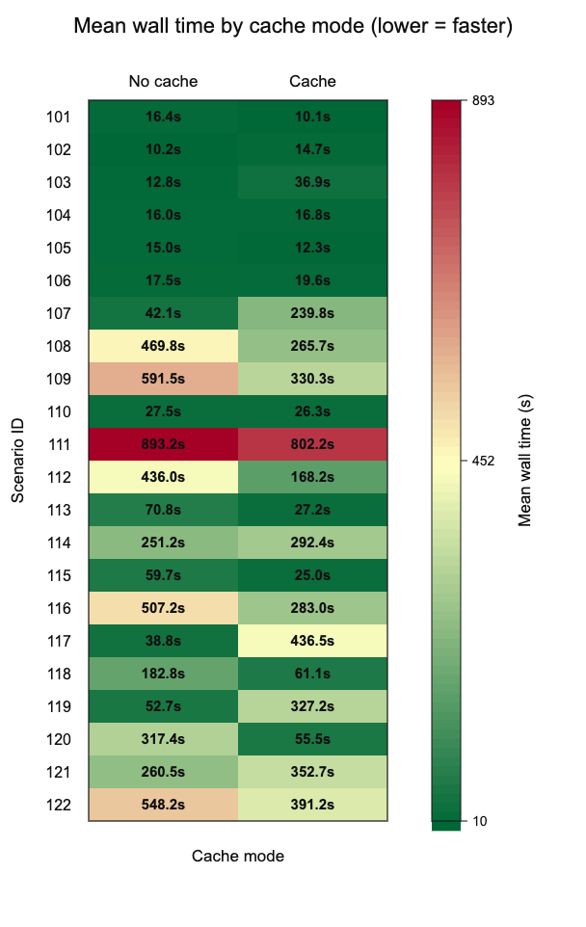
Performance Optimization: Caching
Prefetching DB context to reduce reapeated retrieval overhead
What we optimized
• Identified repeated CouchDB sensor-context lookups on every agent step
• Prefetched and cached asset context at the start of each scenario run
• Eliminated redundant DB round-trips that dominated latency in expensive scenarios
Key findings
• Caching reduces wall time in several expensive scenarios, especially where repeated sensor retrieval occurs
• Large improvements in high-latency runs — confirms database access was the bottleneck
• Some cached runs are slower due to cache misses, different execution paths, or LLM/tool latency

Slide 12
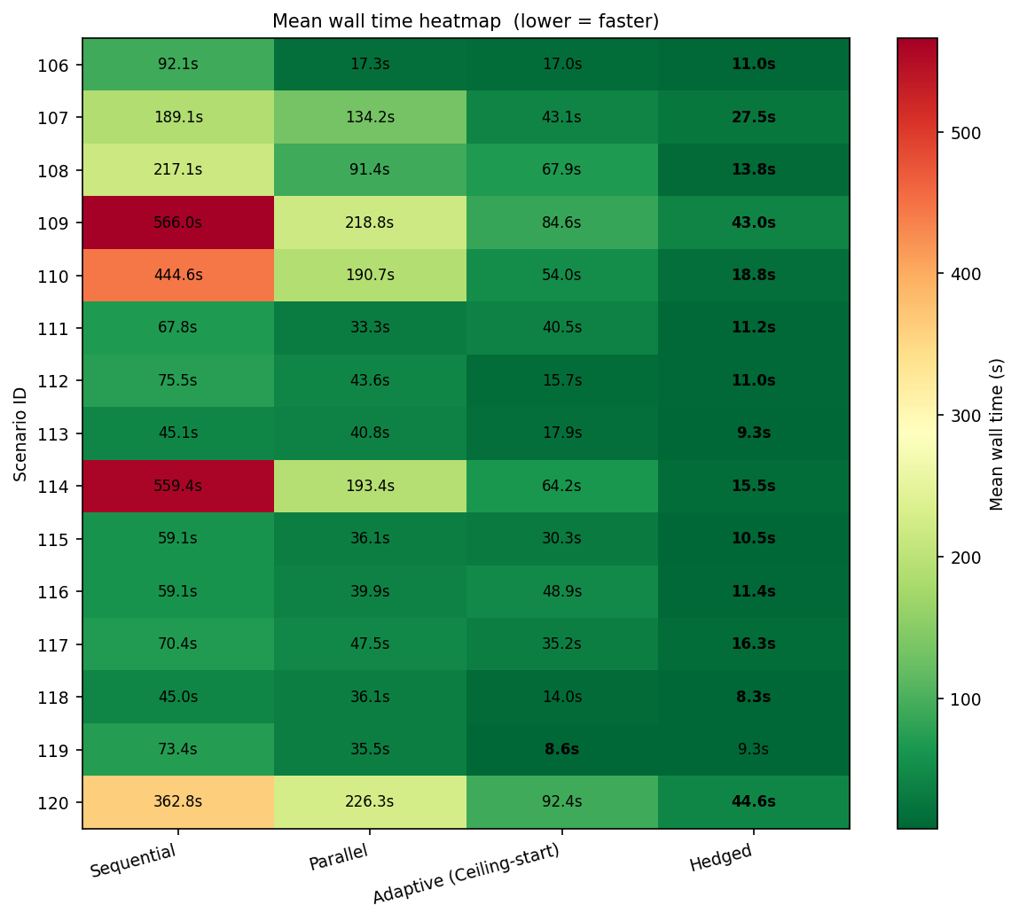
Performance Optimization: Parallelization
Replacing sequential N×M FMSR relevancy calls with asyncio.gather
What we optimized
• FMSR server runs _call_relevancy 45–63 times per scenario (one per sensor × failure-mode pair)
• Original implementation: sequential — each call blocks until the previous completes
• Fix: replaced sequential loop with asyncio.gather for full parallel dispatch
Key findings
• Sequential exceeds 550s with high variance on full-grid queries — performance degrades catastrophically
• Parallel reduces average time but batch-level blocking replaces call-level blocking
• Hedged is fastest across every scenario; Adaptive matches it at half the API cost

Slide 13
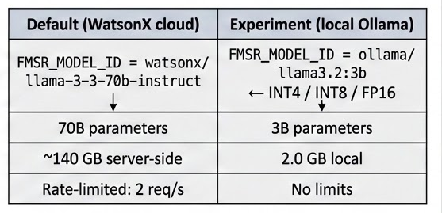
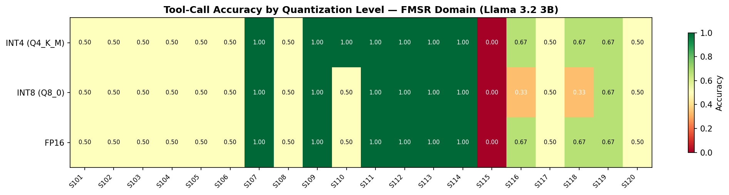
Performance Optimization: Quantization
Can a local 3B model replace a 70B cloud API for binary relevance classification?
The question
• _call_relevancy (FMSR binary classifier) defaults to watsonx/llama-3-3-70b-instruct — runs 45–63× per scenario
• Hypothesis: does this task need 70B parameters? Tested 5 local models × 3 precisions (FP16, INT8, INT4) × 20 scenarios
• Models: Llama 3.2 3B · Qwen2.5 7B · DeepSeek-R1 7B · Granite 3.2 8B · Gemma2 9B → 300 benchmark runs total
Key findings
• Llama 3.2 3B INT4 outperforms WatsonX 70B by +1.5pp — a 3B local model beats a 70B cloud API on this binary task
• INT4 quantization is not just competitive — it is the best-performing precision across multiple models
• All 5 model families stay within 0.02–0.05 of the cloud baseline, making local inference viable

Slide 14
Results: Headline Numbers
40.3%
28x
67%
reduction in wall time (caching)
faster wall time (parallelization)
less memory (quantization)
320s → 55s on tail-bound scenarios
559s → 20s on tail-bound scenarios
6.0 GB FP16 → 2.0 GB INT4

Slide 15
HPML Final Project · Spring 2026
Generative AI Using LLMs Final Project · Spring 2026
Thank You!
Acknowledgments
INSTRUCTOR - Prof. Parijat Dube [Adjunct Professor, Columbia University]
PROJECT PI - Dr. Dhaval C. Patel [IBM Research]
TEACHING ASSISTANT - Berkay Baris Turan
[Project Title]
[A one-sentence description of what you optimized and the headline result]
[Team Name]
[Member 1] · [UNI]
[Member 2] · [UNI]
[Member 3] · [UNI]
[Member 4] · [UNI]
GitHub: github.com/aishani-rachakonda/genai-using-llms-final-project
Name: Shriya Aishani Rachakonda (sr4321)
Email: sr4321@columbia.edu
Dr. Kaoutar El Maghraoui · Columbia University · Week of May 4, 2026

