Slide 1
EMPLOYEE MANAGEMENT SYSTEM
Team Members
1.Aishwarya.K [711715104002]
2.Vinitha.M [711715104307]
3.Monisha.R [711715104702]
Facultyguide : Industrial guide :
Mr.Nandakumar.S.D Ms.Mekala.P
Assistant professor Senior Associate
Department of CSE
Department of CSE, KGiSL Institute of Technology, Coimbatore

Slide 2
Abstract Employee Management System is developed in order to overcome the problem of the prevailing manual system. Employee Management System is a distributed application developed to maintain the details of the employees working in the organization. In our project kg group is the organization which consist of kg school, kg college, kg hospital, kg company. Each categories database will be maintained. So that all the details will be maintained under admin. So the admin can access the records of all the employees. Each category maintains the information about personal details, educational details, certifications ,salary details and leave form of the employees. It enables the user to delete and update records of the employee. It also provides error message while providing invalid data. It send the notification to the manager when any details is updated. It sends notification to the employee regarding any events taking place in the organization.
Department of CSE, KGiSL Institute of Technology, Coimbatore

Slide 3
Area Introduction-Existing system The existing employee management system consist of the information about the employee and stored in the database. It provides lot of features to manage in very well manner. But it does not comprise of any notification for all the employees and will be just maintained.
Department of CSE, KGiSL Institute of Technology, Coimbatore

Slide 4
Proposed System Advantages over existing methods 1. comprises of employee involvement in the projects. 2. Upskilling of employee. 3.Notifications
Department of CSE, KGiSL Institute of Technology, Coimbatore

Slide 5
Literature Review
Drawbacks of existing methods
1. Upskilling will not be known.
2. Does not have any notifications for all employees.
References
Employee Management System-wikipedia
1) https://www.scribd.com/doc/98195636/Employee-Management-System
2) http://krishikosh.egranth.ac.in/bitstream/1/5810058508/1/AnamikaArora.pdf
Department of CSE, KGiSL Institute of Technology, Coimbatore

Slide 6
Architectural Design (DFD/ER diagram/process flow diagram)
Zero Level Data Flow Diagram:
Employee
Management System
Ask Forlogin
LoginDetails
Employee
Manager
View Info
Manage Info

Slide 7
First Level Data Flow Diagram:
user
Login/Register
Manager
Update Details
Employee
Management
System
View details
Result
Execute Query
Salary Details
Leave Form
Database

Slide 8
ER Diagram:
certifications
Provide notification
View updates
Educational details
login
Manager
Register
Personal details
Employee
Salary details
Admin
Leave form

Slide 9
Module Splitup 1.User Interface 2.Database Connectivity 3.Display details 4.Notification
Department of CSE, KGiSL Institute of Technology, Coimbatore

Slide 10
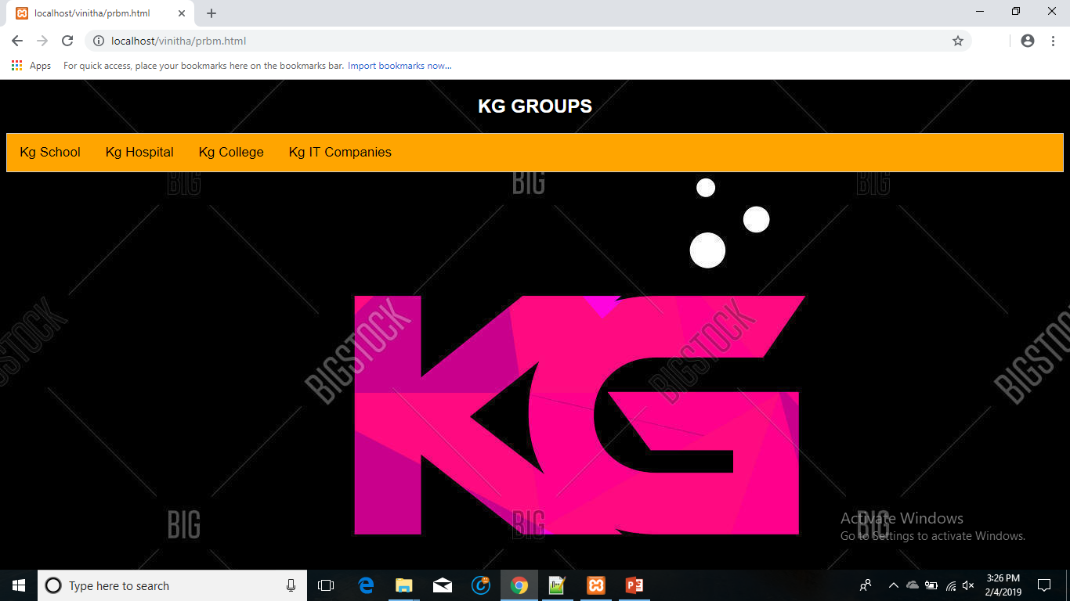
Screen shots of modules under progress.

Slide 11
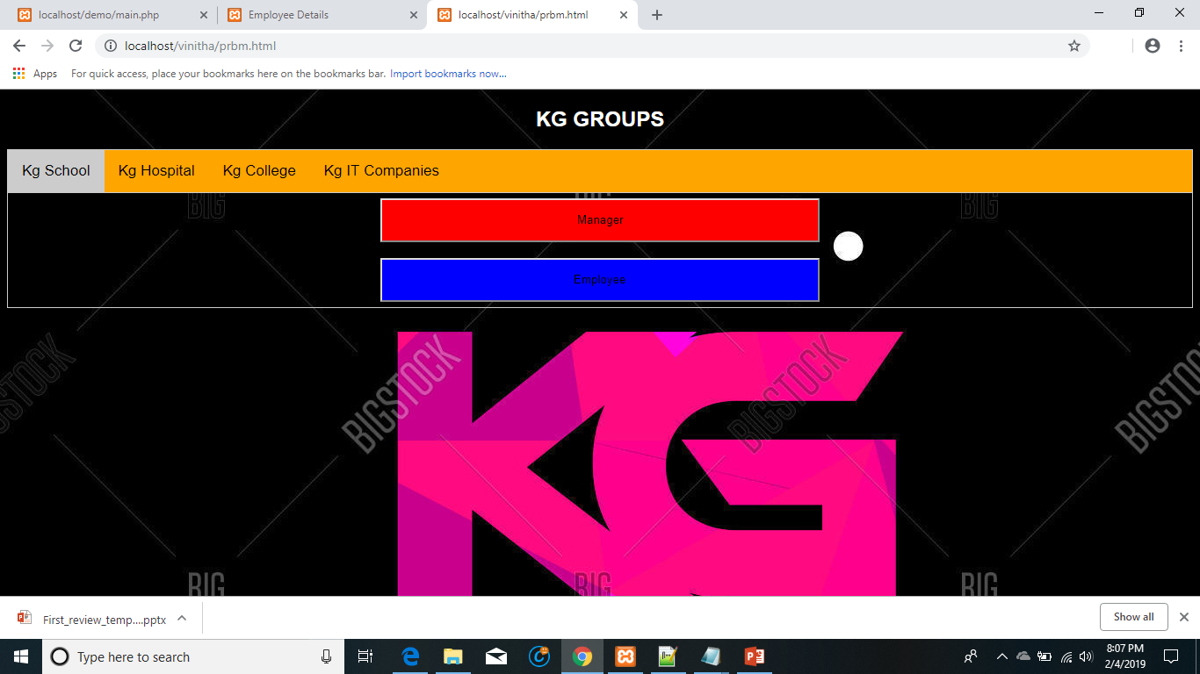

Slide 12
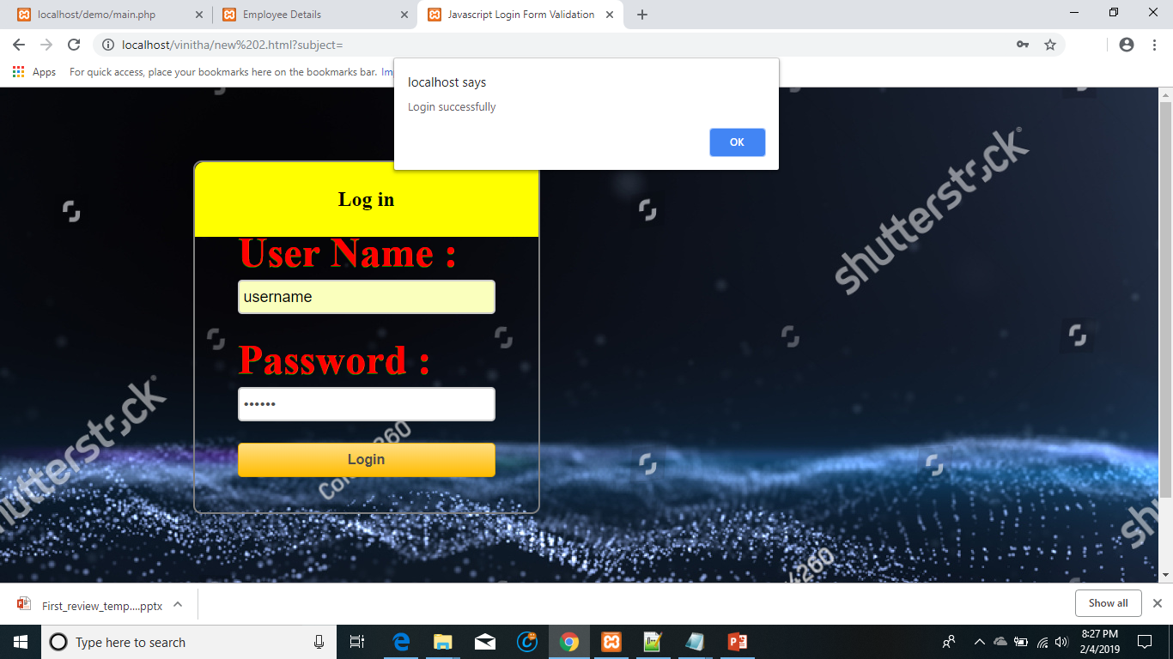

Slide 13
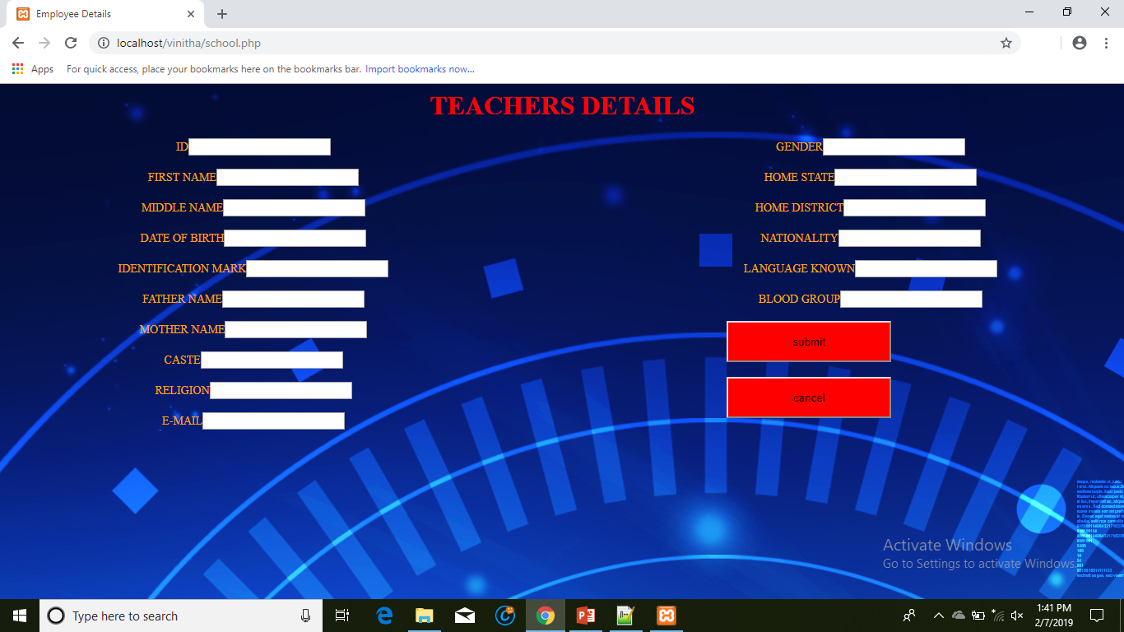

Slide 14
THANK YOU

