Slide 1
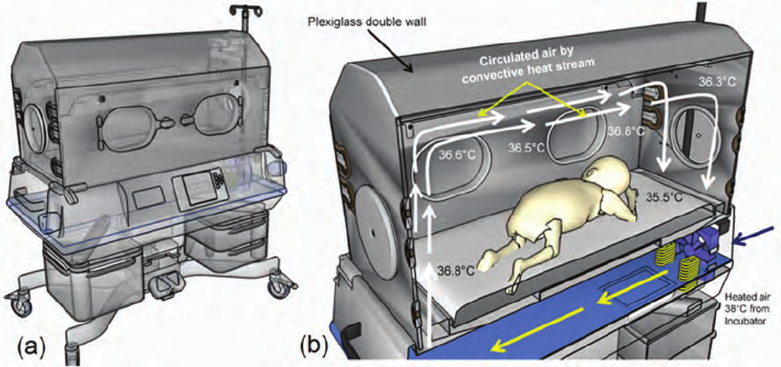
Schematic drawing of a typical convective incubator (a) currently used in many NICU
(b) Cross-section of infant incubator showing the convective heat stream inside incubator, with temperature distribution over incubator geometry (© MedIT, 2010)

Slide 2
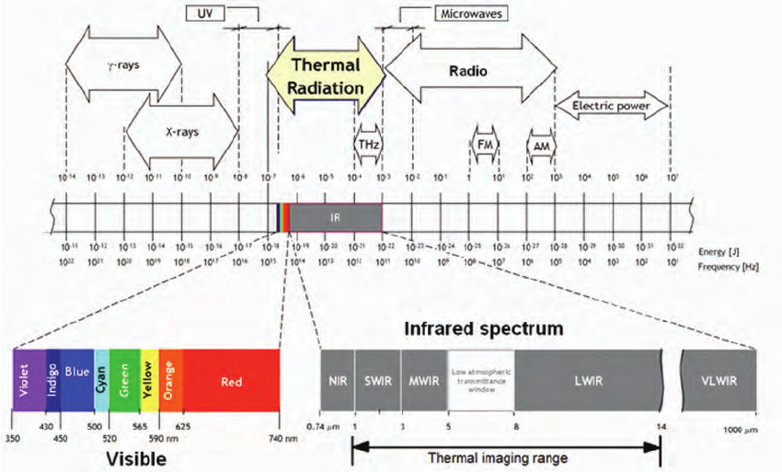
The electromagnetic spectrum with illustration of infrared radiation classification and corresponding wavelengths
(Modified from: Infrared vision, http://mivim.gel.ulaval.ca)

Slide 3
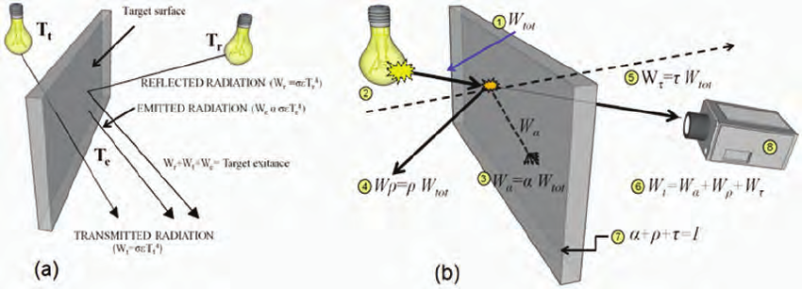
Radiative heat flow mechanism: (a) impinging process of radiation (b) on a target surface as the element contributing to this process.
Parameters:
(1) total incoming energy,(2)radiation source, (3) absorbed energy, (4) reflected energy,(5) transmitted energy,(6) total detected energy,(7) material properties (absorbance (α), transmittance(τ) and reflectance (ρ))(8)infrared energy detector (camera)

Slide 4
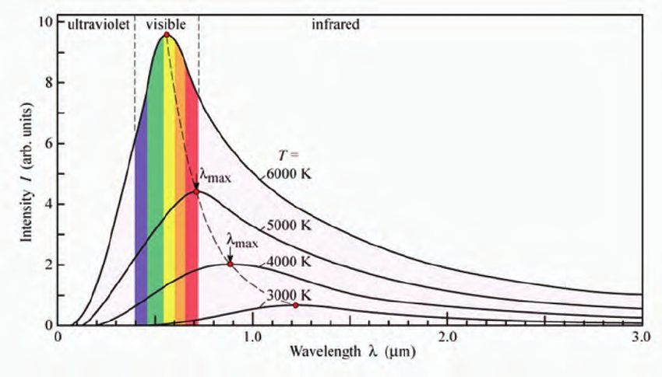
The black body radiation response over the temperature ranges within the specific wavelength and according to Planck’s radiation law that describe the black body radiation

Slide 5
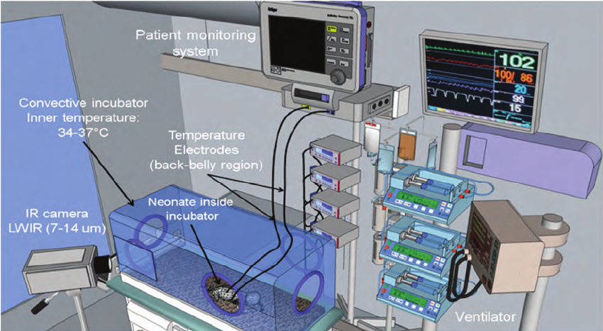
The current setup for neonatal infrared thermography used by the authors inside the NICU with all attached cables and monitoring terminals

Slide 6
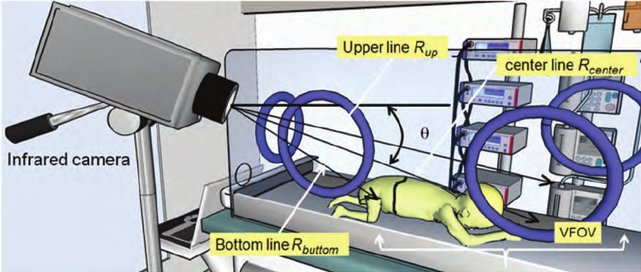
Target size = ⋅ θ(resolution)*R
where θ is the IR camera depression angle, and R is the distance to the target (newborn infant), assuming that the target is normal (perpendicular) to the line-of-sight. However, this is not always the case
Figure illustrates the viewing geometry when looking downward to a neonate inside incubator
The viewing angle condition is essential for correct NIRT measurement, because it is important to know the VFOV for the tested target (newborn infant). This is because the viewing angle will decide how much the coverage of target’s area.

Slide 7
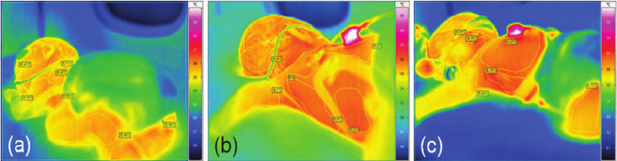
Variation in viewing angle for NIRT (Neonatal infrared thermography)
imaging will lead to varying surface area coverage of target surface (newborn infant) as thermography frames (a), (b) and (c)

Slide 8
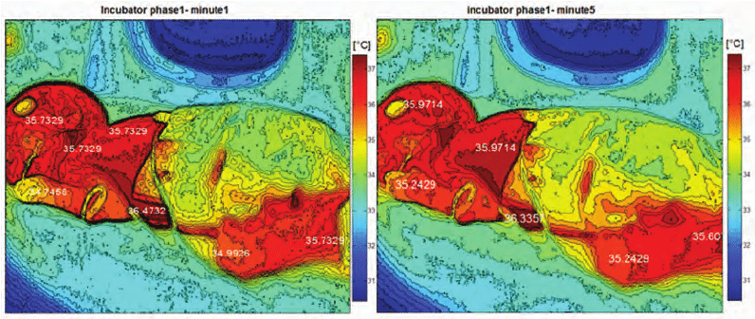
Two thermal images of a neonate inside a convective incubator; which shows a very slight variation of surface temperature overall neonate’s anatomical regions

Slide 9
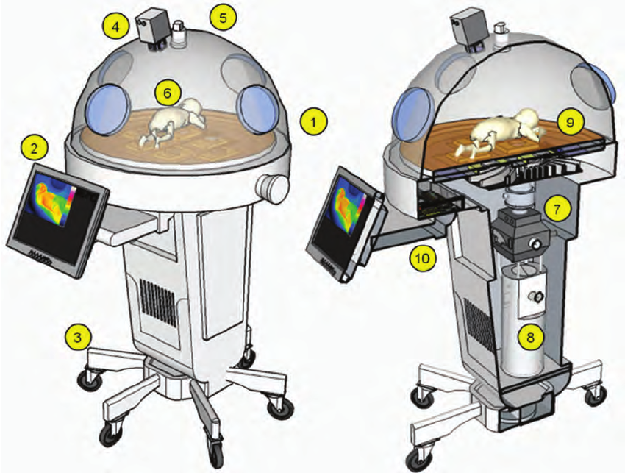
incubator hood
workstation display
transportation base
infrared thermal camera
SpO2 camera
Neonate
Integrative humidifier system
Distilled water tank
Smart mattress including other non-contact sensors and electrodes
Digital electronics for incubator controlling and vital signal processing.

