Slide 1

Predicting Loan Default Risk
Leveraging Data for Smarter Credit Decisions

Slide 2
The Challenge: Navigating Loan Risk
Financial institutions face significant challenges in accurately assessing loan default risk. Traditional methods often fall short in today's complex financial landscape.
Problem Statement
Our Solution
Develop a robust machine learning pipeline to predict loan default risk, enabling better credit decisions and minimizing financial losses.
Utilize customer behavioral and financial data to build a predictive model, enhancing accuracy and efficiency in risk assessment.
Key Technologies:
Python: Data cleaning, EDA, Modeling
Libraries: Pandas, Scikit-learn, XGBoost, SHAP, Matplotlib
Power BI: Dashboarding & Insights

Slide 3
Datasets
Data 1
Data 2
Data 3

Slide 4
Understanding Our Data
Our analysis relies on a comprehensive dataset, simulating real-world loan application scenarios to capture critical indicators of default risk.
Assumed Data Columns:
Category
Features
Demographics
Age, Gender, Marital Status, Education, Employment Status
Financial
Monthly Income, Debt-to-Income Ratio, Credit Score, Loan Amount, Loan Purpose
Behavioral
Number of Credit Cards, Past Due Days, Missed Payments (last 6 months)
Target
Loan Default (0: No, 1: Yes)

Slide 5
Key Insights from Data Analysis
Initial exploration reveals significant patterns, highlighting critical factors influencing loan default risk. These insights guide our model development.
1
Credit Score Impact
Customers with credit_score < 600 are 4x more likely to default.
2
Employment & Purpose Risk
Self-employed individuals have 20% higher default rate; "Small business" loans show the highest default rate.
3
Debt & Payment Behavior
Loan-to-income ratio > 0.4 and Debt-to-income ratio > 0.5 indicate high risk. Missed payments increase default by 35%.
4
Demographic Vulnerabilities
Young borrowers (age < 25) default more on high-value loans; significant variations by education level.
5
SHAP & Visual Clusters
Credit score and loan-to-income ratio are most important; Power BI reveals high default clusters by region/purpose.

Slide 6
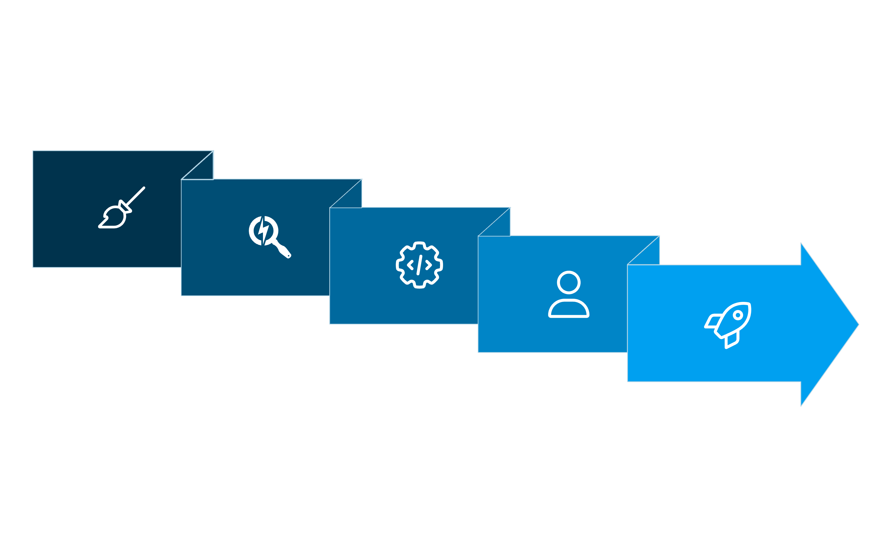





Our Project Workflow: A Phased Approach
Our project is structured into distinct phases, ensuring data quality, insightful analysis, robust modeling, and actionable insights.
Data Cleaning
Feature Engineering
Deployment & Insights
Exploratory Analysis
Modeling

Slide 7
Phase 1: Data Preparation & Exploration
Clean data, uncover patterns, and prepare the dataset for robust machine learning model training.
Data Cleaning
Exploratory Data Analysis (EDA)
Handle missing values (mode/median imputation)
Assess class imbalance in 'loan_default'
Correct anomalies (age/credit score ranges)
Analyze correlation heatmaps
Encode categorical variables (OneHot/Label Encoding)
Visualize distributions: credit score, loan amount by purpose
Compare default rates across education, employment
Detect outliers with boxplots
Phase 2: Feature Engineering & Power BI
Enhance predictive power and translate findings into clear, actionable business insights.
Feature Engineering
Power BI Dashboard
Create new features: loan_to_income_ratio, risk_band
Visualize defaulter demographics
Develop payment_behavior_score
Display default rates by income & credit score bands
Select features using VarianceThreshold, RFE, SHAP
Show loan purposes and missed payment trends
Implement interactive filters (age, gender, education)

Slide 8

Phase 3: Robust Modeling
We evaluate multiple machine learning models to identify the most accurate predictor of loan default, prioritizing performance and interpretability.
Models:
Evaluation Metrics & Techniques:
Logistic Regression (Baseline)
Accuracy, Precision, Recall, F1-Score
Random Forest
ROC AUC Score & Confusion Matrix
XGBoost
SHAP/Feature Importance
LightGBM
SMOTE/ADASYN for imbalance
Neural Network (Optional)
Hyperparameter tuning (GridSearchCV)
Stratified K-Fold Cross Validation

Slide 9






Unlocking Actionable Insights
Our predictive model not only identifies risk but also provides a clear, interpretable understanding of the factors driving loan defaults. This empowers informed decision-making.
Visible Signs
Surface Symptoms
Behavioral Factors
Financial Factors
Underlying Causes

Slide 10




Deliverables & Next Steps
Our project culminates in a comprehensive package, providing all necessary assets for implementation and continued analysis.
Python Notebooks
Power BI Dashboard
Cleaned data, EDA, modeling, and SHAP analyses.
Interactive .pbix file for business insights.
Comprehensive Report
Project Repository
Executive summary, visualizations, model comparison, key recommendations.
GitHub/Google Drive folder with all project assets.

