Slide 1
Effects of VRP optimization on fleet management - a case study
Bjarne Johannessen
Geir Hasle
IFORS 2002

Slide 2
Contents
Comparison between driven and optimized routes
VRP/TSP optimization
Real data
Technical accomplishment
Difficulties encountered
Results

Slide 3
Project Motivation
Relevant for checking the quality of computer generated optimized routes
  few quantitative analyses of the effects of optimization have been published
Demonstrate the savings potential
  both for the society and the company involved

Slide 4
Spider - an advanced route planning system
Optimization algorithm
  Initial solution construction
  Operators
Orders
  Pickup/Delivery
  Time Windows
  Capacities
VRP/SPP

Slide 5
Technical accomplishment
Each vehicle uses GPS equipment
  Detailed registration of the driving pattern of each vehicle
Link detailed trip information to freight data
Comparison of driven plans and plans generated by an advanced route planning system
  Challenge: Address cleaning
  Route planning optimization 2 hours
Supported by the Research Council of Norway

Slide 6
Prerequisites and sources of error
Velocity
  80% of the speed limit
Service time:
  Initially 4 minutes, additionally 2:30
Inaccurate registration
Size estimates for deliveries
Inaccurate addresses
Vehicle capacity
  80% of the capacity is used
Limited time windows on selected orders
Break during the day
  Added 30 minutes in our calculations

Slide 7
Three different approaches
Orders locked to vehicles, limited number of vehicles
  Classical TSP
  Evaluate total driving distance and working time
Orders not locked to vehicles
  VRP
  Evaluate driving distance, time, and number of vehicles
Orders locked to vehicles, all (9) vehicles

Slide 8
Orders locked to vehicles
Four vehicles, five days each
  Totally 20 days of data, the days with best data selected
Travel time is reduced by 18 min. pr. day on average (4%)
Travel distance is reduced in 19 out of 20 instances
Travel distance reduced by almost 50%
  Errors in size estimates
  Missing some time windows
  Load/Unload at depot one or two times

Slide 9
Orders not locked to vehicles
20 days of data
8-9 vehicles each day
Total travel time reduced by 8 hours for each day
  Approximately one hour less working time for each vehicle
Number of vehicles is reduced in 19 out of 20 instances
  Number of vehicles reduced from 8.9 to 7.6 on average (15%)
  For one of the days our system generated a plan which uses only 5 vehicles instead of the original 9 (44%)
Total driving distance reduced by 58 %
  Main reason: Due to large uncertainty according to time windows and order size, we generated much fewer tours to/from the depot
  Different parameter settings yield different results

Slide 10
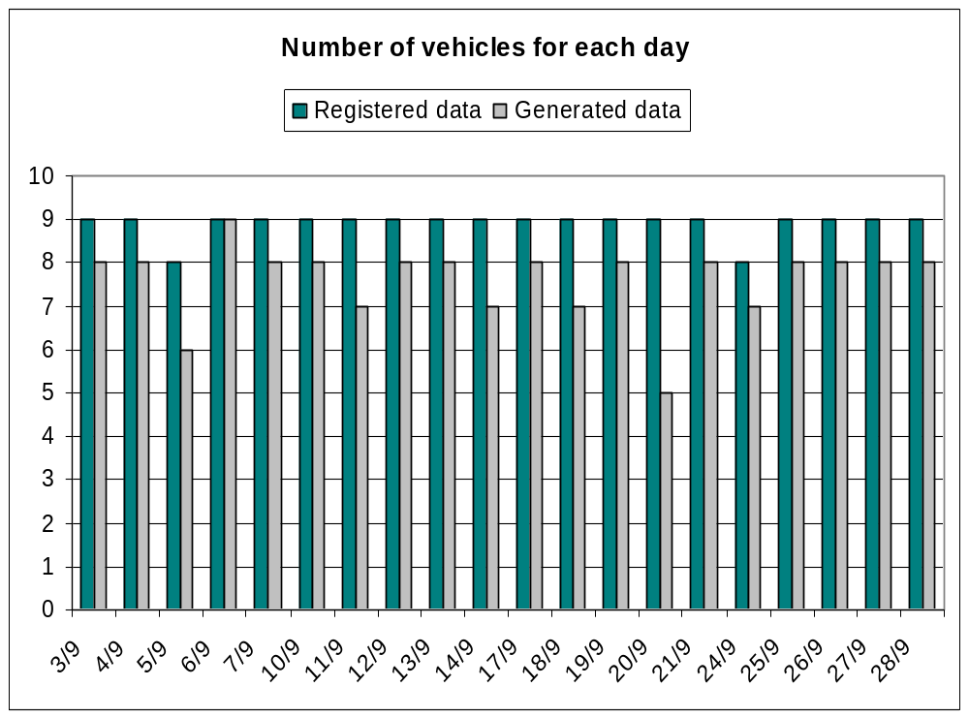
Orders not locked to vehicles (2)

Slide 11
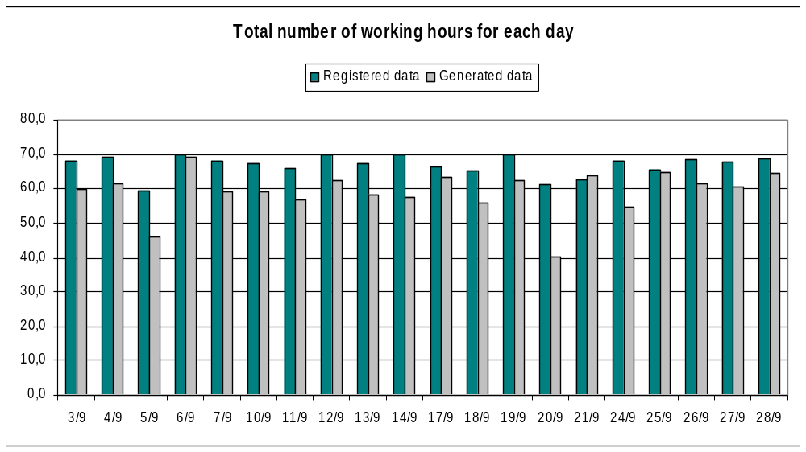
Orders not locked to vehicles (3)

Slide 12
Orders locked to vehicles, all vehicles
One week of data
Comparison:
  Registered data
  Generated plans with orders to vehicles
  Generated plans with unlocked orders
Free orders compared to locked orders
  53 km less pr. day on average (17%)
  35 min less pr. day on average (1%)
  Number of vehicles reduced by 1.3 on average (15%)

Slide 13
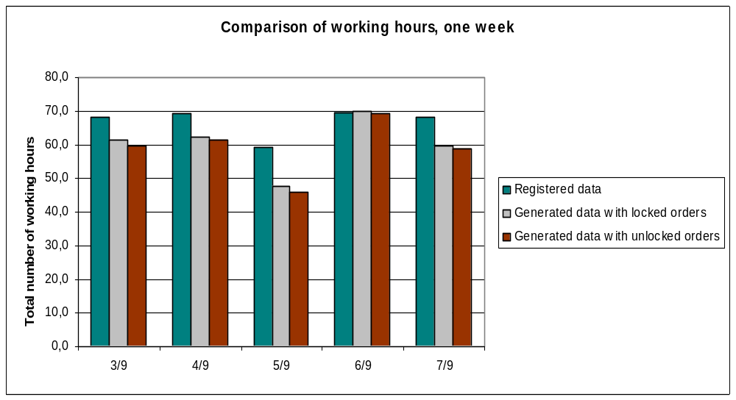
Orders locked to vehicles, all vehicles (2)

Slide 14
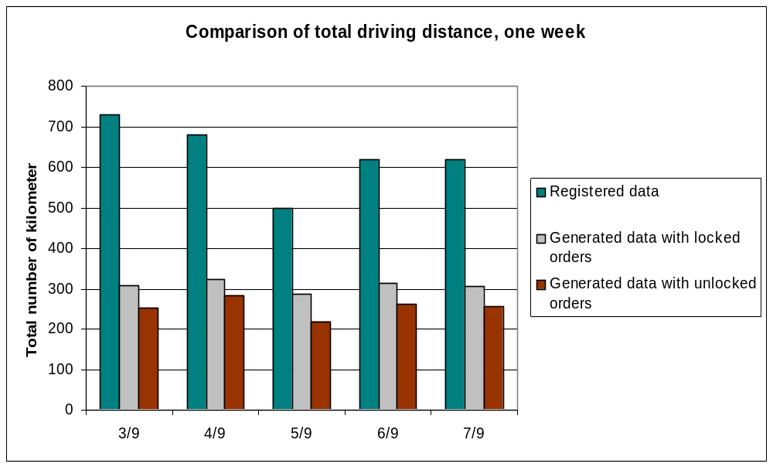
Orders locked to vehicles, all vehicles (3)

Slide 15
A multi purpose project
Develop and test a new data collection method for freight transport
Generate freight matrices based only on GPS registrations
Generate travel times and travel velocities in urban areas
Demonstrate the potential of route planning optimization

Slide 16
Conclusion
Calculations and comparisons demonstrated a savings potential
  Company
  Society
Rich model and detailed data needed to solve real world applications
Results can be applied to public road planning in urban areas

Slide 17
Future work
More efficient way of linking trip data with order data
More detailed time windows
More correct size/dimension data
  Challenge for the companies
Better optimization
  Challenge for the route planning system

Slide 18
Abstract
The use of advanced fleet management tools with VRP optimization is rapidly increasing. However, few quantitative analyses of the effects of optimization have been published. As a case study based on the operations of a typical transportation company, we registered the detailed driving routes for a fleet of lorries over a period of several weeks, in order to quantify the savings potential. We compared the routes "as driven" with routes generated by a sophisticated VRP solver. Although there are a number of issues related with this type of comparison, our study shows that there is a considerable savings potential.

