Slide 1
A Fast Local Search Algorithm for the Vehicle Routing Problem with Time Windows
OLLI BRÄYSY, GEIR HASLE
SINTEF Applied Mathematics, Department of Optimisation, P.O. Box 124 Blindern, N-0314 Oslo, Norway
{Olli.Braysy;Geir.Hasle}@math.sintef.no
WOUT DULLAERT
Ufsia-Ruca Faculty of Applied Economics, University of Antwerp
Prinsstraat 13, 2000 Antwerp, Belgium
wout.dullaert@ua.ac.be

Slide 2
Introduction
Optimization Days, Montreal, Canada, May 6-8th
Development of a new fast local search heuristic for the VRPTW
First application of Threshold Accepting as a post-optimization technique for the VRPTW
A comprehensive computational study consisting of 358 benchmark problems from the literature
New best-known solutions to both real-life problems of Russell (1995), and to 39% of the extended benchmarks by Gehring and Homberger (1999)

Slide 3
Optimization Days, Montreal, Canada, May 6-8th
Generation of the LS solution
PROCESS
METHOD
Build initial solutions
Hybrid construction heuristic
Reduce the number of routes
Injection trees
Reduce distance
Modified Or-Opt and CROSS
exchanges

Slide 4
Optimization Days, Montreal, Canada, May 6-8th
Post-optimization by Threshold Accepting
PROCESS
METHOD
Initial solutions
Generated by LS
Intra-route distance improvement
IOPT exchanges
Inter-route distance improvement
GENICROSS exchanges

Slide 5
Hybrid sequential insertion heuristic
Optimization Days, Montreal, Canada, May 6-8th
Initialization: seed customer randomly selected among the farthest from the depot
Insert the cheapest customer in the best feasible insertion place
  Weighted cost function of additional detour and waiting time
  Subtract the distance of the customer to the depot
Speed-up techniques:
  Only consider geographically close customers to the route for insertion
  Push-forward & push-backward techniques (Solomon et al., 1988)
  Storage of arrival times and latest possible arrival times
  Calculate accumulated waiting time after each insertion place within the current route
Result:
  Generate 5000 feasible solutions for Solomon’s 100 customer problem instances in 1 second on a 700 MHz PC

Slide 6
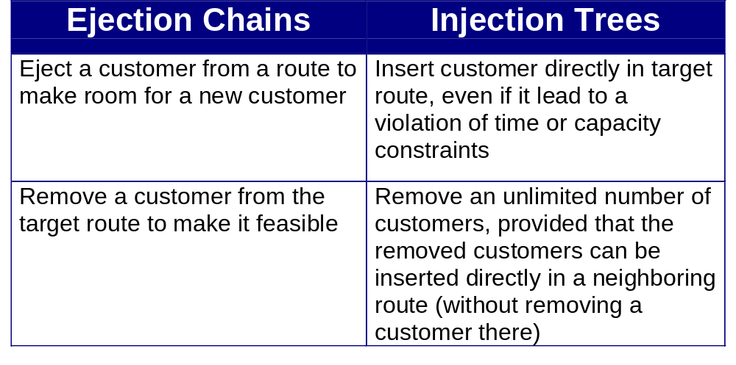
Injection tree heuristic (1)
Optimization Days, Montreal, Canada, May 6-8th
GOAL: reduce number of routes
Similarities with Ejection Chains (Glover, 1991 and 1992)

Slide 7
Injection tree heuristic (2)
Optimization Days, Montreal, Canada, May 6-8th
Implementation:
  Consider first the shortest routes for elimination
  Consider first insertions in geographically close routes, distant routes are disregarded
  Impose a maximum tree length and a maximum on the number of trees to be stored
  Use breadth-first search
  First accept intra-route reinsertions to reduce lateness in target route
  Ignore insertions that increase the distance in the target route more than a dynamically adjusted limit
  Same speed-up techniques as for the hybrid construction heuristic

Slide 8
Distance improvement heuristics
Optimization Days, Montreal, Canada, May 6-8th
GOAL: relocate or exchange segments of customers to reduce distance
Modify CROSS exchanges (Taillard et al, 1997) and Or-Opt exchanges (Or, 1976)
  Also consider inserting the customers in the segment in inverted order
  Try the most promising moves first (first accept)
    First remove customers closest to customers on the other route
    Then consider first the insertion between customers closest on the other route
    Consider only a limited set of closest customers and closest insertion places
  Impose a maximum segment length

Slide 9
Threshold Accepting
Optimization Days, Montreal, Canada, May 6-8th
Modification of Simulated Annealing by Dueck (1990,1993)
Accept worse solution if its difference to the incumbent solution is smaller or equal to a deterministic threshold
Local search operators used:
  IOPT : Or-Opt exchanges in which also the inverted route segment is considered (Bräysy, 2001)
  GENICROSS: based on GENIUS insertion heuristic (Gendreau et al., 1992) and CROSS exchanges (Taillard et al., 1997)
    In exchanging segment between routes, the second insertion is considered only if the first improved the objective function
    All possible insertion places for the segments in both routes are considered
    Also consider insertions between pairs of customers that are not consecutive

Slide 10






Threshold Accepting
Optimization Days, Montreal, Canada, May 6-8th
Step 1. Read in a feasible solution, S_{i}, created by the LS
Set and
Step 2. Repeat steps 3−6 for n iterations.
Step 3. Order the routes in S_{i} randomly
Step 4. Try to improve the current pair of routes in S_{i} using GENICROSS.
Step 5. Try to improve both individual routes in the current pair of routes in S_{i} using IOPT.
Step 6. Lower the threshold by :
  If a better solution is found, store it:
  If no improvement has been found for k iterations, restart the search from the best solution obtained so far at a reinitialized threshold: and
  If , reinitialize the threshold:
Step 7. Return the best solution obtained S_{b}.

Slide 11
Computational results
Optimization Days, Montreal, Canada, May 6-8th
Problem set :
  56 100-customer problem instances Solomon (1987)
  300 extended benchmarks by Gehring and Homberger (1999)
  2 real-life benchmarks of Russell (1995)
The algorithms were implemented in C++ and the computational experiments were conducted using a 700 MHz PC with 128 MB memory and Windows 98 operating system.

Slide 12
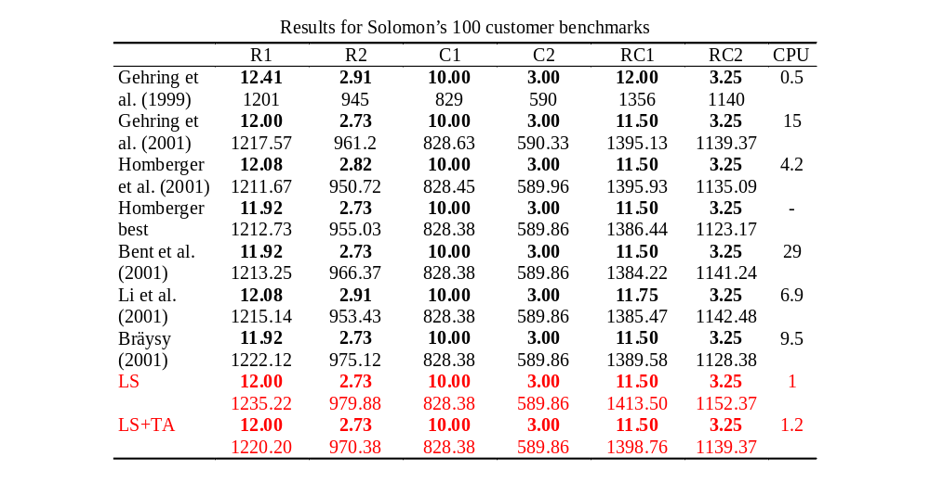

Slide 13
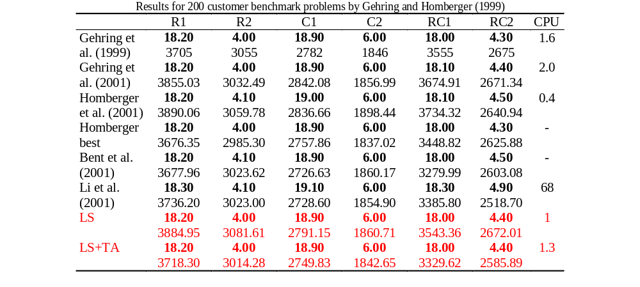

Slide 14
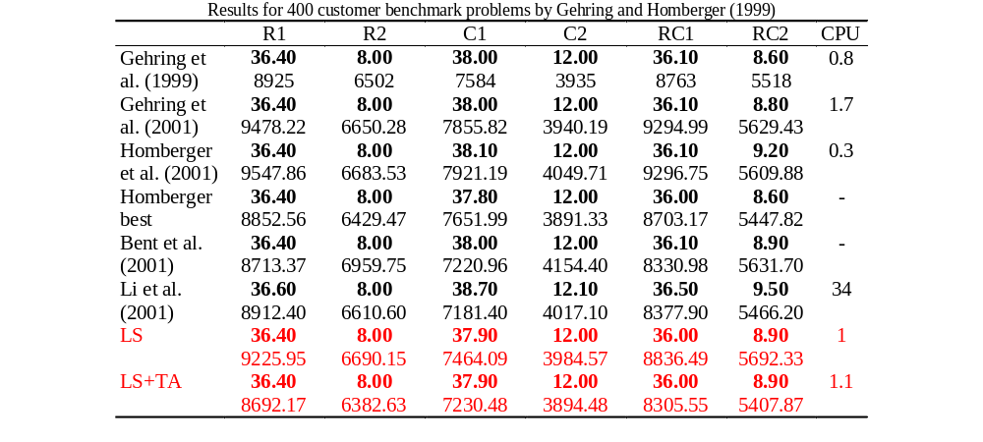

Slide 15
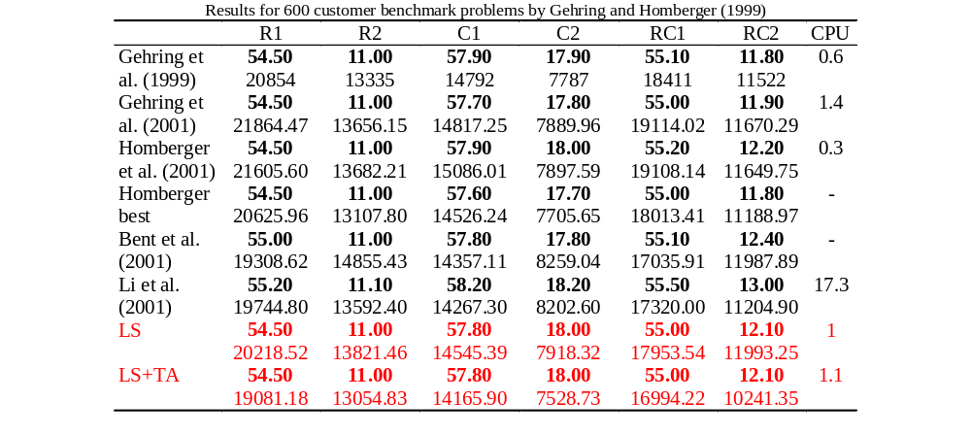

Slide 16
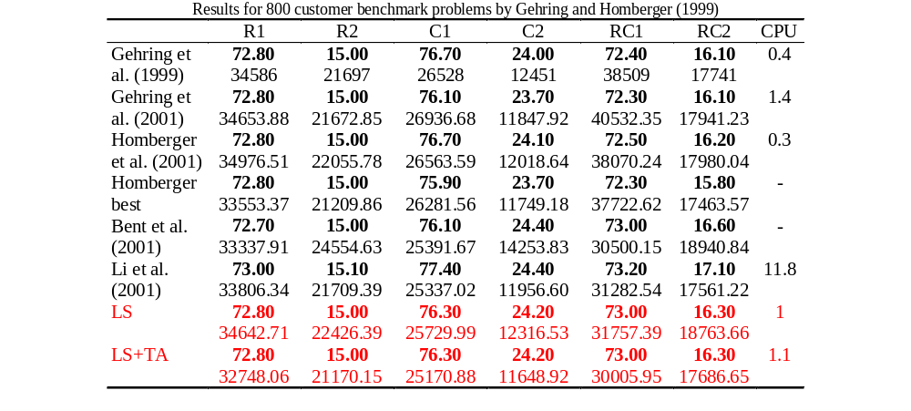

Slide 17
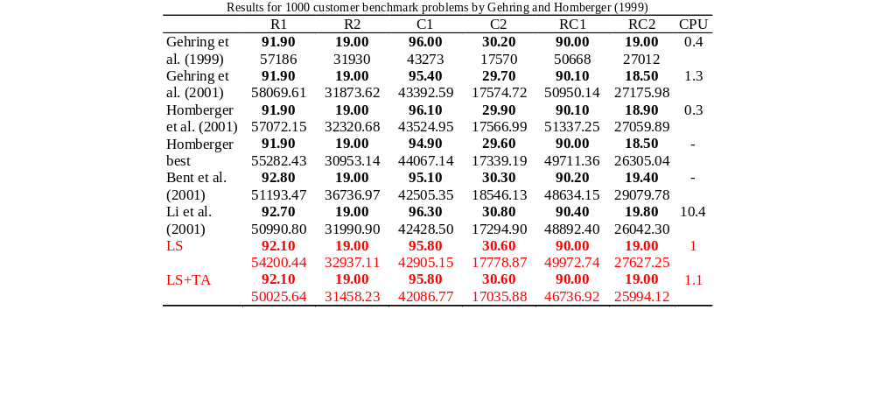

Slide 18
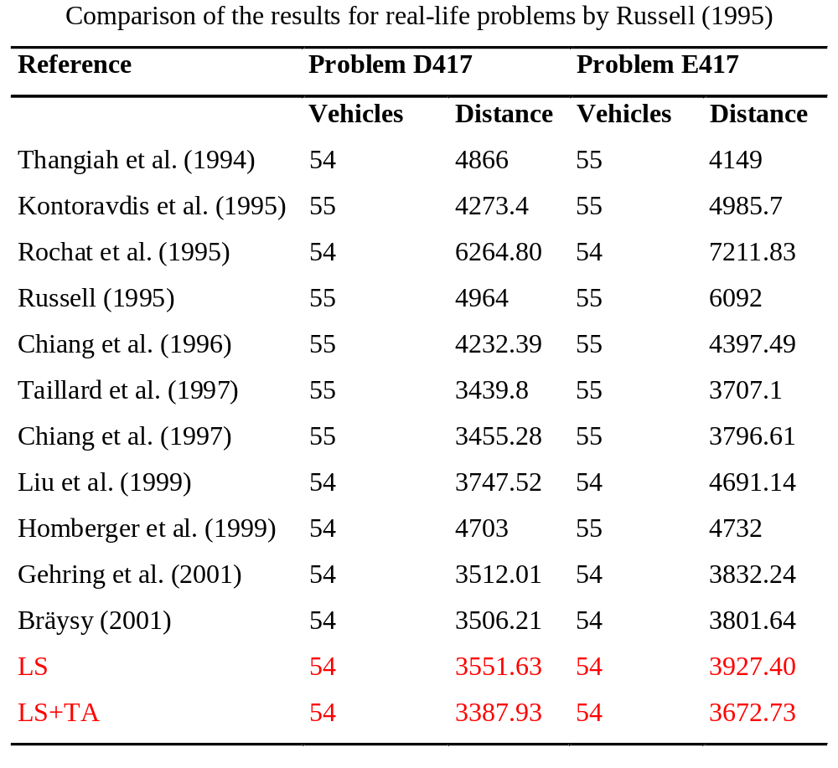

Slide 19
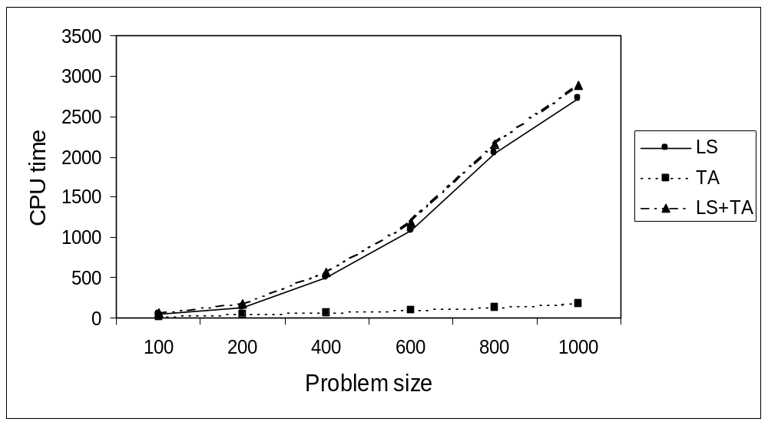

Slide 20
Conclusions
First application of Threshold Accepting to the VRPTW
Development of a new fast construction heuristic and four new improvement heuristics
119 new best solutions obtained for 358 test problems from the literature
Suggest Threshold Accepting as a versatile and fast post-optimization method
More information on the research projects at SINTEF Applied Mathematics: http://www.top.sintef.no

