Slide 1
Quicken Loans - Interview
Bank Marketing Case Study
Data Analysis
By
Aishwarya Setty

Slide 2


OVERVIEW
Performing Data Analysis on a Bank’s Marketing dataset
Data Handling
Data Analysis – EDA
Data Visualization
Data preprocessing for Machine Learning Modeling
Evaluation of deployed model
Insights from data

Slide 3
INTRODUCTION
A European bank ran a campaign, to get more clients to subscribe for a specific Term Deposit.
Machine learning is the next big step in Financial Industry.
Machine Learning Model to predict the probability of people who will sign up. for a Term Deposit.
Term deposit is an investment where you deposit money in the bank for a period on which bank offers some fixed rate interest. At end of the period, client gets the deposited money plus the amount equivalent to fixed rate % of deposited money.
Notes:
Term deposit is an investment where you deposit money in the bank for a period on which bank offers some fixed rate interest. At end of the period, client gets the deposited money plus the amount equivalent to fixed rate % of deposited money.

Slide 4
PROCEDURE
Handle Data
Import Data
Study the Data
Clean the Data
Analyze Data
Machine Learning
Basic exploration
Summary statistics
Visual representation of data
Gathering the insights from data(EDA)
Data Preprocessing
Data Prep for new models

Slide 5
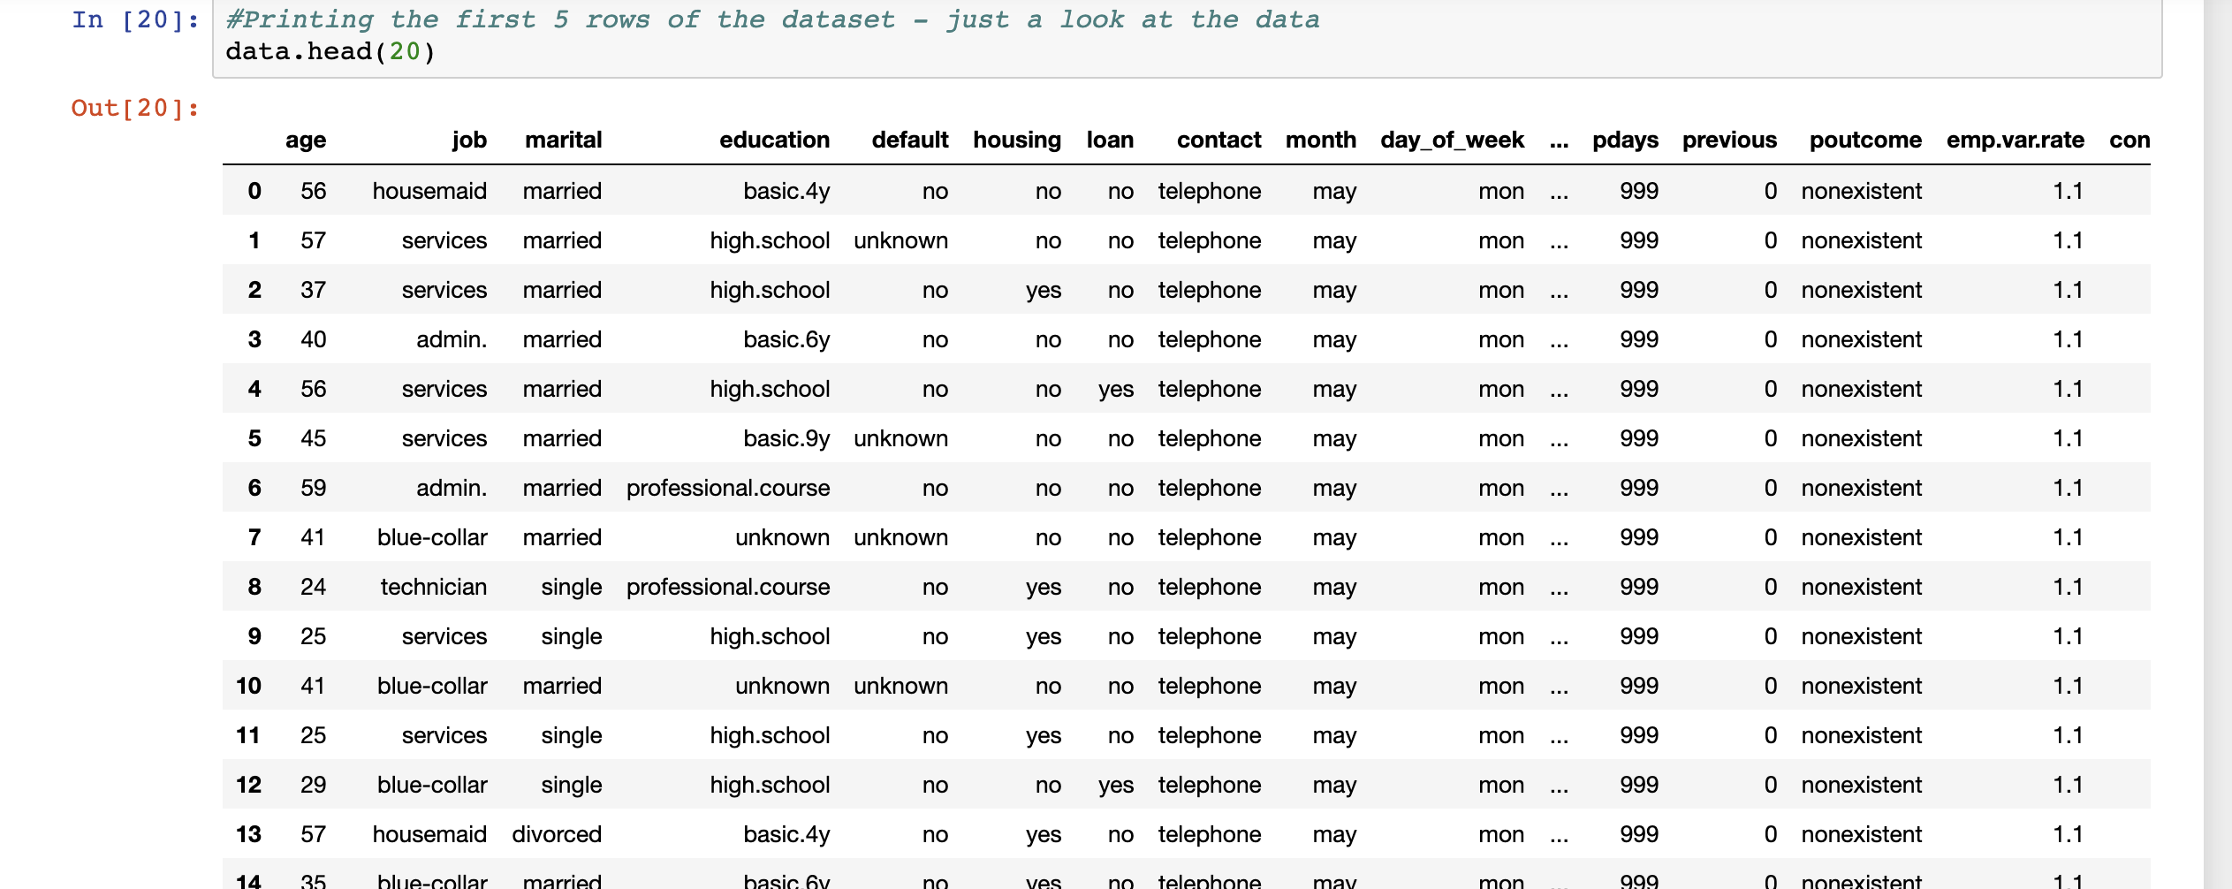
DATASET
Here is a snapshot of the dataset:

Slide 6
ACTIONS PERFORMED
Categorical columns exploration
Numerical columns exploration
Count analysis
Visualization of columns

Slide 7
DATA VISUALIZATION
Bar chats showing column values count
Countplot of columns with target variable
Histogram for column distribution
Box plots for outliers examining

Slide 8
INSIGHTS
Categorical Features
Job
Marital
Education
Contact_Mode
Loan
Previous_Outcome
Month
Numerical Features
Duration
Economic Variables
Campaign
Notes:
High volume of clients – age group
Subscribed client’s financial status
High success rate months
Education of subscribed customers
Previous outcomes relation with new campaign
Number of contact times importance

Slide 9
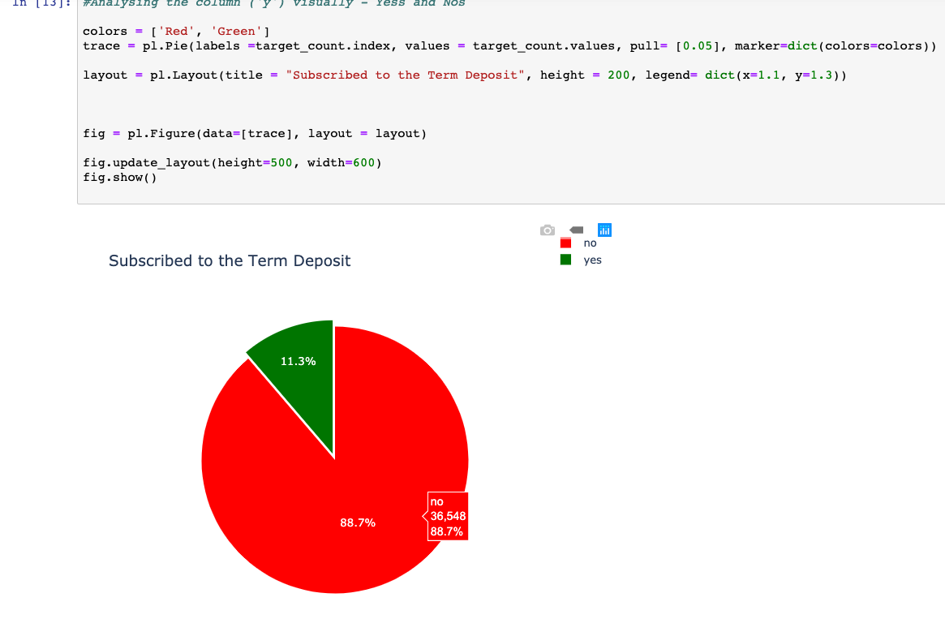
INSIGHTS: CLASS VARIABLE
Class Variable – Depicting Imbalance

Slide 10
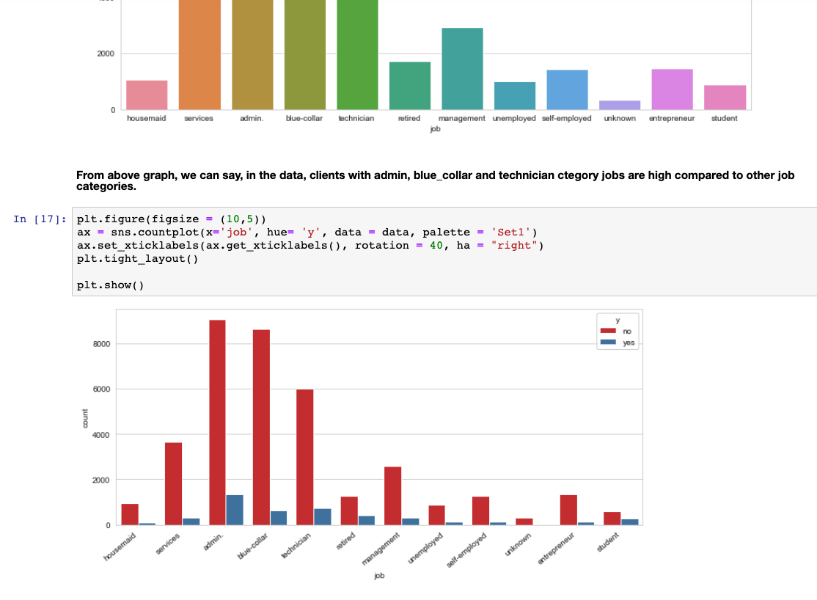
INSIGHTS – ‘Job’
Admin –
3.3% Yes’
22.0% Nos
Technician–
1.8% Yes’
14.6% Nos

Slide 11
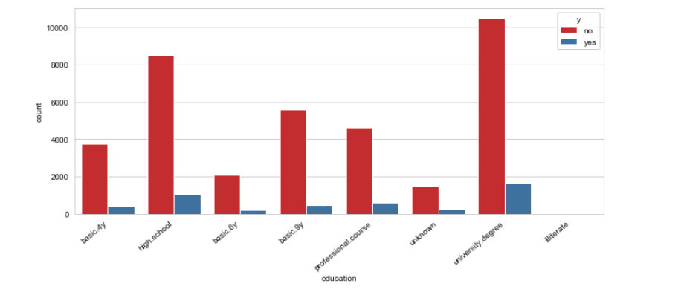
INSIGHTS – ‘Education’
Highest subscribers-University degree
Next highest subscribers High school diploma.

Slide 12
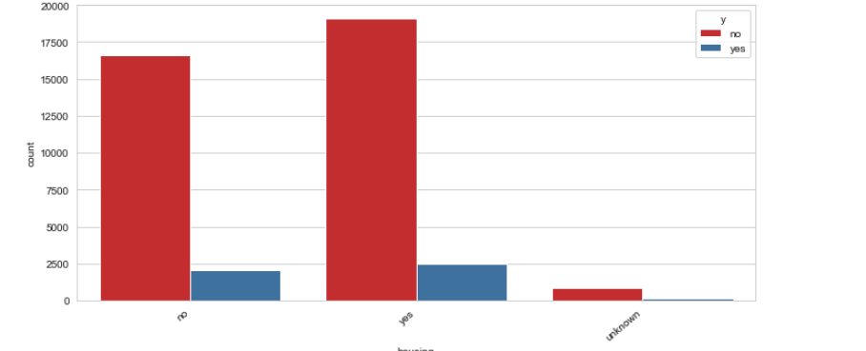
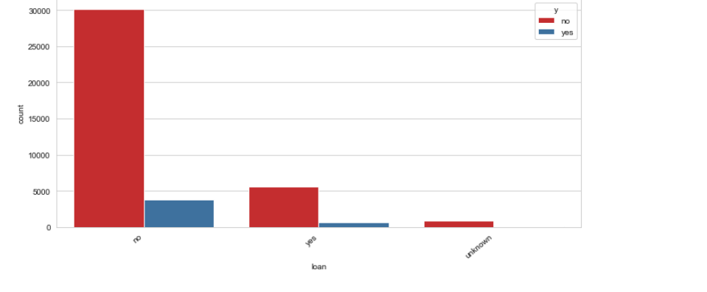
INSIGHTS – ‘Loan’
Housing
Personal
Can not be inferred that – No Loan – Higher chances of subscription

Slide 13
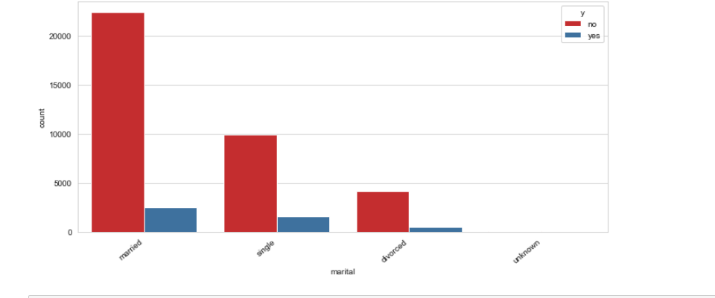
INSIGHTS – ‘Marital’
Married –
6.1% Yes
54.4% No

Slide 14
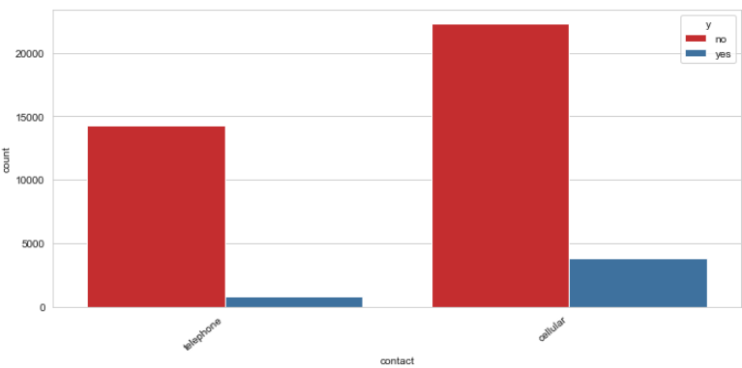
INSIGHTS – ‘Contact_Mode’
Cellular is the most efficient mode of contact

Slide 15
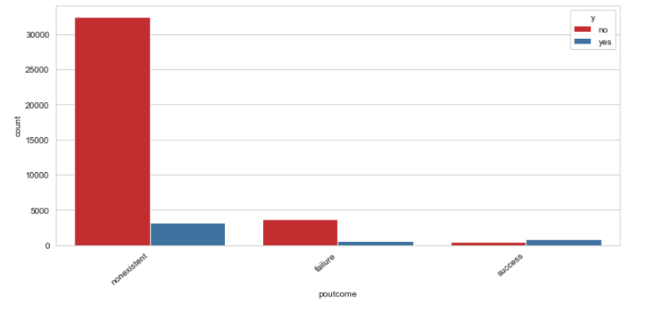
INSIGHTS – ‘Previous_Outcome’
~ 86% - New Customers
Previous success rate holds significance

Slide 16
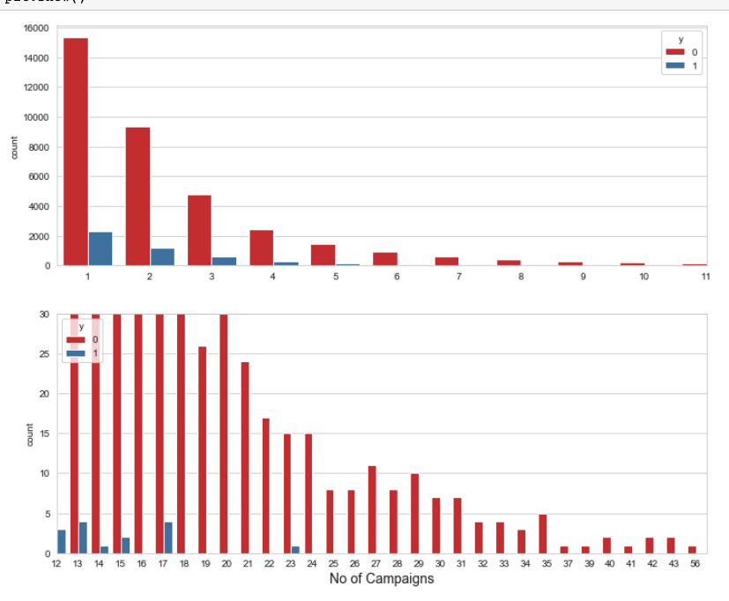
INSIGHTS – ‘Campaign’
Increase in number of contacts –
yields less subscriptions

Slide 17
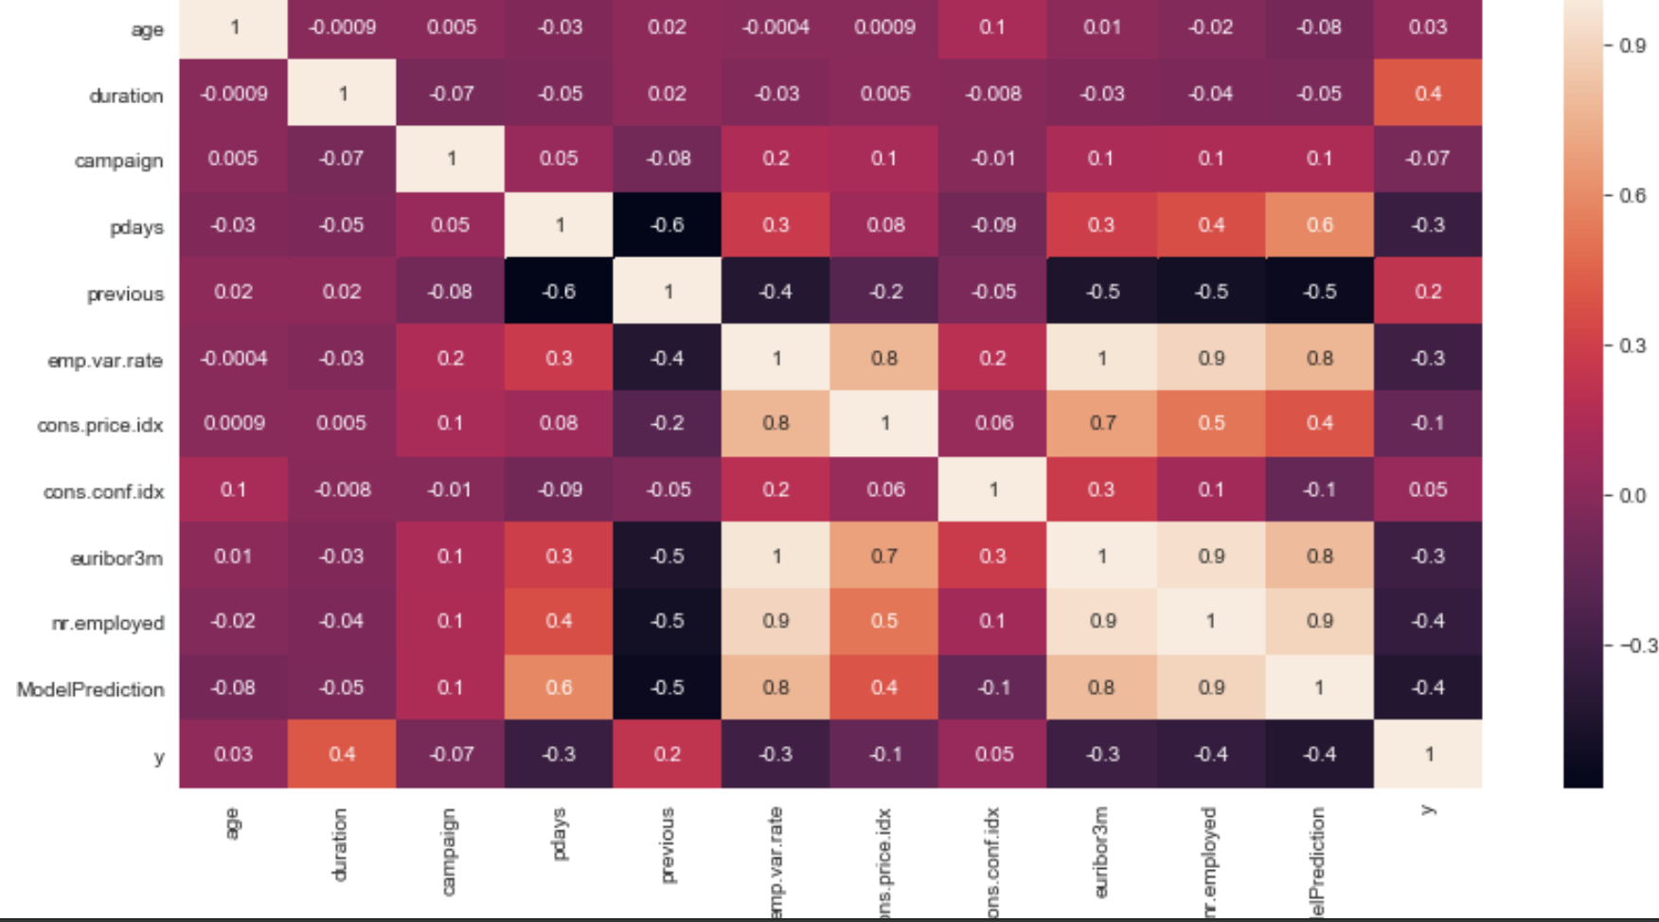
INSIGHTS – Correlation
Economic values with each other have high correlation

Slide 18
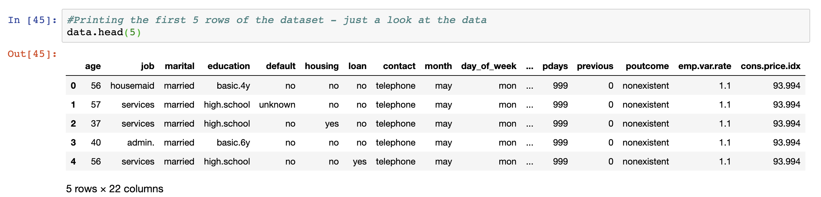
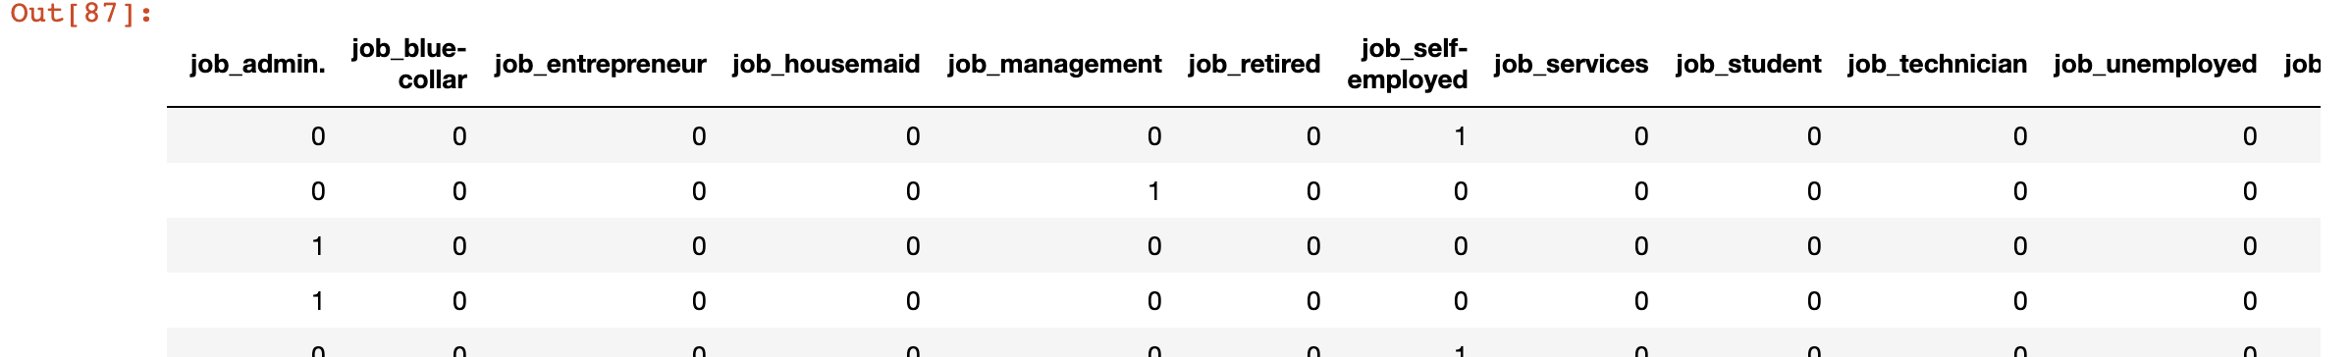
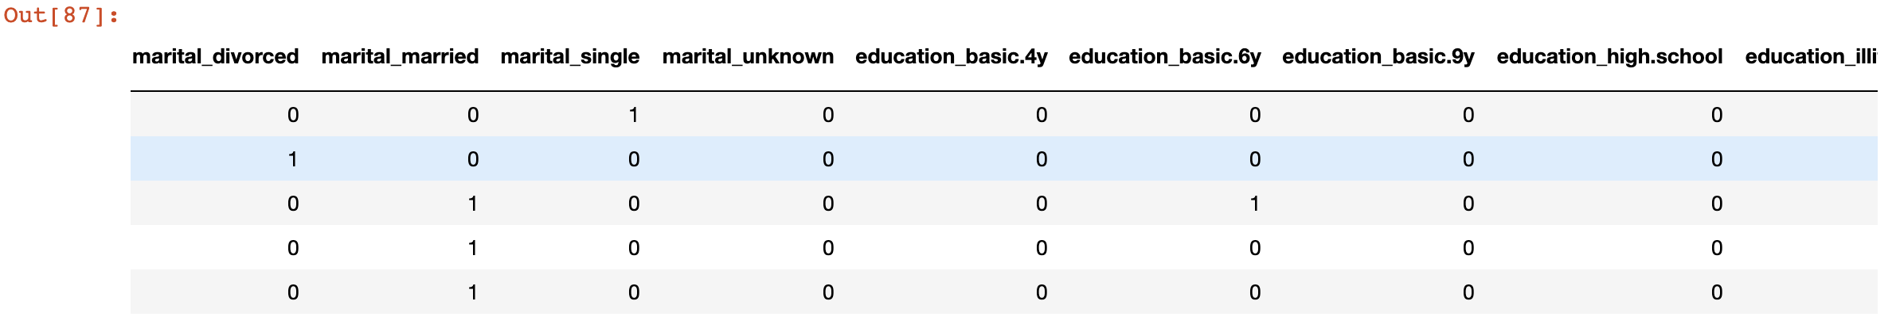
DATA PREPROCESSING
No Nulls
Dropping duplicate rows
Dropping Model Performance column
Independent and class variables
Train and Test split
Label Encoding
One Hot encoding

Slide 19
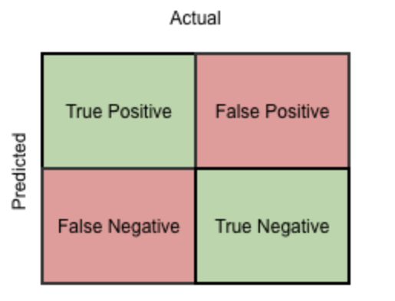

COMPANY DEPLOYED MODEL
Model Performance Evaluation
Confusion Matrix
Current Prediction Model Accuracy
Threshold = 0.9
Accuracy = 0.2
Result:
Not an efficient model – Low accuracy
Notes:
Given model performance was evaluated by comparing
TP = True Positive
TN = True Negative
FP = False Positive
FN = False Negative

Slide 20
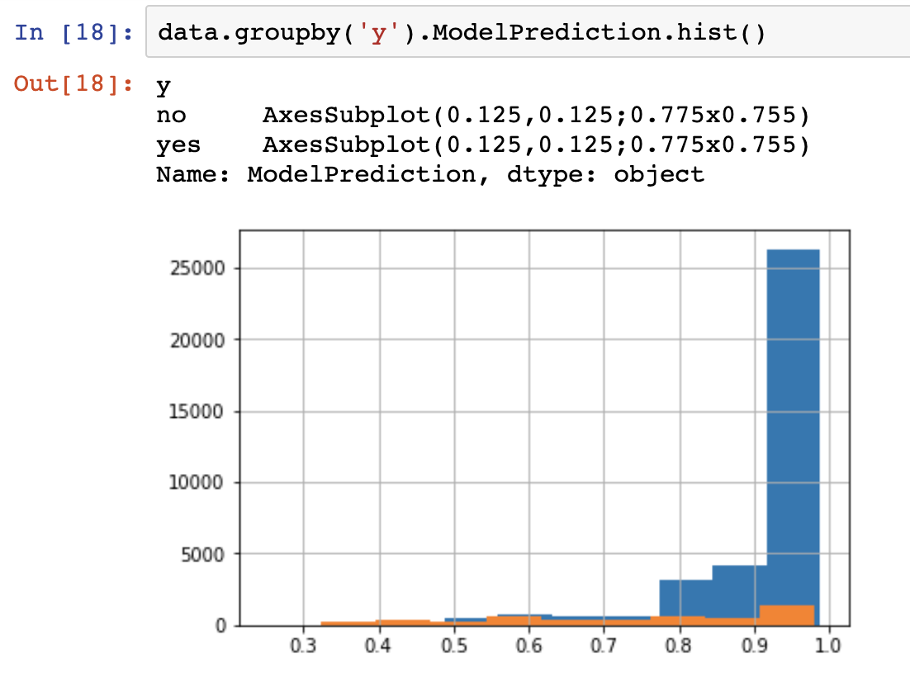
COMPANY DEPLOYED MODEL
Histogram – Model Performance Probabilities
Irrespective of Threshold – Accuracy is still low
Yes, and No classes are not clearly separable

Slide 21
DEPLOYED MODEL
Logistic Regression Model
Binary Classification – Yes or No
Model Accuracy - 0.91

Slide 22
Thank You
Q/A

