Slide 1
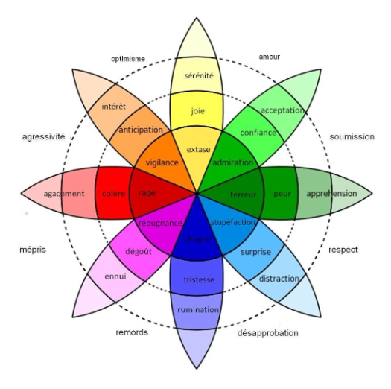
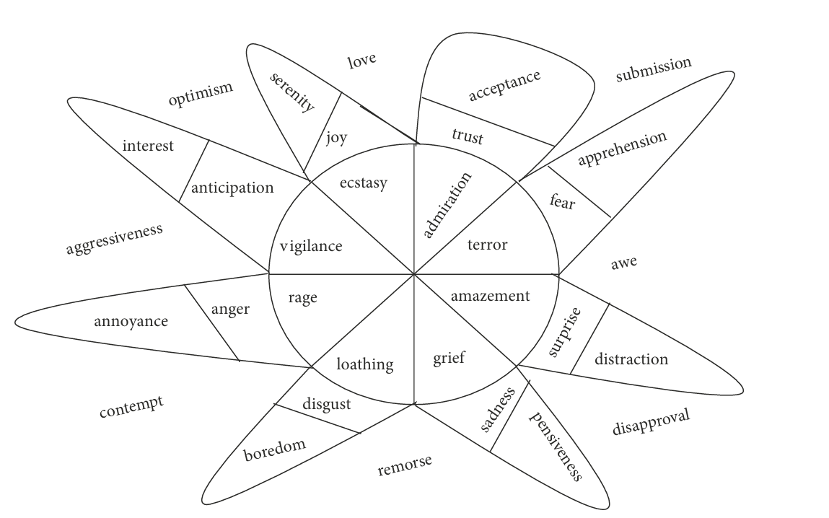
INTRODUCTION AND OVERVIEW
Sentiment: A thought, opinion, or idea based on a feeling about a situation, or a way of thinking about something
Sentiment Analysis: Sentiment analysis finds out the sentiment of the given text in terms of positive, negative, or neutral.
Sentiments can be of many types as shown in the diagram

Slide 2
PROBLEM STATEMENT
Text-Based Emotion Recognition Using Deep Learning Approach:
The given challenge is to build a classification model to predict the sentiment of tweets , sentences and dialogues. The datasets contain the required information and manual tagging has been done. We use Deep Learning to solve this problem
APPROACH
We may adopt one of the following approaches to solve this problem:
LSTM-based RNNs: Utilize LSTM cells for sequential sentiment analysis, inputting word embeddings, and applying regularization techniques.
Transformer Models: Fine-tune BERT or GPT, leveraging contextual understanding, and adjusting architecture and training.
Or later according to the needs we may employ a different idea

Slide 3
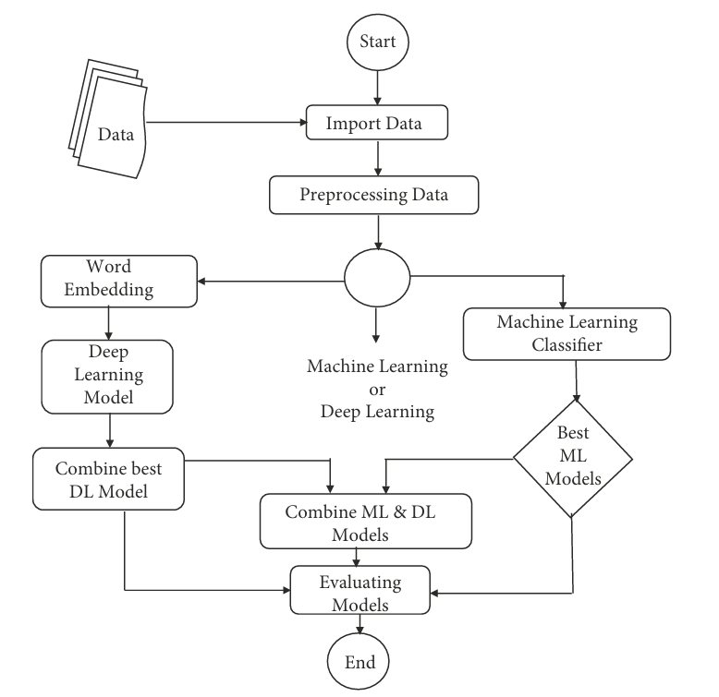
SOLUTIONS
To solve the above problem we can use:
Transformer-based Models (e.g., BERT, GPT):We would like to utilize advanced transformer architectures to fine-tune pre-trained models for sentiment analysis, leveraging attention mechanisms to capture text dependencies and semantic relationships, thereby enhancing sentiment prediction accuracy with contextualized embeddings.
This is our general idea In future maybe we can implement any different algo for solving this purpose.
And this is our proposed workflow:

Slide 4
Features:
Sentiment Analysis: Incorporate sentiment analysis features such as sentiment polarity (positive, negative, neutral) of the text.
Emotion Lexicons: Utilize emotion lexicons or dictionaries to identify words associated with specific emotions. For example, NRC Emotion Lexicon or EmoLex.
Part-of-Speech (POS) Tags: Extract POS tags to capture grammatical structure and identify emotional indicators associated with specific parts of speech.
Impact:
Enhanced Customer Interaction: Businesses can personalize services and marketing by analyzing real-time customer emotions, leading to higher satisfaction.
Improved Mental Health Monitoring: Emotion recognition aids in early detection of mental health issues, enabling timely interventions and personalized support.
Tailored Education: Adaptive learning systems adjust content based on student emotions, fostering engagement and better learning outcomes.

Slide 5
Technologies used
Front End
Framework – ReactJS
Language used – JavaScript
Backend and Database
Database Used-MySQL
Backend -Flask/NodeJS
Machine learning model
Python , NLP , Transformer
Some pretrained models
API for Connection
Flask

Slide 6
Thanks for having us
Ayush Das , CSE(DS)
Aishik Maitra , CSE(DS)
Sonajhoori Maitra , CSE
Upasana Roy , CSE
We thank the kind organizers of Mercer Limitless Hackathon for giving us this chance

Slide 7
Important Links
Link to our github repository→ https://github.com/aishikmaitra/Sentiment-Analysis
Link to demo video→
https://drive.google.com/file/d/1JF1qzayK6WsnmXnywZ3Z8IRvZ4v35W8Y/view

