Slide 1


DBMS Project
CS3002D Database Management System
Hostler Mart
Used Goods Recycle cum Inquiry Management System
( Website for buying and selling second hand products and find lost items inside the campus )

Slide 2
The Team
Group - 30
AISHIK RANA (B180369CS)
AMAN SINGH KADIYAN (B181103CS)
ANANT KUMAR ANAND (B180302CS)
RAVI KUMAR VERMA (B180314CS)
TARUN KANSAL (B180403CS)

Slide 3
Table of Contents
Introduction
The problems
The Solution
Types of Users
The Website
Limitations
Conclusion
References

Slide 4
Introduction
Basically a project or a new creation is the result of some problem. It can be a major problem of world or can small problem of a small area. Our project is not different from this. Our project (website) is also a result to tackle two problems in our college campus or to be specific for hostelers.
So we think our hostler mart is the solution of those problems.

Slide 5
The Problems
So the basic two problems in our campus are
Every student can’t carry their all belonging to their home from hostel, and on the other hand there are some students who can’t afford all new things or don’t want to waste money on some things.
If someone has lost something inside the campus and some other person finds it, both person make emails on college mail inbox although this is useless for all the others other than those two. For this sometimes important mails are hard to find in this mess of lost item/found item.

Slide 6
The Solution
To tackle the previously mentioned two problem we have decided to make an website where one can sell his second hand product and one can buy those products.
On the other hand one can post a report of finding any item inside the campus and one can search for his product in the website instead of mail where all kinds of mail are combined together.

Slide 7
Types of Users
There are basically four types of user in the website
Seller - one who wants to sell his used product in the website.
Buyer - one who wants to buy these products.
Finder - one who finds something inside the campus which belongs to others.
Owner - one who owns those lost items and wants to have back the same

Slide 8
The Website
(Website details and corresponding screenshots)

Slide 9
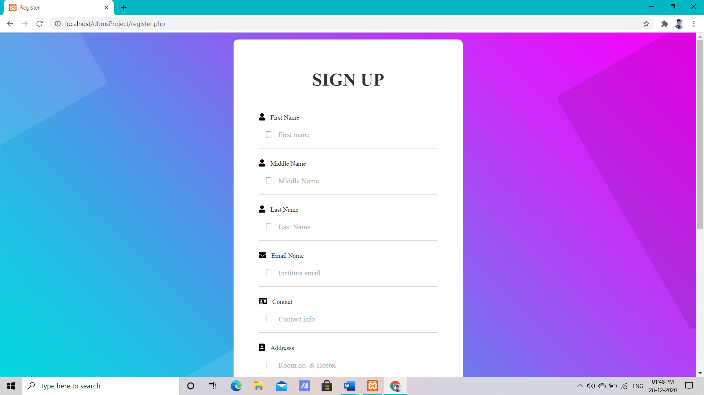
Sign up
If the person is new to the website then he/she has to sign up first with their full details. This is a one time sign up process. After this he/she can do all the four parts of activity mentioned earlier inside the website.

Slide 10
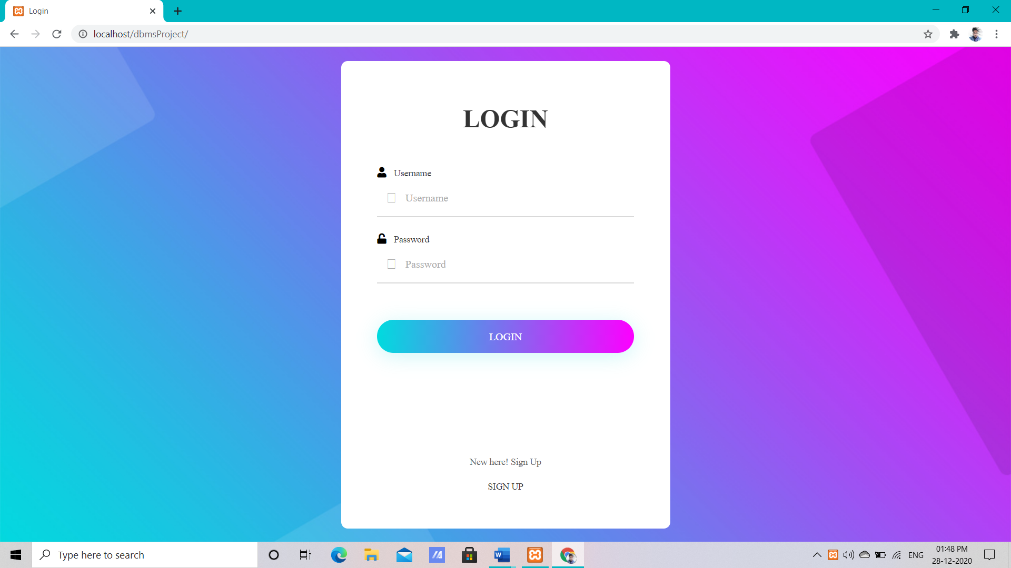
Login
If a person is already signed in he/she can skip the previous step and can directly login to the website with the username and password he provided in the time of sign up.

Slide 11
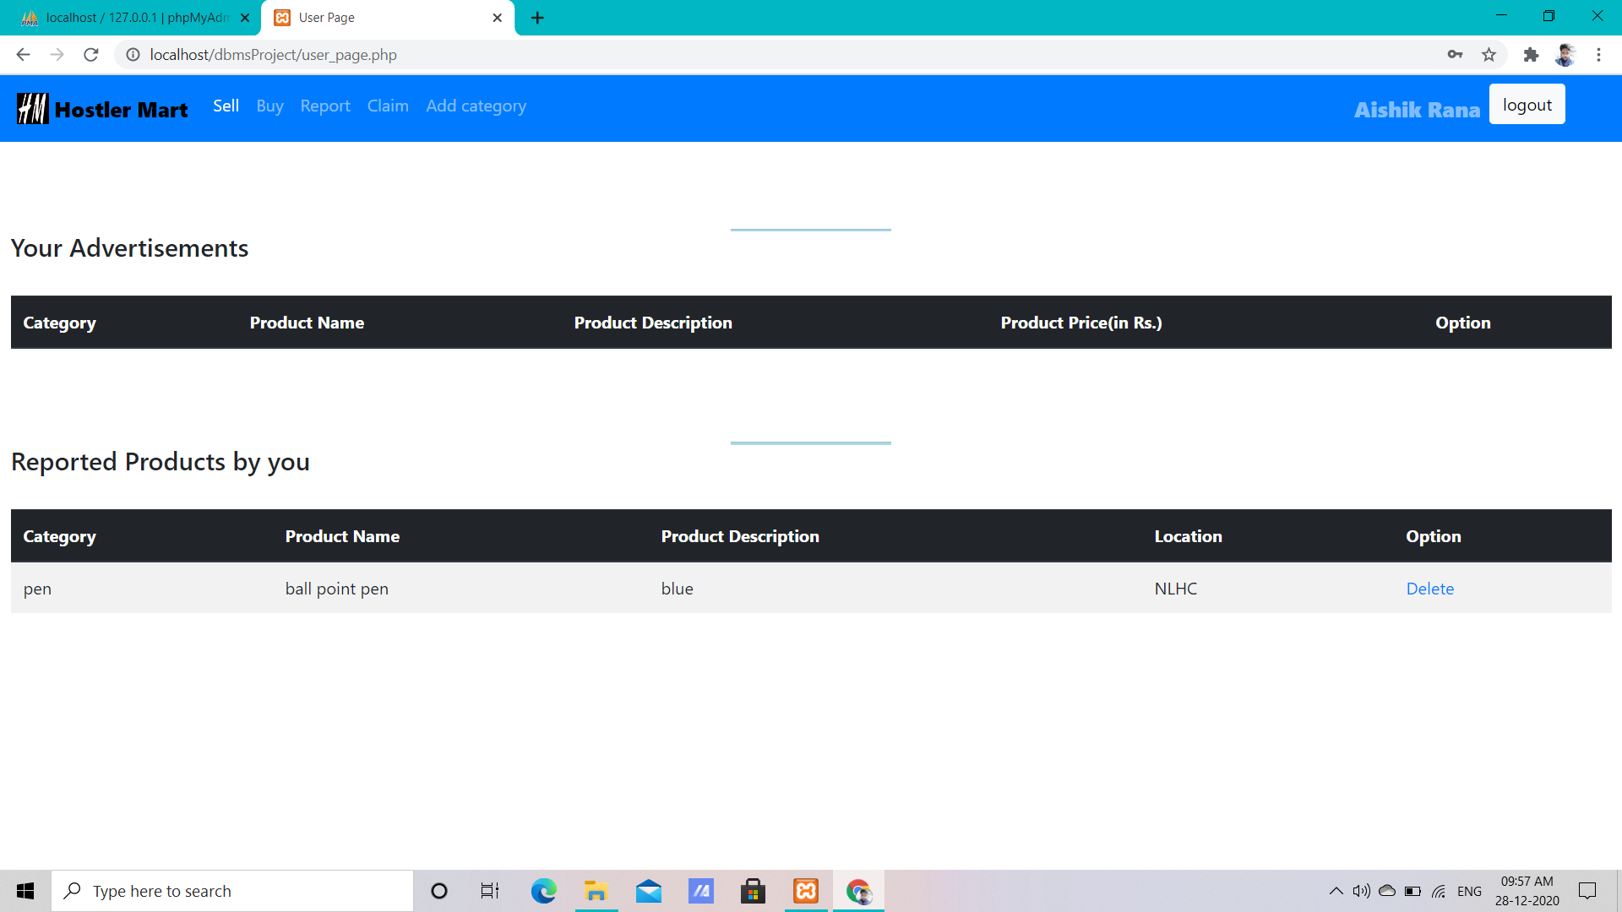
User page
This is the page just after login where an user can see all his activity and also can edit and delete the same.

Slide 12
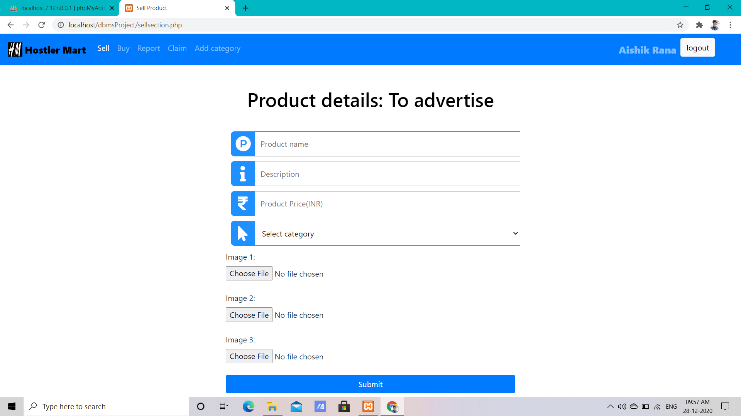
Seller page
Here one can make an advertisement of his/her product which he/she wants to sell. They only have to fill the details , that’s all.

Slide 13
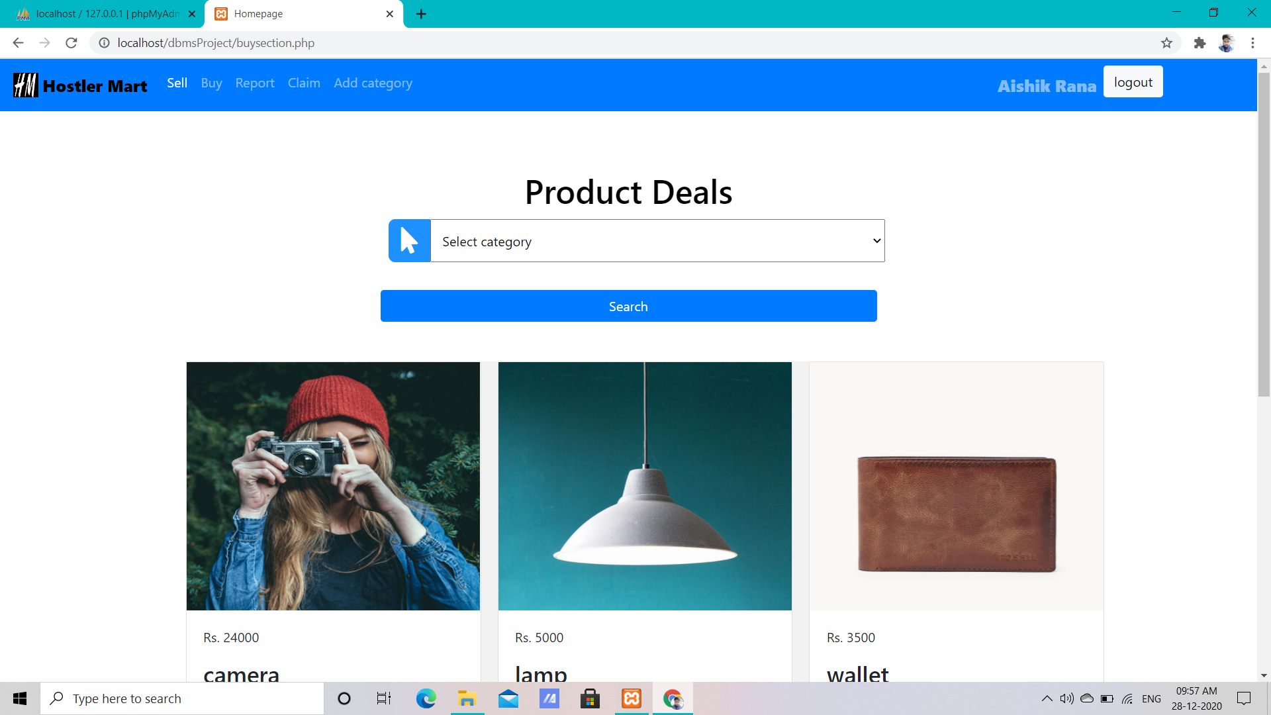
Buyer page
Here one can look for the items available for sale and select what he wants to buy.

Slide 14
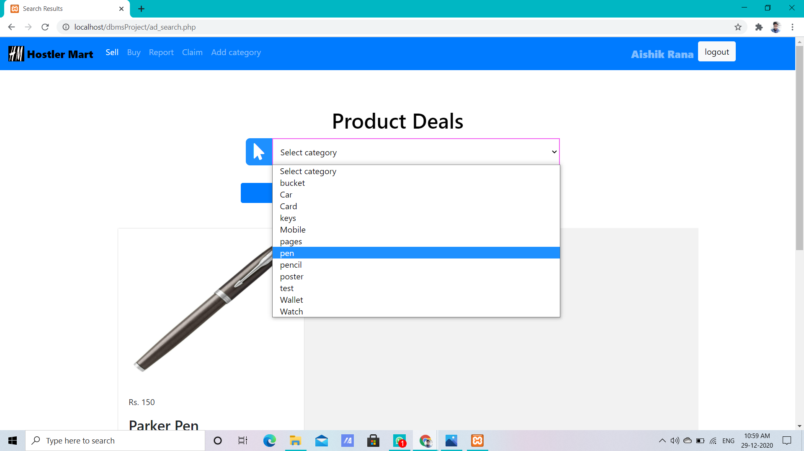
If the buyer wants to search through category he/she can select a category and go through those items.

Slide 15
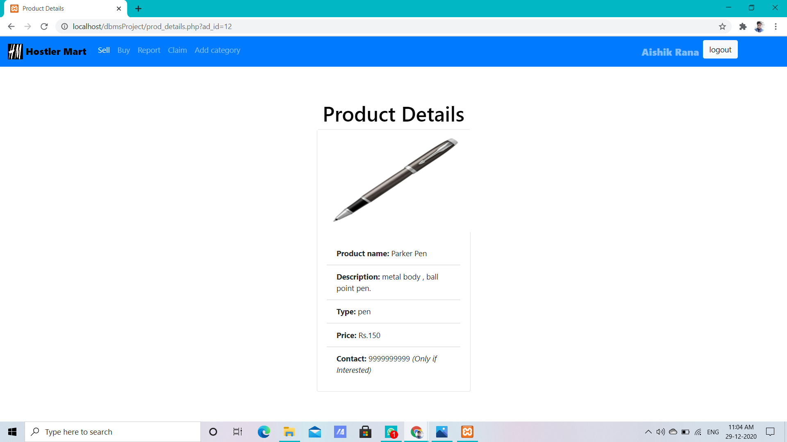
If he is interested in a particular product he/she can click on view details on the particular product and from there he can contact the seller,

Slide 16
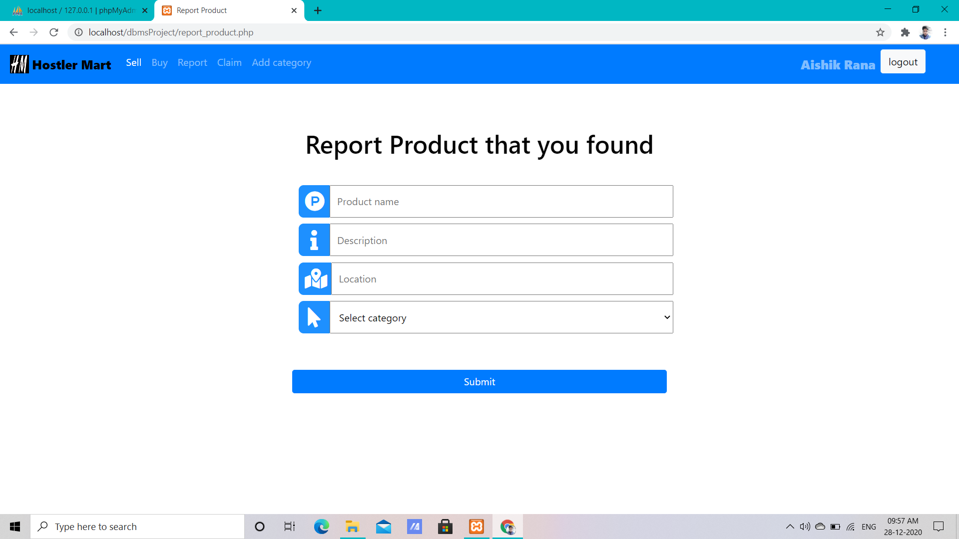
Report Item
Here one can report any item he/she has found in the campus and wants to give it to its owner.

Slide 17
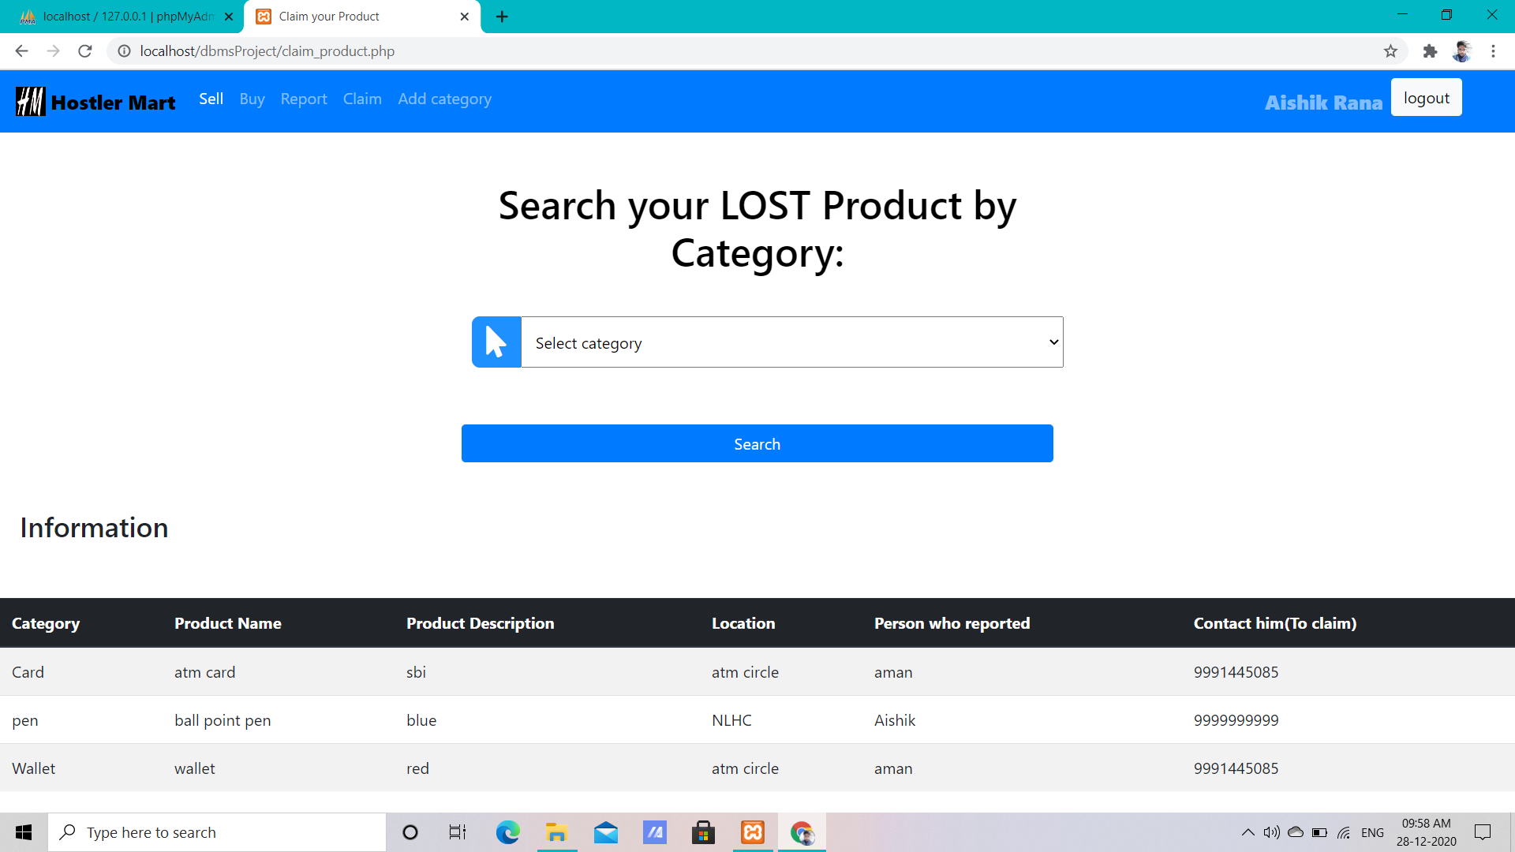
Claim Item
Here the owner of an item present in the claim section can have the details and contact the finder.

Slide 18
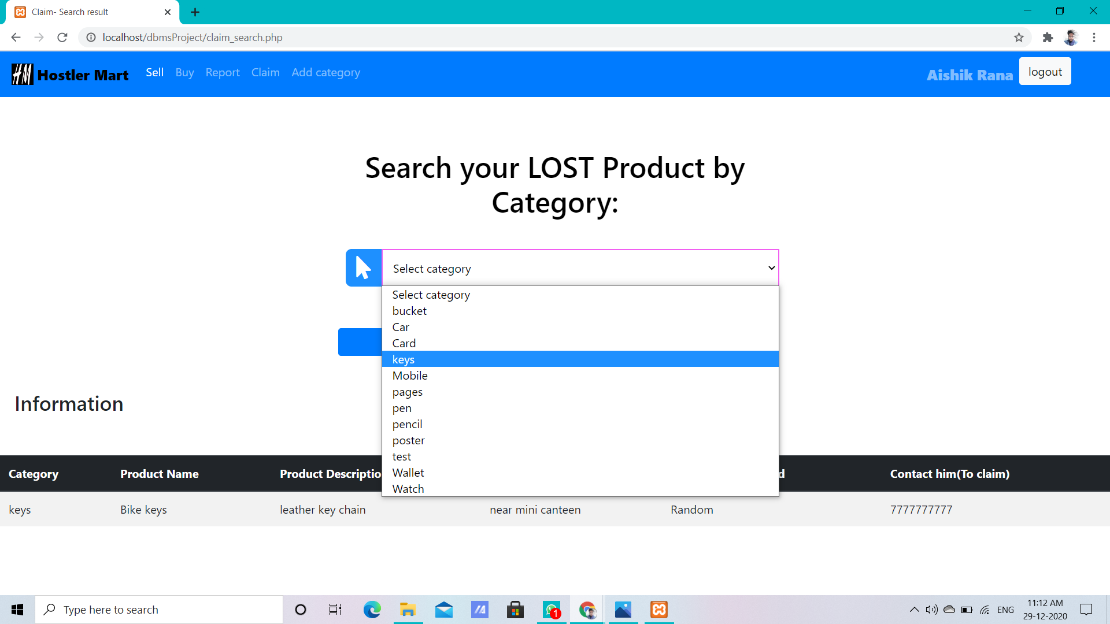
He / she can search products by category as well. For example ‘key’

Slide 19
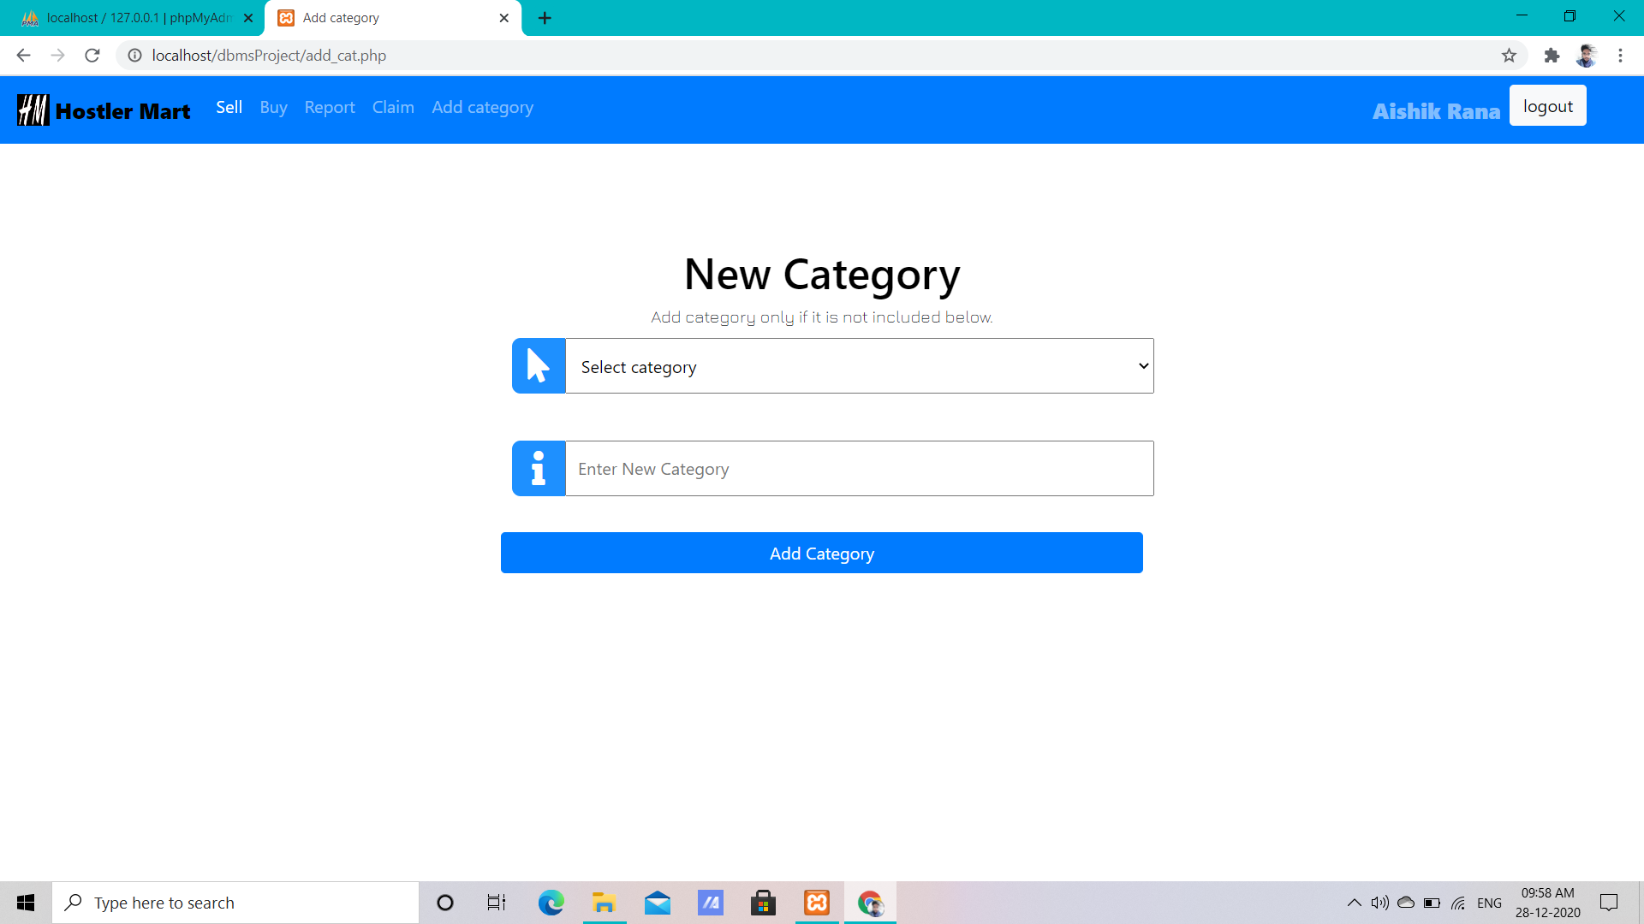
Add category
In case the category of the product one wants to sell or the item one wants to return is not present in the website , one can add new category to the website.

Slide 20
Limitations

Slide 21
We have some limitations inside our website.
Our website mainly focused on two problem , so the website is not versatile.
We didn’t include any dedicated chat box for lack of time and knowledge.
We didn’t include any ‘buy now’ or ‘add to cart’ option as the sellers are not professional , so the price may vary. So we think it’s better to have conversation with each other before buying. For this we have provided the contact number of the seller.
In claim section we also have provided the contact number as many misleading claim will occur. So it’s better to have conversation and after providing proof , one will allow to get one’s item.
For the misleading claims we also avoided image upload part in report item section.

Slide 22
Conclusion
The motivation behind our project is to solve two problems in one shot in our hostel that we usually face in our day to day life. And now through this project of ours we feel like we have succeeded a little bit.
Through our website one student who can not afford or don’t want to waste money on the day to day things , they can have easy access to second hand products. On the other hand those who can’t carry all their belongings to their home , they can make some money by selling those to the needy ones.
Again for the second part of our website students can easily find their lost belongings without spamming in the college mail inbox.

Slide 23
References
www.w3schools.com
Web result with site links
W3Schools
www.php.net
PHP: Hypertext Preprocessor
www.getbootstrap.com
Bootstrap · The most popular HTML, CSS, and JS library in the world.

Slide 24
Thank You

