Slide 1
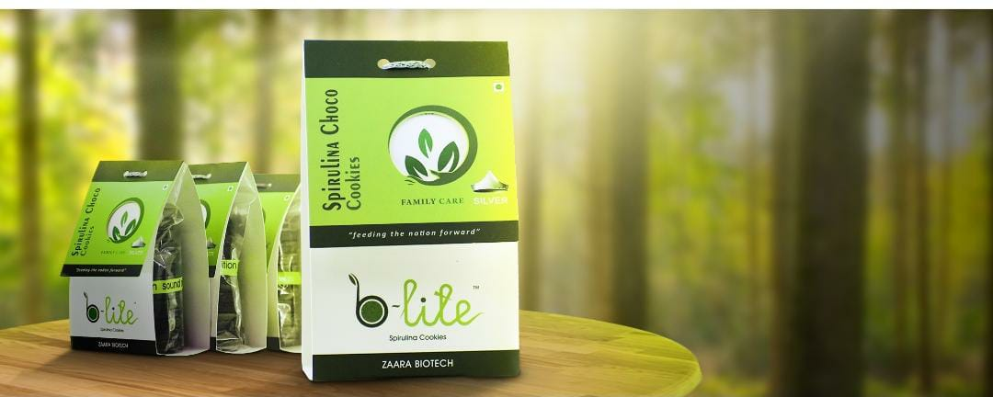

ZAARA
BIOTECH
MS3001D ENGINEERING ECONOMICS
AISHIK RANA

Slide 2
QIP PROJECT
GROUP 25
AMAN SINGH KADIYAN B181103CS
ANANT KUMAR ANAND B180302CS
AISHIK RANA B180369CS
RAVI KUMAR VERMA B180314CS
TARUN KANSAL B180403CS

Slide 3
TABLE OF CONTENTS
Overview
The Interviewee
The Team
Consumer Base
Types of Costs
Competition & Sales
Success story
Future Plans

Slide 4
OVERVIEW
Zaara Biotech is a Indian Food product Company .
This company started as a course project by a group of students and founded on 2016.
It,s main motive is to cure food crisis through a very unique and nearly unknown source i.e algae.
It is "India's first Algal-Seaweed food product manufacturing biotech students' startup." in collaboration with b-lite.

Slide 5
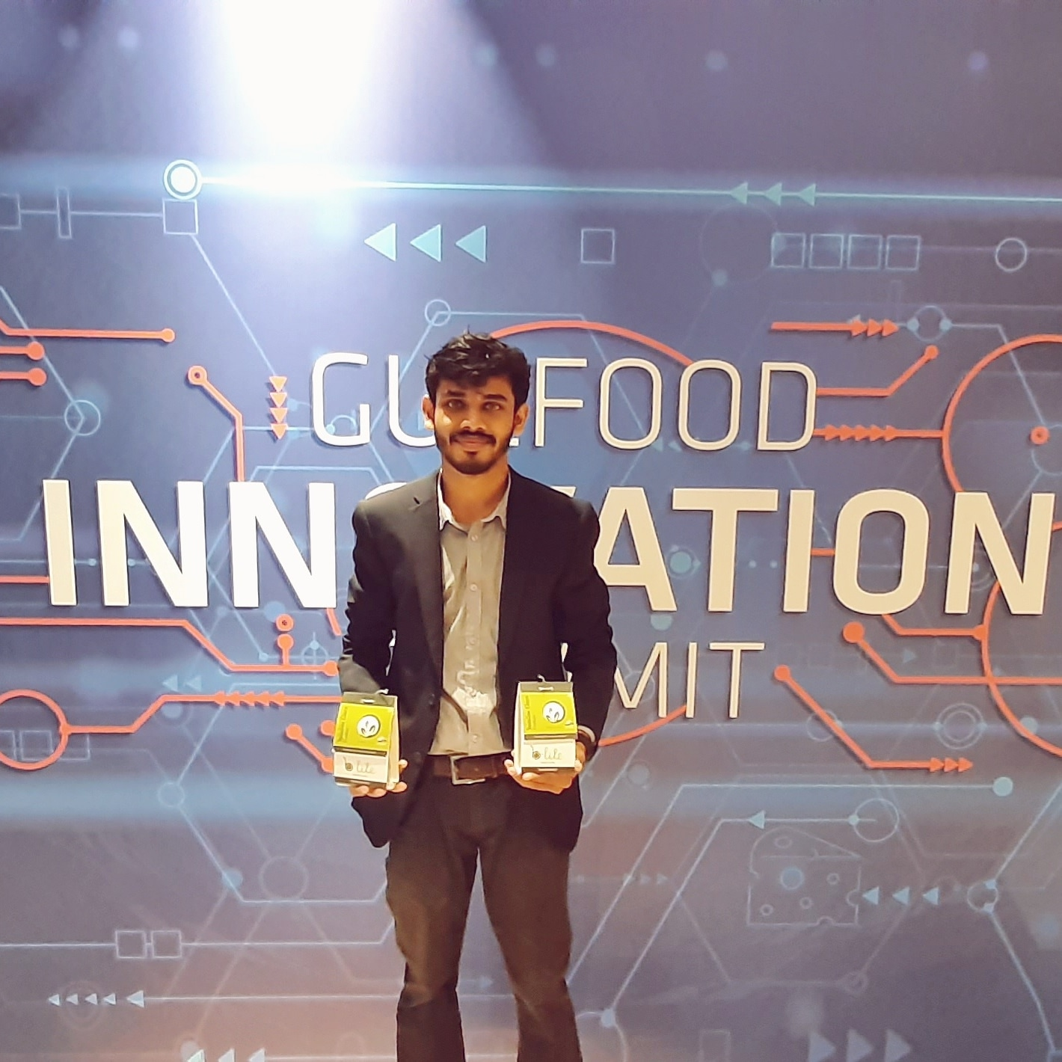
Mr. Najeeb bin Haneef
CEO and Founder of Zaara Biotech
Completed his B. Tech on Biotechnology and Genetic Engineering from Sahrdaya college of engineering and technology , Thrissur .

Slide 6
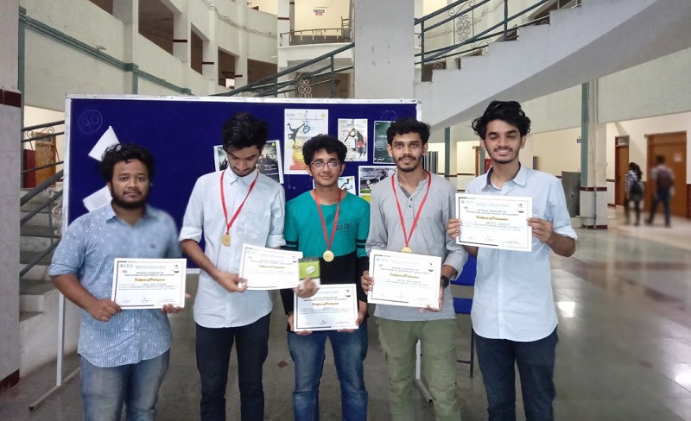
THE TEAM

Slide 7

CONSUMER BASE
General people who loves cookies .
Gym guys as it contains whey protein.
People who are health conscious and can replace their breakfast with these cookies.
Marine crew , who have less supply but need more nutrients .

Slide 8
FIXED COST
VARIABLE COST
SUNK COST
Infrastructure.
Cost for baking equipment, fuel supply etc.
Raw materials , imported from USA and Canada.
Wages of employees.
Travel and transport for employees.
Investment in equipment suitable for low scale production proved.

Slide 9
COMPETITION AND SALES
As this is a new idea so this company doesn’t have many competitors in market as for now. But in near future where people are beginning to concern more about their health this company might get competitors in this field.
They are targeting cookies , snacks to insert algae and in this field there are many companies making cookies and snacks .

Slide 10
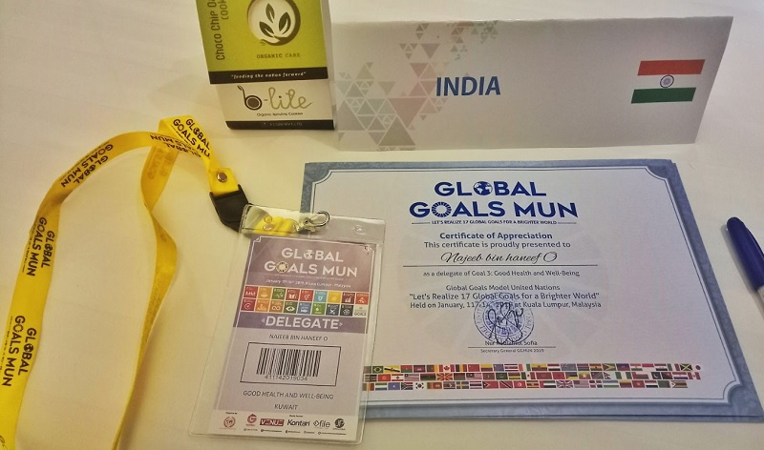
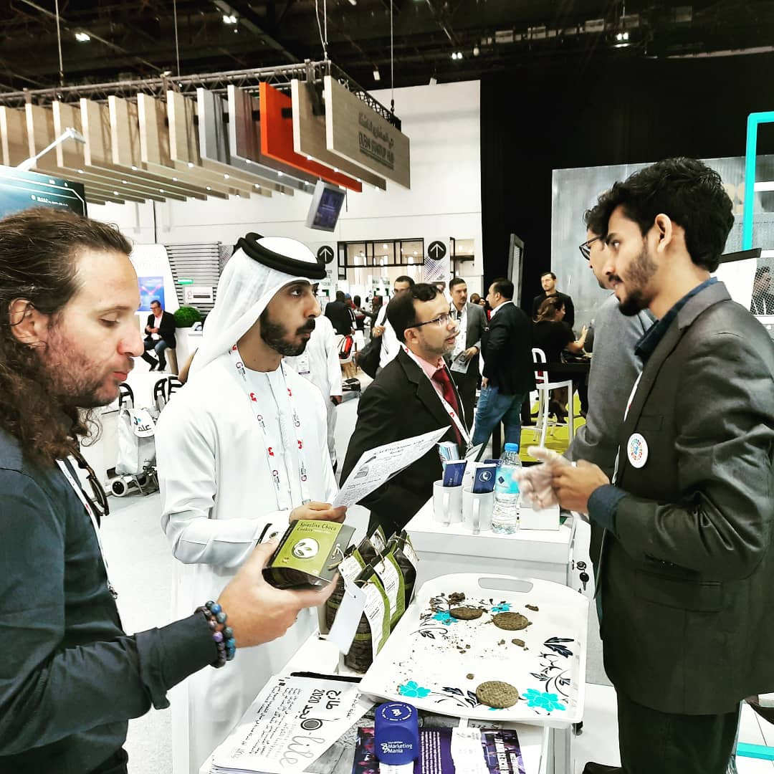
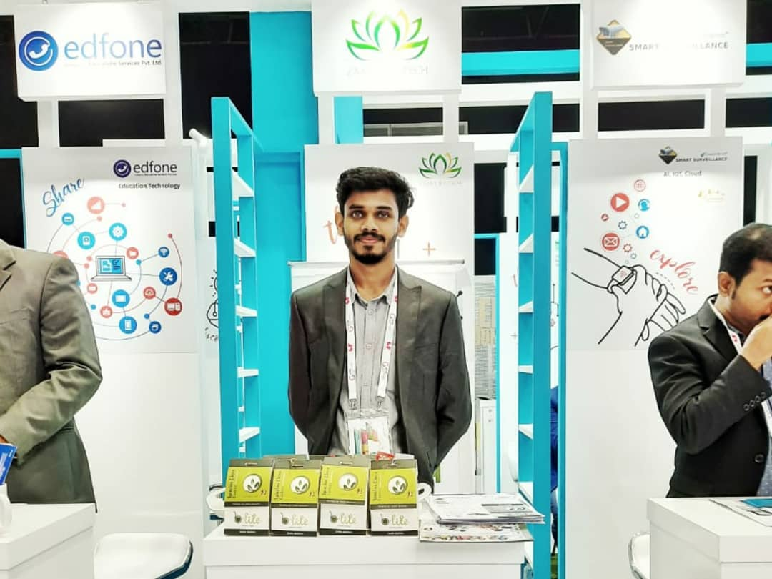
SUCCESS
Global Goals MUN held in Malaysia described B-Lite Cookies as one of the best innovative product in Asia .
Recognised and incorporated in the Central Institute of Fisheries and Technology, at Willington Island.

Slide 11
FUTURE PLANS
SHORT TERM
They are targeting cookies and snacks through which they are introducing their product and concept to others.
Instead of only paying attention to the health, they are also paying attention to the taste of their products
LONG TERM
For long term they are adapting with situation and reaching more and more people. As people are now being more concern with their health , in future they are more likely to accept these products as their basic needs and reject those harmful synthetic products.

Slide 12
Thank You

