Slide 1

Implement Trace SDR Method
Software Engineering Project
Advisor: Prof. Damir Dobric
Ang Ngawang Sherpa
M.Eng. Information Technology
ang.sherpa@stud.fra-uas.de
Aishin Abdulla Yoosufali
M.Eng. Information Technology
Matriculation Number: 1359022
aishinabdullayoosufali@stud.fra-uas.de

Slide 2
AGENDA
AGENDA
Introduction
Project Implementation
Code Demonstration
Sparse Distributed Representations (SDRs)
How SDR are generated
Tracing of SDRs
Purpose of the project topic
Existing and New Model
Procedures for new model
Procedures for Unit Test building
Code explanation
Unit Test project
Conclusion
Implement Trace SDR Method

Slide 3
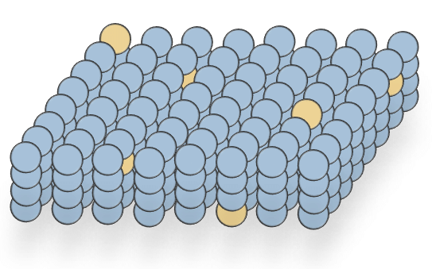
INTRODUCTION
SDR contains thousands of bits constituted as 0’s and 1’s, the bit 1 is a comparatively active neuron and bit 0 is indicated as an inactive neuron. This is what SDR is responsible for and has a meaning to it.
In the HTM research, it has found that the Spatial Pooler Learning algorithm, which continuously generates the SDR, has an encoded input or sequence.
The StringifyVector method, which is already implemented generates or trace out the SDRs.
The SDR sets allot the same semantic attributes because of the active bits in the same index.
Experiment shows the work of SDR vectors having active bits on the similar locations and also dissimilar or inactive bits.
The purpose is to produce a similar method Stringify_TraceSDR shows how to differ between two SDR sets in a well arranged index.
Furthermore, to differentiate between the two SDR vectors having similar index bit, a padding active neurons, we created at places that have not the same index or inactive bits in the SDRs.
Fig. Source
Implement Trace SDR Method

Slide 4
PROJECT IMPLEMENTATION
Existing model to trace SDRs
The algorithm in HTM, traces out the SDR to process the information. The StringifyVector method, an already existing method produces the output such as two SDR vectors. The result shows indexes of bits that are active.
The following extant method StringifyVector shows how to trace out the SDR vectors.
Helpers.StringifyVector(lyrOut.PredictiveCells.Select(c => c.Index).ToArray())
Designed model in this project
The new StringifyTraceSDR method, which will create a well formatted set of SDR vectors.
The following StringifyTraceSDR method shows how to differentiate between two SDR vectors in a well arranged indices of active and inactive bits.
string StringifyTraceSDR(List<int[]> sdrs)
Implement Trace SDR Method

Slide 5
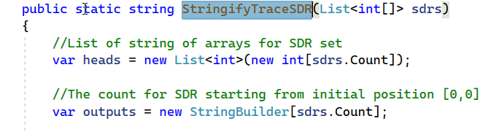
PROJECT IMPLEMENTATION | Executed Procedures
Step 1
The experiment took place considering two SDR vectors, stored the vectors in a list of strings.
Step 2
The new method is applied to create a well format of these SDR encodings.
Implement Trace SDR Method

Slide 6
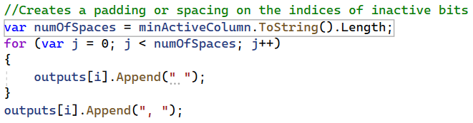
PROJECT IMPLEMENTATION | Executed Procedures
Step 3
In StringifyTraceSDR() method, while detecting index of inactive bits, a padding or spacing will replace with the indices of inactive vectors.
Implement Trace SDR Method

Slide 7
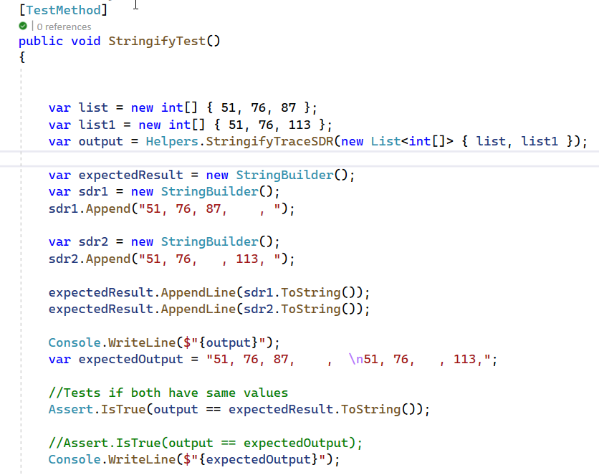
PROJECT IMPLEMENTATION | Unit test execution
A successful Unit test project was also implemented on SringifyTraceSDR method
Implement Trace SDR Method

Slide 8
CODE DEMONSTRATION
Implement Trace SDR Method Project
Project file
Helper class file
1
Helpers Class Project
Walk through the implementation in Heplers class
2
Unit test project
Show the successful unit test build
3
Result
Output of the project
4
Implement Trace SDR Method

Slide 9
THANK YOU
Implement Trace SDR Method

