Slide 1
QUICK ASSESSMENT OUTCOME
What We Have??? | What We Need???
Source Code - Java Source Code Environment Setup - NetBeans/Eclipse - MySQL - GIT HUB Requirements - Old Requirements - New Requirements - Enhancement Requirements | Planning Phase - Enhancement Requirements - Domain Model - Use Cases - Quick Planning Iteration Phase - Database Schema - Implementation Sequence Diagram - Implementation Class Diagram - Test Cases and Test Report

Slide 2
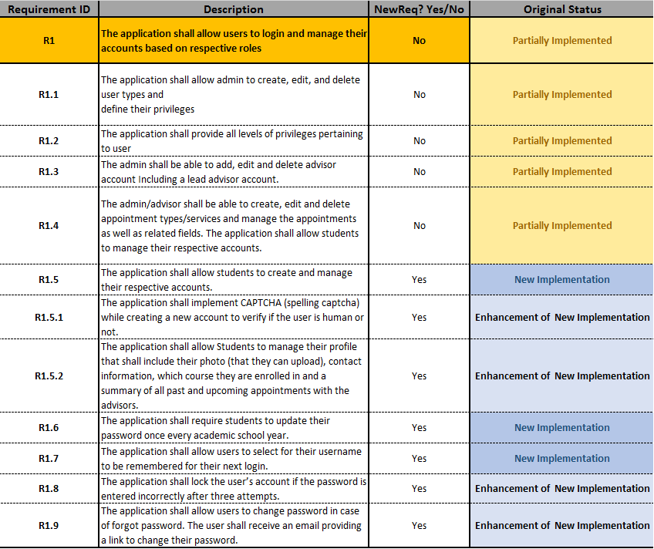
QUICK REQUIREMENT ANALYSIS

Slide 3
Planning Phase

Slide 4
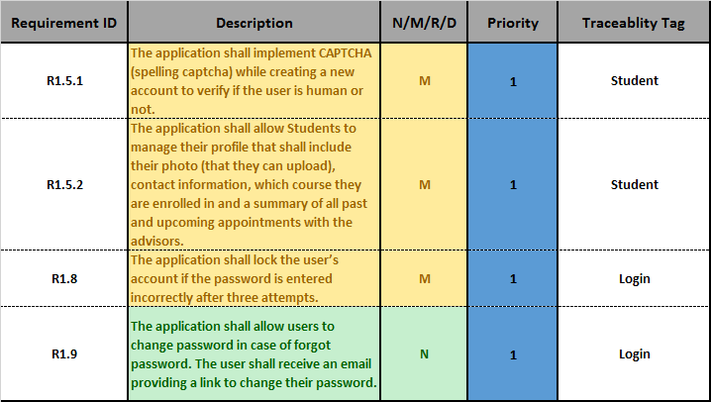
ENHANCEMENT REQUIREMENT ANALYSIS

Slide 5
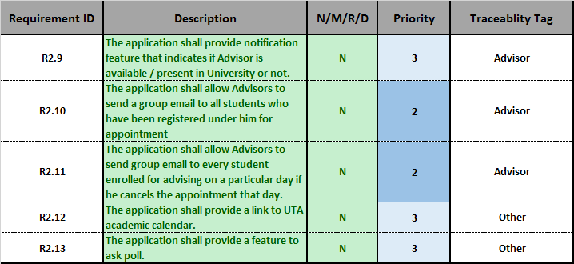
ENHANCEMENT REQUIREMENT ANALYSIS

Slide 6
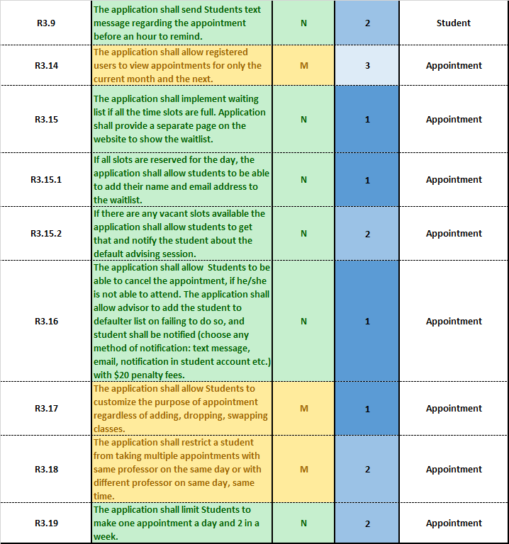
ENHANCEMENT REQUIREMENT ANALYSIS

Slide 7
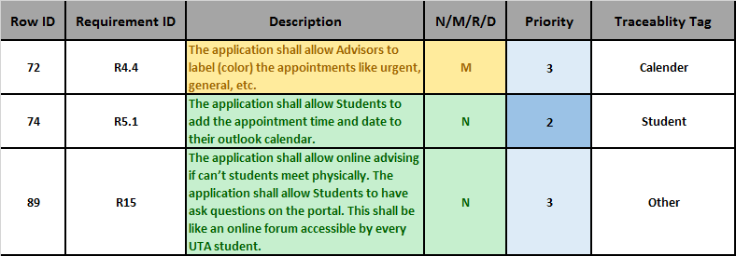
ENHANCEMENT REQUIREMENT ANALYSIS

Slide 8
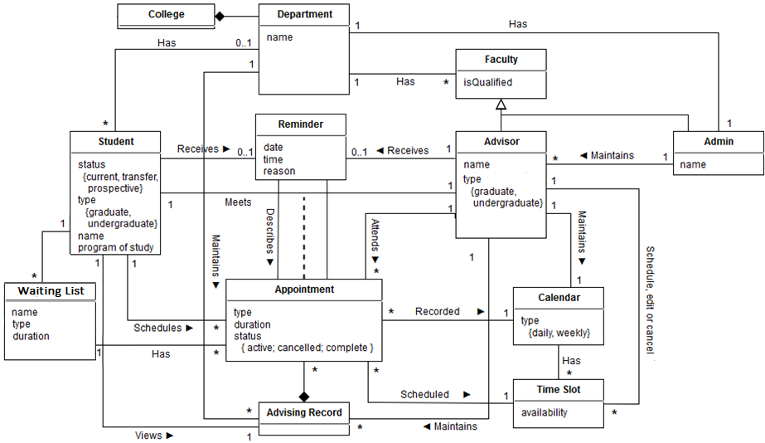

REVERSE ENGINEERED DOMAIN MODEL

Slide 9
LEGACY REQUIREMENTS AND USECASES
Legacy Requirements | Legacy UseCases
R1. The application shall allow users to login and manage their accounts based on respective roles. | UC1. Login User UC3. Logout User
R1.3. The admin shall be able to add and delete advisor account. | UC6. Create Advisor Account UC10. Delete Advisor Account
R1.4.The advisor shall be able to create, edit and delete appointment types/services and manage the appointments as well as related fields. | UC7. Create Time Slot UC8. Edit Time Slot UC9. Delete Time Slot
R2.5. The application shall allow advisors/students to view the details provided by the student while scheduling appointment. R3. The application shall allow student to schedule an appointment. | UC11. Show Appointment Details

Slide 10
LEGACY REQUIREMENTS AND USECASES
Legacy Requirements | Legacy UseCases
R3.8. The application shall allow the student to cancel a scheduled appointment. R4.1. The application shall allow advisors to cancel an appointment with a reason for cancellation. | UC12. Cancel Appointment
R6. The application shall allow students to register with the system. | UC13. Create Account
R6.3. When the user login in for the first time, the application shall prompt to change the temporary password. | UC2. Reset Password
R7. The application shall allow users to provide feedback. | UC4. Submit Feedback
R8. The application shall allow users to report bugs. | UC15. Report Bugs

Slide 11
ENHANCEMENT REQUIREMENTS AND USECASES
Enhancement Requirements | Enhancement UseCases
R1.5.1. The application shall implement CAPTCHA (spelling captcha) while creating a new account to verify if the user is human or not. | UC13. Create Student Account (M)
R1.5.2. The application shall allow Students to manage their profile that shall include their photo (that they can upload), contact information, which course they are enrolled in and a summary of all past and upcoming appointments with the advisors. | UC16. Manage Profile (N)
R1.8. The application shall lock the user’s account if the password is entered incorrectly after three attempts. | UC1. Login User(M)

Slide 12
ENHANCEMENT REQUIREMENTS AND USECASES
Enhancement Requirements | Enhancement UseCases
R1.9. Forgot password option to change password. The user should receive an email providing a link to change their password. | UC17. Forgot Password (N)
R3.14. The application shall allow registered users to view appointments for only the current month and the next. | UC11. Show Appointment (M)
R3.15. The application shall implement waiting list if all the time slots are full. Application shall provide a separate page on the website to show the waitlist. | UC18. Create Waiting List (N)

Slide 13
ENHANCEMENT REQUIREMENTS AND USECASES
Enhancement Requirements | Enhancement UseCases
R3.15.1. If all slots are reserved for the day, the application shall allow students to be able to add their name and email address to the waitlist. | UC19. Add to Waiting List (N)
R3.16. The application shall allow Students to be able to cancel the appointment, if he/she is not able to attend. The application shall allow advisor to add the student to defaulter list on failing to do so, and student shall be notified (choose any method of notification: text message, email, notification in student account etc.) with $20 penalty fees. | UC12. Cancel Appointment (M) UC20. Create Defaulters List (N) UC21. Add to Defaulters List (N) UC22. Delete from Defaulters List (N)

Slide 14
ENHANCEMENT REQUIREMENTS AND USECASES
Enhancement Requirements | Enhancement UseCases
R3.17. The application shall allow Students to customize the purpose of appointment regardless of adding, dropping, swapping classes. R3.18. The application shall restrict a student from taking multiple appointments with same professor on the same day or with different professor on same day, same time. R3.19. The application shall limit Students to make one appointment a day and 2 in a week. | UC14. Create Appointment (M)

Slide 15
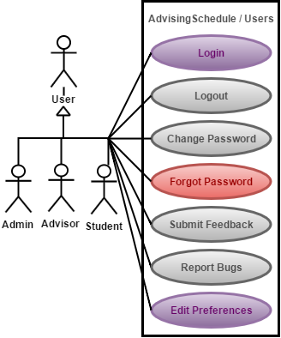
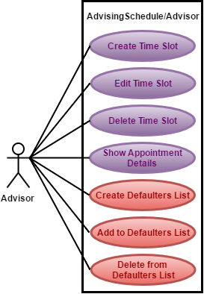
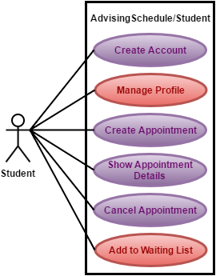
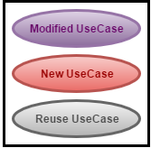
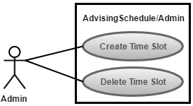
USECASE DIAGRAM

Slide 16
Iterative Phase

Slide 17
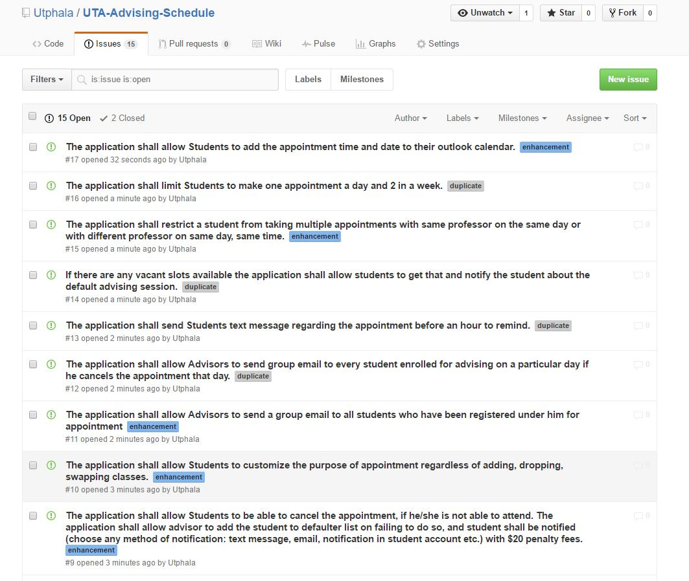
GITHUB FOR ITERATIVE PLANNING
GitHub Link for UTA Advising Schedule: https://github.com/Utphala/UTA-Advising-Schedule

Slide 18
EXPANDED ENHANCEMENT USECASE
UC13 Create Student Account (M)
Actor: Anonymous User | System: Advising Schedule
 | 0. Advising Schedule displays the welcome page.
1. TUCBW the user clicks the “Register Student” link from the menu. | 2. Advising Schedule displays the “Create Student” form.
3. The user fills out all fields on the create student form and clicks the Submit button. | 4. Advising Schedule displays the welcome page with the success message “Student account successfully created.” *
5. TUCEW the user sees the welcome page with the success message “Student account successfully created.”
Non trivial step (*)

Slide 19
EXPANDED ENHANCEMENT USECASE
UC16 Manage Profile (N)
Actor: Student | System: Advising Schedule
 | 0. Advising Schedule displays the student home page.
1. TUCBW the student clicks on “Edit Profile” link from the menu. | 2. Advising Schedule displays the “Profile” page.
3. The user fills out the fields on the profile page and clicks on Update button. | 4. Advising Schedule displays the student profile page with the success message “Profile successfully updated.” *
5. TUCEW the student sees the profile page with the success message “Profile successfully updated.”
Non trivial step (*)

Slide 20
EXPANDED ENHANCEMENT USECASE
UC1 Login User (M)
Actor: User | System: Advising Schedule
 | 0. Advising Schedule displays welcome page. A username and password field are displayed in the page header area.
1. TUCBW a user enters their username and password and clicks “Submit”. | 2. If the user authenticates correctly, Advising Schedule displays the user’s dashboard. Else if user makes 3 attempts to login with wrong password then Advising Schedule displays error message “Incorrect Username or Password. Account Locked.”*
3. TUCEW the user sees their dashboard or error message “Incorrect Username or Password. Account Locked.”.
Non trivial step (*)

Slide 21
EXPANDED ENHANCEMENT USECASE
UC17 Forgot Password (N)
Actor: User | System: Advising Schedule
 | 0. Advising Schedule displays welcome page.
1. TUCBW a user clicks “Forgot Password” link. | 2. Advising Schedule displays the forgot password page. *
3. User enters registered email id and clicks on “Submit” button. | 4. The system displays the “Temporary password has been sent to your registered email id successfully.” and the welcome page. *
5. TUCEW the user sees the success message “Temporary password has been sent to your registered email id successfully.” and the welcome page.
Non trivial step (*)

Slide 22
EXPANDED ENHANCEMENT USECASE
UC11 Show Appointment (M)
Actor: User (Student/Advisor) | System: Advising Schedule
 | 0. Advising Schedule displays the user dashboard.
1. TUCBW the user clicks on an appointment in the upcoming appointments table. | 2. Advising Schedule displays the appointment detail page for the selected appointment. *
3. TUCEW the user sees the appointment detail page for the selected appointment.
Non trivial step (*)

Slide 23
EXPANDED ENHANCEMENT USECASE
UC18 Create Waiting List (N)
Actor: Advisor | System: Advising Schedule
 | 0. Advising Schedule displays the advisor dashboard.
1. TUCBW the advisor clicks the “Create Waiting List” link from the menu. | 2. Advising Schedule displays the calendar view.
3. The advisor selects an existing appointment time slot from the options. | 4. Advising Schedule displays a modal “Create Waiting List” form. The start time is pre-filled based on which existing appointment time slot the advisor clicked on the calendar, but it is editable.
5. The advisor fills out the number of waiting list seats, and whether the waiting list is recurring and clicks the Submit button. | 6. Advising Schedule displays the calendar view with the success message “Waiting list successfully created.”*
7. TUCEW the advisor sees a success message “Waiting list successfully created.” and the calendar view.
Non trivial step (*)

Slide 24
EXPANDED ENHANCEMENT USECASE
UC19 Add to Waiting List (N)
Actor: Student | System: Advising Schedule
 | 0. Advising Schedule displays the student dashboard.
1. TUCBW a student clicks the “Add to Waiting List” link from the menu. | 2. Advising Schedule displays the calendar view, with all time slots for all advisors the student is able to meet with. The time slot will show the advisor name and show all the time slot that is taken.
4. The student clicks on an unavailable time slot with the desired advisor. | 6. Advising Schedule displays a modal “Waiting List” form. Advisor, student, and start time are pre-filled and un-editable.
7. The student selects an advising task, optionally enters notes and clicks the Submit button. | 8. Advising Schedule displays the waiting list page on student dashboard with the newly added waiting list appointment and displays a success message “Successfully added to waiting list.” *
9. TUCEW the student sees the waiting list page on student dashboard and a success message “Successfully added to waiting list.”
Non trivial step (*)

Slide 25
EXPANDED ENHANCEMENT USECASE
UC12 Cancel Appointment (M)
Actor: User (Advisor/Student) | System: Advising Schedule
 | 0. Advising Schedule displays the appointment details page for a selected appointment.
1. TUCBW user clicks the “Cancel Appointment” button. | 2. Advising Schedule displays the cancellation modal.
3. The user enters an appropriate reason for cancellation and selects the “Cancel Appointment” button. | 4. Advising Schedule displays the user dashboard page with the appointment removed and the “Appointment canceled” success message. *
5. TUCEW the user sees the dashboard with the appointment removed and the “Appointment canceled” success message.
Non trivial step (*)

Slide 26
EXPANDED ENHANCEMENT USECASE
UC20 Create Defaulter List (N)
Actor: Advisor | System: Advising Schedule
 | 0. Advising Schedule displays the advisor dashboard.
1. TUCBW an advisor clicks the “Create Defaulter Link” link from the menu. | 2. Advising Schedule displays a modal “Defaulter List” form. Advisor, penalty, time are pre-filled and un-editable.
3. The advisor enters the student details and clicks on “Submit” button. | 4. Advising Schedule displays the defaulter’s list page on advisor dashboard with the newly added defaulter details and displays a success message “Student added to defaulters list successfully.”*
.5 TUCEW the student sees the defaulter list page on advisor dashboard and a success message “Student added to defaulters list successfully.”
Non trivial step (*)

Slide 27
EXPANDED ENHANCEMENT USECASE
UC21 Add to Defaulter List (N)
Actor: Advisor | System: Advising Schedule
 | 0. Advising Schedule displays the advisor dashboard.
1. TUCBW an advisor clicks the “Add to Defaulter List” link from the menu. | 2. Advising Schedule displays the Add to Defaulter List form.
3. The advisor enters the details and clicks on Submit button. | 4. Advising Schedule displays the updated Defaulter List page and a success message “Student added to the Defaulter List successfully.” *
5. TUCEW the advisor sees the updated Defaulters List page and success message “Student added to the Defaulter List successfully.”
Non trivial step (*)

Slide 28
EXPANDED ENHANCEMENT USECASE
UC22 Delete from Waiting List (N)
Actor: Advisor | System: Advising Schedule
 | 0. Advising Schedule displays the Defaulter List page.
1. TUCBW the advisor clicks the “Delete” option for a student in the Defaulter List table. | 2. Advising Schedule displays a confirmation message asking whether the advisor really wants to delete the advisor.
3. Admin clicks “Yes” to continue deleting the student. | 4. Advising Schedule displays the updated Defaulter List page with the student removed and the success message “Student removed from the Defaulter List successfully.” *
5. TUCEW the admin sees a success message “Student removed from the Defaulter List successfully” and the updated advisor table.
Non trivial step (*)

Slide 29
EXPANDED ENHANCEMENT USECASE
UC19 Create Appointment (M)
Actor: Student | System: Advising Schedule
 | 0. Advising Schedule displays the student dashboard.
1. TUCBW a student clicks the “Schedule Appointment” link from the menu. | 2. Advising Schedule displays the calendar view, with all time slots for all advisors the student is able to meet with. The time slot will show the advisor name and show whether the slot is available or taken.
3. The student clicks on an available time slot with the desired advisor. | .4 Advising Schedule displays a modal “Schedule Appointment” form. Advisor, student, and start time are pre-filled and un-editable.
5. The student selects and advising task, optionally enters notes and clicks the Submit button. | 6. Advising Schedule displays the student dashboard with the newly added appointment and displays a success message “Appointment scheduled.” or error message “Exceeded number of appointments.”*
7. TUCEW the student sees the success message “Appointment scheduled.” or error message “Exceeded number of appointments.”
Non trivial step (*)

Slide 30
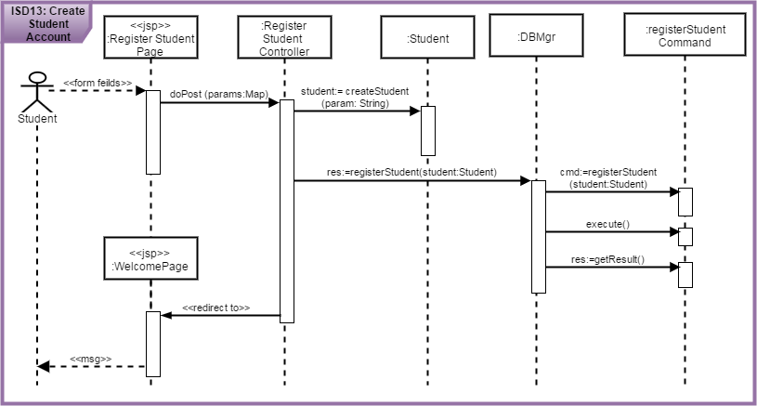
IMPLEMENTATION SEQUENCE DIAGRAM (ISD/DSD)
UC13 Create Student Account (M)
Command Pattern
Controller Pattern

Slide 31
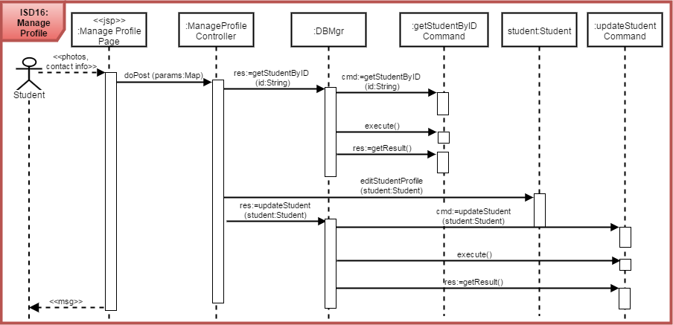
IMPLEMENTATION SEQUENCE DIAGRAM (ISD/DSD)
UC16 Manage Profile (N)

Slide 32
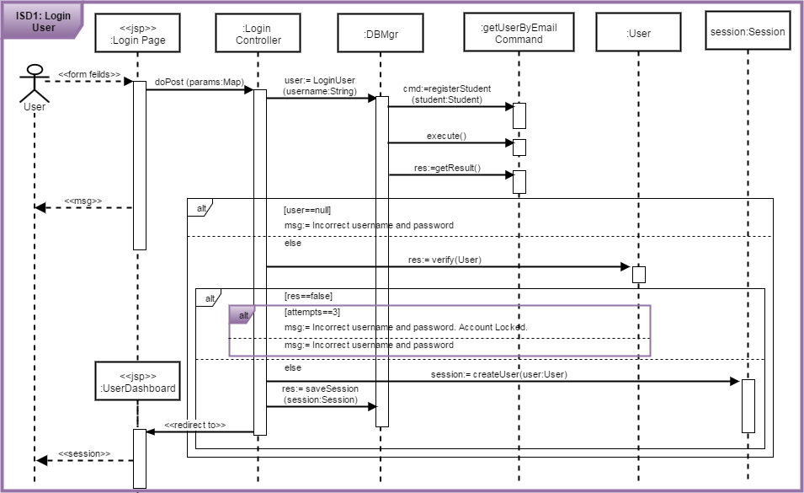
IMPLEMENTATION SEQUENCE DIAGRAM
UC1 Login User (M)
Expert
Pattern

Slide 33
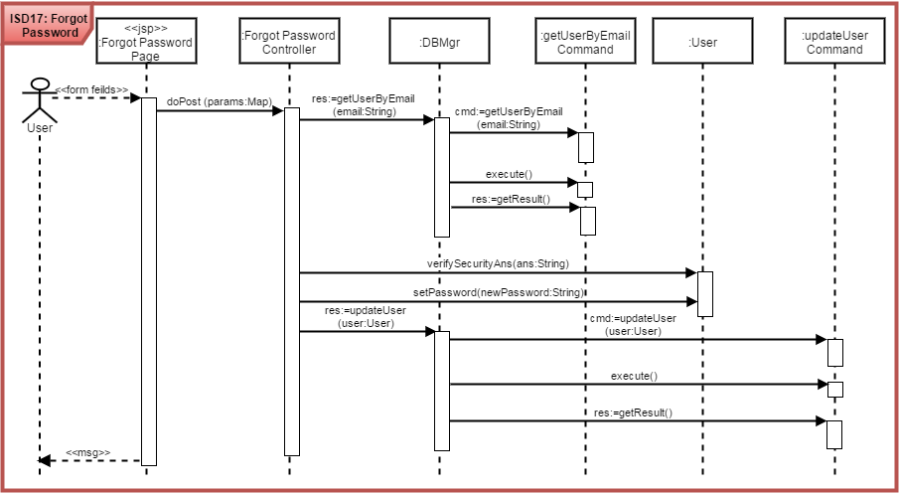
IMPLEMENTATION SEQUENCE DIAGRAM (ISD/DSD)
UC17 Forgot Password (N)

Slide 34
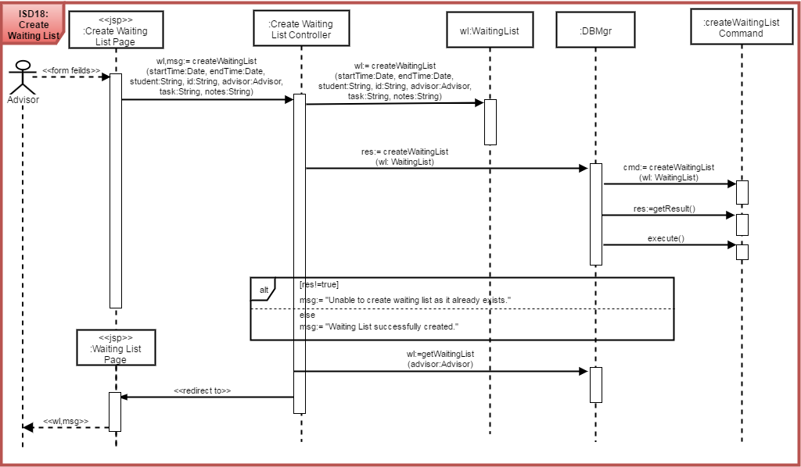
IMPLEMENTATION SEQUENCE DIAGRAM (ISD/DSD)
UC18 Create Waiting List(N)
Creator
Pattern

Slide 35
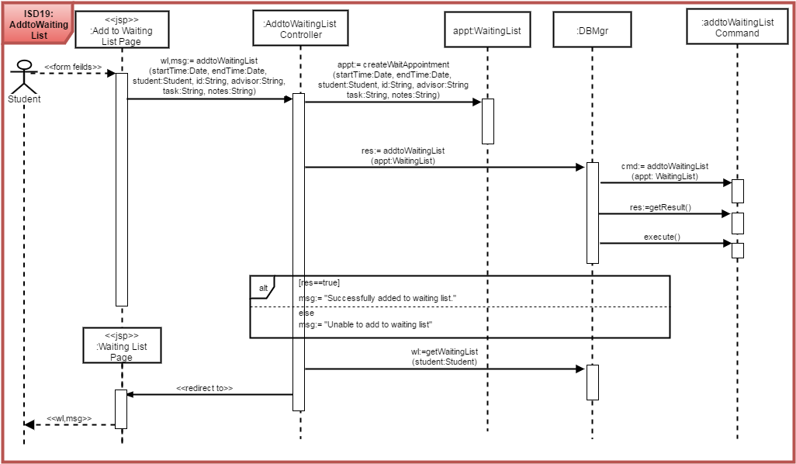
IMPLEMENTATION SEQUENCE DIAGRAM (ISD/DSD)
UC21 Add to Waiting List(N)

Slide 36
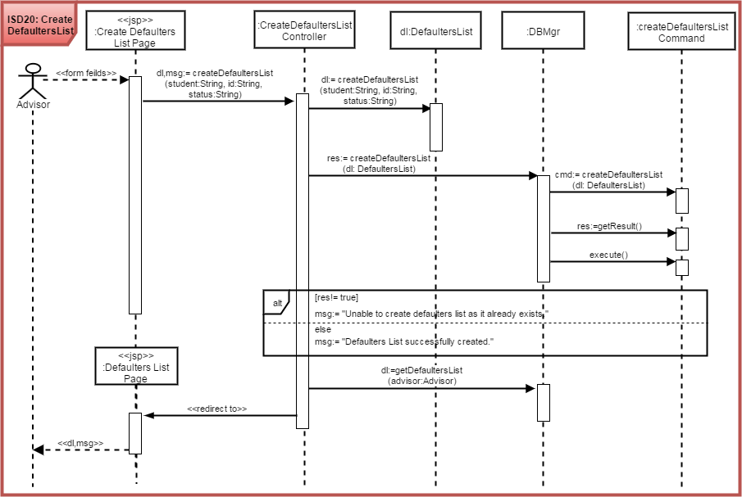
IMPLEMENTATION SEQUENCE DIAGRAM (ISD/DSD)
UC20 Create Defaulters List(N)

Slide 37
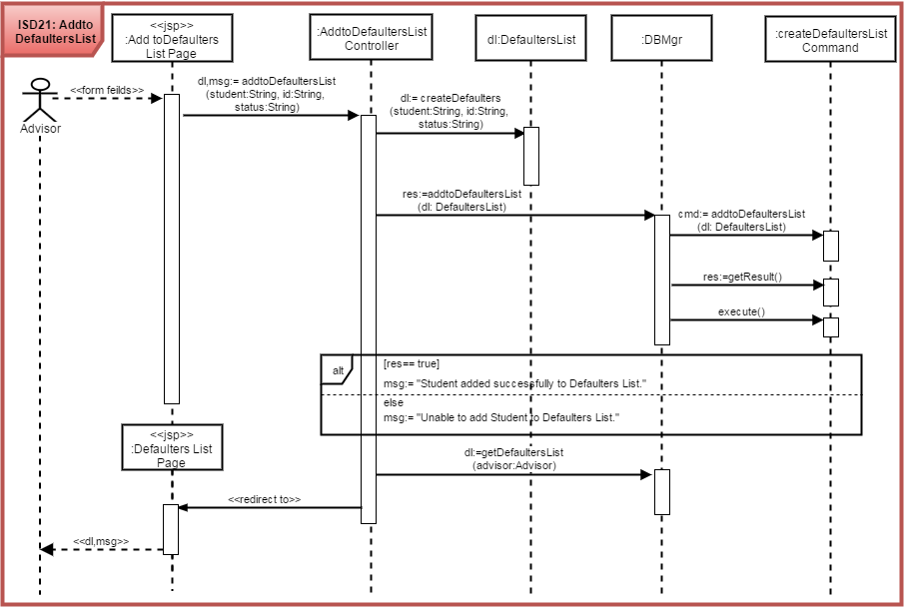
IMPLEMENTATION SEQUENCE DIAGRAM (ISD/DSD)
UC21 Add to Defaulters List(N)

Slide 38
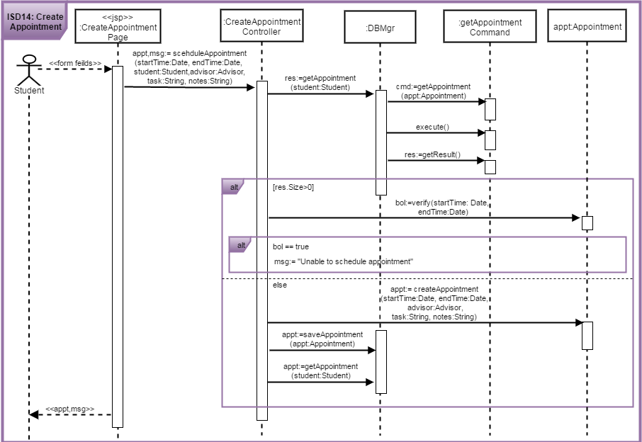
IMPLEMENTATION SEQUENCE DIAGRAM (ISD/DSD)
UC13 Create Appointment(M)

Slide 39
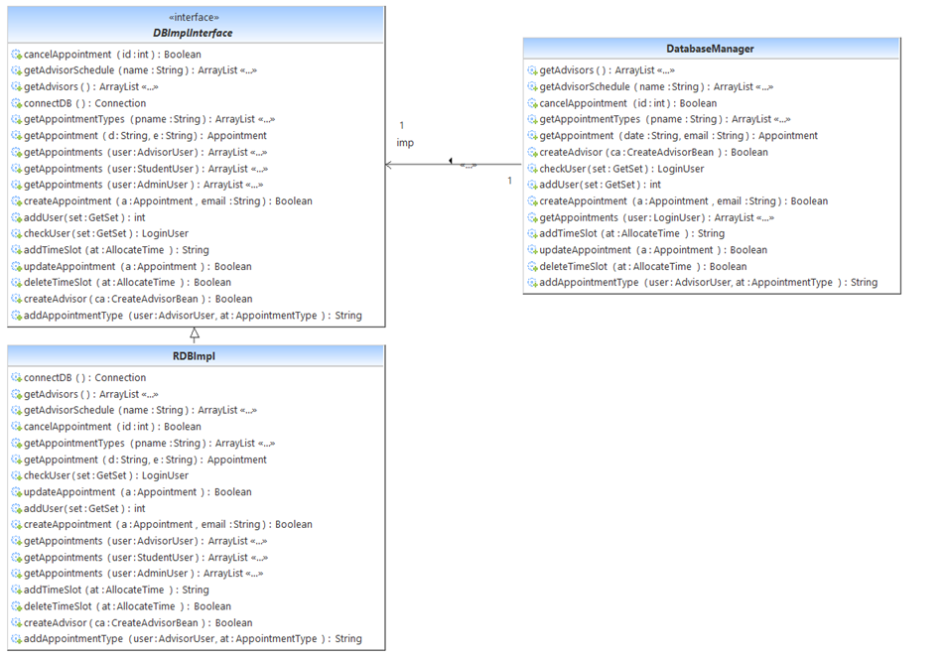
IMPLEMENTATION CLASS DIAGRAM (ICD/DCD)
Bridge Pattern

Slide 40
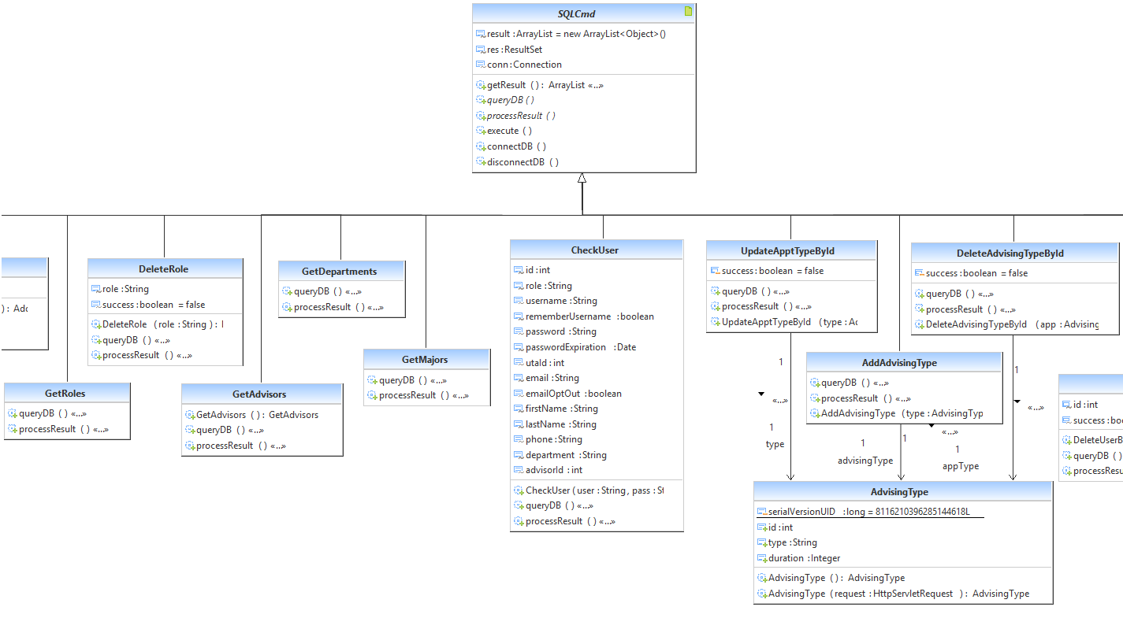
IMPLEMENTATION CLASS DIAGRAM (ICD/DCD)

Slide 41
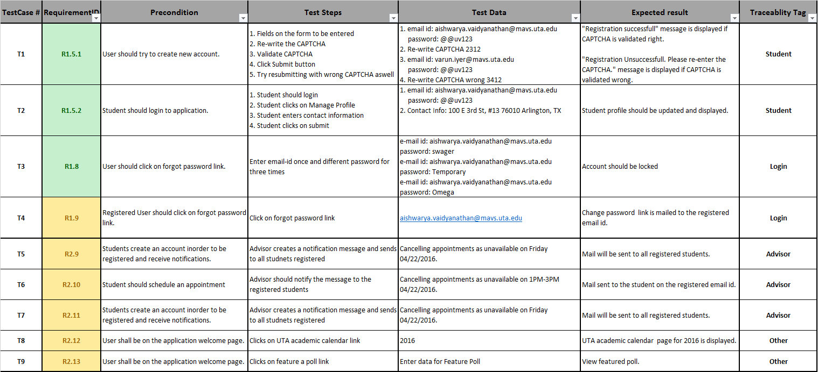
TEST CASES

Slide 42
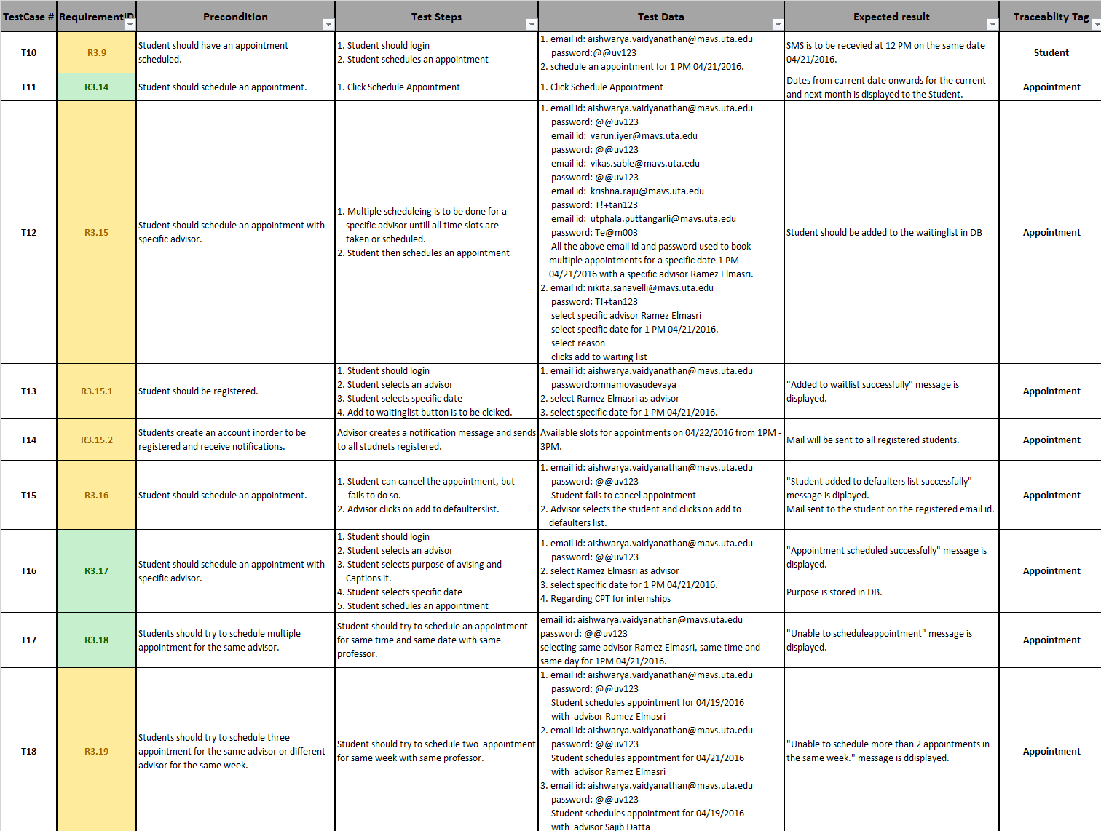
TEST CASES

Slide 43
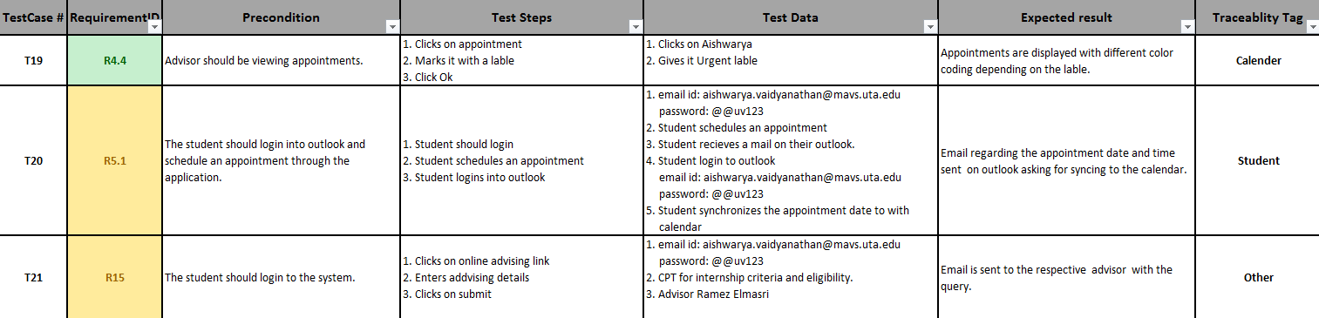
TEST CASES

Slide 44
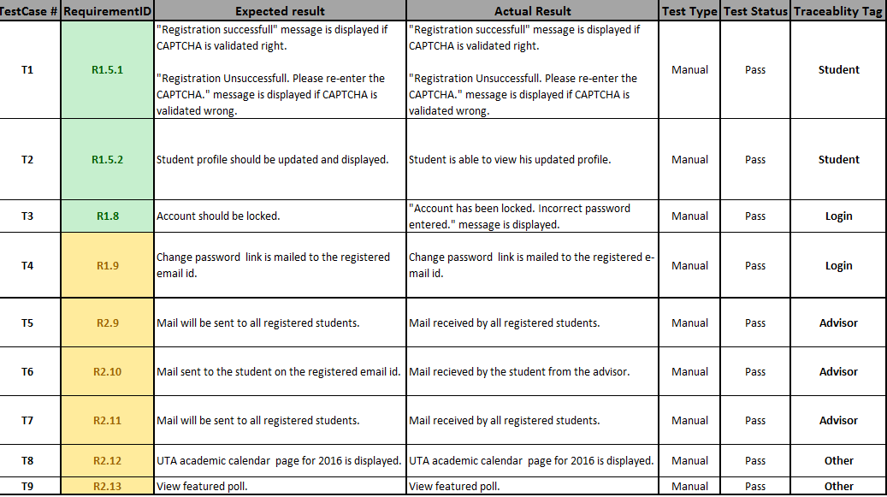
TEST REPORT

Slide 45
TEST REPORT

Slide 46
TEST REPORT

Slide 47
N-PROCESS MODEL ANALYSIS
Commitment Driven Approach:
Velocity driven approach required historical data for planning, so team chose commitment driven approach.
Identified requirements as reused, modified and new
Derived relevant artifacts for all the requirements
Assigned requirements priorities critical, major, minor
Tasks of high priorities were chosen first
Estimated effort for each task to be accomplished
Discussed within the team and assigned tasks
Tasks were assigned iterations based on how much every individual in the team agreed to commit.
Tasks accomplished were discussed at the end of each iteration
Effort estimation was performed and tasks unaccomplished were reworked upon again for every iteration
Each iteration was 1 week duration (real time it is 2 – 4 weeks)

Slide 48
QUESTIONS???

