Slide 1


Facebook Web Scrapper

Slide 2
Table of Contents
01
Introduction
02
Scope
03
Technology Stack
04
Solution Architecture
05
Workflow and Data Captured

Slide 3
Introduction
What is Web Scraping -
Web Scraping (also termed Screen Scraping, Web Data Extraction, Web Harvesting etc.) is a technique used to extract large amounts of data from websites whereby the data is extracted and saved to a local file in your computer or to a database in table (spreadsheet) format.
Use of Web Scraping -
Data plays a crucial role in business hence it’s important to have the right data in the right format for analysis and further use
This collected data can be used in various ways like:
For Marketing: Lead Generation
A web scraper can be used to gather contact details of businesses or individuals from websites like yellowpages.com etc. Details like email address, phone, website URL etc. can be easily extracted using a web scraper.
For Businesses / eCommerce:
Market Analysis, Price Comparison, Competition Monitoring
Companies catering products or services related to a specific domain need to have a comprehensive data of similar products and services which appear in the market every day. A Web Scraper software can be used to keep a constant watch on this data. You can get all the required information from a variety of sources at the click of a button
For Research
Scrape hospital/clinic websites to build a catalog of health physicians including their contact details
Scrape reviews of products and places/hotels/restaurants
Potential customers

Slide 4
Scope
Phase 1 - To build a reusable scrapper for Facebook, organize the collected data in proper format
Phase 2 – Implementation of data analytics for effective marketing and customer reach
1) Facebook Analytics:
You can see details of reach and engagements on posts and comments on Facebook Pages, as well as statistics of the people who like your page and its post.
2) Evaluation of Post / Event:
Evaluate the users social support as positive, negative through reactions
3) Sentiment classification/Sentiment Analysis and Opinion Mining:
Understanding their sentiments through post /comments can help us mine knowledge and capture users' ideas without necessarily going through all data, which will save us a huge amount of time.
4) Segmentation of audiences and personalized advertisements for finding potential customers
5) Have a real-time overview of people’s requirements of products /services based on comment discussions/ post

Slide 5
Technology Stack
Technologies used:
Python 3
Scrapy: Scrapy is a fast-high-level web crawling and web scraping framework, used to crawl websites and extract structured data from the web pages.
Challenges faced:
There were challenges in terms of technicality like:
1) Login into website form
2) access to Facebook data,
3) dealing with JavaScript, ajax calls.
4) With Selenium, Facebook denied access to more data from their server within few pages.

Slide 6
Technology Stack (continued…)
WHY SCRAPY:
The biggest feature is that it is built on Twisted, an asynchronous networking library, which makes the speed and performance of scraping better.
Some websites like Facebook will be behind a login wall. Scrapy has built in form handling which you can setup to login to the websites before beginning your scrape.
Scrapy is fault-tolerant, it lets you handle errors gracefully without interrupting the scraping if one request fail.
Scrapy can do multiple requests at the same time being asynchronous which allows scraping runs to be much faster.
Scrapy enables you to easily post-process any data you find. (it may have extra line breaks, extra commas in random places). Scrapy will let you handle these cases in a straightforward fashion.
Facebook site:
Using Mobile-optimized website’ m.facebook.com which doesn’t use any AJAX using Scrapy.

Slide 7
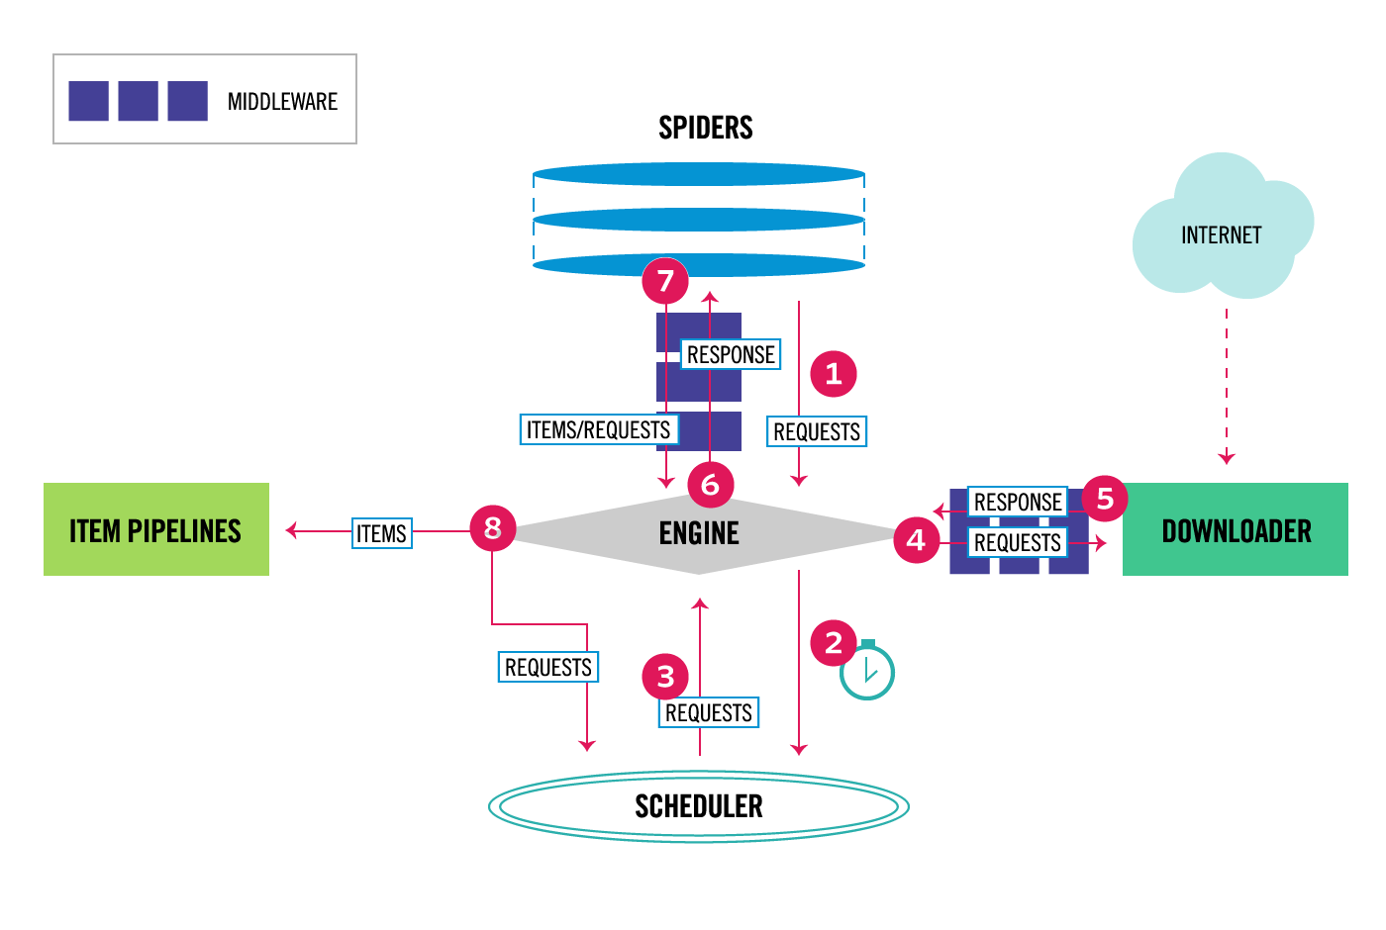
Solution Architecture

Slide 8
Workflow and Data Captured
1) Credentials Input:
Feed credentials (email id and password) to Scrapy Form Request ,it will fill the form with credentials in start URL and returns home page.
2) Crawl through page and new pages if any to fetch contents using Scrapy Request function.
3) Fetch the scrapped data from response which request function sends to callback functions .

Slide 9


THANK YOU
ADDRESS
NITOR INFOTECH INC.
120 W Golf Rd Ste 210, Schaumburg IL 60195, USA
GLOBAL DELIVERY CENTRE PUNE, INDIA
Rhine, Block 1.5, Embassy Tech Zone, Rajiv Gandhi InfoTech Park, Hinjewadi Phase - II, Pune, Maharashtra 411057
WEBSITE
www.nitorinfotech.com

