Slide 1

EDA – BIKE SHARING DEMAND ANALYSIS
Sunday, 27 July 2025
Aishwarya kumar singh
Intern – NEXTHIKES IT SOLUTIONS
(Microsoft Excel, Power Query)

Slide 2
PROJECT INSIGHTS
01
02
03
Data acquisition & Understanding
Understanding the Problem statement
Getting the raw/uncleaned data
Initial exploration
Data transformation & cleaning
Handling inconsistent data
Data corrections
Normalizing & scaling
Visualizing & reporting
Pivot tables & charts
Correlations & key matrices
Recommendations/Conclusion

Slide 3
Data Acquisition
As an intern the data was acquired from nexthikes IT solutions
IT contained three raw/uncleaned data sheets about bike sharing demand analysis. These sheets have the following names:
dataset_1.xlsx
dataset_2.xlsx
dataset_3.xlsx
These files were uncleaned, so first step was to understand them while acquiring and then clean them.
To do this, the first step was to understand the problem statement.
PROBLEM statement:
“Analyzing bike-sharing data helps understand how weather, time, and holidays affect bike rentals. This project uses Excel skills to clean, combine, and study datasets to find useful patterns that improve business planning. Organized data leads to better decisions faster”

Slide 4
Initial Exploration
The exploration started with three files.
First sheet (dataset_1.xlsx):
This file was cleaned by reading the data. steps involved in it are:
Converted the data to a table and then applied filter on first column ‘instant’.
Checked for blank and duplicate data in the sheet with conditional formatting.
This sheet was cleaned by this step since there were no duplicates and blank data was found.
The sheet was named Cleaned_DS_1. This was saved parallelly in the same workbook.
Project was saved with the name – project-1-internship.xlsx

Slide 5
Initial Exploration
second sheet (dataset_2.xlsx):
The entire sheet was copied into the project workbook as a new sheet with same name. Blank and duplicate entries were checked in it using conditional formatting and formulas. This sheet had 11 blank entries and no duplicate data.
Blank entries were present in atemp column. There were different approaches to clean this data but best was to fill entries in the blank cells. The blank cells in the column were filled using median formula
=MEDIAN(IF(ISNUMBER(dataset_2!C$2:C$611), dataset_2!C$2:C$611))
Also, the sheet was applied with filters on the column ‘instant’ having smallest to largest entry, after it was converted to an excel table with all headers having filters activated. The sheet was saved in the same workbook as CLEANED_DS_2.XLSX
THIRD SHEET (DATASet_3.xlsx):
This sheet contains large set of data match that of both previous sheets. The count of the table starts from instant id 611 and reaches to 1000.
Now since there are no other discrepancy, duplicity, or blank data present this sheet is now completed with initial exploration eda process. Sheet is saved in the same workbook with the name Cleaned_DS_3.xlsx
The sheet was converted to excel table and filter was added to instant column.

Slide 6
Data Transformation
MERGING CLEANED DATASET FILES:
The cleaned sheets were merged using POWER QUERY merge and append options.
Latest file was named DS-1-2-merged having clean data
Now, this merged file was applied with filters on instant column from smallest to largest entries
This is the cleaned version of the merged sheets
The latest sheet is merged/appended with Cleaned_DS_3 and gives the final sheet as DS-1-2-3-appended
This all is done using power query

Slide 7
Data Corrections & Handling Inconsistencies
The sheet was now removed with inconsistencies. Those involve:
Headers were renamed
Normallized data was converted to generalized data
Columns – Season ,Year, Month, Hour, IsHoliday, Weekday, WeatherCondition, ScaledTemperature, RelativeHumidity, BeaufortWindspeed were eirhter created or updated with generalized data.
Sheet was filled with generalized data using excel formulas. Also, conditional formatting was applied to make data appear appealing.

Slide 8
Formula implementation on columns
Season - Conditional Excel formula applied based on the date to extract the season based on the month of the year.
Year – TEXT formula to get the year out of DateOfEntry column
Month – Same as like YEAR is done
IsHoliday – If True is found in the entire column of IsHoliday it is converted to YES otherwise it is a NO
Weekday – Using CHOOSE formula to convert the numerical values to actual Weekday using DateOfEntry column
WeatherCondition – This is calculated by dividing a year in 4 seasons and 12 months and then based on generalized formula it is achieved in string format to describe the weather condition of a season.
ScaledTemperature – As like WeatherCondition this is also calculated similarly with a generalized formula and values.
RelativeHumidity – This is calculated based on the normalized value which is converted to generalized value using a formula of conversion.
BeaufortWindspeed – This is used column to get the windspeed of actual realistic values using a generalized formula.

Slide 9
Visualization, pivot tables, charts, & correlations
Based on already cleaned and completed sheet DS-1-2-3-appended, there are different pivot tables and other sheets created in the same work book.
Date-weather-pt : Date and weather relation in a pivot table
Date-wise-riders-pt: Riders count based on the date
Humidity-total-riders-pt: Total Riders based on humidity level
Riders-by-month-and-BWS-pt: Riders by Windspeed and month in combination
Weather-wise-riders-pt: Riders based on the weather condition
Riders-sum-against-weekdays-pt: Riders total sum based on week days
Riders-wd-hc-pt: Sum of total riders based on weekdays and humidity condition
Miscellaneous: Sheet for Miscellaneous functions in excel
Correlation-matrix-and-ds: Correlation matrix and descriptive statistics is present here
Vlookup: Applying Vlookup on the data to get minimal required data from a large data
Index-match: Applying index match on the data to get minimal required data from a large data
Forecasting: Forecasting sheet as a part of excel functions

Slide 10
Normalized to Generalized Weather Conditions
Season Weather Situation Representation
Season | Normalized Code | Weather Condition
Winter | 1 | Clear Sky
 | 2 | Foggy / Misty
 | 3 | Light Snow / Rain
 | 4 | Western Disturbance
Summer | 1 | Clear / Sunny
 | 2 | Hot & Humid
 | 3 | Dust Storm / Loo Winds
 | 4 | Pre-Monsoon Thunderstorm
Monsoon | 1 | Heavy Rainfall
 | 2 | Intermittent Showers
 | 3 | Overcast & Humid
 | 4 | Thunderstorms with Rain
Autumn | 1 | Clear
 | 2 | Dry & Breezy
 | 3 | Atmospheric Haze
 | 4 | Chilly Dusk

Slide 11
Formula Matrix
Season-WeatherSituation-Temperature Representation
Season | Weather Situation | ScaledNormalizedTemperature Calculation
Winter | Clear Sky | ROUND(10 + (dataset_1!J2 / 0.46) * (25 - 10), 1 )
 | Foggy / Misty | ROUND(0 + (dataset_1!J2 / 0.46) * (15 - 0), 1)
 | Light Snow / Rain | ROUND(-5 + (dataset_1!J2 / 0.46) * (10 - (-5)), 1 )
 | Western Disturbance | ROUND(5 + (dataset_1!J2 / 0.46) * (20 - 5), 1)
Summer | Clear / Sunny | ROUND(30 + (dataset_1!J2 / 0.46) * (53 - 30), 1)
 | Hot & Humid | ROUND(26 + (dataset_1!J2 / 0.46) * (45 - 26), 1)
 | Dust Storm / Loo Winds | ROUND(35 + (dataset_1!J2 / 0.46) * (50 - 35), 1)
 | Pre-Monsoon Thunderstorm | ROUND(28 + (dataset_1!J2 / 0.46) * (48 - 28), 1)
Monsoon | Heavy Rainfall | ROUND(22 + (dataset_1!J2 / 0.46) * (28 - 22), 1)
 | Intermittent Showers | ROUND(24 + (dataset_1!J2 / 0.46) * (32 - 24), 1)
 | Overcast & Humid | ROUND(25 + (dataset_1!J2 / 0.46) * (33 - 25), 1)
 | Thunderstorms with Rain | ROUND(23 + (dataset_1!J2 / 0.46) * (30 - 23), 1)
Autumn | Clear | ROUND(20 + (dataset_1!J2 / 0.46) * (30 - 20), 1)
 | Dry & Breezy | ROUND(18 + (dataset_1!J2 / 0.46) * (28 - 18), 1)
 | Atmospheric Haze | ROUND(16 + (dataset_1!J2 / 0.46) * (26 - 16), 1)
 | Chilly Dusk | ROUND(15 + (dataset_1!J2 / 0.46) * (25 - 15), 1)
Temperature Formula Mathematical Explanation
Formula
Generalized Temperature = T_{min} + (Normalized Value / Maximum Normalized Value) X (T_{max} - T_{min})
Part | Description
dataset_1!J2 | Normalized temperature value (e.g., between 0 and 0.46) present in dataset_1
0.46 | The normalized value that is scaled to a proportion of full range between 0 and 1 which is present in sheet dataset_1. This is the max value present there.
T_{min} | Minimum value of temperature of target range in actual temperature scale. Here it is based on season and the weather situation separately. Each season has 4 different weather situations ranging from 1 to 4
T_{max} | Maximum value of temperature of target range in actual temperature scale. Here it is based on season and the weather situation separately. Each season has 4 different weather situations ranging from 1 to 4
ROUND(..., 1) | This rounds the calculationn of tempearture to 1 decimal place for better readability

Slide 12
Dashboard
Dashboard is created using Pivot Tables, Pivot Charts, Slicers, etc.
Pivot Charts include:
Stacked Column Chart
Area Charts
Line Charts, etc.
On weekdays the demand seems to be higher.
Temperature and Beaufort Windspeed correlate efficiently

Slide 13
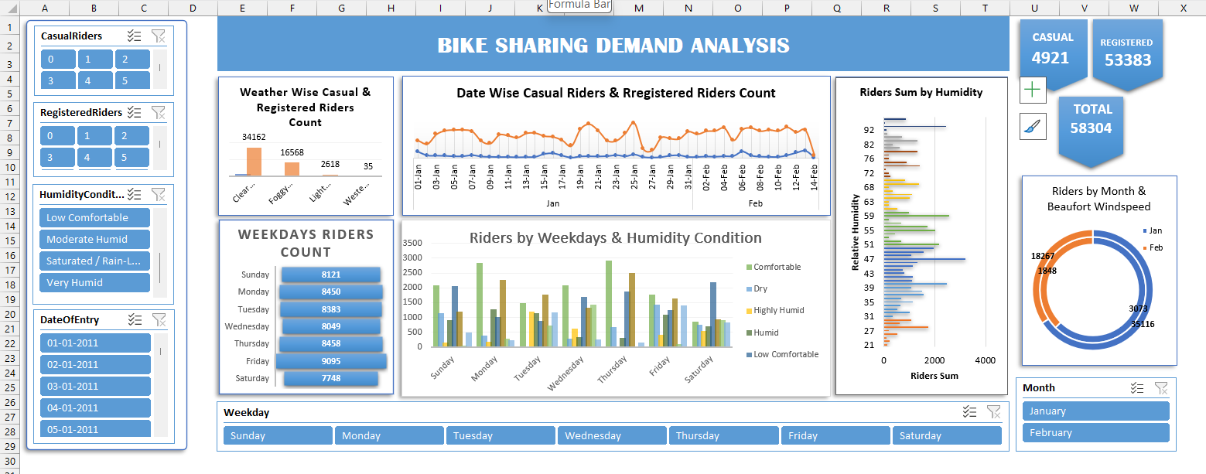
Dashboard

Slide 14
Conclusion
The project was completed successfully, understanding the key concepts and features of MS EXCEL to create an interactive and scalable dashboard which shows the seasonal, weather, and time based bike demands.
This also helps in understanding the pattern of the requirements.
The report suggests the key efficient pointers in decision making which helps in keeping things at place and also plan for the future needs and requirements of the Market.

Slide 15
THANKYOU

