Slide 1
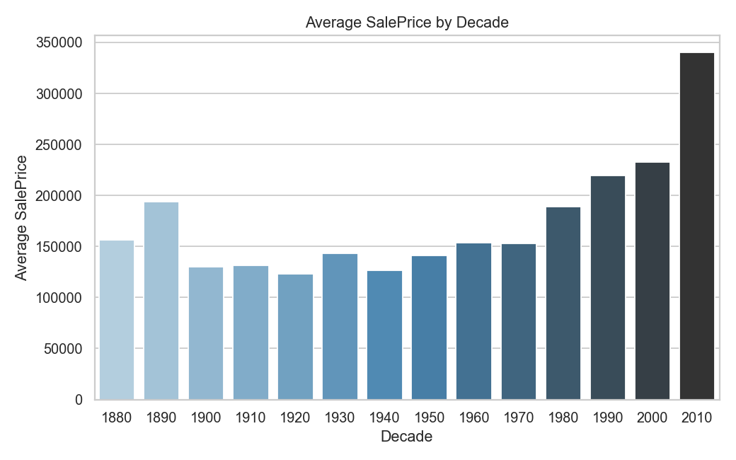
EDA FOR REAL ESTATE PRICING
Aishwarya Kumar Singh
Intern – Nexthikes IT Solution
Sunday, October 05, 2025

Slide 2
Agenda
1
2
3
4
5
Introduction
Data Quality Assurance
Reproducible Cleaning Pipeline
Exploratory Data Analysis (EDA) & Timelines
Summary

Slide 3

Introduction
The housing market is influenced by a wide range of factors such as location, property size, amenities, construction year, and neighborhood characteristics. To make informed decisions—whether for pricing, investment, or policy planning—it is essential to analyze housing data systematically.

Slide 4

Primary goals
Loading the Data
Cleaning the Data
Univariate Analysis
Bivariate Analysis
Multivariate Analysis
Feature Engineering
Market Trends & Historical Pricing
Consumer Preferences & Amenities

Slide 5
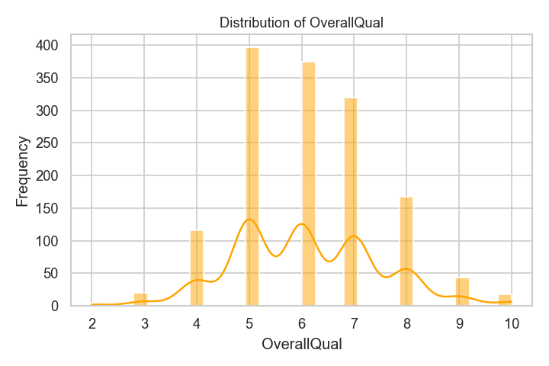
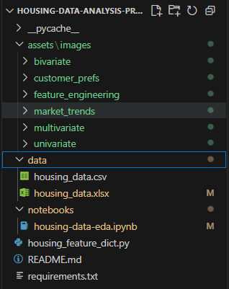
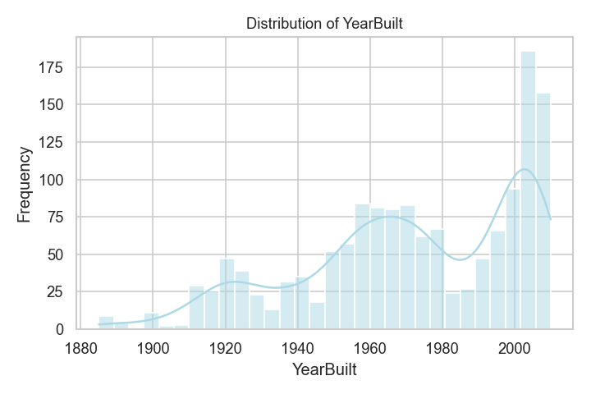
Folder Structure & Analysis Report Screenshots
Folder Structure

Slide 6





Major Steps – EDA Workflow
PRE-EDA Work
Load Data and convert the dataset to Excel(xlsx) format from CSV format
Preview the Dataset
Using head() and tail(), one can preview the data and get idea what is all that is included in the dataset
Data Summary
Data summary can be viewed using info() method
Data Dictionary
This helps in adding the reference dictionary for features used in HOUSING DATA
Checking Missing Values
It will check the missing values in features with percentage.
Continue...

Slide 7
Major Steps – EDA Workflow
Data Cleaning with Pandas
Data cleaning include removing duplicates and other essential cleaning steps. There is method of drop_duplicates() to drop the duplicates
Clean Dataset & Handle Outliers
This ensures data quality by eliminating missing values, removing, and addressing any anomalies or inconsistencies in the dataset.
Analysis Methods
Perform Univariate, Bivariate, and Multivariate Analysis
Feature Engineering
Introduces new variables that might enhance the model's ability to predict house prices
Market Trends & Historical Pricing
Analyze the dataset temporally, looking at trends in house prices over different periods
In continuation …

Slide 8
Folder Architecture Model
Conversion of format
Convert the file from CSV to XLSX format to avoid future xlsxwriter or pandas method issues
Here when format is converted the name of the file becomes housing_data.xlsx
In this workbook we will create different worksheets from python library code. We will not do anything manually in the workbook or worksheet.
Code Modularity
Constants declared at the top of the notebook code.
Folders will be created for different work purpose such as assets, data, notebooks
These are used to keep things clean and readable

Slide 9
Tools and Libraries​
Data Manipulation
Visualization
Data Cleaning
Pandas 🐼
NumPy 🔢 – The core numerical computing library in Python, providing fast array operations, mathematical functions, and the foundation for scientific computing. ​
Matplotlib 📊 – A versatile plotting library in Python that enables the creation of a wide range of static, animated, and interactive visualizations.
Seaborn 🎨 – A statistical data visualization library built on Matplotlib, making it easy to create attractive and informative plots with minimal code. ​
Pandas 🐼 – A powerful Python library for data manipulation and analysis, offering intuitive DataFrame structures to clean, transform, and explore datasets efficiently.
Styling
openpyxl 📘 – A Python library to read, write, and style Excel (.xlsx) files, enabling automated reporting, formatting, and multi‑sheet data exports directly from code.

Slide 10
Analysis and Graphs
Univariate Analysis
Explored single features’ distributions, central tendency, and spread using histograms, bar plots, and boxplots to detect skewness and outliers.
Bivariate Analysis
Examined relationships between two variables with scatter plots, correlation heatmaps, and grouped bar charts to identify trends and associations.
Multivariate Analysis
Analyzed interactions among multiple features using pair plots, heatmaps, and 3D scatter plots to uncover deeper patterns and dependencies.
Outlier Detection
Identified extreme values through boxplots and IQR whiskers, then capped or adjusted them to prevent skewed insights in downstream analysis.
Missing Value Analysis
Assessed missingness patterns with heatmaps and bar charts, then applied imputation or feature dropping strategies for reliable, consistent datasets.

Slide 11
Workbook & Plot/Graphs using Python Code
Housing Data
Code overwrote the main sheet with cleaned DataFrame, applied formatting, adjusted column widths, and saved reliable, analysis‑ready dataset.
Outlier Report
Code calculated outliers using IQR, logged capped values into a new sheet, and styled table for transparent stakeholder reporting.
Excel workbook and its worksheets were created using code, with each sheet uniquely capturing specific analysis results, ensuring automation, transparency, and reproducibility throughout.
Excel sheets were directly updated in the workbook once any analysis is completed and workbook can be reopened to see the sheets those were added.
To see the graphs and the worksheets, one needs to wait for generation of the images(plots/graphs) and the workbook. Once done, they can be seen in the respective folders and workbook.
Dropped Features
Code tracked columns removed due to excessive missingness, wrote them into a dedicated sheet, ensuring auditability and reproducibility.
Missing Feature Analysis
Code computed missing percentages per feature, exported results into a styled sheet, enabling quick visualization of data quality issues.
Code Importance
Code helps in automating the tasks. All sheets were created dynamically using python code, which shows data can be analyzed much better way using code, rather than doing it manually to adjust in the workbook.

Slide 12



FUTURE STEPS
Build Predictive Models
Incorporate the External Economic Indicators
Implement logging to track the outcomes and a step-by-step record.
Linear Regression
Random Forest

Slide 13
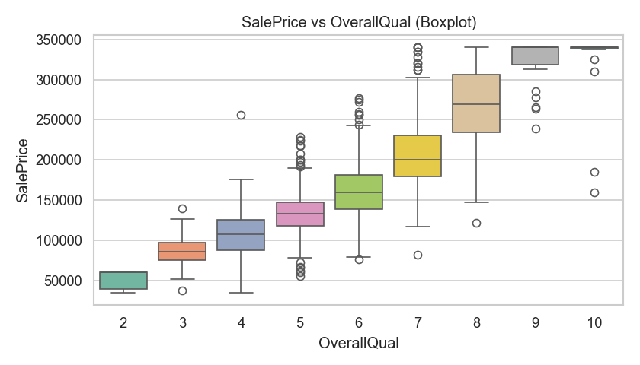
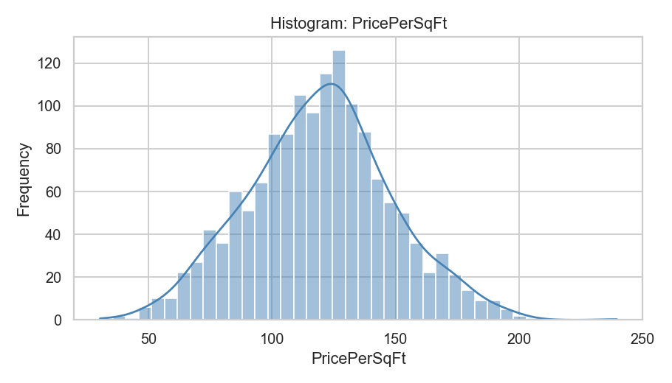
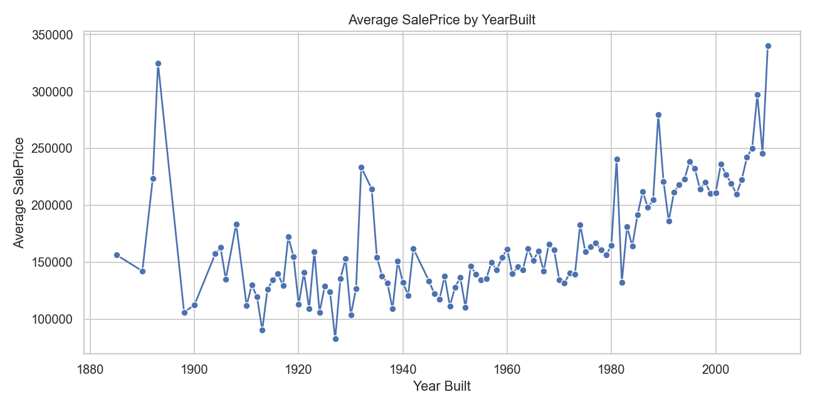
Screenshots
Bivariate Analysis
Feature Engineering
Market Trends

Slide 14

Summary
Systematic data analysis reveals key patterns in housing markets.
Helps stakeholders make informed, data-driven decisions.
Next steps:
Advanced modeling
Regional segmentation
Time-based price trend analysis

Slide 15

Thank you
Aishwarya Kumar Singh
github.com/aishks14

