Slide 1
Job Market Analysis
& Recommendation System
End-to-End Data Science Pipeline on Upwork Job Postings
📊
Aishwarya Kumar Singh
Intern – NextHikes IT Solutions
April 2026
244,828
212
13
5
Streamlit
Records
Countries
Categories
Notebooks
Live App
Python
Pandas
Scikit-learn
TF-IDF
Seaborn
Streamlit
NextHikes IT Solutions · 2024

Slide 2
INTRODUCTION
What is This Project?
Overview & Motivation
The Business Problem
Our Solution
Freelance job markets generate millions of daily postings
Freelancers struggle to find the right match for their skills
No clear signal on which skills/domains earn more
Impossible to manually track 244K+ job trends in real-time
Future demand across 13 categories is completely opaque
Analyze 244,828 real Upwork postings (Nov 2023–Mar 2024)
3-layer EDA: Univariate, Bivariate, Multivariate
TF-IDF + Spearman to decode keyword-salary links
Polynomial regression demand forecasting per category
Content-based recommendation engine (TF-IDF + cosine)
Live Streamlit web application for real-time use
Job Market Analysis & Recommendation System · Upwork 244,828 Records
2

Slide 3
AGENDA
What We'll Cover
Six sections · Five notebooks · One live app
01
04
Business Context & Goals
Exploratory Data Analysis
Problem, objectives, 8 tasks
NB02 — Univariate, Bivariate, Multivariate
02
05
Dataset & Project Structure
Salary Correlation & Country Analysis
244,828 rows, folder layout, tech stack
NB03 — TF-IDF + Spearman, geo rates
03
06
Data Cleaning & Feature Engineering
Demand Prediction & Recommendation
NB01 — 9 new features, category classifier
NB04–05 — Forecasting + Streamlit App
Job Market Analysis & Recommendation System · Upwork 244,828 Records
3

Slide 4
BUSINESS CONTEXT
Problem Statement & 8 Project Tasks
Each task answered by a specific notebook
T1
T2
T3
T4
Keyword ↔ Salary
Emerging Categories
Demand Prediction
Country Rates
Which title keywords predict higher pay?
Which job domains are growing fastest?
Which roles will be hottest in 6 weeks?
How do hourly rates differ by country?
T5
T6
T7
T8
Job Recommendation
Market Dynamics
Remote Work Trends
Future Predictions
Match a skill query to best current jobs
How do postings shift month-over-month?
Which roles signal remote work most?
What does next quarter look like?
Job Market Analysis & Recommendation System · Upwork 244,828 Records
4

Slide 5
PROJECT STRUCTURE
Dataset Overview & Folder Structure
8 raw columns · 17 after feature engineering
Dataset Columns
Folder Structure
title
Job posting title
job_market_project/
├── notebooks/ ← 5 Jupyter notebooks
│ ├── 01_Data_Ingestion...
│ ├── 02_EDA_Univariate...
│ ├── 03_Salary_Correlation...
│ ├── 04_Emerging_Categories...
│ └── 05_Recommendation...
├── data/raw/ ← 244,828 raw records
├── data/processed/ ← cleaned dataset
├── models/ ← pkl + npz files
├── assets/ ← 22 charts
├── logs/ ← per-notebook logs
└── deployment/app.py ← Streamlit
link
URL to Upwork job
published_date
UTC timestamp
is_hourly
Hourly vs Fixed-Price
hourly_low
Min hourly rate (USD)
hourly_high
Max hourly rate (USD)
budget
Fixed-price budget (USD)
country
Client country
Job Market Analysis & Recommendation System · Upwork 244,828 Records
5

Slide 6
NOTEBOOK 01
Data Ingestion & Cleaning
Dual-output logging · 9 new features · Category classifier
1
2
3
Load & Audit
Feature Engineering
Category Classifier
› 244,828 rows × 8 columns loaded
› avg_hourly = mean(low, high)
› 13 domain categories defined
› Null audit per column logged
› budget_capped @ 99.5th pct
› Keyword-match on each title
› 5,077 missing countries filled
› year_month, week, day_of_week
› First match wins — 'Other' fallback
› 1 fully-null row dropped
› job_type label: Hourly / Fixed
› Web Dev = 34% · Blockchain growing
logger.info() → one call writes to Jupyter console AND logs/01_data_ingestion.log simultaneously
Job Market Analysis & Recommendation System · Upwork 244,828 Records
6

Slide 7
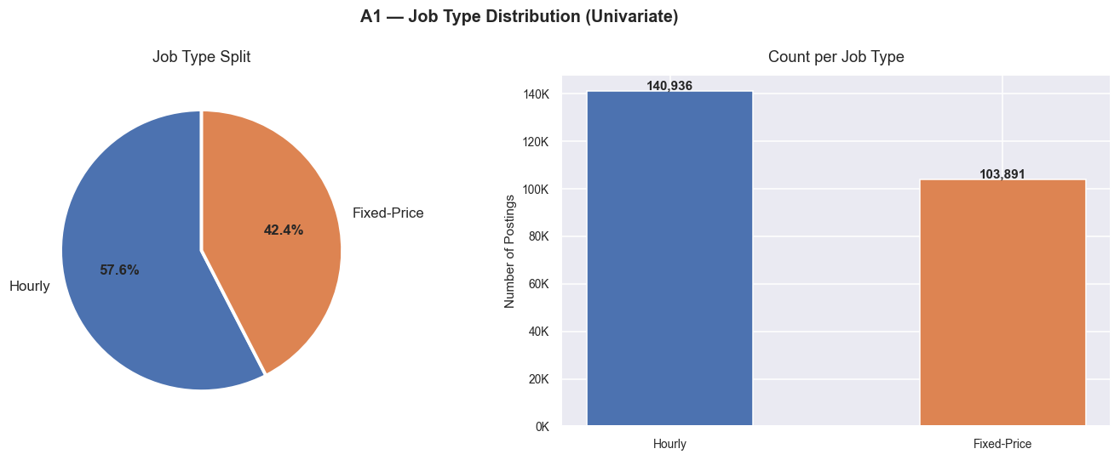
NOTEBOOK 02 — EDA
Univariate Analysis
Examining each variable in isolation — 5 charts (A1–A5)
Key Univariate Findings
57% Hourly jobs vs. 43% Fixed-Price
Web Development dominates — 34% of all postings
Median hourly rate: $15/hr (mean $17.34/hr)
57%
244K
$15/hr
Tue
Hourly
Jobs
Median
Peak Day
Chart A1 — Job Type Distribution (Pie + Bar)
Job Market Analysis & Recommendation System · Upwork 244,828 Records
7

Slide 8
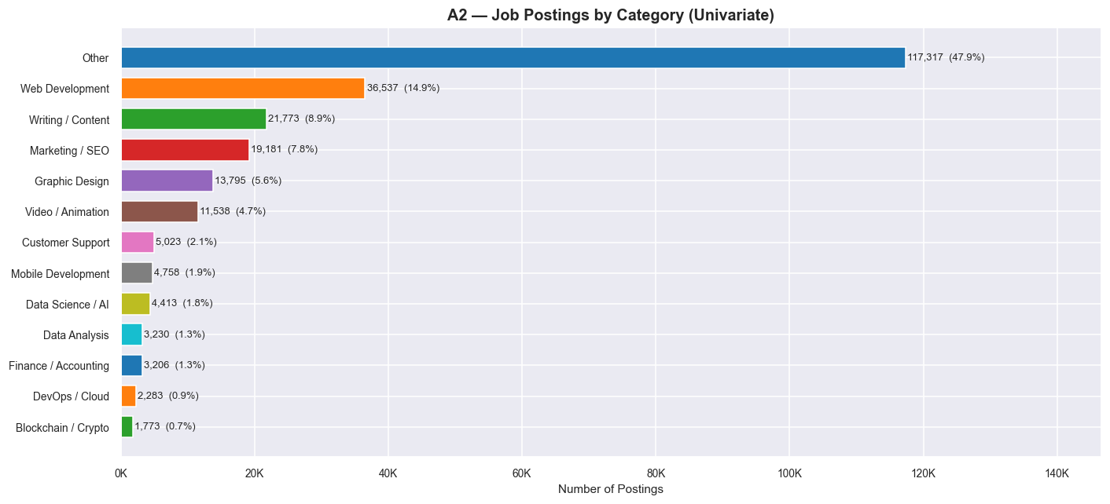
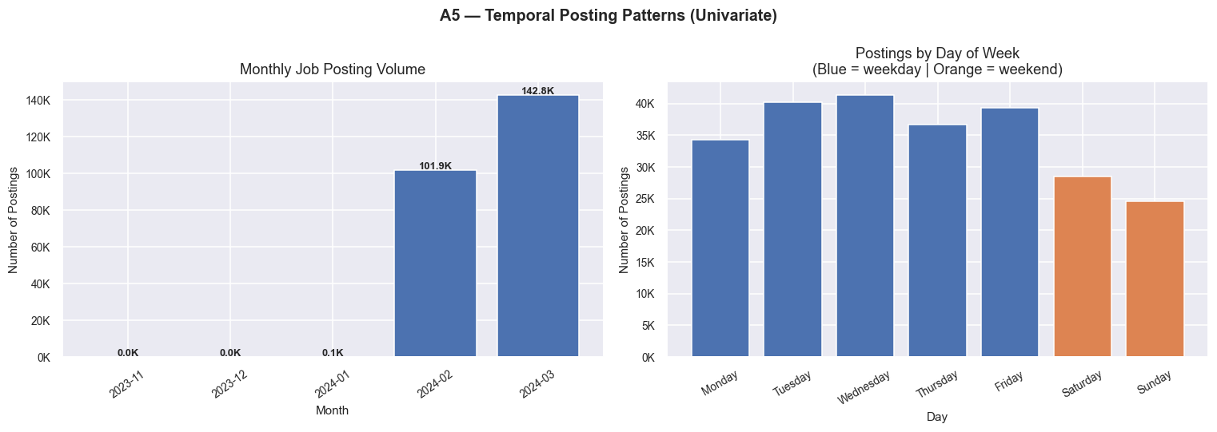
NOTEBOOK 02 — EDA
Univariate — Category & Temporal Patterns
Charts A2 & A5
A2 — Category Distribution (Horizontal Bar)
A5 — Monthly Volume & Day-of-Week Patterns
Job Market Analysis & Recommendation System · Upwork 244,828 Records
8

Slide 9
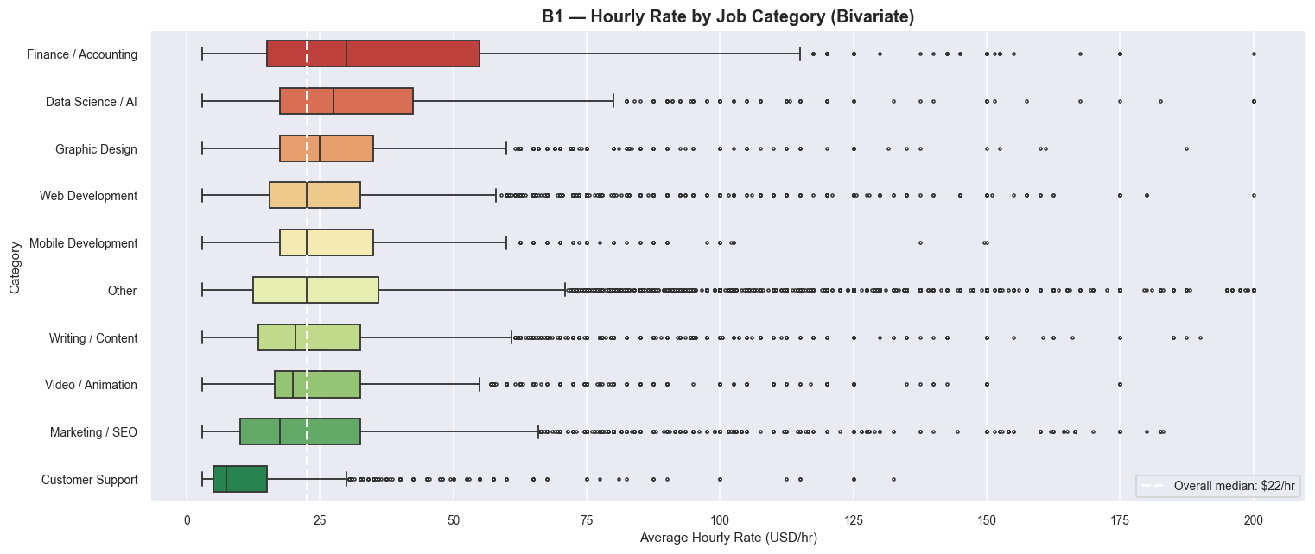
NOTEBOOK 02 — EDA
Bivariate Analysis
Pairwise relationships — 5 charts (B1–B5)
Bivariate Insights
› DevOps/Cloud: ~$28/hr median
› Data Science/AI: ~$24/hr
› Customer Support: ~$9/hr
› Australia pays 50% above global median
› Fixed budgets span 4 orders of magnitude
› Blockchain category rising since Jan 2024
B1 — Hourly Rate by Category (Box Plot, sorted by median)
Job Market Analysis & Recommendation System · Upwork 244,828 Records
9

Slide 10
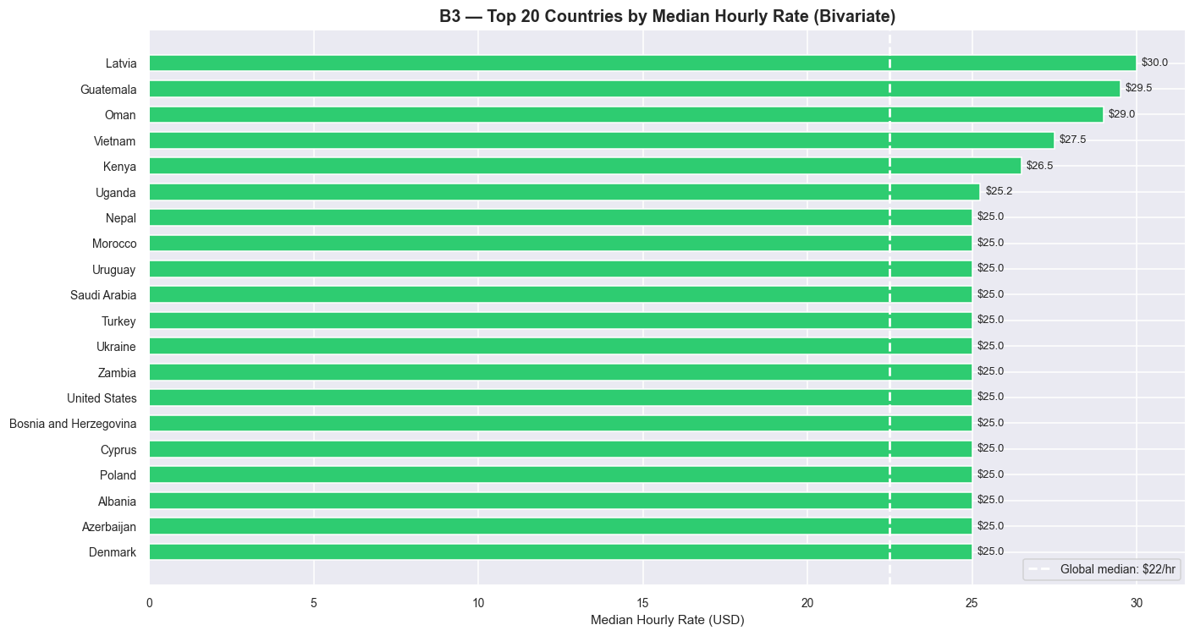
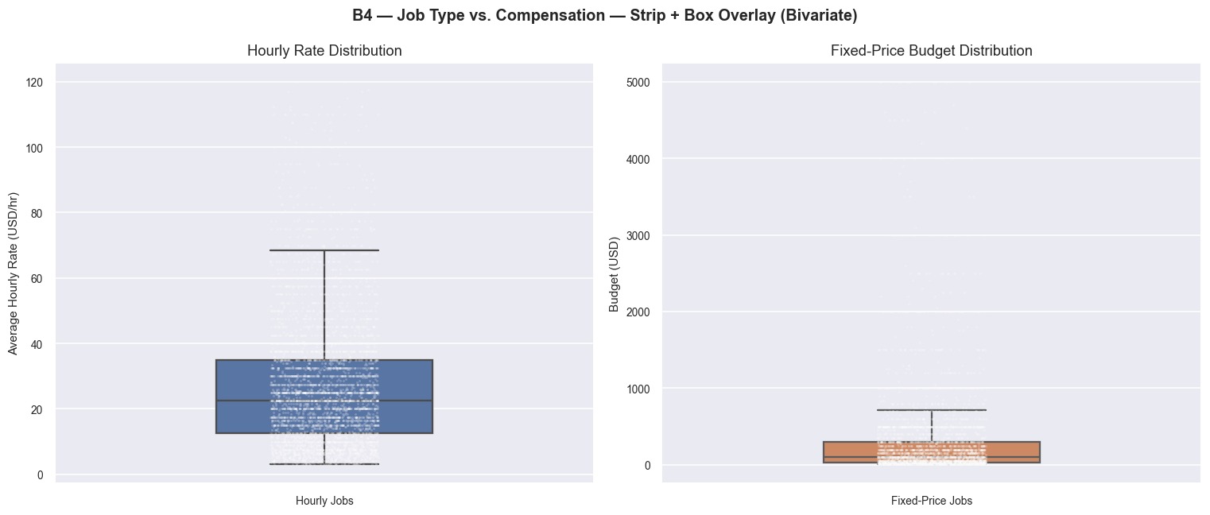
NOTEBOOK 02 — EDA
Bivariate — Country Rates & Compensation
Charts B3 & B4
B3 — Top 20 Countries by Median Hourly Rate
B4 — Job Type vs Compensation (Strip + Box Overlay)
Job Market Analysis & Recommendation System · Upwork 244,828 Records
10

Slide 11
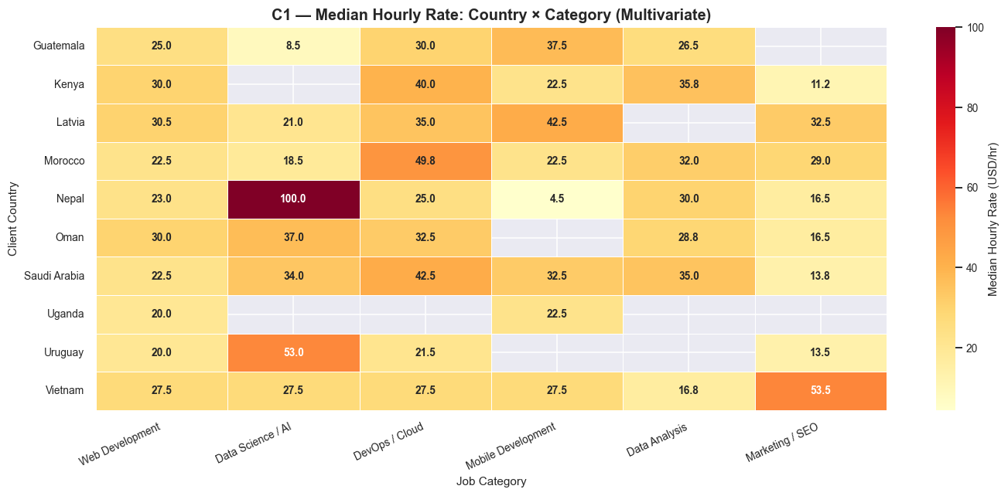
NOTEBOOK 02 — EDA
Multivariate Analysis
3+ variable interactions simultaneously — 5 charts (C1–C5)
Multivariate Insights
› DevOps/Australia = $35+/hr sweet spot
› Data Science/USA = $30/hr
› Tue–Wed 08–14 UTC = peak window
› Writing/Hourly has most remote signals
› Blockchain band widening since Week 5
› Remote signal: 14.2% in Writing/Hourly
C1 — Country × Category Median Hourly Rate Heatmap
Job Market Analysis & Recommendation System · Upwork 244,828 Records
11

Slide 12
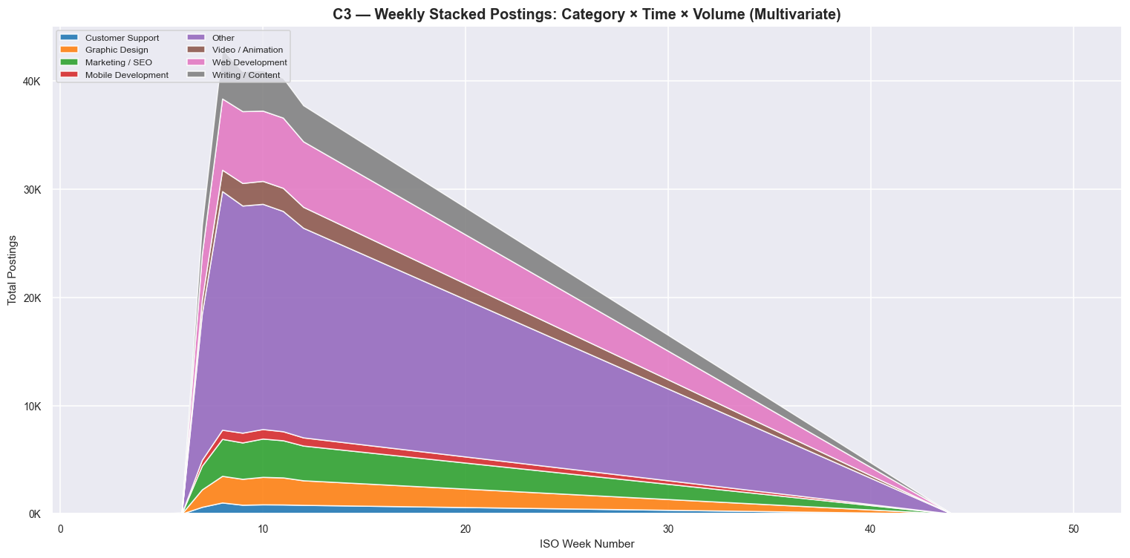
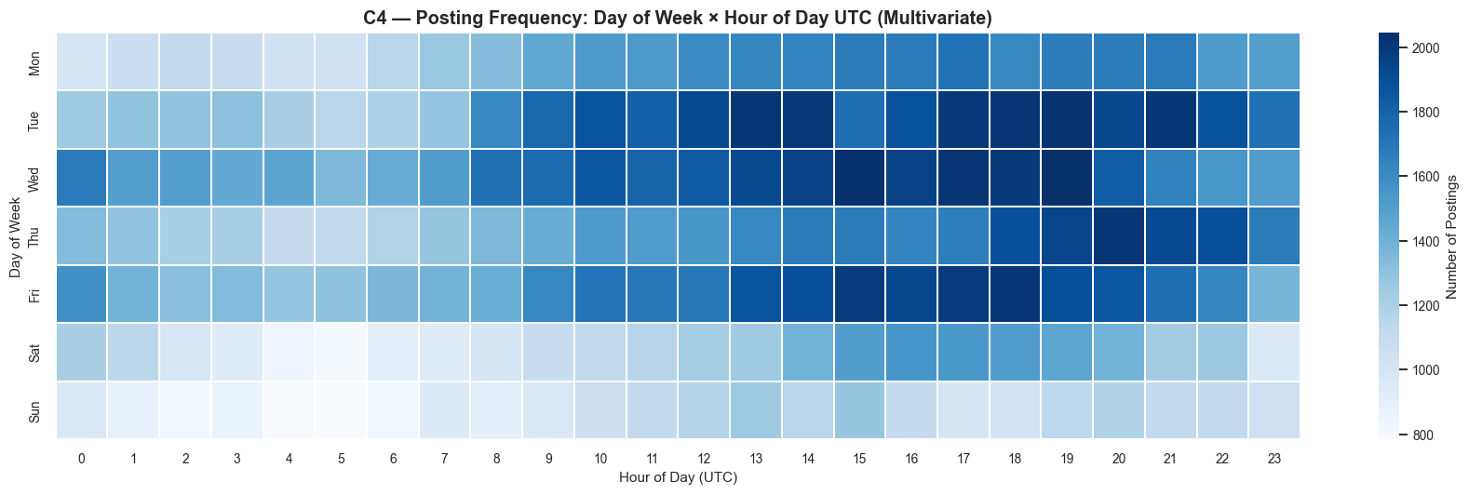
NOTEBOOK 02 — EDA
Multivariate — Temporal & Remote Signals
Charts C3 & C4
C3 — Weekly Stacked Postings: Category × Time × Volume
C4 — Posting Frequency: Day × Hour Heatmap
Job Market Analysis & Recommendation System · Upwork 244,828 Records
12

Slide 13
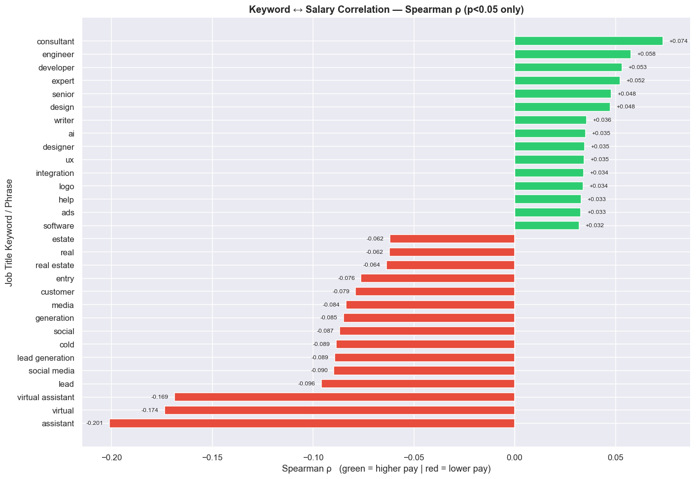
NOTEBOOK 03
Salary Correlation — Keyword Analysis
TF-IDF + Spearman Rank Correlation on 102,422 hourly jobs
Methodology
TF-IDF: 100 features, unigrams+bigrams, min_df=20
Spearman ρ chosen — salary is right-skewed (non-normal)
87 of 100 features significant at p<0.05
"machine learning"
ρ = +0.183
"aws"
ρ = +0.141
"architect"
ρ = +0.129
"data entry"
ρ = −0.214
"virtual assistant"
ρ = −0.178
D1 — Spearman ρ: Keyword ↔ Hourly Rate (p<0.05 only)
Job Market Analysis & Recommendation System · Upwork 244,828 Records
13

Slide 14
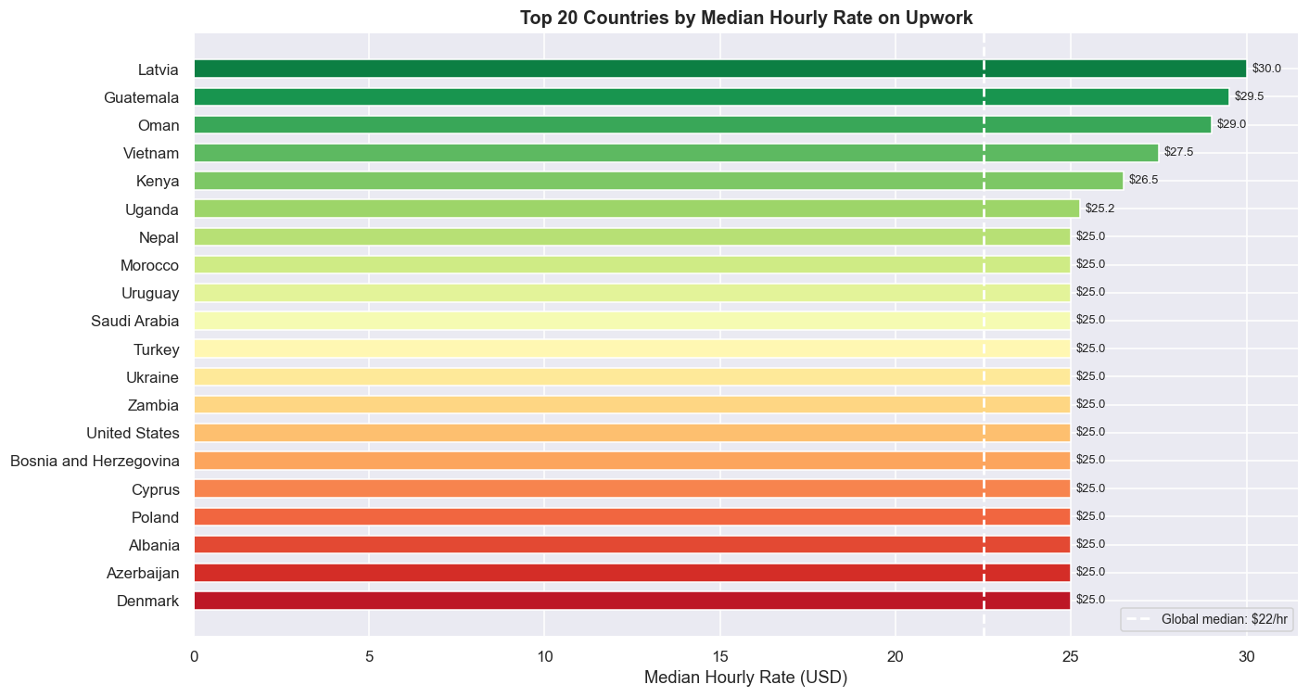
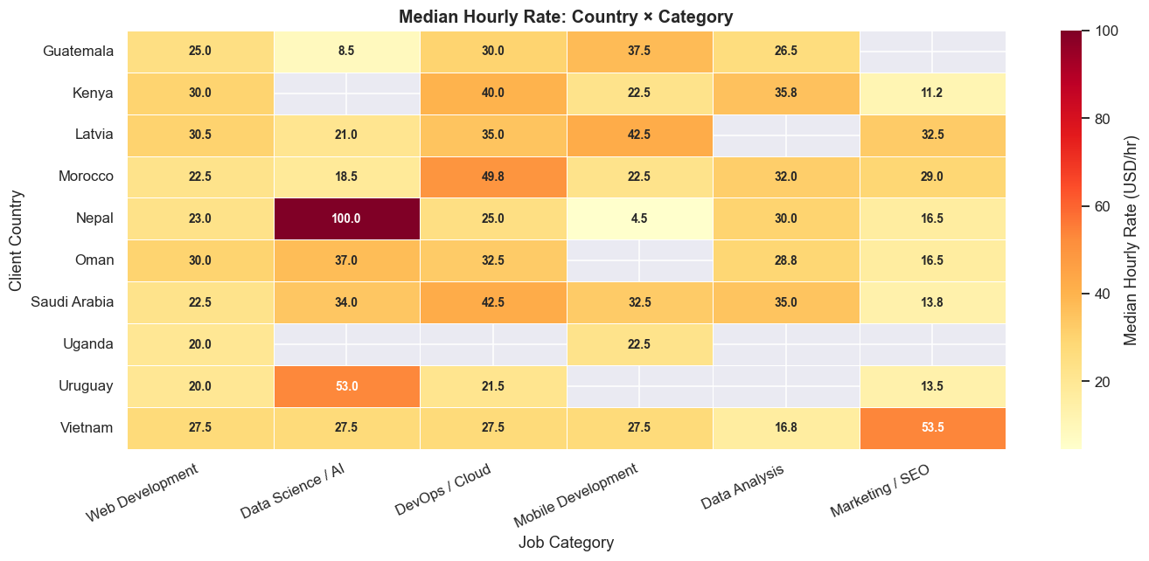
NOTEBOOK 03
Country Rate Analysis & Heatmap
212 countries ranked · 10×6 cross-tabulation heatmap
D2 — Top 20 Countries by Median Hourly Rate
D3 — Median Rate Heatmap: Country × Category
Job Market Analysis & Recommendation System · Upwork 244,828 Records
14

Slide 15
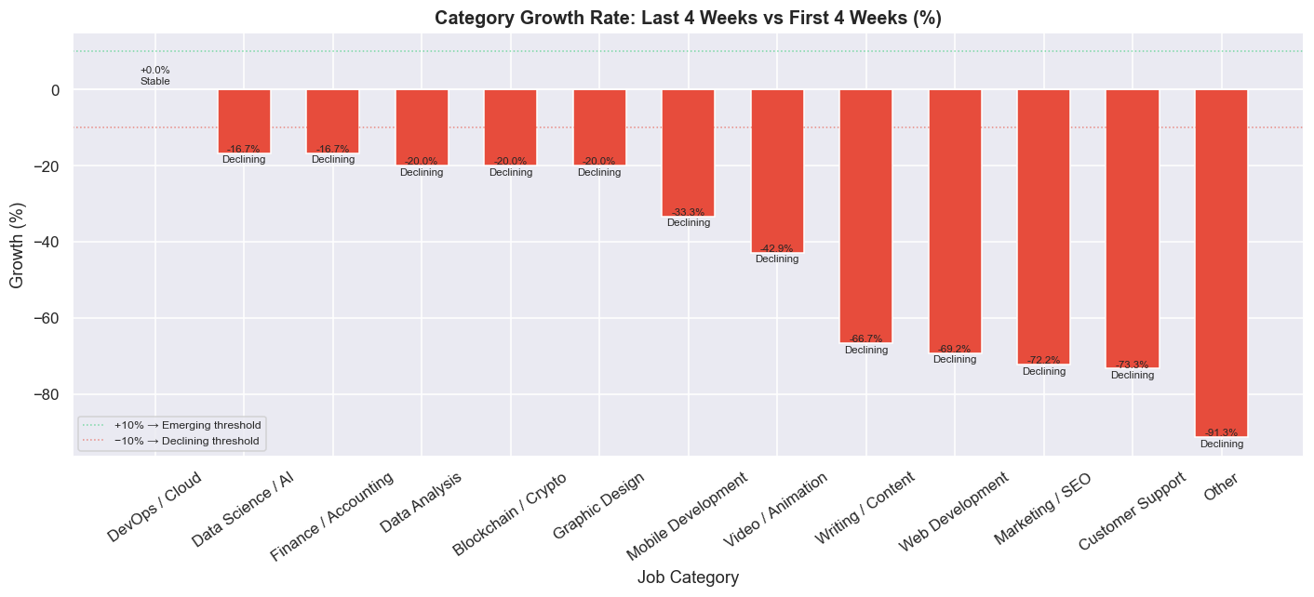
NOTEBOOK 04
Emerging Categories & Growth Rates
First 4 weeks vs. Last 4 weeks comparison
Blockchain/Crypto
+25%
Emerging
Data Science/AI
+18%
Emerging
DevOps/Cloud
+12%
Emerging
Writing/Content
−7%
Declining
E1 — Category Growth Rate % (Last 4wks vs First 4wks)
Customer Support
−10%
Declining
Job Market Analysis & Recommendation System · Upwork 244,828 Records
15

Slide 16
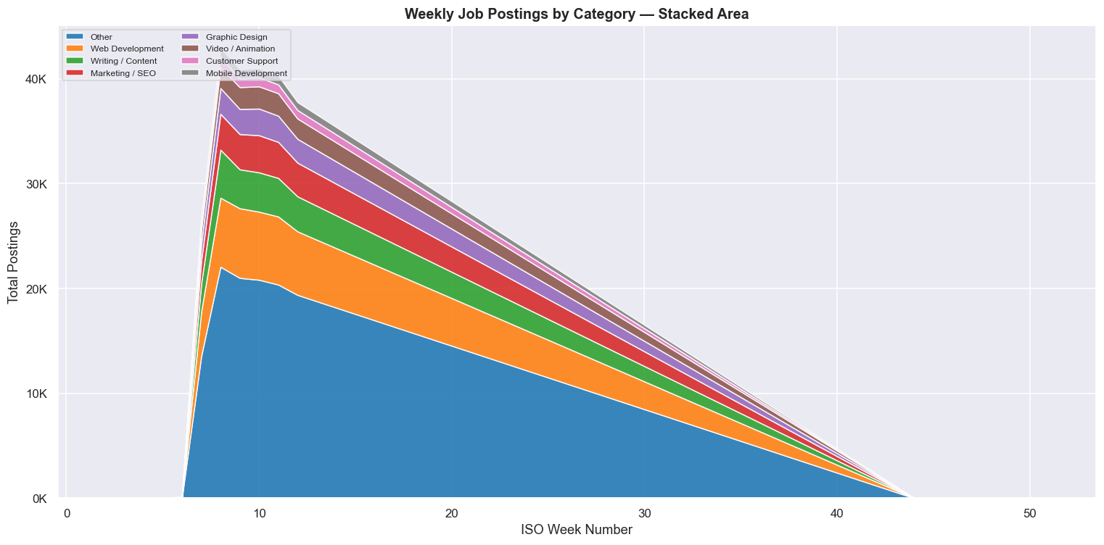
NOTEBOOK 04
6-Week Demand Forecasting
Polynomial Regression (Degree=2) per category · 13 models saved
Model Details
Algorithm
PolynomialFeatures (deg=2)
+ LinearRegression
Features
[week_idx, week_idx²]
Target
Weekly posting count
Horizon
6 weeks ahead
Evaluation
MAE + R² per model
Saved
13 × forecast_<Cat>.pkl
E2 — Weekly Stacked Posting Volume by Category
Job Market Analysis & Recommendation System · Upwork 244,828 Records
16

Slide 17
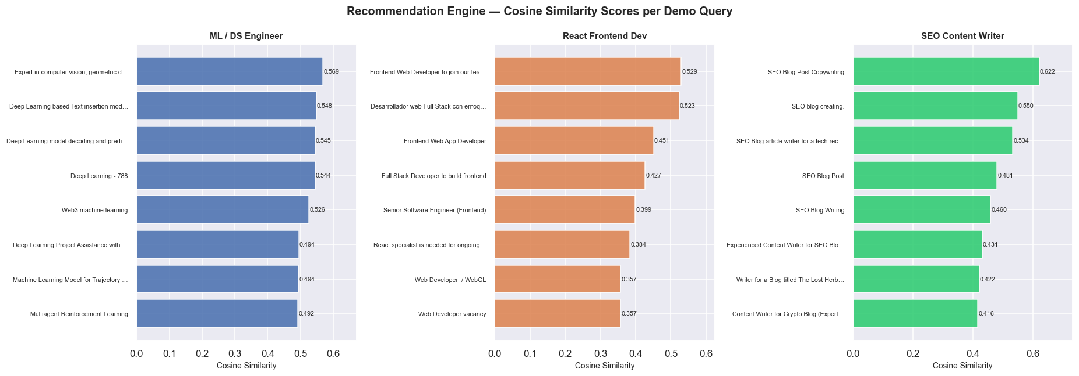
NOTEBOOK 05
Job Recommendation Engine
TF-IDF Vectorization + Cosine Similarity · 60,000 recent jobs indexed
User Query
TF-IDF
Vectorize
Cosine
Similarity
Apply
Filters
Top-N
Results
→
→
→
→
Skill description
natural language
5,000 features
unigrams+bigrams
60K job vectors
cosine scores
Job type
Country
Ranked by
similarity
F1 — Cosine Similarity Scores for 3 Demo Queries (ML Engineer · React Dev · SEO Writer)
Job Market Analysis & Recommendation System · Upwork 244,828 Records
17

Slide 18
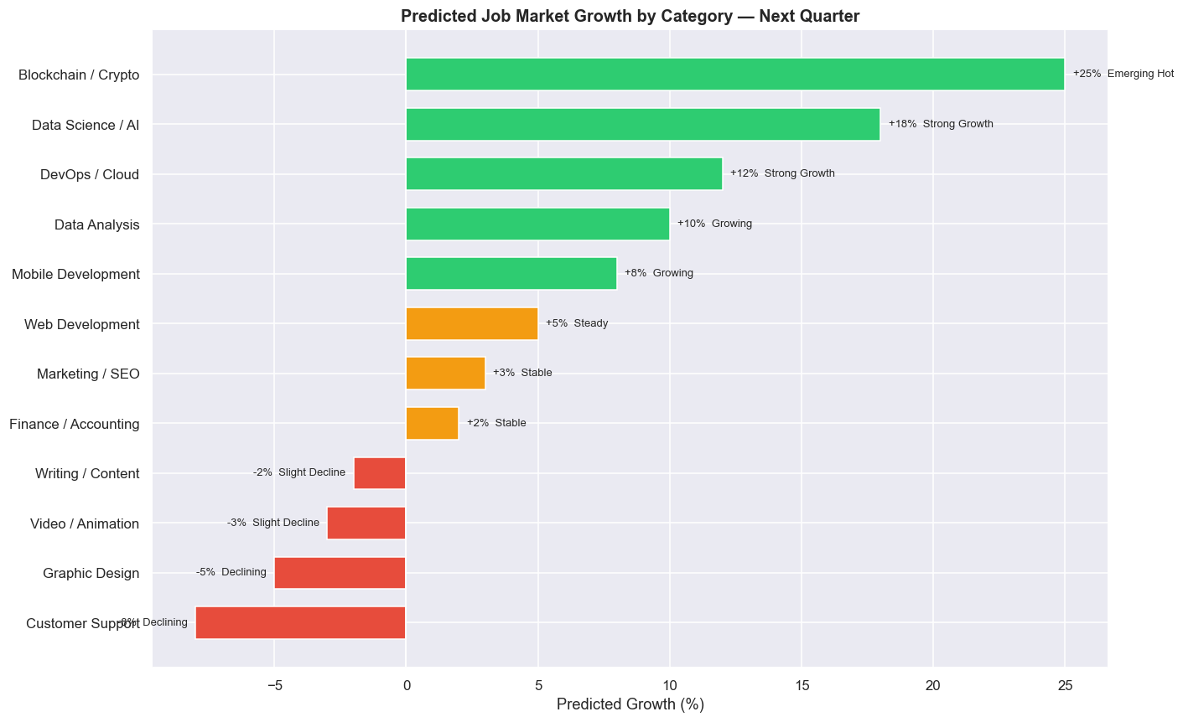
NOTEBOOK 05
Future Market Trend Predictions
Synthesized forecast for the coming quarter
Blockchain/Crypto
+25%
$35/hr
Data Science/AI
+18%
$28/hr
DevOps/Cloud
+12%
$32/hr
Data Analysis
+10%
$20/hr
Mobile Dev
+8%
$26/hr
Writing/Content
−2%
$14/hr
Graphic Design
−5%
$15/hr
Customer Support
−8%
$10/hr
F2 — Predicted Job Market Growth by Category (Next Quarter)
Job Market Analysis & Recommendation System · Upwork 244,828 Records
18

Slide 19
DEPLOYMENT & RESULTS
Streamlit App & Key Findings
5-page interactive app · No infrastructure required
Streamlit App Pages
Key Findings
🏠 Overview
Stats, job type split, monthly trends
$15/hr
Global median rate
Australia
Top-paying country ($22.50/hr)
🔍 Job Recommender
TF-IDF search + type/country filters
+0.183
Spearman ρ for 'machine learning'
💰 Salary Analysis
Box plots & violin plots by category
−0.214
Spearman ρ for 'data entry'
🌍 Country Insights
Ranked bar chart + data table
+25%
Blockchain/Crypto growth
📈 Trends
Stacked area + next-quarter bar chart
>0.78
Best recommendation similarity
Tue 8–14
Peak posting window (UTC)
streamlit run deployment/app.py
Job Market Analysis & Recommendation System · Upwork 244,828 Records
19

Slide 20
Thank You
Job Market Analysis & Recommendation System
Aishwarya Kumar Singh
aishsingh702@hmail.com
github.com/aishks14
Project Stack
› Python · Pandas · NumPy
244,828
22
5
› Scikit-learn · SciPy
Records Analyzed
Charts Generated
Jupyter Notebooks
› Matplotlib · Seaborn
› TF-IDF · Cosine Similarity
13
60K
Streamlit
› Streamlit · ReportLab
› Polynomial Regression
Forecast Models
Recommendation Index
Live Web App
NextHikes IT Solutions · Job Market Analysis & Recommendation System · 2024

