Slide 1
TKINTER SCIENTIFIC CALCULATOR
AISHWARYA KUMAR SINGH
Intern – NEXTHIKES IT SOLUTIONS
SUNDAY, 31 AUGUST, 2025

Slide 2
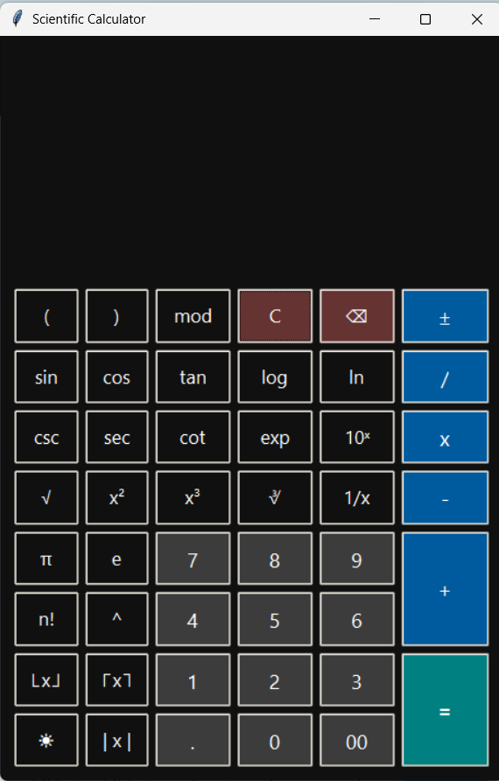
agenda
PYTHON - CORE
TKINTER LIBRARY
HANDS ON VISUAL STUDIO CODE (IDE)
GITHUB
Application development using python

Slide 3

About PROECT
This project aims at building a smooth, and, working scientific calculator having a GUI, based
on Tkinter Library of Python

Slide 4
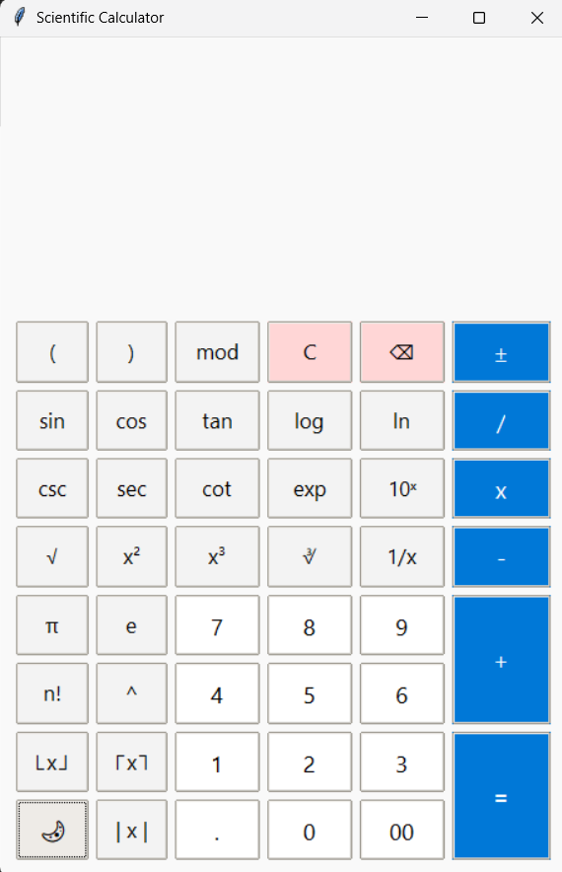
Project overview
Combining functionality and user-friendliness, for Trigonometric, Logarithmic, and Arithmetic Functions

Slide 5

PROJECT INTRODUCTION
A DESKTOP BASED SCIENTIFIC CALCULATOR BULT USING PYTHON
USED TKINTER FOR gui and math for scientific calculations
Designed for both as basic and advance mathematical tasks
This includes dynamic theming and robust error handling

Slide 6

ARCHITECTURE overview

Slide 7

Code Architectural structure
MAIN CLASS – Scientificcalculator
Modules used –
tkinter, ttk(GUI Components)
MATH – Scientific functions
Constants.py – used for styling and storing constant values
Design USED –
Grid layout used with responsive button placements

Slide 8
Functional capabilities
GUI panel for scientific calculator of geometry size 460x680
Important Basic operations:
+, -, x , /, mod
Scientific Functions:
Trigonometry:
sin, cos, tan, csc, sec, cot
Logarithmic:
log, ln
Exponential:
exp, 10^x
Roots & Powers
√, ∛, x², x³, xʸ(x^y)
Others:
n!, 1/x, |x|, floor, ceil

Slide 9
Expression and Evaluation
Calculator uses eval() method with a restricted set of safe functions. This helps in evaluating the operations smoothly.
Trigonometric inputs are converted to radians
It allows to handle the following scenarios:
Overflow
Invalid Inputs
Division by Zero
Theme functions
Used for creating the themes
Utilities functions
These are used to help the main functions in different calculations
Trigonometric & Other functions
Calculator Functions
Backend Calculator functions that help in making calculator available for every operation
Used to perform trigonometric, logarithmic, and other operations

Slide 10
Theme & Code management
Day Theme
Used a light background and dark text
Night Theme
Used dark background and light text
Theme Toggle Button
Theme toggle button is provided to change the theme from day to night and vice-versa.
Windows-style buttons using ttk themes
Theme toggle (☀ / 🌙)
Clean layout with grid system is provided
Constants file
There is a separate file for storing constants and styling. This is used in the main python calculator file.
Clear separation of logic and UI
Methods are divided into smaller parts to keep the code clean and modular. Logic helps in integrating the functionality smoothly
Scientific Notation Formatting
Scientific notation formatting is also kept in mind while creation of the calculator logics.
Proper Error Messages
"Empty input", "Invalid Input", "Cannot divide by zero"

Slide 11
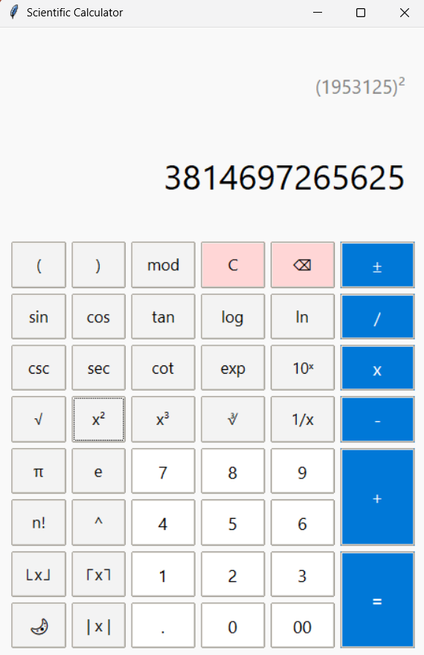
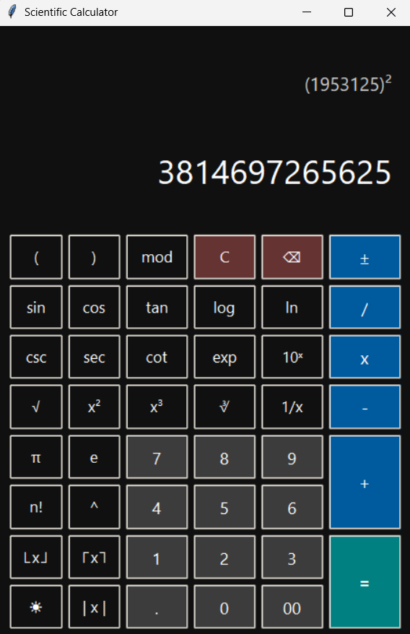
Calculator image / theme images
Day Theme ☀
Night Theme 🌙

Slide 12
Summary & future scope
This project demonstrates a functional, themed scientific calculator
It used Tkinter library to display the GUI
It was developed as a part of building a robust, extensible scientific calculator
It provides functionality close to windows scientific calculator
It has a clean intuitive interface
advance features of tkinter library and extensive use of python in project development were explored
Code was pushed to github which was a part of project learnings
Overall, a great combination of python code and library with gui including programming with mathematical analysis of the formulas
Future scope:
Commitment to learn and create features such as operation history, memory storage(M+, M-), and more advance math functions implementation

Slide 13

Thank you
Aishwarya kumar singh | github.com/aishks14

