Slide 1
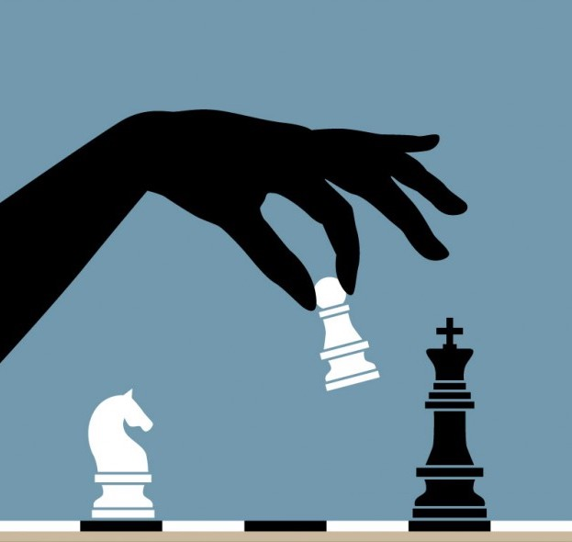
Photo Analysis With Neural Nets (for Chess)
P A W N
T E A M
Connor Pryor [Product Owner]
Jacob Katzeff
Erik Koenitzer
David McLellan
Aishni Parab
December 8th 2017 Image courtesy: freepik.com

Slide 2
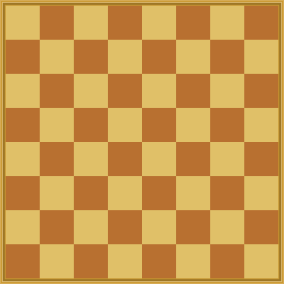
Application Domain
Problem: A player has to leave an in-person game of chess, but would like to continue the game later, likely after everything has to be put away
The Answer: An Android app that converts a photo of said chess game into a playable virtual representation

Slide 3
Project Goals
Convert an image of a chess game into a digital representation (Done)
Integrate with an Android app that allows users to continue play with the digital representation (Err...)

Slide 4
Challenges
Development Product
Trouble choosing from various ML and Chess APIs
Speed and accuracy in image classification
Getting an ML model to run in-app
Nature of project made biggest issues with integration hard to discover early
Development Project
SCRUM was difficult to stay consistent
Difficult to merge schedules
Managing course load with project demands
Notes:
Development Product: We had some trouble finding the right way to do various things we wanted to do. Even in late stages, we weren’t sure which ML or Chess API’s to use for ease of use. Development Project: SCRUM was difficult to stay consistent. With everyone’s busy schedules, it was difficult for everyone to be constantly putting in a large amount of time in between each daily scrum. Some missed meetings also added some level of confusion and miscommunications.

Slide 5
Accomplishments
Development Process
Increased group cohesion as the project developed
Development Product
Created a functional image recognition model (average accuracy: ~85%)
Created an app that can play chess from a start state produced from a photo (labeling must happen on a PC though…)

Slide 6
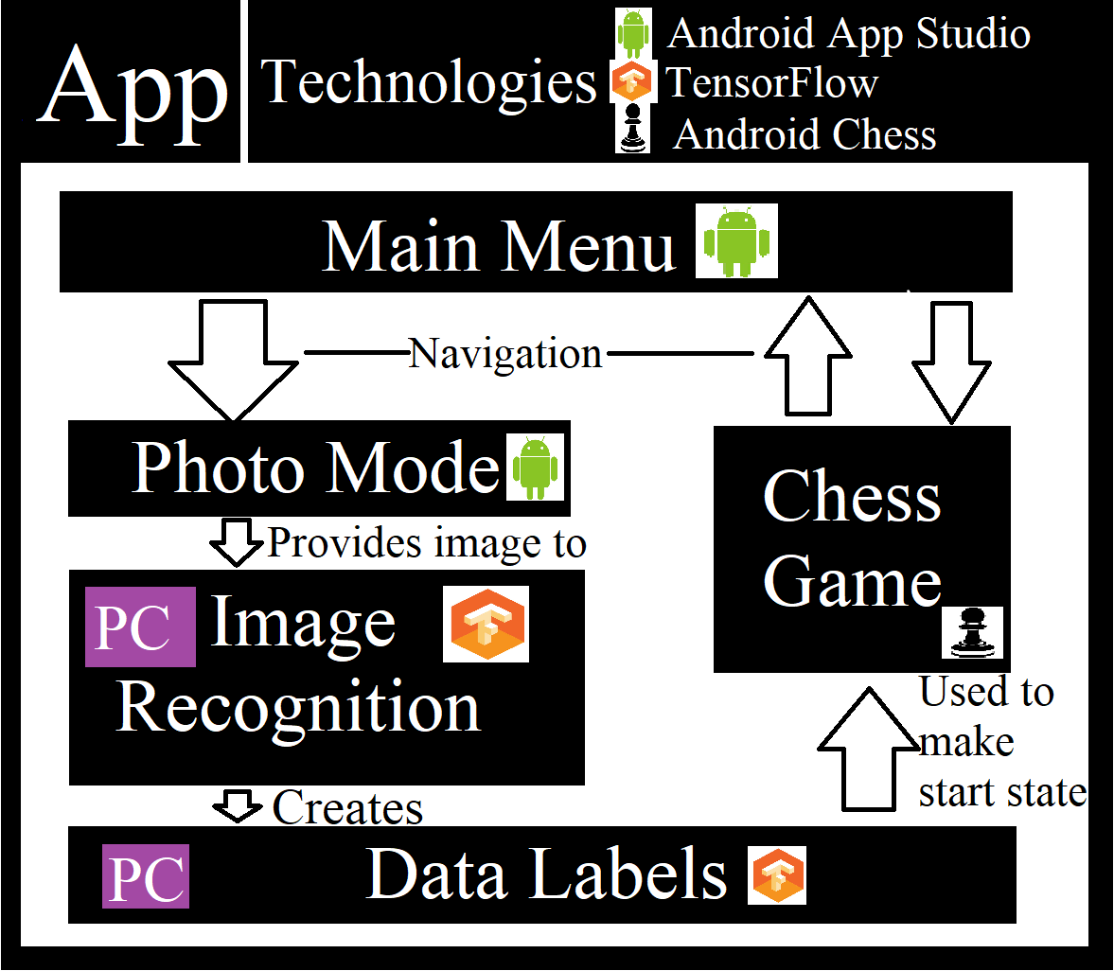
System Overview Diagram

Slide 7
App Demonstration
Images of input image, intermediate image (post-transformation), and final board output here, in case app doesn’t work

Slide 8
Project Management Techniques
Split-Development Approach: One group handled the app, the other handled matters of ML/Image Recognition
Shared Responsibility: Labeling data was distributed between the whole team
Spikes: Much time spent researching previously published results and APIs
Close Communication: Used Discord to keep in touch

Slide 9
Things Liked & Loathed
Liked
Learning new tools and techniques
Working in a team
Applying SCRUM principles
Loathed
Less face-to-face and more remote working
Manually labeling data was cumbersome
Integration turned out much, much tougher than anticipated

Slide 10
Lessons Learned
What Worked
Splitting development into ML & App teams
In-person meetings
Research Spikes
Didn’t Work
Doing Daily Scrums online
Using few software engineering practices
Wish We
Met face-to-face more
Had time to add more advanced features
Had time to fully integrate ML & App

Slide 11
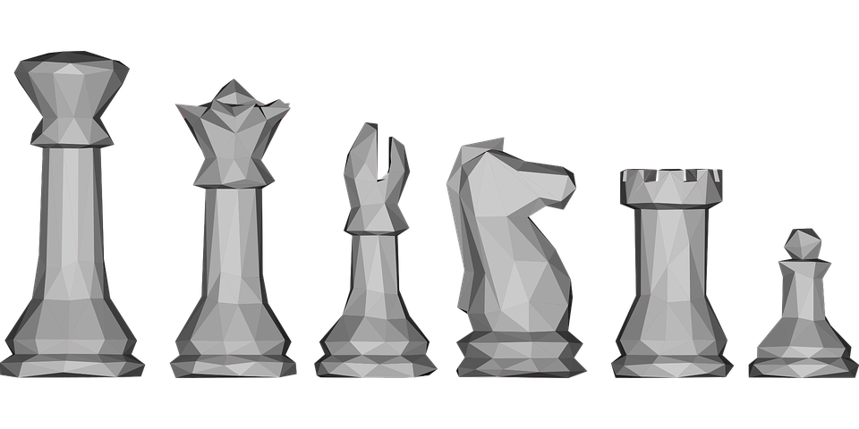
Questions?

