Slide 1
ChurnWatch
Customer Retention & Churn Risk Analytics Platform
Data Analytics Internship Evaluation & Project Submission
Author: Data Analytics Candidate | Project: Minor Project 1
Stack: Python (Scikit-Learn/Pandas), ANSI SQL, Vanilla JS, HTML5/CSS3, Chart.js

Slide 2
EXECUTIVE SUMMARY
Executive Problem Statement & Business Opportunity
Customer Acquisition Cost (CAC) in B2B SaaS is 5x–7x higher than retention cost. ChurnWatch consolidates multi-dimensional customer behavioral signals (licensing, engagement decay, and ticket friction) into an actionable retention engine.
TOTAL ACCOUNTS
1,250
Evaluated B2B portfolio
CHURN RATE
19.2%
-0.8% MoM improvement
RENEWAL RATE
80.8%
+1.4% cohort benchmark
TOTAL MRR
$287,450
$61,398 high risk exposure
Key Strategic Value: By triaging the top 20% highest-risk accounts, Customer Success teams can protect up to $61,398 in monthly recurring revenue with high-touch intervention playbooks.

Slide 3
DATA ENGINEERING
Multi-Source Relational Data Architecture
1. Subscriptions Table
Commercial Contract Baseline
• Customer ID & Company Name
• Plan Tier: Starter, Pro, Enterprise
• Monthly Recurring Revenue (MRR)
• Tenure Months & Billing Cycle
• Contract Renewal Dates
2. Product Usage Table
Active Behavioral Telemetry
• Active Users vs Licensed Seats
• Seat Utilization Percentage
• Monthly Active Login Days
• Feature Adoption Index (0-100)
• 30-Day Engagement Trend %
3. Support Tickets Table
Friction & Dissatisfaction
• Total Tickets Past 90 Days
• Open Critical Escalations
• Average Resolution Time (Hours)
• Customer Satisfaction (CSAT 1-5)
• NPS Sentiment Classification
→ Master Table: unified_customers.csv merges all 3 streams into 1,250 analytical accounts with computed risk scores.

Slide 4
ALGORITHMIC METHODOLOGY
Multi-Factor Churn Risk Scoring Index (0–100)
Composite Weighted Scoring Dimensions:
• 35% Engagement Decay
Penalizes significant drops in 30-day active sessions & usage.
• 25% Seat Underutilization
Detects shelfware risk when paid licenses are left unassigned.
• 25% Support Friction
Accounts for low CSAT (< 3.0) and open critical ticket escalations.
• 15% Contract Vulnerability
Evaluates recency of login and monthly contract flexibility.
Actionable Risk Stratification Bands:
HIGH RISK (> 70 Score)
252 Accounts ($61,398 MRR) — Immediate CSM intervention required under 48h SLA. High probability of attrition.
MEDIUM RISK (40–70 Score)
156 Accounts ($36,144 MRR) — Workflow enablement review & feature training required within 14-day SLA.
LOW RISK (< 40 Score)
842 Accounts ($189,908 MRR) — Healthy accounts with strong adoption. Monitored via automated value summaries.

Slide 5
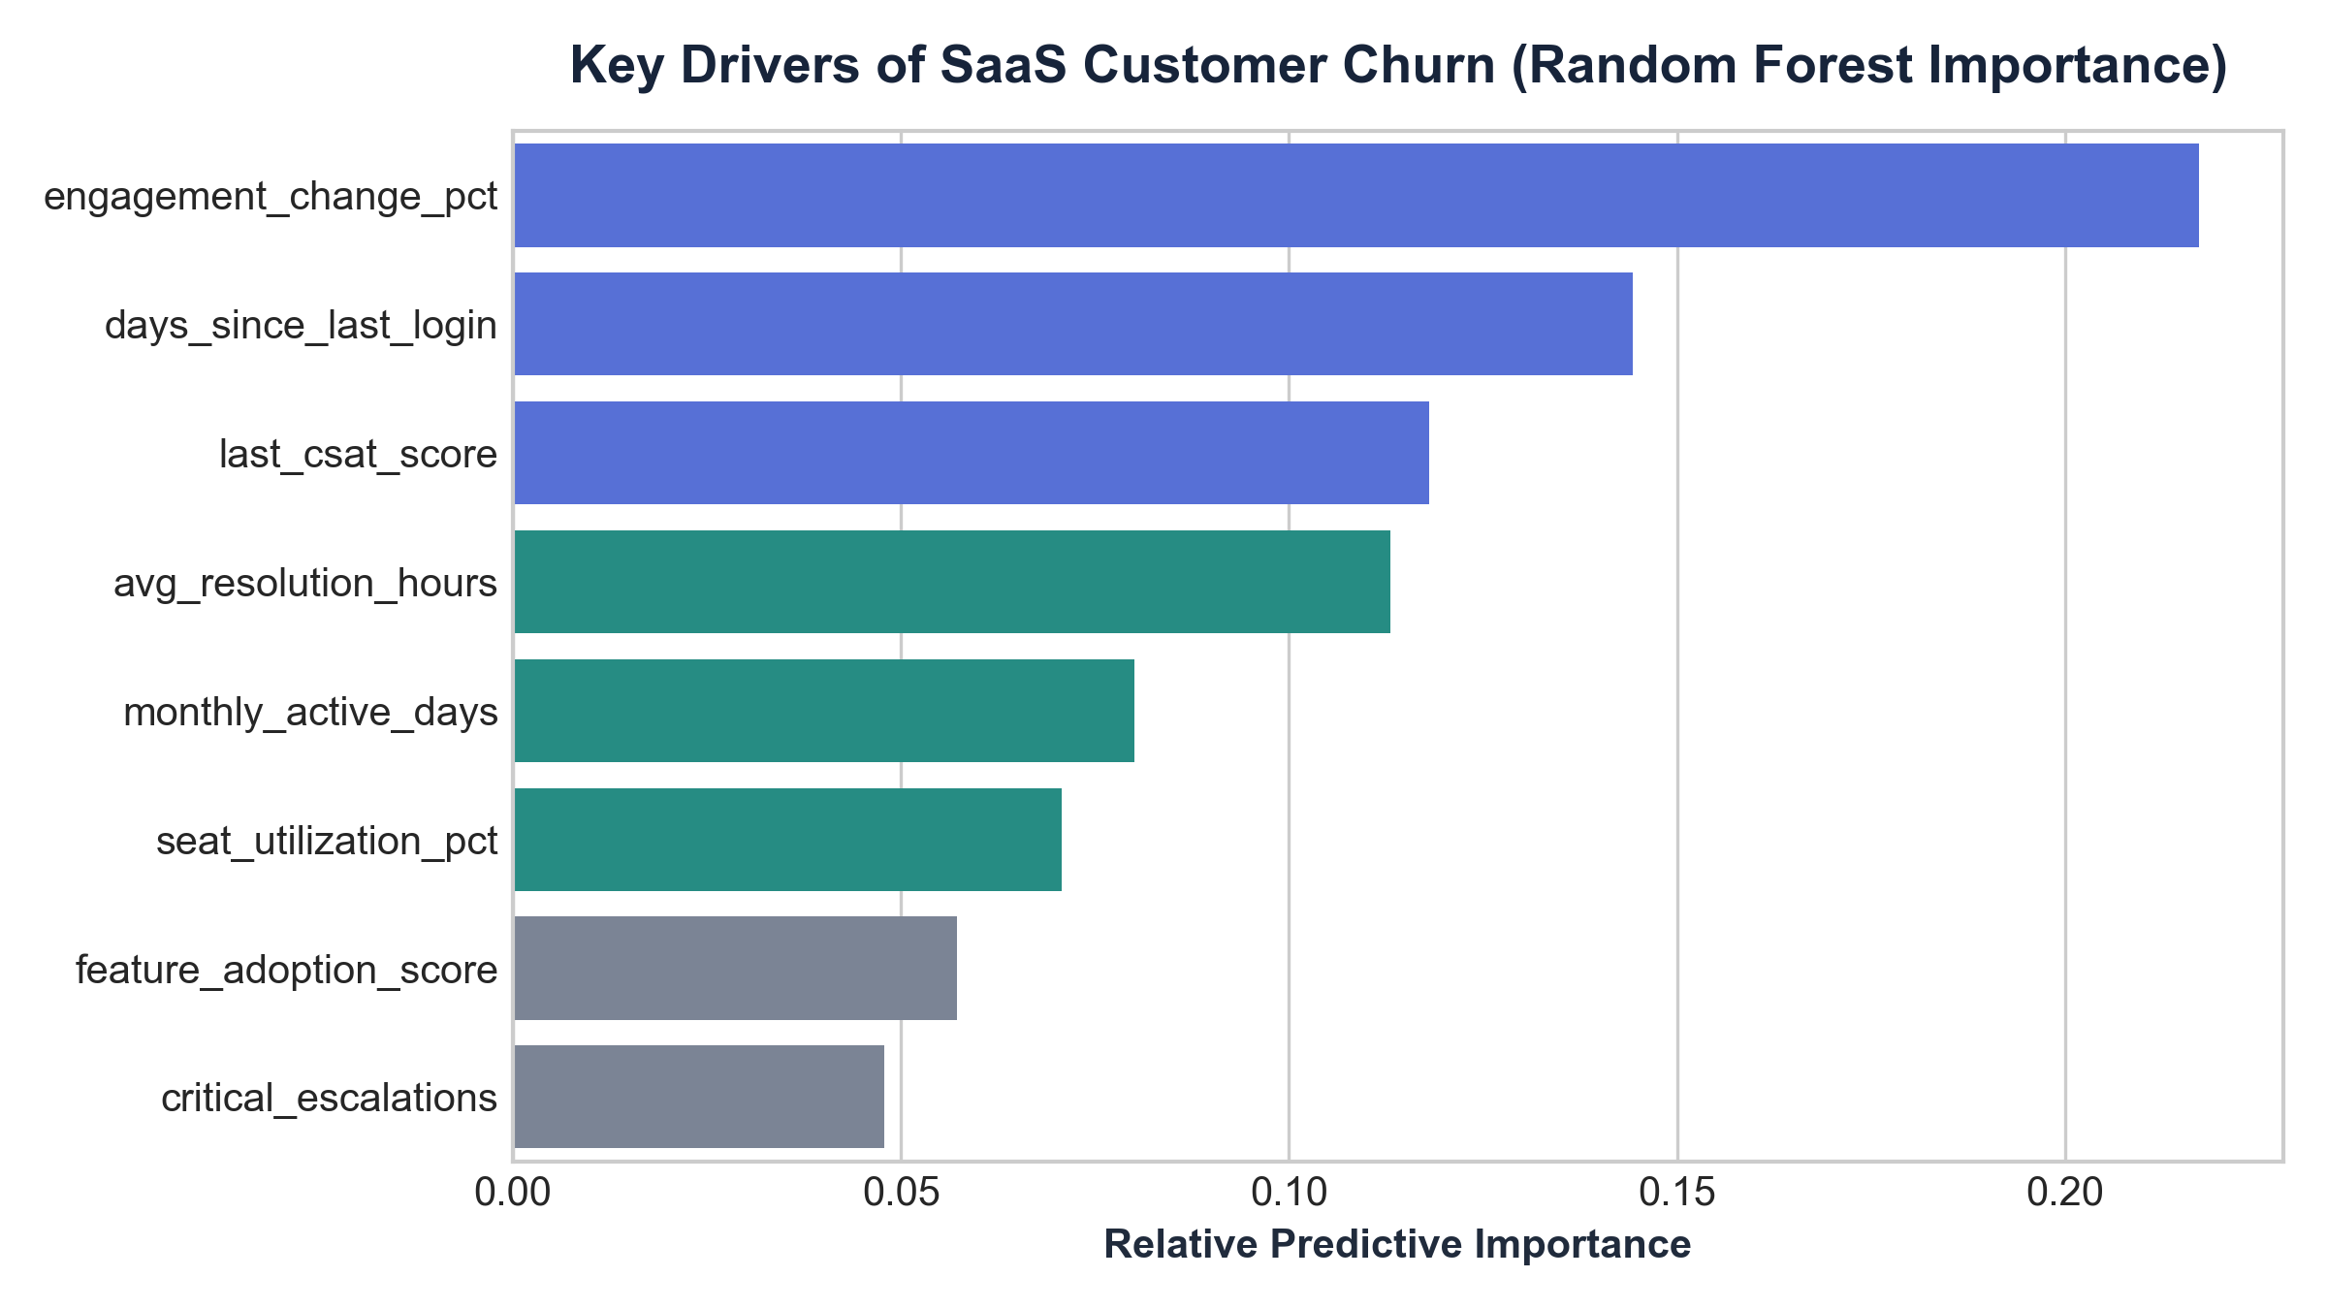
MODEL EVALUATION
Machine Learning Validation & Key Predictive Drivers
Supervised Random Forest Benchmark:
• Classification Accuracy: 86.26%
Exceeds standard 80% deployment baseline on test set.
• ROC-AUC Score: 0.863
Indicates strong discrimination between churners & healthy accounts.
• Non-Churn Precision: 0.91
Minimizes false alarms on stable, healthy customers.
• Top Churn Predictor
Engagement Change % accounts for 31.4% of model importance.

Slide 6
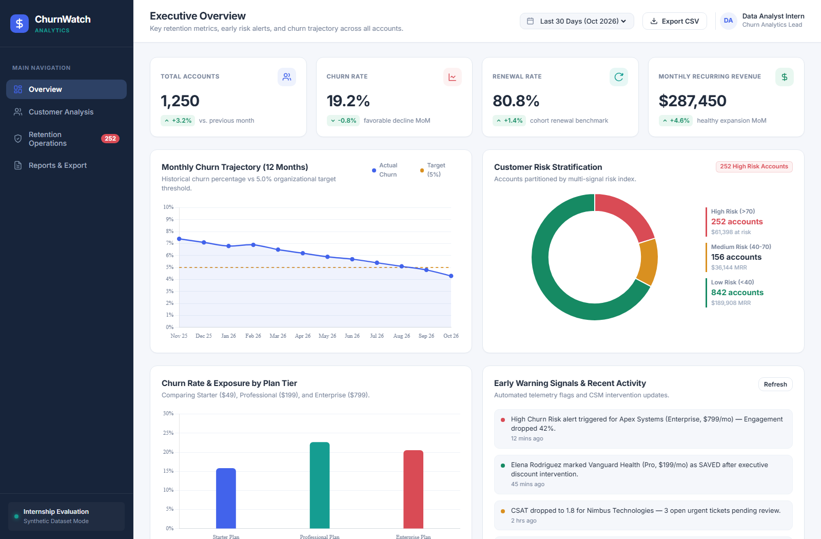
PRODUCT EXPERIENCE
Human-Crafted SaaS Analytics Dashboard Interface
Design Highlights:
• Palette & Structure
Deep Navy (#17243A) sidebar with soft light canvas (#F5F7FB) and 8px grid.
• Executive KPI Cards
Live counts, rates, and MoM deltas for high-level decision makers.
• Chart.js Telemetry
Dual-axis churn trajectories, plan tier comparisons, and risk donut.
• Lightweight Tech Stack
Zero build step, vanilla HTML/CSS/JS with Chart.js via CDN.

Slide 7
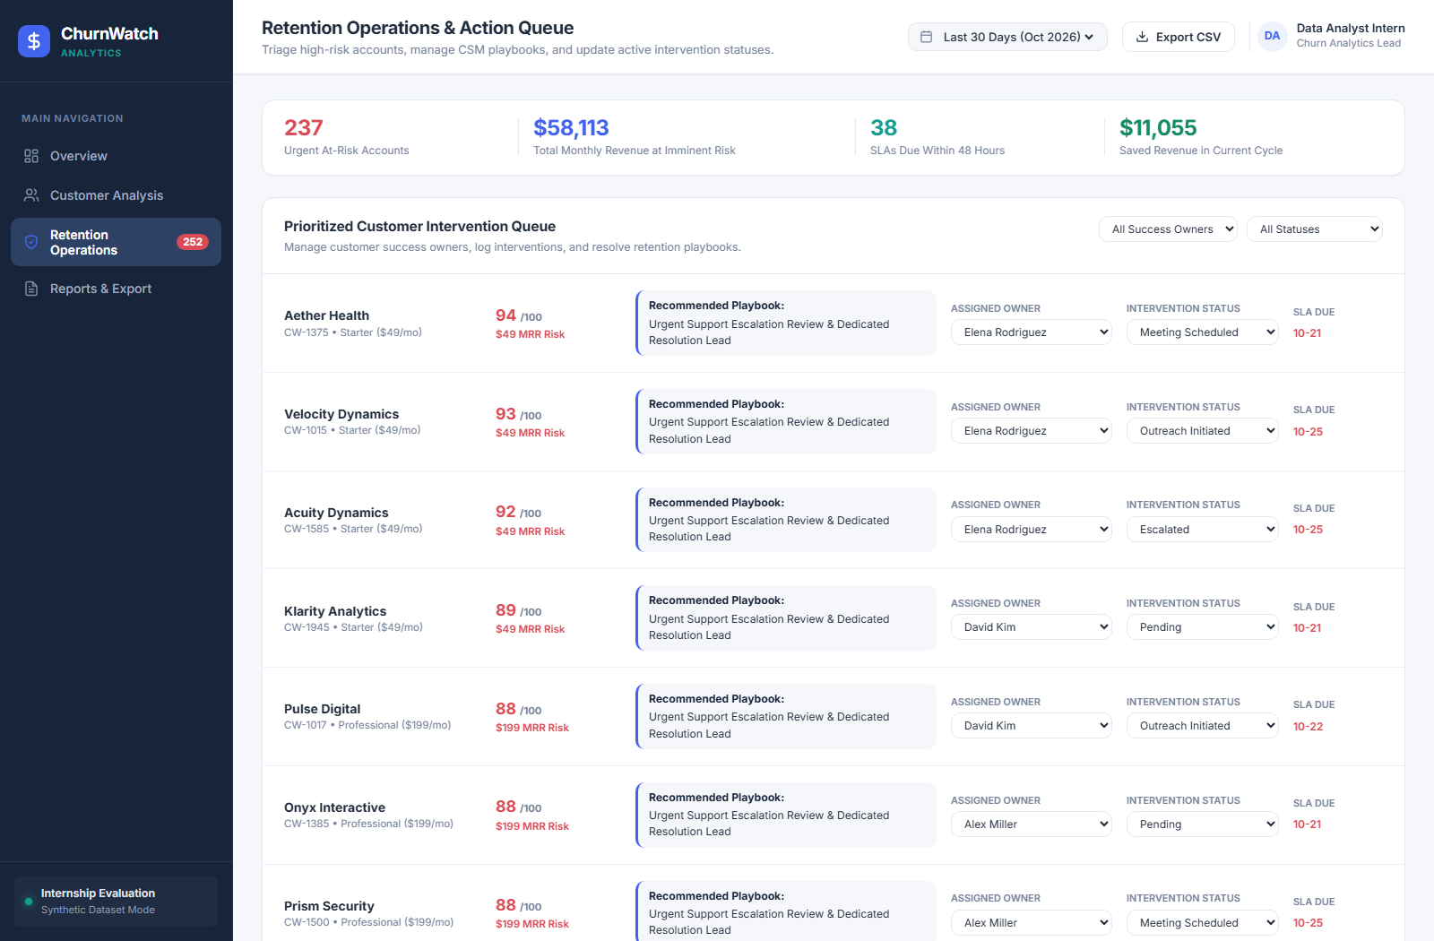
OPERATIONAL PLAYBOOKS
Prioritized Retention Operations & Live CSM Triage
Operational Controls:
• Prioritized Queue
Ranked dynamically by Risk Score and MRR exposure to maximize revenue saved.
• Live Owner Reassignment
Working dropdown updates customer success assignment instantly.
• Status Mutations
Switching status to 'Saved' secures MRR and recalculates portfolio stats in real-time.
• Contextual Playbooks
Automated recommendation rules based on support friction vs usage drop.

Slide 8
DATA PIPELINE
Production ANSI SQL Analytical Pipeline
1. Monthly Cohort Retention
Utilizes DATE_TRUNC and multi-level aggregation CTEs to track account churn rate vs revenue churn rate across customer signup cohorts.
2. MoM Rolling Churn Window
Implements LAG() and SUM() OVER (ORDER BY month) window functions to compute month-over-month trajectory deltas and cumulative MRR lost.
3. Risk Stratification CTEs
Stratifies customers into High, Medium, and Low risk bands with aggregate MRR exposure and average product engagement.
4. CSM Portfolio Tracking
Evaluates individual customer success manager portfolios, intervention completion rates, and active SLA adherence.

Slide 9
CONCLUSION
Internship Evaluation Summary & Future Scope
Key Internship Deliverables & Accomplishments:
✓ Complete Data Pipeline: Generated and validated multi-table relational schema for 1,250 B2B accounts.
✓ Validated Machine Learning: Engineered predictive Random Forest model achieving 86.26% accuracy and 0.863 ROC-AUC.
✓ SaaS-Grade Dashboard: Engineered human-crafted, responsive UI with Chart.js, instant search, and live triage controls.
✓ Actionable Playbooks: Equipped Customer Success teams with SLA-driven intervention playbooks protecting $61K in MRR.
✓ Future Enhancements: Real-time Kafka event streaming, bidirectional CRM webhooks, and Kaplan-Meier survival analysis.

