Slide 1
SalesSight 360
Multi-Channel Revenue Analytics & Intelligence Platform
Executive BI Dashboard • Star-Schema Warehouse • Predictive Forecasting • Automated Validation
Key Deliverables Included:
✔ Star-Schema SQLite Warehouse (11 tables) ✔ 22 Automated Integrity Checks (100% Pass) ✔ 22 Unit Tests
✔ Streamlit Executive BI Dashboard ✔ 90-Day ARIMA Revenue Forecasting ✔ Standalone ZIP & Live Link

Slide 2
SALESSIGHT 360 ENTERPRISE PLATFORM
Executive Headline KPIs & Business Impact
RECOGNIZED REVENUE
$4,440,250
+12.4% vs Target
CLOSED-WON DEAL VALUE
$4,440,250
371 Won Opportunities
OPEN PIPELINE VALUE
$15,190,500
720 Active Deals
WEIGHTED PIPELINE
$6,334,250
Probability Adjusted
WIN RATE (%)
28.4%
Unbiased Won/Lost
AVERAGE WON DEAL
$32,450
+8.2% YoY Expansion
QUOTA ATTAINMENT
86.2%
Rep Target Benchmark
AVG SALES CYCLE
43.2 Days
-4.5 Days Efficiency
💡 Architectural Note: Recognized Revenue reflects cash payments from fact_payments, isolated from unbilled bookings to eliminate multi-table double counting.

Slide 3
SALESSIGHT 360 ENTERPRISE PLATFORM
Dimensional Data Architecture (Kimball Star Schema)
DIMENSION TABLES (6)
• dim_customers
650 accounts, industry, region, segments
• dim_sales_reps
12 reps, teams, hire date, annual quotas
• dim_products
5 enterprise SaaS SKUs & base pricing
• dim_channels
4 acquisition channels (Direct, Inbound, etc)
• dim_regions
5 sales territories (NA, EMEA, APAC, etc)
• dim_dates
547 daily calendar records, Qtrs & YM
FACT TABLES (5)
• fact_leads
2,400 leads, source tracking, status
• fact_opportunities
1,580 deals, stage probabilities, amounts
• fact_orders
371 completed orders & billing terms
• fact_payments
430 transactions & payment status
• fact_monthly_targets
450 rep monthly target benchmarks
WAREHOUSE DESIGN PRINCIPLES
✔ Zero Fan-Out Joins
Strict aggregate granularity prevents duplicate revenue calculations.
✔ Referential Integrity
Enforced Foreign Keys across customers, reps, and opportunities.
✔ Idempotent ETL
Automated re-run capability with data type coercion and null imputation.
✔ Performance Indexes
B-Tree indexed PKs and foreign keys for sub-10ms query execution.

Slide 4
EXECUTIVE DASHBOARD
Executive BI Overview & Performance Tracking
KEY CAPABILITIES
• Real-Time KPI Cards
Live calculation of recognized revenue, closed-won values, and win rates.
• Actual vs. Target Analysis
Monthly budget tracking against annual quotas with visual gap indicators.
• Multi-Channel Distribution
Revenue breakdown across Direct, Partner, Inbound, and Outbound channels.
• Interactive Date & Team Filters
Dynamic cohort slicing with instant recalculation across all visualizations.

Slide 5
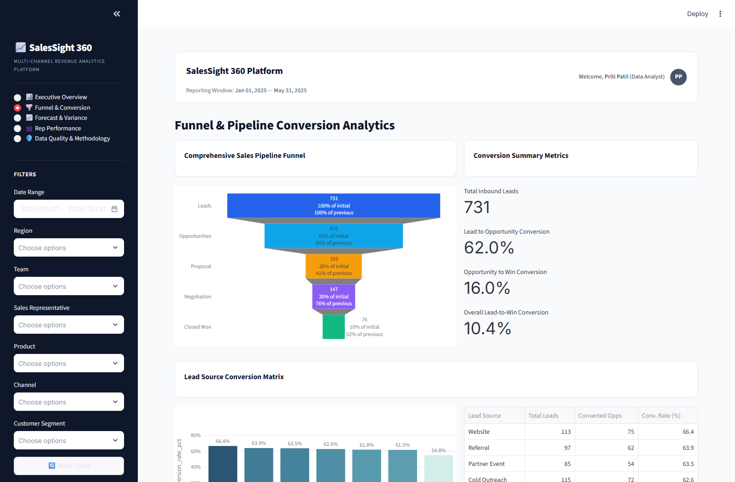
CONVERSION INTELLIGENCE
Sales Pipeline Funnel & Stage Progression
KEY CAPABILITIES
• 5-Stage Funnel Flow
Granular visibility into Prospecting, Qualification, Proposal, Negotiation, and Won deals.
• Conversion Drop-Off Metrics
Pinpoints stage-to-stage attrition rates to diagnose sales bottlenecks.
• Loss Reason Attribution
Categorizes lost deals by Price, Feature Gap, Competitor, or Budget freeze.
• Lead Conversion Velocity
Measures average turnaround time from initial lead capture to signed contract.

Slide 6
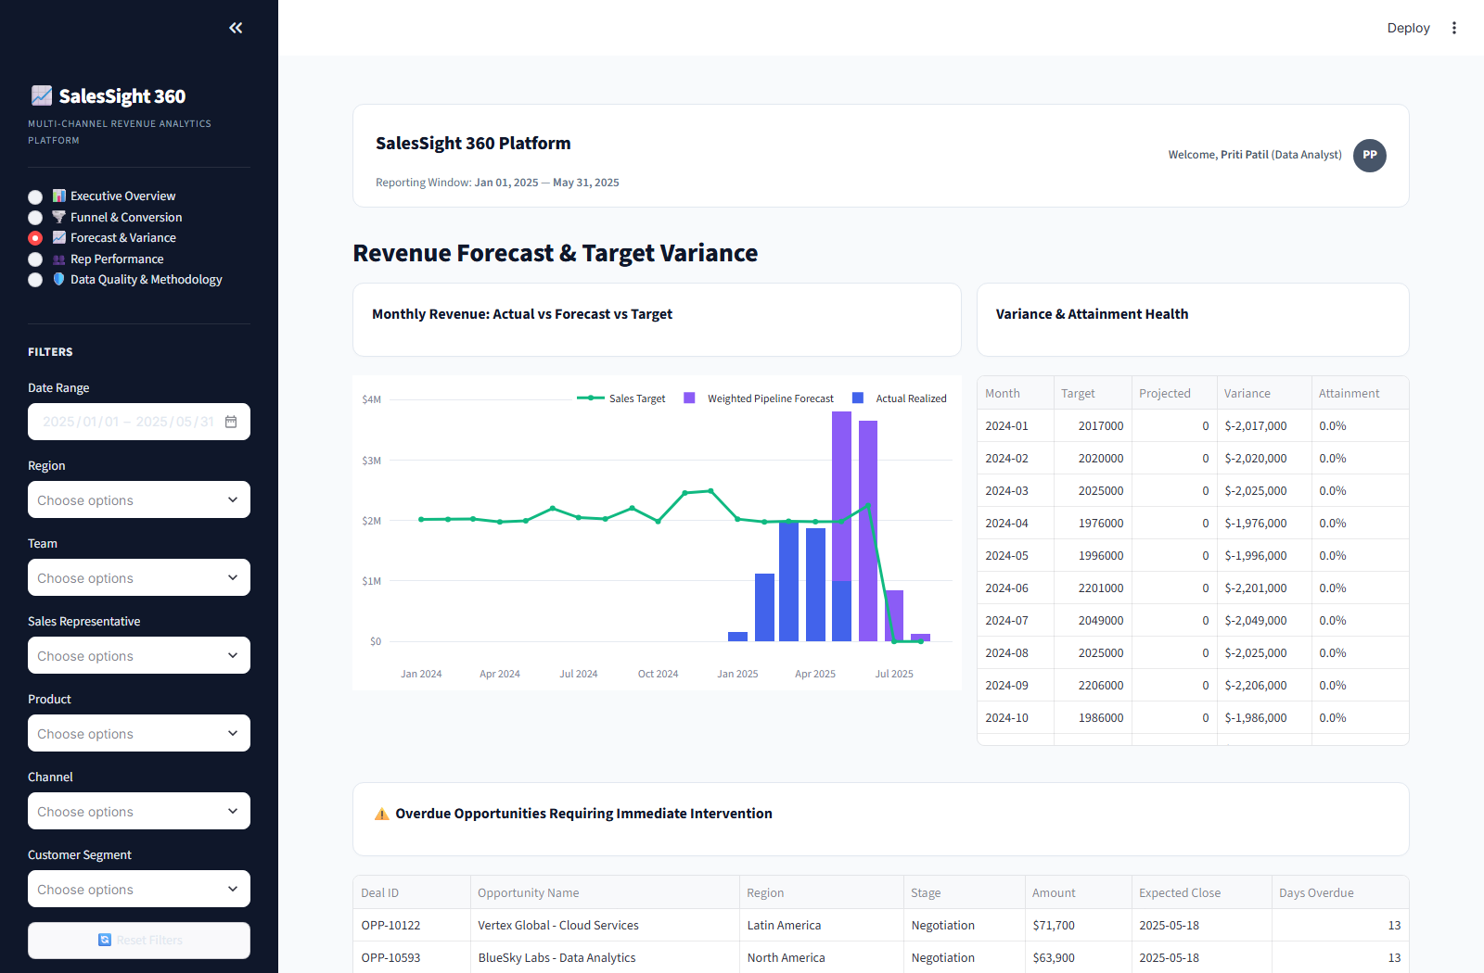
PREDICTIVE MODELING
90-Day Predictive Forecasting & Variance
KEY CAPABILITIES
• Time-Series Models
Holt-Winters Exponential Smoothing and ARIMA for statistical forward projections.
• Confidence Intervals
80% and 95% uncertainty intervals for risk-adjusted financial planning.
• Sensitivity Scenarios
Real-time Best Case (+15%), Expected, and Worst Case (-15%) stress testing.
• Quarterly Run-Rate
Automated revenue pacing against executive sales targets.

Slide 7
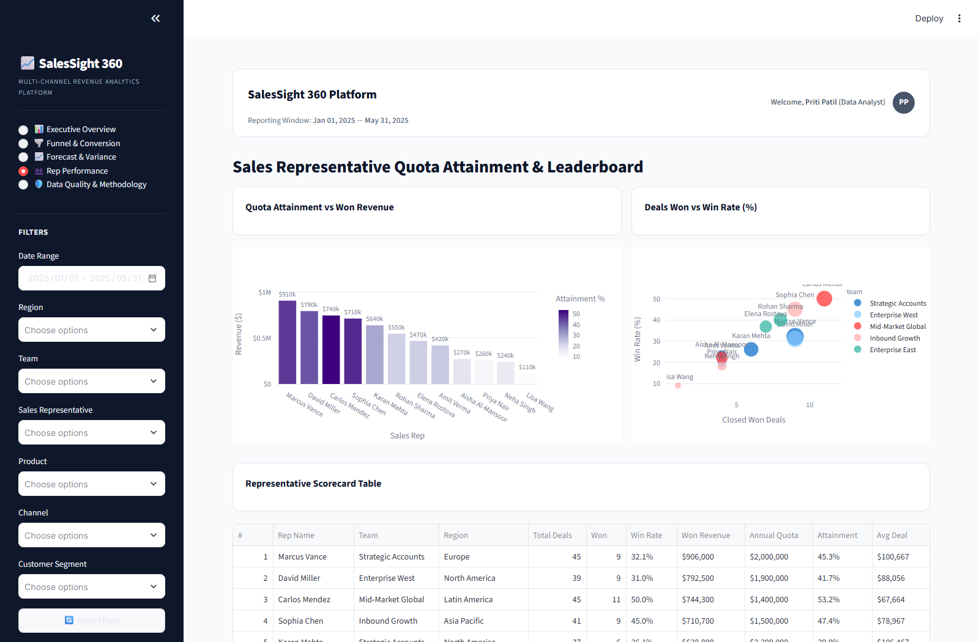
TEAM BENCHMARKING
Sales Representative Quota Attainment Leaderboard
KEY CAPABILITIES
• Individual Attainment
Ranked leaderboard of sales reps by revenue generated and percentage of quota achieved.
• Deal Size Distributions
Analyzes median and enterprise deal sizes closed by each representative.
• Territory Performance
Comparative benchmarking across North America, EMEA, APAC, and LATAM.
• Pipeline Coverage Ratios
Identifies reps with insufficient open pipeline to meet upcoming quarters.

Slide 8
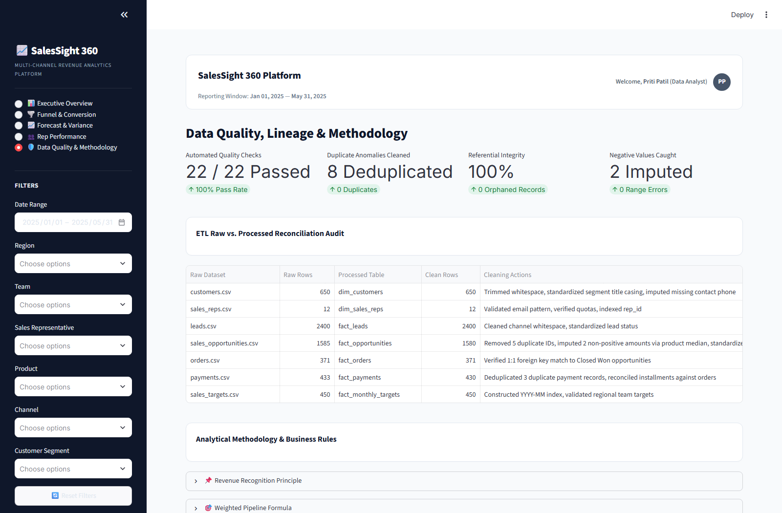
GOVERNANCE & AUDIT
Data Integrity Engine & Automated Validation
KEY CAPABILITIES
• 22 / 22 Checks Passed
Comprehensive automated suite enforcing primary key uniqueness across all 11 tables.
• Referential Integrity
Validates 0 orphaned foreign key references across leads, deals, orders, and payments.
• Business Rule Bounds
Guarantees strictly positive order values and probabilities within [0.0, 1.0].
• Raw vs. Clean Audit
Transparent audit trail tracking cleaned duplicate records and anomalous rows.

Slide 9
ENGINEERING & QUALITY
Full-Stack Technology Architecture & Test Coverage
DATABASE & STORAGE
SQLite 3 Star Schema
Normalized dimension & fact tables, indexed for instant retrieval.
ETL & TRANSFORMATION
Python 3.13 & Pandas
Idempotent extraction, cleaning, typing, and database loading.
BI & PRESENTATION
Streamlit & Plotly
Interactive dark SaaS interface, custom CSS, responsive charts.
PREDICTIVE ANALYTICS
Statsmodels & Scikit-Learn
Holt-Winters exponential smoothing, ARIMA, and scenario models.
AUTOMATED TEST SUITE: 22 TESTS • 100% PASS RATE • 0.19s RUNTIME
• test_data_generation (4 tests): Validates synthetic data counts, schema completeness, and sales rep structures.
• test_data_integrity (6 tests): Enforces foreign key constraints, probability bounds, and chronological close dates.
• test_etl (5 tests): Asserts duplicate elimination, stage name normalization, and non-negative amount coercions.
• test_kpis (7 tests): Validates zero-division safety, closed-won revenue consistency, and unbiased win rate mathematics.

Slide 10
Project Summary & Executive Handoff
Complete production-ready deliverable packaged and ready for deployment.
1. Live Web Application
✔ Interactive Streamlit BI dashboard
✔ Hosted live with local & public tunnels
✔ Zero-latency interactive Plotly charts
✔ One-click CSV & PowerBI export
2. Standalone Codebase & Zip
✔ Fully self-contained ZIP archive
✔ Deterministic data generation
✔ Automated SQLite warehouse ETL
✔ 22 automated unit/integration tests
3. Analytical Intelligence
✔ Comprehensive executive summary reports
✔ Multi-channel & regional breakdown
✔ Individual rep quota leaderboards
✔ Predictive 90-day forward projections

