Slide 1
ML25/26-11
Implement Reminder Agent
Cloud Migration of a Conversational AI System to Microsoft Azure with a Model Context Protocol (MCP) Server
KavyaSree Thabjul (1633324) · Bavana Jadala (1629828) · Aishwarya Rajendra Sawant (1629688)
Branch Name – TechTrio-ReminderAgent
Frankfurt University of Applied Sciences — Information Technology Course, Module Cloud Computing (Damir Dobric)

Slide 2
Abstract
ReminderAgent is a conversational AI system for saving and retrieving personal reminders — restaurants, books, travel plans — through free-form natural language, built on the Microsoft Agent Framework with hybrid retrieval combining metadata filtering and 1,536-dimensional OpenAI cosine similarity search.
At a Glance
9
MCP tools exposed
4
Azure storage services integrated
This cloud computing project migrates the console-based implementation to Microsoft Azure, preserving the original console application unchanged and extending the system with a new MCP tools deployed as a Docker container on Azure App Service over Streamable HTTP.
51
Integration tests, 84% on real Azure
1536
Dimensional OpenAI embeddings
1
Entry points, one shared tool library
ReminderAgent — Cloud Computing Project (ML25/26-11)
2

Slide 3
Introduction
Problem statement and goals & scope
Problem Statement
Five Project Goals
Personal information management tools fail at both ends of the task: rigid categories/tags at capture time, and exact-recall requirements at retrieval time.
The prior Software Engineering project solved this with free-form NL input and hybrid retrieval (metadata filters + cosine similarity), but was limited by:
  Linear cosine-scan scalability
  Single-user, flat-file (CSV/JSON) storage isolation
  No way to expose tools to remote AI clients without cloning/running locally
Replace flat-file storage with Azure SQL Database (native VECTOR(1536) column)
Replace local Photos/ folder with Azure Blob Storage + SAS tokens
Add async bulk import (CSV/JSON/ZIP) via Azure Queue Storage with poison-queue retries
Preserve the console app unchanged; add a new MCP tools alongside it
Deploy the MCP Server as a Docker container on Azure App Service over Streamable HTTP
ReminderAgent — Cloud Computing Project (ML25/26-11)
3

Slide 4
Technology Choices & Literature Review
Microsoft Azure
Model Context Protocol
OpenAI Models
Native VECTOR(1536) column in Azure SQL; all four storage primitives in one resource group; first-class Docker hosting on App Service.
Clients discover & invoke tools autonomously at runtime from [Description] attributes — no bespoke client integration needed.
text-embedding-3-small for 1,536-dim semantic vectors; GPT-4o-mini for NL routing, via Microsoft.Extensions.AI abstraction.
Literature Foundations
ReAct (Yao et al.) — LLM as intent router: reason → act → observe → reason, realised via IChatClient / AIFunctionFactory
Retrieval-Augmented Generation (Lewis et al.) — retrieval and generation kept as separate, independently verifiable steps
BERT (Devlin et al.) & Sentence-BERT (Reimers & Gurevych) — contextual and sentence-level embeddings underpin semantic search
Adaptive-RAG (Jeong et al.) — retrieval strategy should adapt to query complexity
ReminderAgent — Cloud Computing Project (ML25/26-11)
4

Slide 5
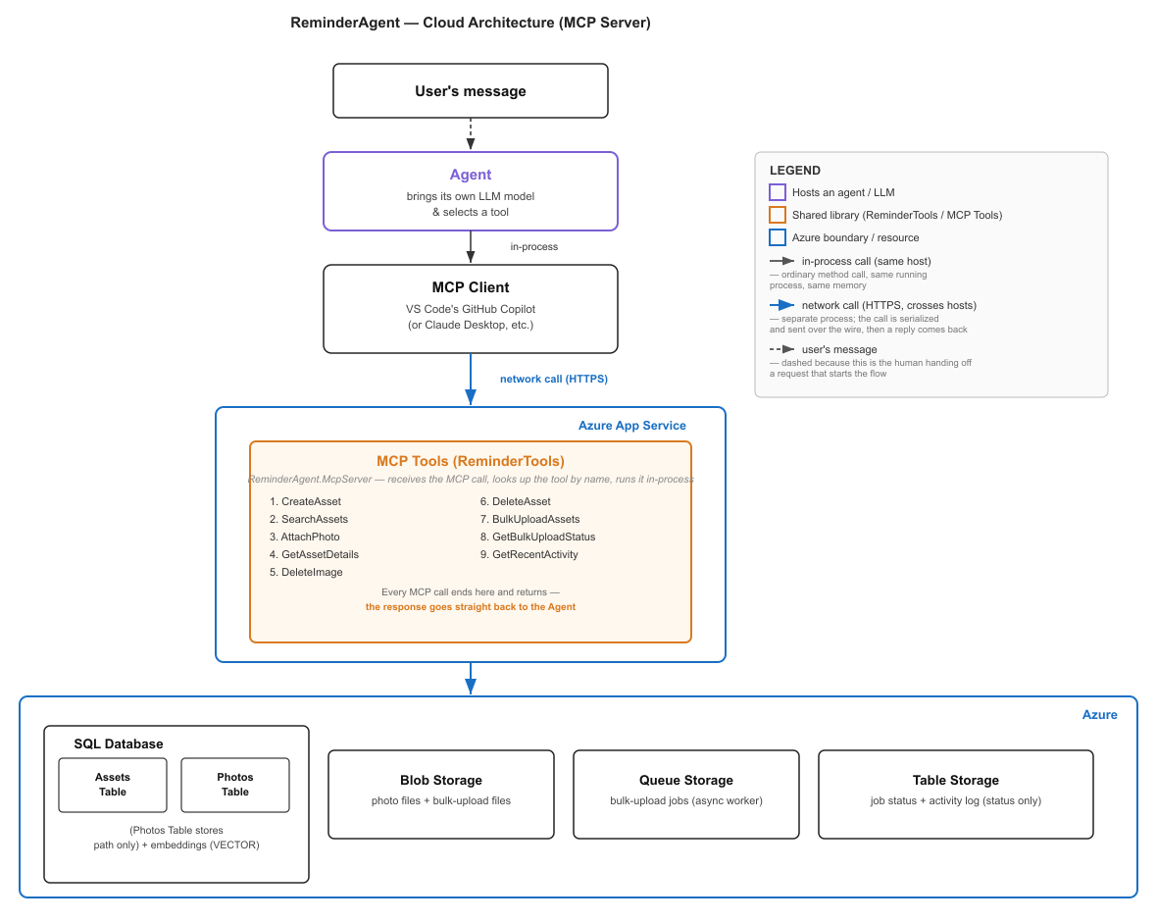
System Architecture
User's message — the human hands off a request; this is where the flow starts
Agent — inside the MCP client, brings its own LLM and picks which tool to call.
MCP Client — sends the tool call over HTTPS to the deployed server.
MCP Tools (ReminderTools) — runs in Azure App Service, looks up and executes the tool, returns the response.
Azure — ReminderTools reads from and writes to four Azure services:
SQL Database - Assets + Photos Table
Blob Storage — photo files + bulk-upload files
Queue Storage — bulk-upload jobs, processed by an async background worker
Table Storage — job status + activity log (status only)
ReminderTools
(9 shared tools)
User's Message
Agent (client LLM)
selects tool in-process
ReminderAgent — Cloud Computing Project (ML25/26-11)
5

Slide 6
The Nine MCP Tools
ReminderTools — the shared execution layer
1
CreateAsset
2
SearchAssets
3
GetAssetDetails
Inserts row, then fills VECTOR(1536) embedding via async UPDATE
Unified search: metadata filters + keyword ranking, auto semantic fallback
Full record incl. linked photos; reuses stored SAS AccessKey
4
AttachPhoto
5
DeleteImage
6
DeleteAsset
Validates extension, uploads to Blob, writes BlobName/Url/SAS to Photos
Deletes by GUID or asset name; asks to disambiguate multi-photo assets
Explicitly removes photos + blobs, then the asset row (CASCADE as safety net)
7
BulkUploadAssets
8
GetBulkUploadStatus
9
GetRecentActivity
Uploads file, enqueues job, returns Job ID immediately (async worker)
Reads job summary (total/succeeded/failed) from Table Storage
Reads ActivityLog newest-first via reverse-tick RowKey pattern
ReminderAgent — Cloud Computing Project (ML25/26-11)
6

Slide 7
Test Suite & Results
51 integration tests across four MSTest classes
84% of tests (43/51) run with no substitution at all — real Azure SQL, Blob, Queue, and Table services.
[DoNotParallelize] and a per-class hex run-ID prevent connection-pool exhaustion and data collisions.
McpServer_Protocol_Tests launches the real server as an OS child process and drives it over Streamable HTTP — genuine JSON-RPC coverage that in-process mocking cannot reach.
ReminderAgent — Cloud Computing Project (ML25/26-11)
7

Slide 8
Deployment Evidence
Live on Azure App Service
App Service: Running
Container Registry
Container status Running under App Service Plan "TechTrio", region North Europe. Health check returns HTTP 200: "ReminderAgent MCP Server is running. MCP endpoint: /mcp".
Docker image reminderagent-mcpserver pushed to Azure Container Registry (mcpserverreminderagent, Germany West Central) with tag v2.
Azure SQL persistence
Table Storage activity log
DATALENGTH(Embedding) = 6,152 bytes per row — confirms the full 1,536-dim OpenAI vector is stored in the native VECTOR(1536) column.
ActivityLog table records every tool call (CreateAsset, SearchAssets, AttachPhoto, DeleteImage, GetRecentActivity) with UTC timestamp and Success flag.
MCP client connectivity
End-to-end verification
GitHub Copilot Chat and Claude Desktop both connected to the live HTTPS endpoint and listed all nine ReminderTools methods with zero client-side configuration.
BulkUploadAssets and AttachPhoto verified live via Claude Desktop: a CSV was processed by the background worker and a photo attached and retrieved via its SAS link.
ReminderAgent — Cloud Computing Project (ML25/26-11)
8

Slide 9
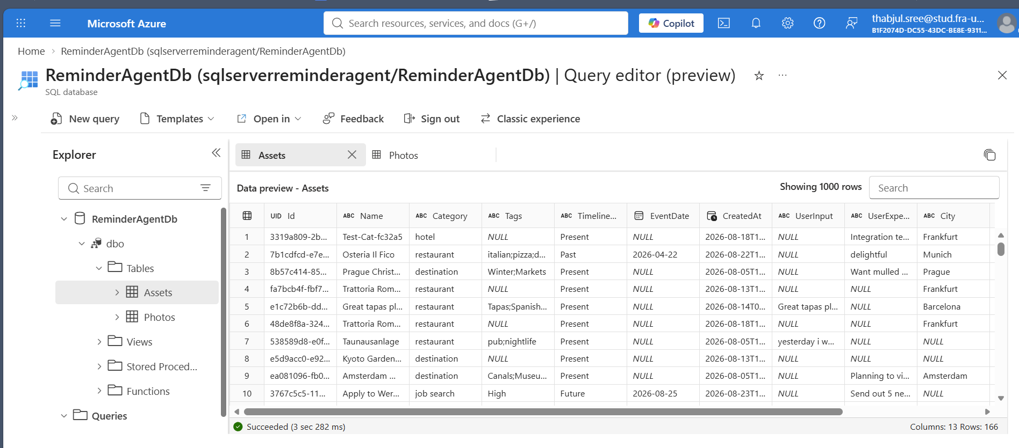
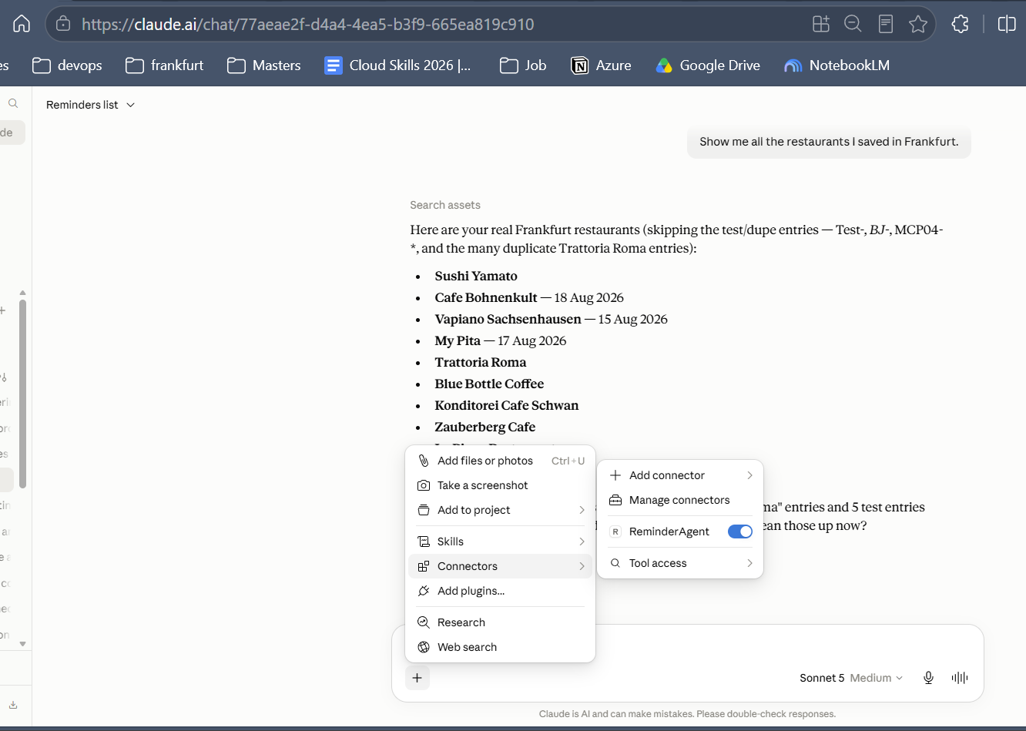
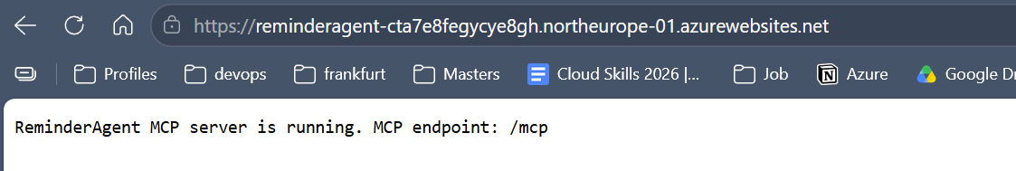
Deployment Evidence
SQL Database
Using Claude.ai has Agent
MCP Tools Running
ReminderAgent — Cloud Computing Project (ML25/26-11)
9

Slide 10
Conclusion
ReminderAgent was migrated from a single-machine console app with flat-file storage to a fully deployed cloud-native service on Microsoft Azure — while keeping its original local conversational interface fully intact.
✓
Azure SQL, Blob, Queue, and Table Storage fully integrated and operational
✓
Semantic search over 1,536-dim OpenAI embeddings functioning correctly
✓
9 MCP tools live on a real network-accessible HTTPS endpoint
✓
Verified end-to-end with GitHub Copilot Chat and Claude Desktop
✓
Docker image deployed via Azure Container Registry to Azure App Service (North Europe)
Frankfurt University of Applied Sciences | Module Cloud Computing | Instructor: Damir Dobric

