Slide 1

Reminder Agent
An AI-Powered Natural Language Asset Management System Using the Microsoft Agent Framework
Course: Information Technology
Course Module: Software Engineering
Professor: Damir Dobric
Project Name: ML 25/26 -11 Implement Reminder Agent
Team Name: Tech_Trio
Team: KavyaSree Thabjul (1633324),
Bavana Jadala (1629828),
Aishwarya Rajendra Sawant (1629688)

Slide 2
The Problem
Current Tools Fall Short
The Memory Gap
Existing personal information tools require exact keyword recall at retrieval and structured input at capture, ineffective for real-world scenarios.
The restaurant someone mentioned at lunch, or the book title that came up in conversation, gone by the time you reach your phone. And when you do find a moment to write something down, the app wants a category, a tag, a properly filled field. Forms and tags do not make capture easier. They make you give up and forget it anyway.

Slide 3
The Solution
Natural Language
AI-Powered Extraction
Semantic Search
Type one sentence: "remind me of that Italian place in Frankfurt Ginnheim, went last March, loved it."
GPT-4o-mini acts as intent router, automatically generating name, category, city, date, and experience from your input.
Retrieve by meaning, not exact keywords. OpenAI embeddings enable cosine similarity scoring for context-based matching.

Slide 4
Core Technology Stack
C# / .NET 10
GPT-4o-mini
Modern, type-safe language with async/await support for responsive user experience.
Orchestration and RAG generation for intent routing and natural language understanding.
text-embedding-3-small
CSV + JSON Storage
1,536-dimensional vectors for semantic similarity and retrieval tasks.
Lightweight file-based persistence without database server requirements.

Slide 5
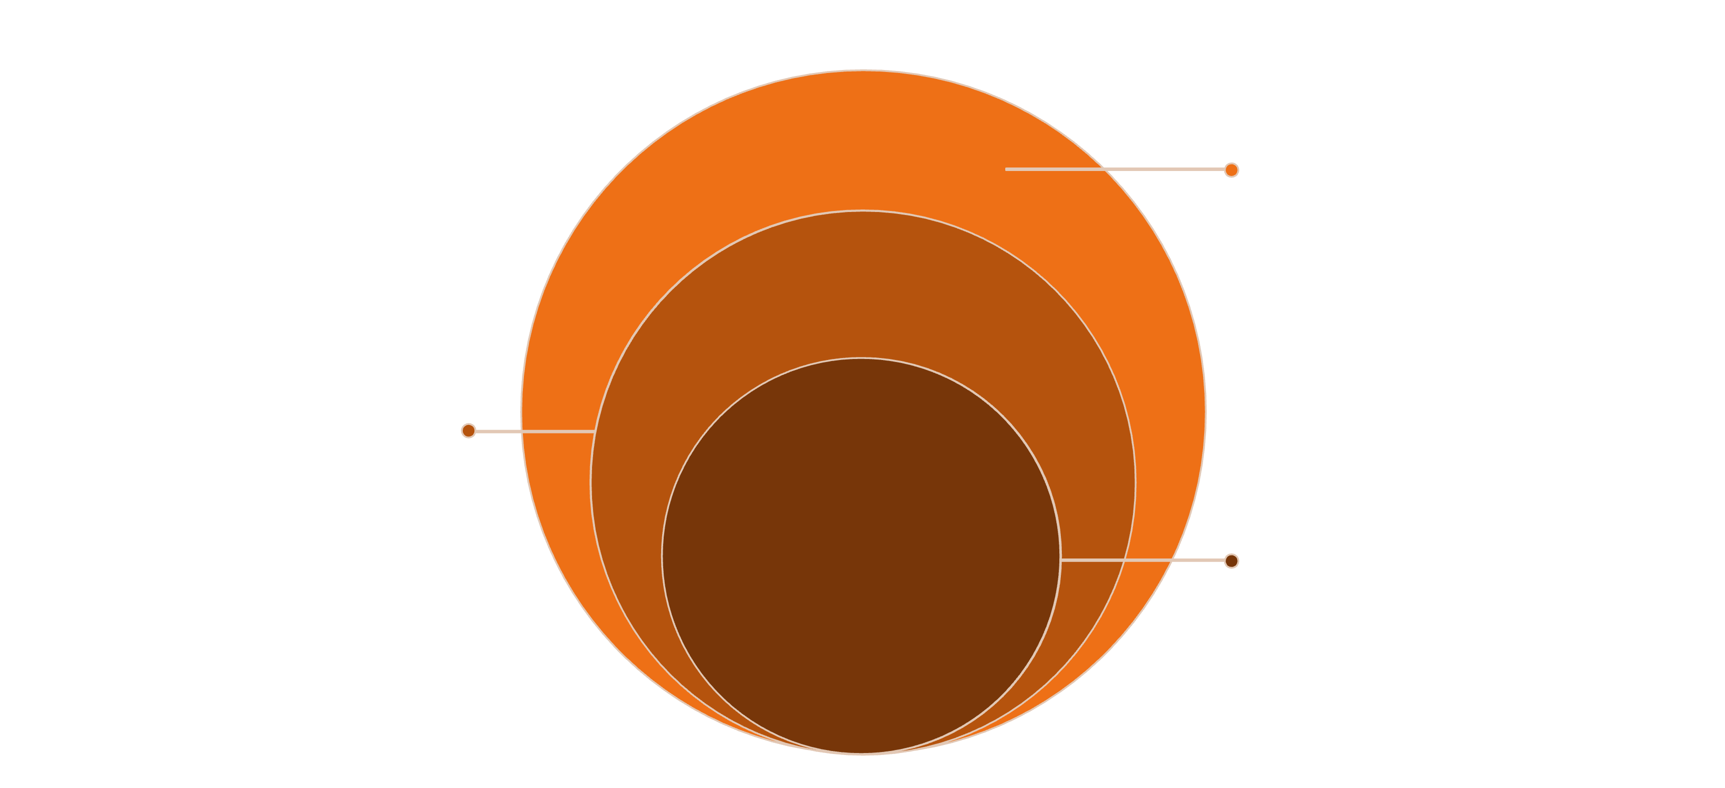
System Architecture
Outer: Infrastructure
CSV, JSON, Embeddings, Similarity, Logger services
Mid: Orchestration & Tools
IChatClient + GPT-4o-mini; ReminderTool (7 methods)
Core: Presentation
Program.cs REPL handling user I/O

Slide 6
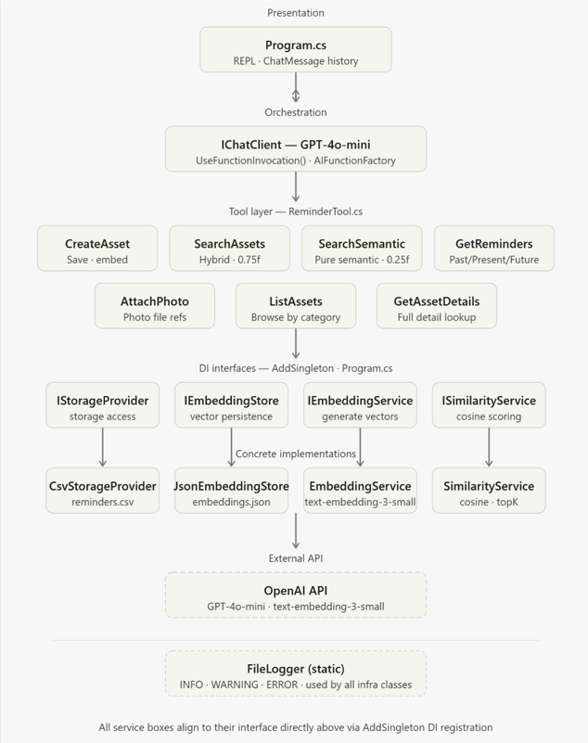
System
Process
Flow

Slide 7
Seven Tool Functions
01
02
03
CreateAsset
SearchAssets
GetReminders
Save new reminders with automatic field extraction
Structured queries with filters
Timeline-scoped retrieval
04
05
06
SearchRemindersSemantic
AttachPhoto
ListAssets
Meaning-based vector search
Link images to existing assets
Browse all stored reminders
07
GetAssetDetails
View complete asset information

Slide 8
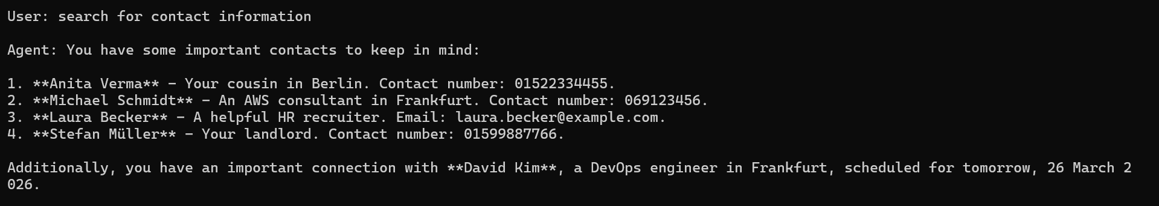
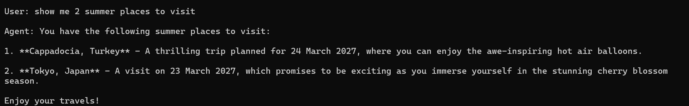
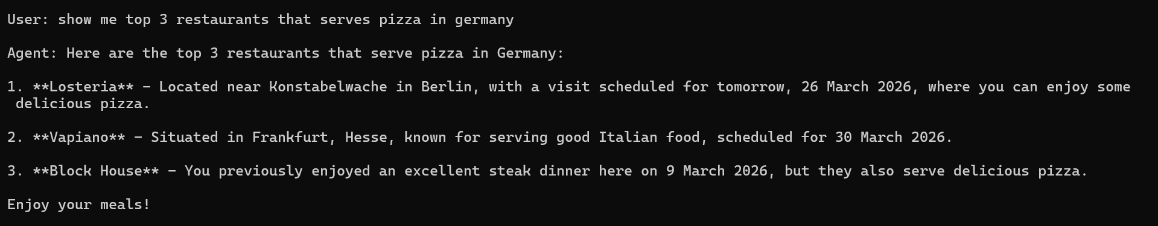
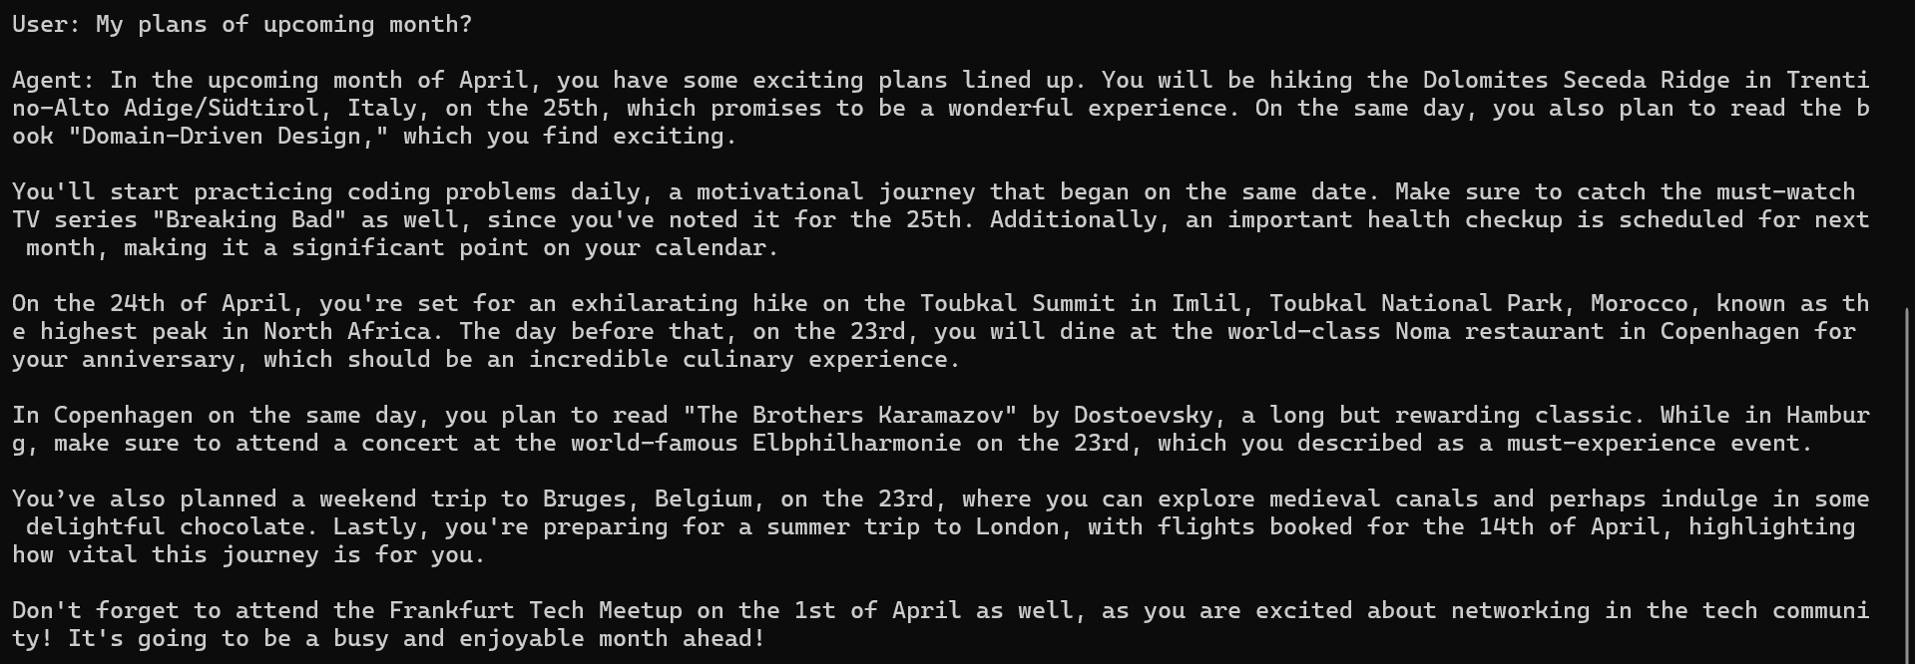
Results:
Contacts Details (GetAssetDetails)
Places Suggestions (SearchRemindersSemantic)
Restaurants Suggestions (SearchAssets)
Next Month Reminders (GetReminders )

Slide 9

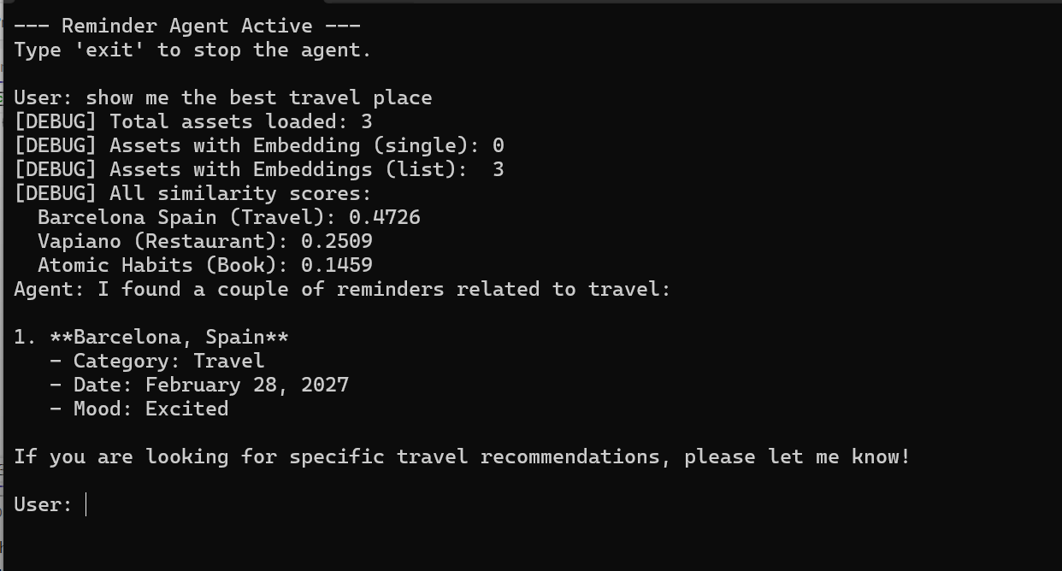


Semantic Search in Action
Save Time
Combined representation of Name, Category, UserInput, Experience, and Tags generates 1,536-dimensional embedding
Query Time
Query embedding generated and compared against stored embeddings using cosine similarity
Ranked Results
Similarity threshold 0.25 for semantic queries, 0.75 for structured pipelines

Slide 10
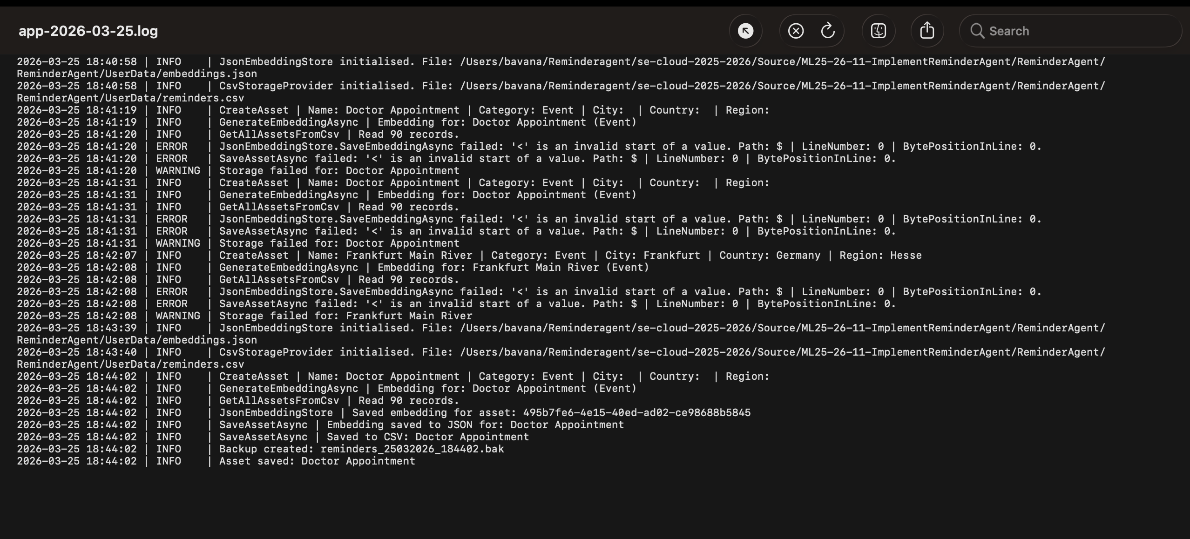
File Logger
FileLogger records every save, search, embedding call, and error with a timestamp and level, INFO, WARNING, or ERROR.
A new log file is created automatically every day, giving us a complete audit trail to trace exactly what happened and when.

Slide 11
Data Model & Storage
Why Flat Files?
reminder.csv
No database, no ORM, no setup
Portable – runs anywhere
Two files do everything:
reminders.csv
embeddings.json
Split because CSV can't store float[] cleanly- Json can
Linked by the same Guid per asset
Id, Name, Category, TimelineState, EventDate, CreatedAt, Tags, Metadata, UserInput, UserExperience, PhotoRefs
embeddings.json
{ "5cfd...": [0.012, -0.034, 0.091 ...],
"c94f...": [-0.003, 0.071, 0.044 ...] }
Guid → float[1536] • one entry per asset
Crash-safe: Backup copy created after each write

Slide 12
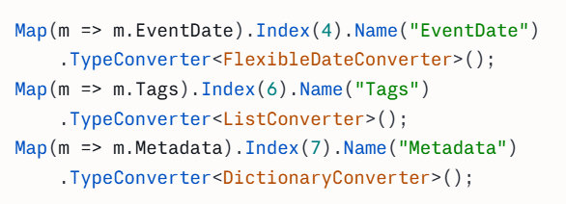
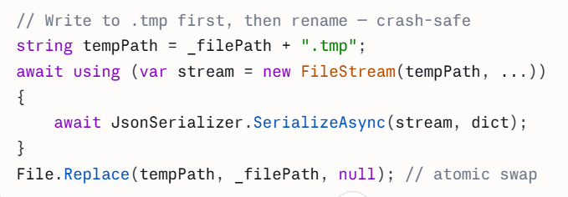
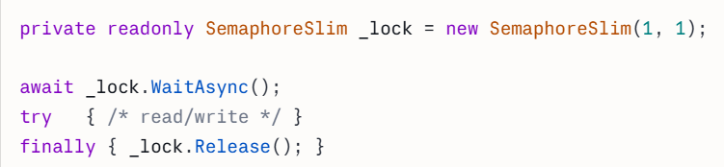
CSVStorageProvider Structure & Safety Patterns
AssetMap – the column mappings
Atomic Write
2. The 3 custom converters
2. Threads Safety (Semaphore Slim)
1. ListConverter "paris;travel" <-> List<string> 2.DictionaryConverter "City=Paris|Country=FR" <-> Dict<string,string> 3. FlexibleDateConverter Handles 14 date formats

Slide 13
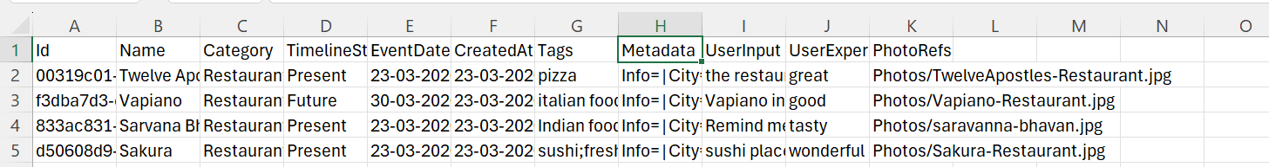
CSV & JSON Format
CSV
JSON

Slide 14
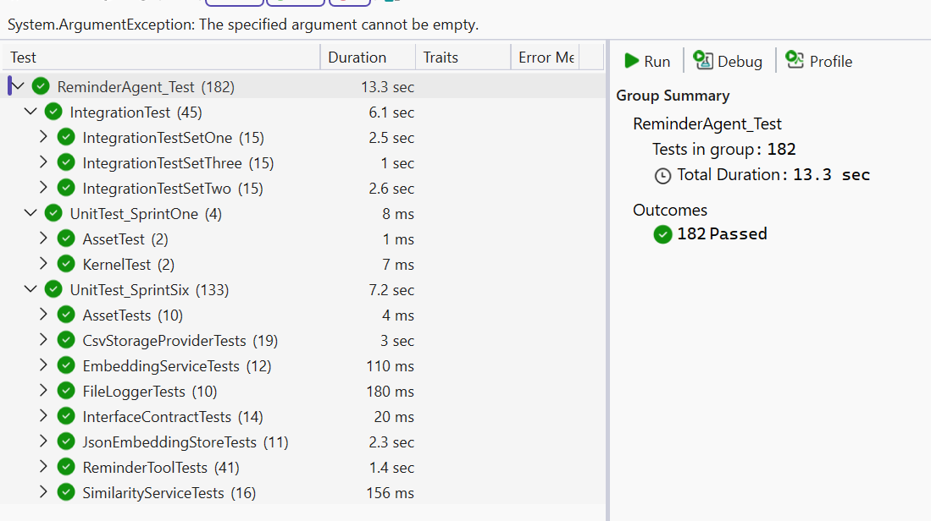
Testing & Quality Assurance
182
2
3
Total Tests
Unit Test Sets
Integration Sets
Unit and integration tests combined
Full coverage across all operations
Real file system testing
Unit Test Coverage
Integration Test Areas
Attachment workflows
Location queries
Relative time expressions
Special characters
Concurrent write atomicity
Storage providers (CSV + JSON)
Similarity service edge cases
Date parsing and filtering
Interface contracts via reflection

Slide 15


