Slide 1
Algorithms
Single Source Shortest Path
(Dijkstra’s Algorithm)

Slide 2
Shortest Path Problems
What is shortest path ?
shortest length between two vertices for an unweighted graph:
smallest cost between two vertices for a weighted graph:
B
B
210
A
A
450
60
190
C
unweighted graph
C
weighted graph
200
130
D
D
E
E

Slide 3
Shortest Path Problems
How can we find the shortest route between two points on a map?
Model the problem as a graph problem:
Road map is a weighted graph:
vertices = cities
edges = road segments between cities
edge weights = road distances
Goal: find a shortest path between two vertices (cities)

Slide 4
Shortest Path Problems
Input:
Directed graph G = (V, E)
Weight function w : E → R
Weight of path p = ⟨v₀, v₁, . . . , v_{k}⟩
Shortest-path weight from u to v:
δ(u, v) = min w(p) : u v if there exists a path from u to v
∞ otherwise
Shortest path u to v is any path p such that w(p) = δ(u, v)
t
x
3
6
9
3
4
s
0
2
1
2
7
5
3
5
11
6
y
z
p

Slide 5
Variants of Shortest Paths
Single-source shortest path
G = (V, E) ⇒ find a shortest path from a given source vertex s to each vertex v ∈ V
Single-destination shortest path
Find a shortest path to a given destination vertex t from each vertex v
Reverse the direction of each edge ⇒ single-source
Single-pair shortest path
Find a shortest path from u to v for given vertices u and v
Solve the single-source problem
All-pairs shortest-paths
Find a shortest path from u to v for every pair of vertices u and v

Slide 6
Optimal Substructure of Shortest Paths
Given:
A weighted, directed graph G = (V, E)
A weight function w: E → R,
A shortest path p = ⟨v₁, v₂, . . . , v_{k}⟩ from v₁ to v_{k}
A subpath of p: p_{ij} = ⟨v_{i}, v_{i+1}, . . . , v_{j}⟩, with 1 ≤ i ≤ j ≤ k
Then: p_{ij} is a shortest path from v_{i} to v_{j}
Proof: p = v₁ v_{i} v_{j} v_{k}
w(p) = w(p_{1i}) + w(p_{ij}) + w(p_{jk})
Assume ∃ p_{ij}’ from v_{i} to v_{j} with w(p_{ij}’) < w(p_{ij})
⇒ w(p’) = w(p_{1i}) + w(p_{ij}’) + w(p_{jk}) < w(p) contradiction!
v_{j}
p_{ij}
p_{jk}
v₁
p_{1i}
p_{ij}’
v_{k}
v_{i}
p_{1i}
p_{ij}
p_{jk}

Slide 7
Shortest-Path Representation
For each vertex v ∈ V:
d[v] = δ(s, v): a shortest-path estimate
Initially, d[v]=∞
Reduces as algorithms progress
π[v] = predecessor of v on a shortest path from s
If no predecessor, π[v] = NIL
π induces a tree—shortest-path tree
Shortest paths & shortest path trees are not unique
t
x
3
6
9
3
4
s
0
2
1
2
7
5
3
5
11
6
y
z

Slide 8
Initialization
Alg.: INITIALIZE-SINGLE-SOURCE(V, s)
for each v ∈ V
do d[v] ← ∞
π[v] ← NIL
d[s] ← 0
All the shortest-paths algorithms start with INITIALIZE-SINGLE-SOURCE

Slide 9
Relaxation
Relaxing an edge (u, v) = testing whether we can improve the shortest path to v found so far by going through u
If d[v] > d[u] + w(u, v)
we can improve the shortest path to v
⇒ update d[v] and π[v]
s
s
u
v
u
v
After relaxation:
d[v] ≤ d[u] + w(u, v)
5
2
9
5
2
6
RELAX(u, v, w)
RELAX(u, v, w)
u
v
u
v
5
2
7
5
2
6

Slide 10
RELAX(u, v, w)
if d[v] > d[u] + w(u, v)
then d[v] ← d[u] + w(u, v)
π[v] ← u
All the single-source shortest-paths algorithms
start by calling INIT-SINGLE-SOURCE
then relax edges
The algorithms differ in the order and how many times they relax each edge

Slide 11
Dijkstra’s Algorithm
Single-source shortest path problem:
No negative-weight edges: w(u, v) > 0 ∀ (u, v) ∈ E
Maintains two sets of vertices:
S = vertices whose final shortest-path weights have already been determined
Q = vertices in V – S: min-priority queue
Keys in Q are estimates of shortest-path weights (d[v])
Repeatedly select a vertex u ∈ V – S, with the minimum shortest-path estimate d[v]

Slide 12
Dijkstra (G, w, s)
t
1
x
INITIALIZE-SINGLE-SOURCE(V, s)
S ← ∅
Q ← V[G]
while Q ≠ ∅
do u ← EXTRACT-MIN(Q)
S ← S ∪ {u}
for each vertex v ∈ Adj[u]
do RELAX(u, v, w)
∞
∞
10
9
s
0
2
3
4
6
5
7
∞
∞
2
y
z
t
1
x
∞
∞
10
10
9
s
0
2
3
4
6
5
7
∞
∞
5
2
y
z

Slide 13
Example
t
1
x
t
1
x
10
∞
8
14
8
14
13
10
9
10
9
s
0
2
3
4
6
s
0
2
3
4
6
5
7
5
7
5
∞
5
7
7
2
2
y
z
y
z
t
x
t
1
x
1
8
9
8
13
9
10
9
10
9
2
3
4
6
s
0
2
3
4
6
s
0
5
7
5
7
5
7
5
7
2
2
y
z
y
z

Slide 14
Dijkstra's Shortest Path Algorithm
Find shortest path from s to t.
2
24
3
9
s
18
14
6
6
2
30
4
19
11
15
5
5
6
20
16
7
t
44

Slide 15
Dijkstra's Shortest Path Algorithm
S = { }
PQ = { s, 2, 3, 4, 5, 6, 7, t }
∞
∞
2
24
3
0
9
s
∞
18
14
6
6
2
∞
30
∞
4
19
11
15
5
5
6
20
16
7
t
44
distance label
∞
∞

Slide 16
Dijkstra's Shortest Path Algorithm
S = { }
PQ = { s, 2, 3, 4, 5, 6, 7, t }
delmin
∞
∞
2
24
3
0
9
s
∞
18
14
6
6
2
∞
30
∞
4
19
11
15
5
5
6
20
16
7
t
44
distance label
∞
∞

Slide 17
Dijkstra's Shortest Path Algorithm
S = { s }
PQ = { 2, 3, 4, 5, 6, 7, t }
decrease key
∞
∞
9
X
2
24
3
0
9
s
∞
14
18
14
X
6
6
2
∞
30
∞
4
19
11
15
5
5
6
20
16
7
t
44
distance label
∞
15
∞
X

Slide 18
Dijkstra's Shortest Path Algorithm
S = { s }
PQ = { 2, 3, 4, 5, 6, 7, t }
delmin
∞
∞
9
X
2
24
3
0
9
s
∞
14
18
14
X
6
6
2
∞
30
∞
4
19
11
15
5
5
6
20
16
7
t
44
distance label
∞
15
∞
X

Slide 19
Dijkstra's Shortest Path Algorithm
S = { s, 2 }
PQ = { 3, 4, 5, 6, 7, t }
∞
∞
9
X
2
24
3
0
9
s
∞
14
18
14
X
6
6
2
∞
30
∞
4
19
11
15
5
5
6
20
16
7
t
44
∞
15
∞
X

Slide 20
Dijkstra's Shortest Path Algorithm
S = { s, 2 }
PQ = { 3, 4, 5, 6, 7, t }
decrease key
∞
33
∞
X
9
X
2
24
3
0
9
s
∞
14
18
14
X
6
6
2
∞
30
∞
4
19
11
15
5
5
6
20
16
7
t
44
∞
15
∞
X

Slide 21
Dijkstra's Shortest Path Algorithm
S = { s, 2 }
PQ = { 3, 4, 5, 6, 7, t }
∞
33
∞
X
9
X
2
24
3
0
9
delmin
s
∞
14
18
14
X
6
6
2
∞
30
∞
4
19
11
15
5
5
6
20
16
7
t
44
∞
15
∞
X

Slide 22
Dijkstra's Shortest Path Algorithm
S = { s, 2, 6 }
PQ = { 3, 4, 5, 7, t }
32
∞
33
∞
X
X
9
X
2
24
3
0
9
s
∞
14
18
14
X
6
6
2
44
∞
∞
4
30
X
19
11
15
5
5
6
20
16
7
t
44
∞
15
∞
X

Slide 23
Dijkstra's Shortest Path Algorithm
S = { s, 2, 6, 7 }
PQ = { 3, 4, 5, t }
32
∞
33
∞
X
X
9
X
2
24
3
0
9
s
∞
14
18
14
X
6
6
2
44
∞
∞
4
30
X
19
11
15
5
5
6
20
16
7
t
44
∞
15
delmin
∞
X

Slide 24
Dijkstra's Shortest Path Algorithm
S = { s, 2, 6, 7 }
PQ = { 3, 4, 5, t }
32
∞
33
∞
X
X
9
X
2
24
3
0
9
s
∞
14
18
14
X
6
6
2
44
35
∞
X
∞
4
30
X
19
11
15
5
5
6
20
16
7
t
44
59
∞
∞
15
X
X

Slide 25
Dijkstra's Shortest Path Algorithm
S = { s, 2, 6, 7 }
PQ = { 3, 4, 5, t }
delmin
32
∞
33
∞
X
X
9
X
2
24
3
0
9
s
∞
14
18
14
X
6
6
2
44
35
∞
X
∞
4
30
X
19
11
15
5
5
6
20
16
7
t
44
59
∞
∞
15
X
X

Slide 26
Dijkstra's Shortest Path Algorithm
S = { s, 2, 3, 6, 7 }
PQ = { 4, 5, t }
32
∞
33
∞
X
X
9
X
2
24
3
0
9
s
∞
14
18
14
X
6
6
2
44
35
34
∞
X
X
∞
4
30
X
19
11
15
5
5
6
20
16
7
t
44
51
59
∞
∞
15
X
X
X

Slide 27
Dijkstra's Shortest Path Algorithm
S = { s, 2, 3, 6, 7 }
PQ = { 4, 5, t }
32
∞
33
∞
X
X
9
X
2
24
3
0
9
s
∞
14
18
14
X
6
6
2
44
35
34
∞
X
X
∞
4
30
X
19
11
15
5
5
6
20
delmin
16
7
t
44
51
59
∞
∞
15
X
X
X

Slide 28
Dijkstra's Shortest Path Algorithm
S = { s, 2, 3, 5, 6, 7 }
PQ = { 4, t }
32
∞
33
∞
X
X
9
X
2
24
3
0
9
s
∞
14
18
14
X
6
6
2
35
34
45
∞
44
X
X
X
∞
4
30
X
19
11
15
5
5
6
20
16
7
t
44
50
51
59
∞
∞
15
X
X
X
X

Slide 29
Dijkstra's Shortest Path Algorithm
S = { s, 2, 3, 5, 6, 7 }
PQ = { 4, t }
32
∞
33
∞
X
X
9
X
2
24
3
0
9
s
∞
14
18
14
X
6
6
2
35
34
45
∞
44
X
X
X
∞
4
30
X
19
11
15
5
delmin
5
6
20
16
7
t
44
50
51
59
∞
∞
15
X
X
X
X

Slide 30
Dijkstra's Shortest Path Algorithm
S = { s, 2, 3, 4, 5, 6, 7 }
PQ = { t }
32
∞
33
∞
X
X
9
X
2
24
3
0
9
s
∞
14
18
14
X
6
6
2
35
34
45
∞
44
X
X
X
∞
4
30
X
19
11
15
5
5
6
20
16
7
t
44
50
51
59
∞
∞
15
X
X
X
X

Slide 31
Dijkstra's Shortest Path Algorithm
S = { s, 2, 3, 4, 5, 6, 7 }
PQ = { t }
32
∞
33
∞
X
X
9
X
2
24
3
0
9
s
∞
14
18
14
X
6
6
2
35
34
45
∞
44
X
X
X
∞
4
30
X
19
11
15
5
5
6
20
16
7
t
44
delmin
50
51
59
∞
∞
15
X
X
X
X

Slide 32
Dijkstra's Shortest Path Algorithm
S = { s, 2, 3, 4, 5, 6, 7, t }
PQ = { }
32
∞
33
∞
X
X
9
X
2
24
3
0
9
s
∞
14
18
14
X
6
6
2
35
34
45
∞
44
X
X
X
∞
4
30
X
19
11
15
5
5
6
20
16
7
t
44
50
51
59
∞
∞
15
X
X
X
X

Slide 33
Dijkstra's Shortest Path Algorithm
S = { s, 2, 3, 4, 5, 6, 7, t }
PQ = { }
32
∞
33
∞
X
X
9
X
2
24
3
0
9
s
∞
14
18
14
X
6
6
2
35
34
45
∞
44
X
X
X
∞
4
30
X
19
11
15
5
5
6
20
16
7
t
44
50
51
59
∞
∞
15
X
X
X
X

Slide 34
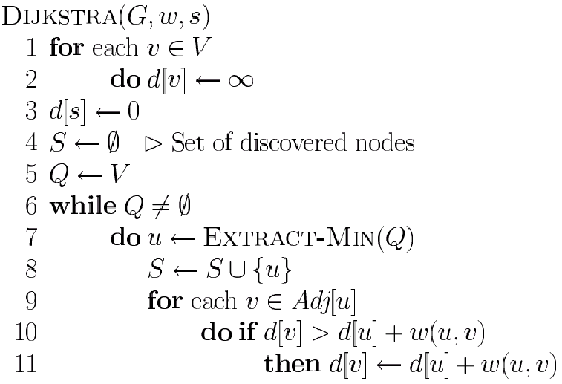
Dijkstra’s Pseudo Code
Graph G, weight function w, root s
relaxing edges

Slide 35
Dijkstra (G, w, s)
INITIALIZE-SINGLE-SOURCE(V, s)
S ← ∅
Q ← V[G]
while Q ≠ ∅
do u ← EXTRACT-MIN(Q)
S ← S ∪ {u}
for each vertex v ∈ Adj[u]
do RELAX(u, v, w)
Running time: O(VlgV + ElgV) = O(ElgV)
Θ(V)
O(V) build min-heap
Executed O(V) times
O(lgV)
O(E) times; O(lgV)

Slide 36
Dijkstra’s Running Time
Extract-Min executed |V| time
Decrease-Key executed |E| time
Time = |V| T_{Extract-Min} + |E| T_{Decrease-Key}
T depends on different Q implementations
Q | T(Extract-Min) | T(Decrease-Key) | Total
array | Ο(V) | Ο(1) | Ο(V ²)
binary heap | Ο(lg V) | Ο(lg V) | Ο(E lg V)
Fibonacci heap | Ο(lg V) | Ο(1) (amort.) | Ο(V lgV + E)

Slide 37
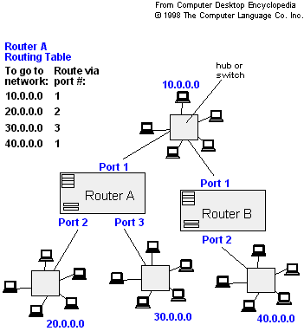
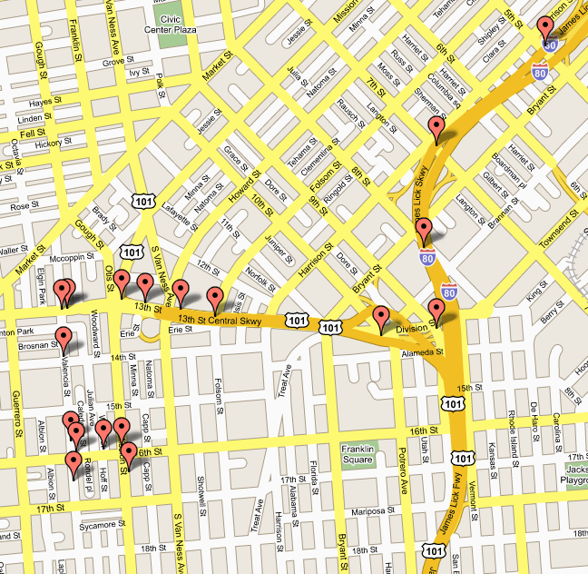
Applications of Dijkstra's Algorithm
- Traffic Information Systems are most prominent use
- Mapping (Map Quest, Google Maps)
- Routing Systems

Slide 38
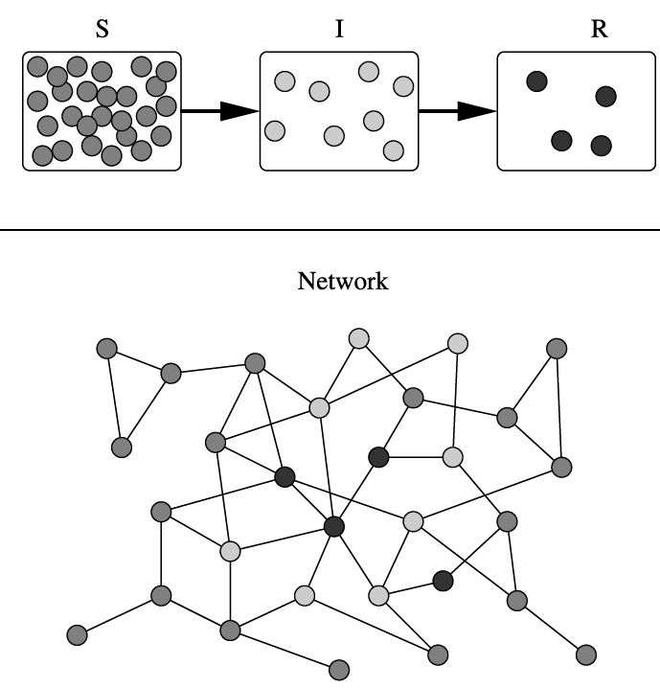
Applications of Dijkstra's Algorithm
One particularly relevant this week: epidemiology
Prof. Lauren Meyers (MIT, Biology Dept.) uses networks to model the spread of infectious diseases and design prevention and response strategies.
Vertices represent individuals, and edges their possible contacts. It is useful to calculate how a particular individual is connected to others.
Knowing the shortest path lengths to other individuals can be a relevant indicator of the potential of a particular individual to infect others.

