Slide 1
Northwind Dataset
The Northwind database contains the sales data for a fictitious company called "Northwind Traders," which imports and exports specialty foods from around the world.
It is an excellent tutorial schema for a small-business ERP, with customers, orders, inventory, purchasing, suppliers, shipping, employees, and single-entry accounting.

Slide 2
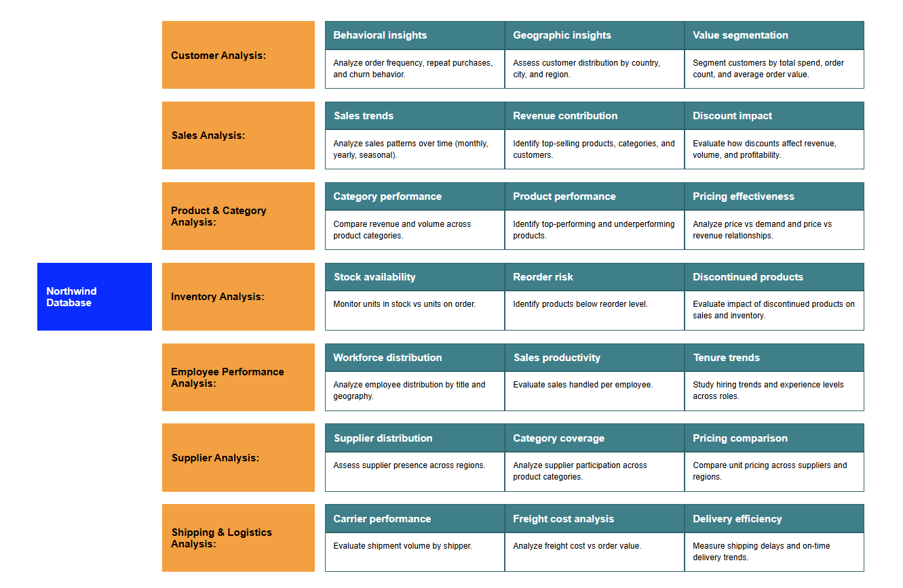
MECE Breakdown

Slide 3
Dataset Overview
Northwind Traders sample database
  Customers -- Customer Raw Data
  Orders -- Order Raw Data
  Order Details -- Order Details Data
  Products -- Products Raw Data
  Employees -- Employees Raw Data
  Suppliers -- Suppliers Raw Data
  Shippers -- Shippers Raw Data
  Categories -- Category Raw Data

Slide 4
Sales Analysis
Examines sales trends, revenue contribution, and discount impact over time.
Supports decisions by revealing top-performing products, seasonal patterns, and profitability drivers.

Slide 5
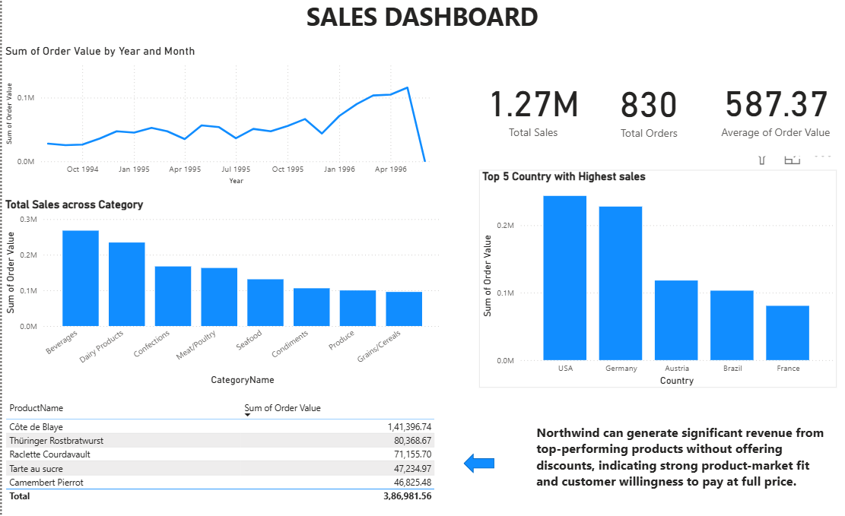

Slide 6
Customer Analysis
Analyzes customer behavior, geography, and value segmentation to understand who buys, how often, and from where.
Helps identify high-value customers and repeat purchase patterns for targeted strategies.

Slide 7
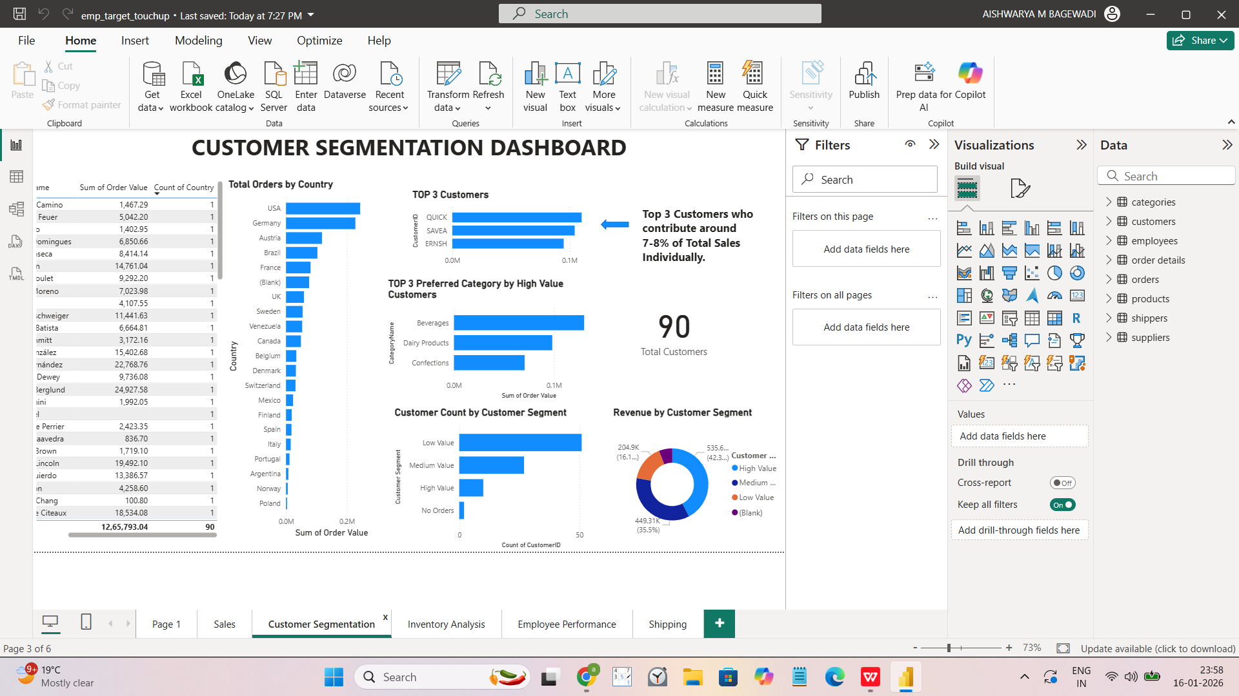

Slide 8
Employee Performance Analysis
Assesses workforce distribution, sales productivity, and tenure trends.
Provides insights into employee efficiency and contribution to overall sales performance.

Slide 9
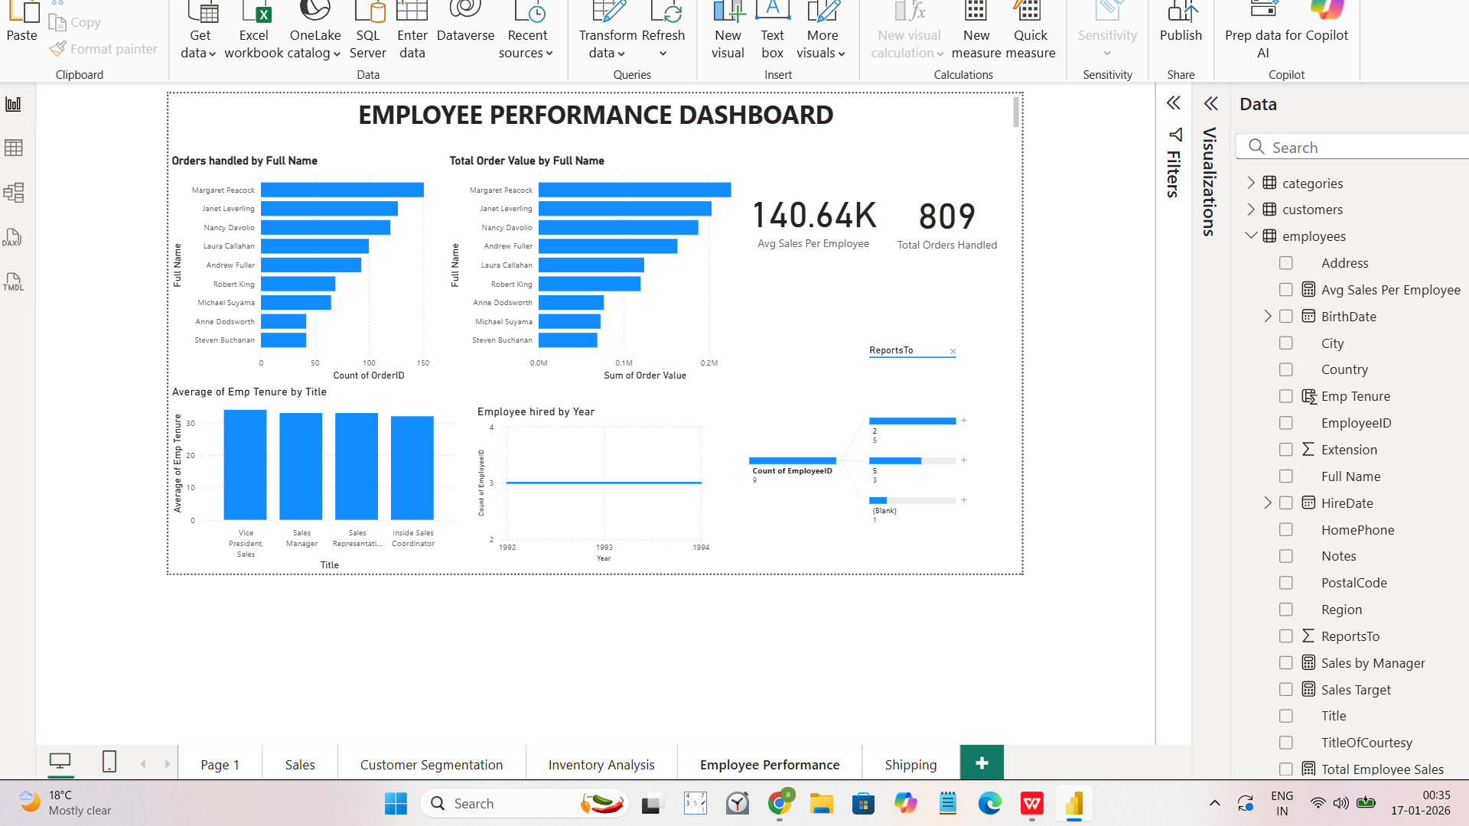

Slide 10
Inventory Analysis
Tracks stock availability, reorder risks, and discontinued products.
Ensures optimal inventory levels, reducing stockouts and excess holding costs.

Slide 11
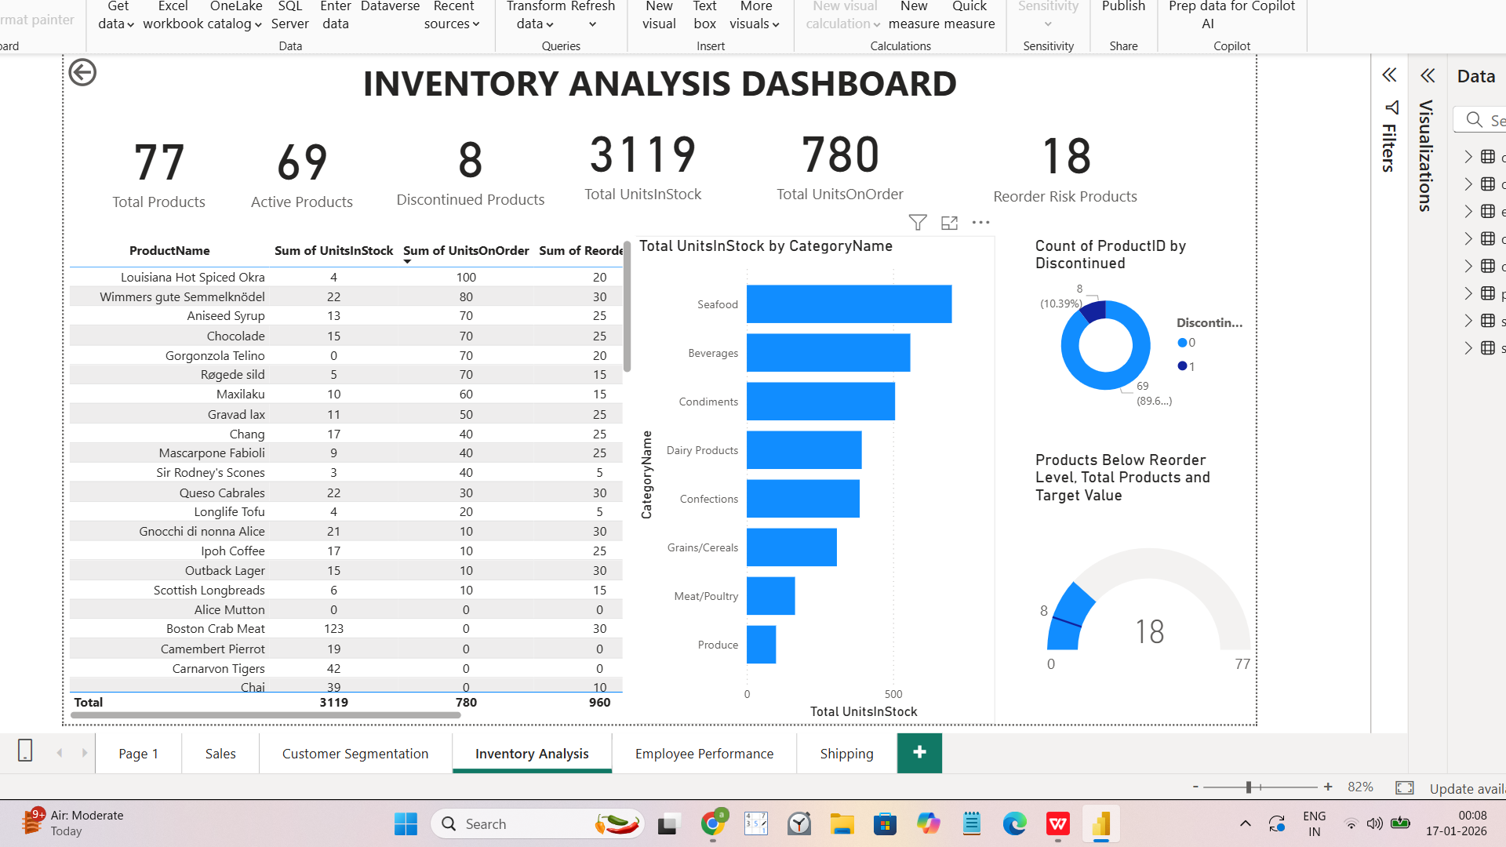

Slide 12
Shipping Analysis
Evaluates carrier performance, freight costs, and delivery efficiency.
Supports cost control and timely delivery through logistics performance monitoring.

Slide 13
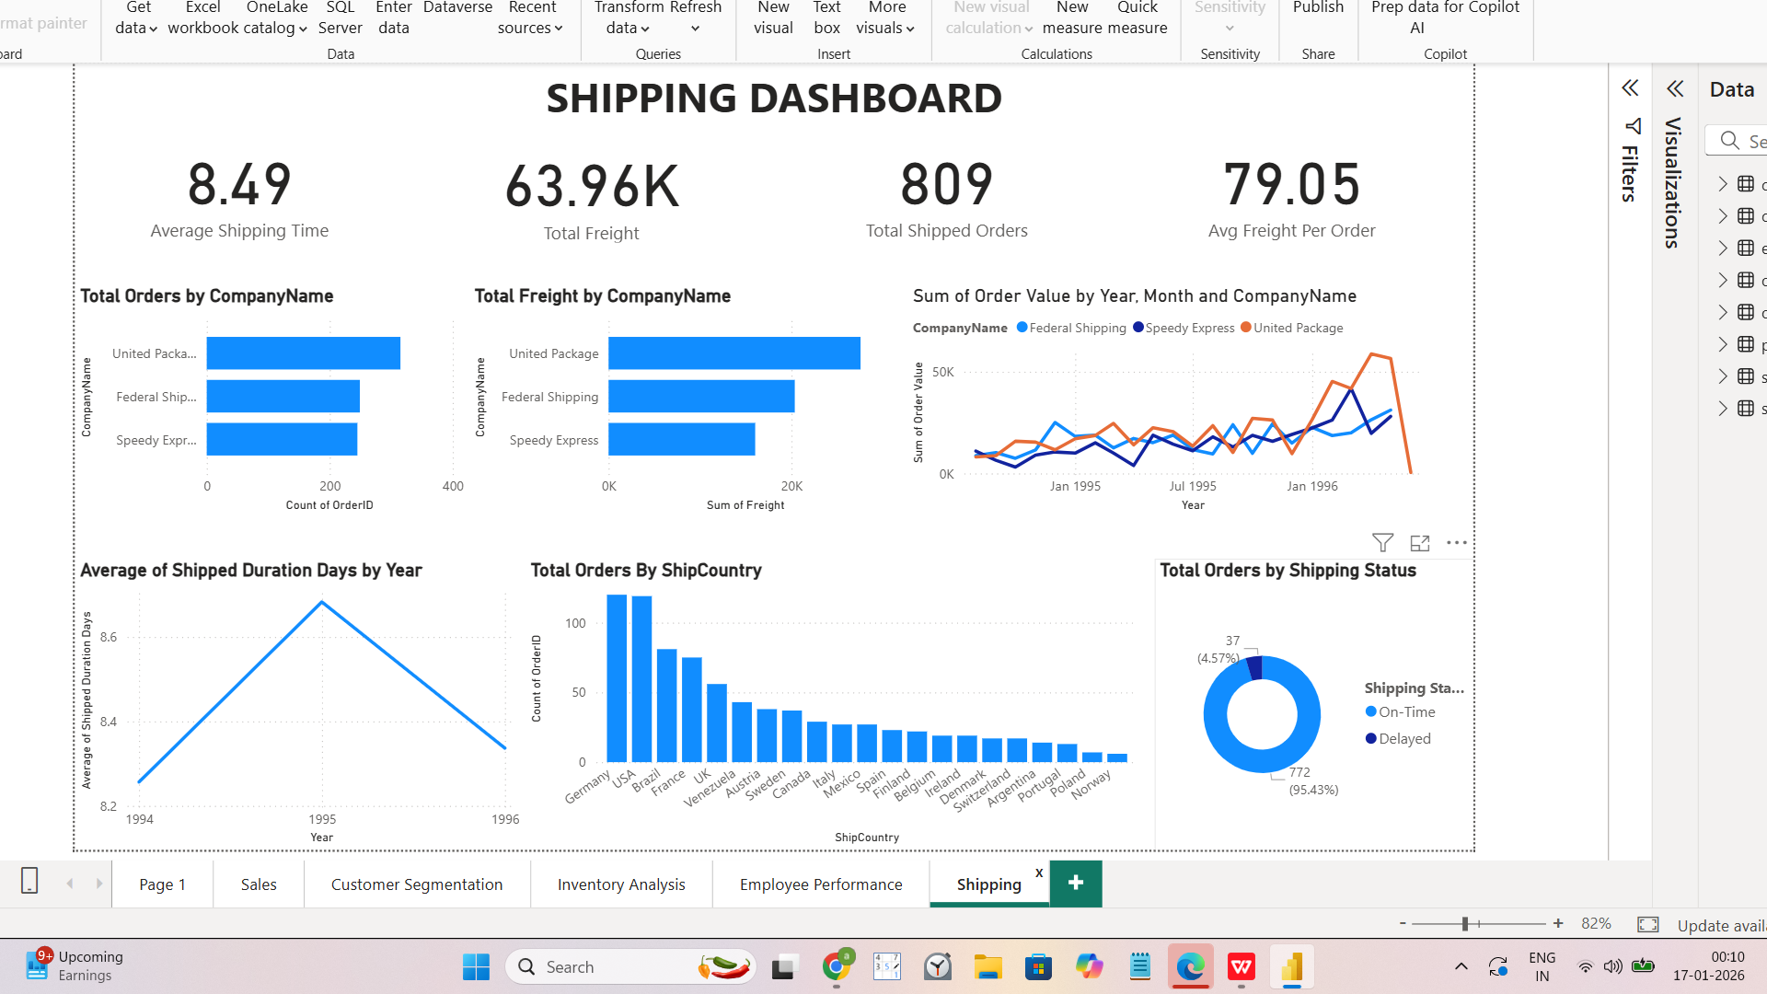

Slide 14
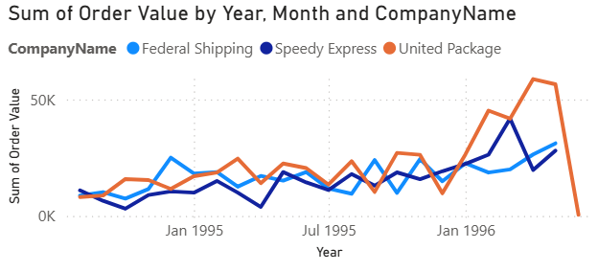
ANOMALIES IDENTIFIED IN NORTHWIND DATA
1 .Sudden Downfall in United Package Order Value
United Package shows a sharp decline in order value over time
Other shippers (Federal Shipping, Speedy Express) show growth or stability

Slide 15
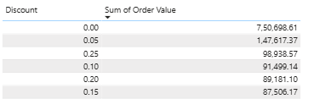
2.High-Revenue Products Selling Without Discounts
Common assumption: “Discounts drive sales”.
Top Products generates high order value at discount 0.00%

Slide 16
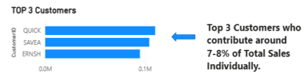
3.Revenue Highly Concentrated in a Few Customers
Top 3 customers contribute ~7–8% of total revenue
High-value segment contributes a disproportionate share

Slide 17
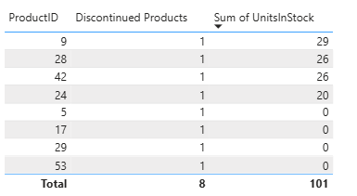
4.Discontinued Products Still
Holding Stock
Discontinued products still have units in stock.
Capital locked in dead inventory → margin & storage cost issue.

Slide 18
THANK YOU

