Slide 1
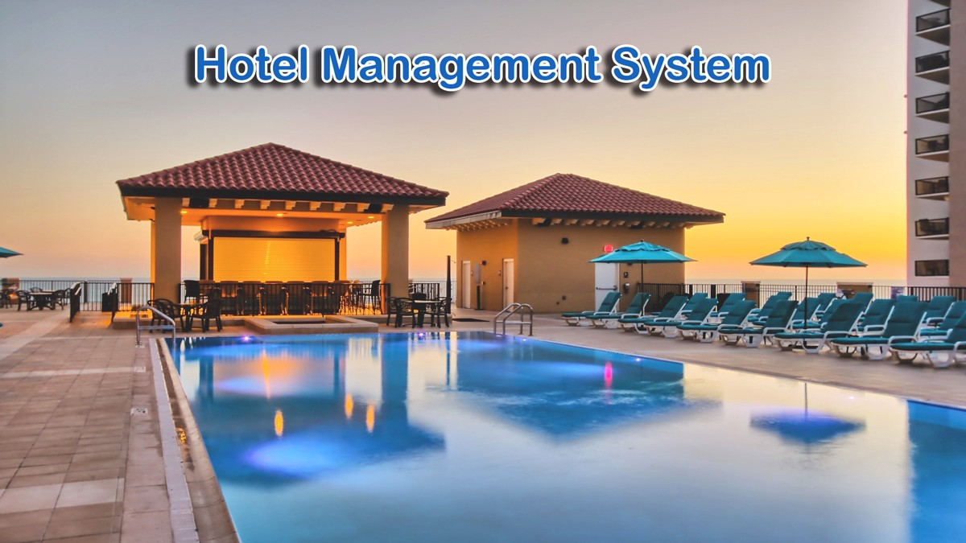
GROUP-2 hotel management SYSTEM

Slide 2
* Rachala Manisha (46281801)​ * Aishwarya Palled (46282510)​ * Swathi B.R (46282511)​ * Shridevi Prabhu S (46282519)​ * Geethanjali​ Goddumarri (46282520)​ * Mallela ReddyPriya (46282530)​ ​ ​
PRESENTED​ BY:-

Slide 3
CONTENT
INTRODUCTION
REQUIREMENTS
PROJECT PURPOSE
FUNCTIONAL REQUIREMENTS
SOFTWARE REQUIREMENTS
FLOW CHART
ER DIAGRAM
USE CASE DIAGRAM
SEQUENCE DIAGRAM
TOOLS
ADVANTAGES
CONCLUSION

Slide 4
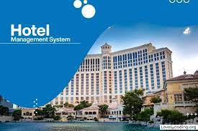
INTRODUCTION
Hotel management system is a system that allows us to reserving rooms, checking whether the rooms are vacant or not by using this this system.
The system provides the information regarding the different rooms and facilities.
This hotel management system purpose is to make the room bookings simple

Slide 5
REQUIREMENTS
Project Purpose.
Functionalities of the System.
Software Requirements.

Slide 6
Project purpose
The main purpose of this project is to build an application program to reduce the manual work for managing hotel room Bookings.
This application will help in accessing the information regarding the available hotel rooms and gives admin the power and flexibility to manage the entire system.
This hotel management system makes booking easy and simple.

Slide 7
FUNCTIONAL REQUIREMENTS
All records are saved in a file
Key features of the system are:
1. Login as admin: there exists only one admin for the system
2. Perform the operations such as add , display, modify rooms , search and view
customer details
3. Customer must register to the system and can perform the operations such as
book, search and checkout.

Slide 8
SOFTWARE REQUIREMENTS
Client/Server System.
Operating system: Linux.
Platform : Ubuntu/C++.

Slide 9
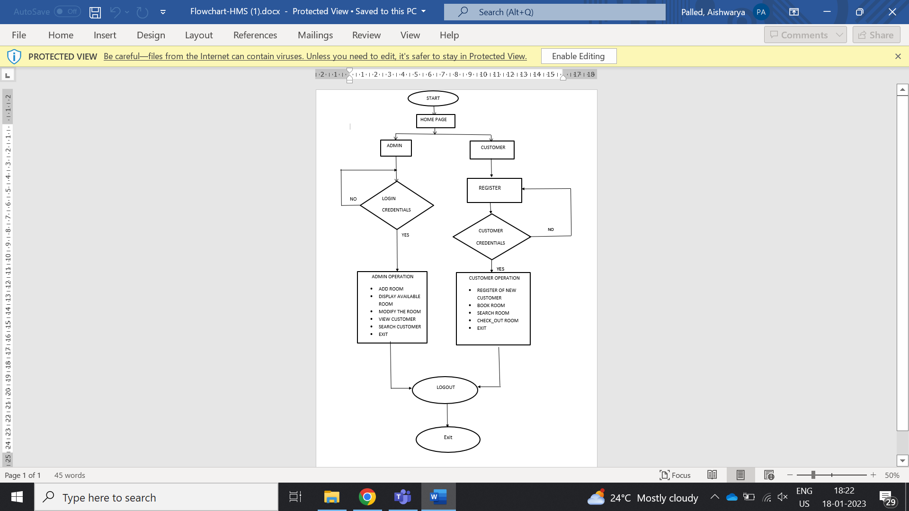
FLOW CHART

Slide 10
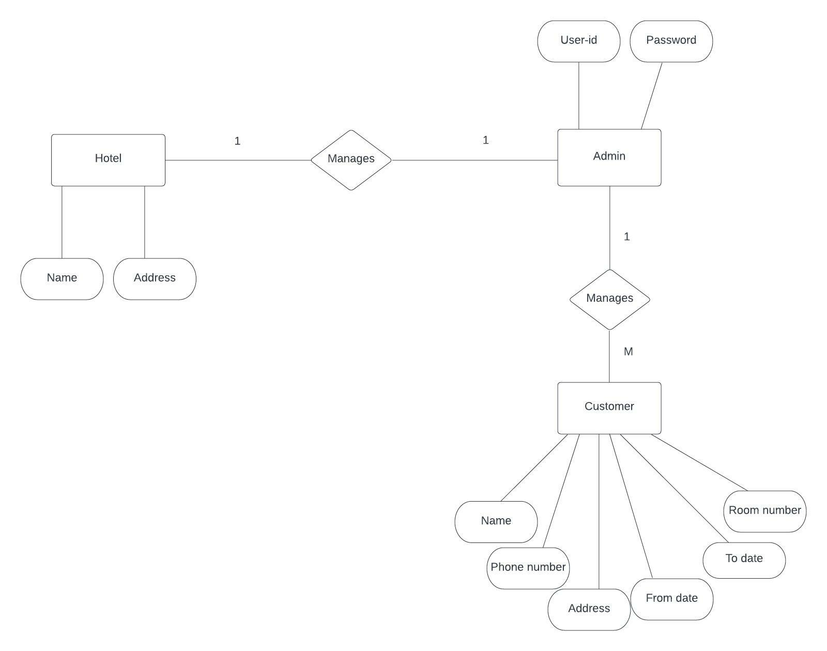
ER DIAGRAM

Slide 11
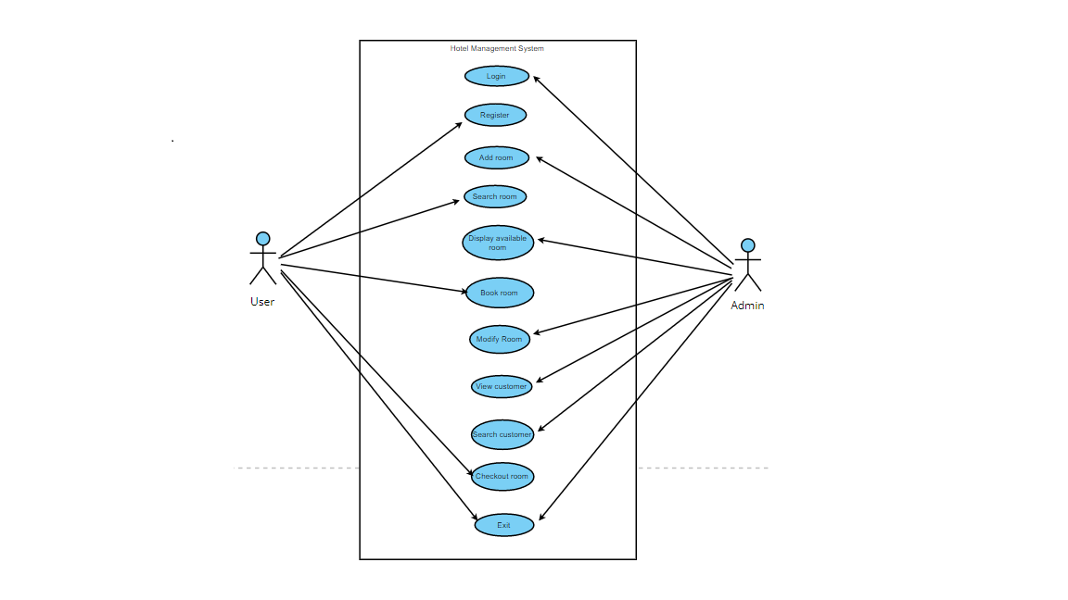
USE CASE DIAGRAM

Slide 12
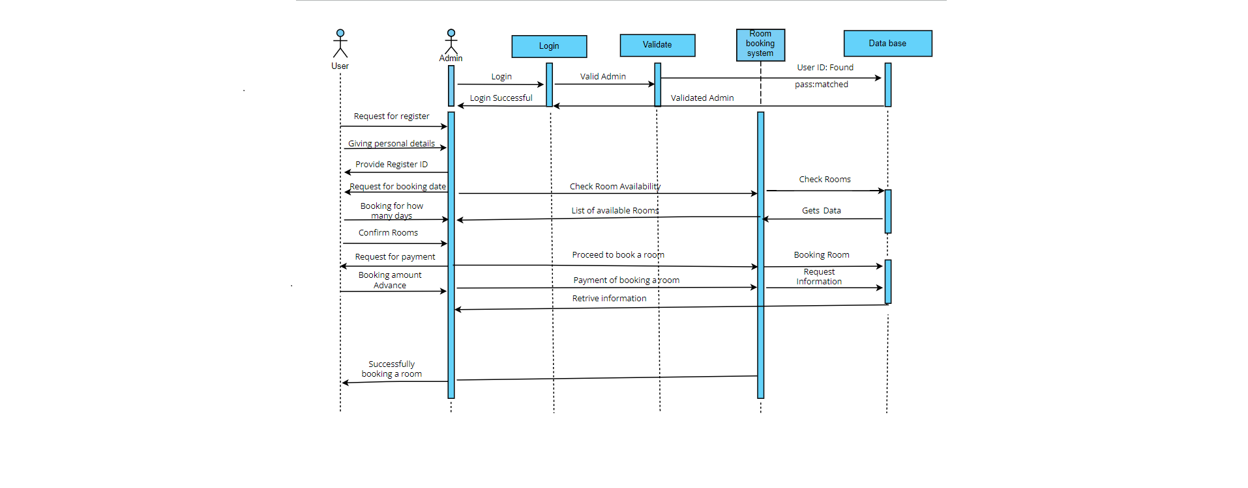
SEQUENCE DIAGRAM

Slide 13
TOOLS
Valgrind : It is memory checking tool to detect memory leaks and it majorly focus on dynamic memory.
Makefile : Tool used for run and compile program automatically in more efficient way.
Unit testing: Unit testing is used to test a particular code or for to a particular function .
IT testing: IT testing is used to test for enter code after the integration is done

Slide 14
ADVANTAGES
It saves user time in searching a Room.
It saves Organization resources and expenses.
This system is effective and saves time and cost of users.
The system is useful as it calculates an exact cost of room for requested number of days.

Slide 15
CONCLUSION
The project “Hotel Management System” is aimed to develop to maintain the day-to-day state of admission/Vacation of Residents.
It provide solution for hotel to manage most of their work using computerized process.
This software application will help admin to handle customers information, room allocation details, payment details, billing information etc.

Slide 16




