Slide 1
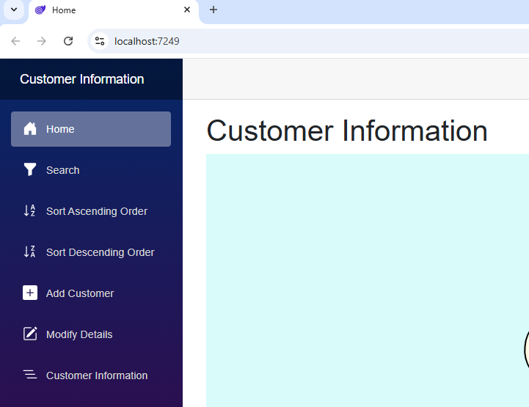
Customer Information System

Slide 2
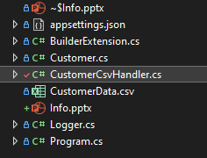

Slide 3
LINQ List Extension Method Static Class Static Constructor Pre Registered Services @inject JSRuntime and NavigationManager @binding

