Slide 1
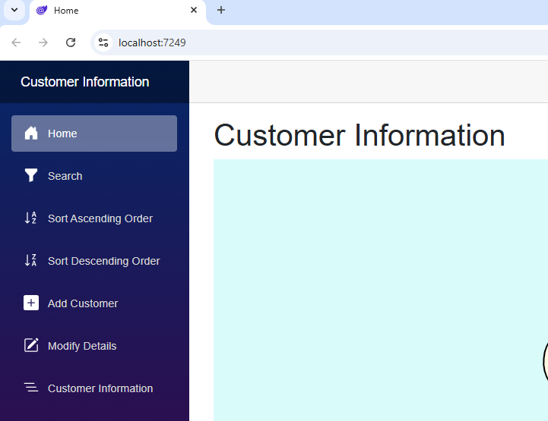
Customer Information System

Slide 2
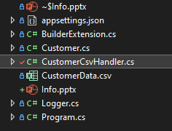

Slide 3
LINQ List Extension Method Static Class static constructor Static Constructor Pre injected Services @inject JSRuntime and NavigationManager @binding

