Slide 1
Creative and Innovative project
IT7611
Team members:
2015115054 – Soundarya.R
2015115034 – Nivethika.R
2015115122 – Aishwarya.S
2015115057 – Surya.B

Slide 2
ARRang
An IOS app that allows even a child to orient the kolam according to the space provided.

Slide 3
Problem Statement
kolam is a good old tradition found in south and south east asian countries, particularly in India. Every morning, millions of women draw kolam on the ground. Kolams are thought to bring prosperity to homes. Kolam is a symbol of south Indian culture. Thats why rangoli competition plays an unique part in every cultural festivals.

Slide 4
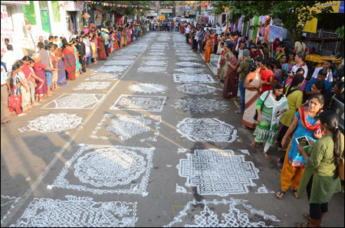
Mylapore Festival(Jan 4-7)

Slide 5
Problem Statement(Continued)
The important difficulty while drawing Kolam is that the confusion whether it will fit a plane or not. Till now we don’t have any digital assistance for this. We are now introducing our app which when user enters the number of dots to put a Kolam of their favour will detect the given plane(Using AR) and fits the kolam according to the plane and as it is zoomed in or zoomed out the correct projections of line that has to be drawn in that position of the plane so as to complete the kolam will be displayed.

Slide 6
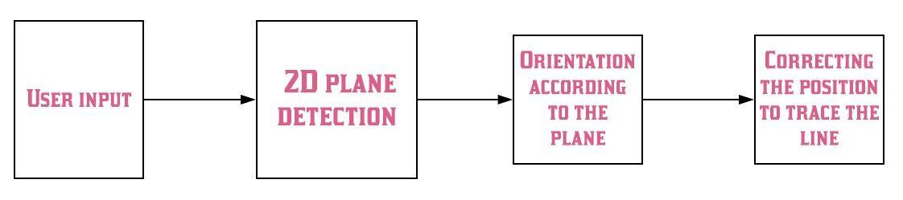
Flow model

Slide 7
Conclusion
There are large numbers of NRI’s out there who are having desire to draw kolam but cant because of lack of guidence. Our app will surely help out those people. There is no need to worry about the space because the app itself will take care of it. JUST PROJECT AND START DRAWING!!

