Slide 1

ReadyGo…

Slide 2

Team
Team Members:
Aakash Nagori
Aishwariya
Nandhini
Sowmiya
Zinat Parvin

Slide 3
Introduction
Purpose of ReadyGo…?
Our Features

Slide 4
Objective
On Time Service
Easy Payment
Customer Satisfaction
Friendly User Interface

Slide 5
Scope Of The Project
This application reduces the manual operations required to maintain all the records of :
i)Users
ii) Cabs
iii)Drivers
iv)Booking history

Slide 6
Project Category
Software Requirements:
1.Sublime, VS code.
2.Spring Tool Suite 3.9 (STS).
3.Oracle 11g.

Slide 7
Project Category
Languages Used:
Front End: HTML, CSS,
Java Script, Bootstrap.
Back End: Java.
Database: Oracle 11g.

Slide 8
Project Category
Modules:
SignUp Form
SignIn Form
Drivers Registration Form
Cabs Registration Form
Cab Booking Form

Slide 9
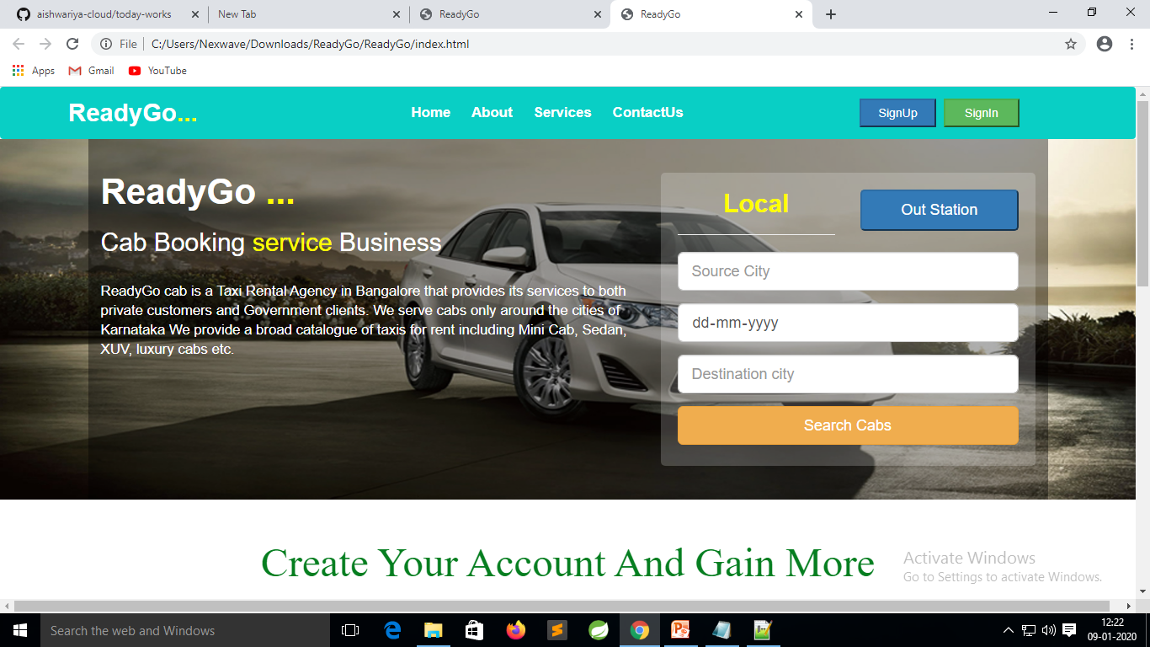
Home Page

Slide 10
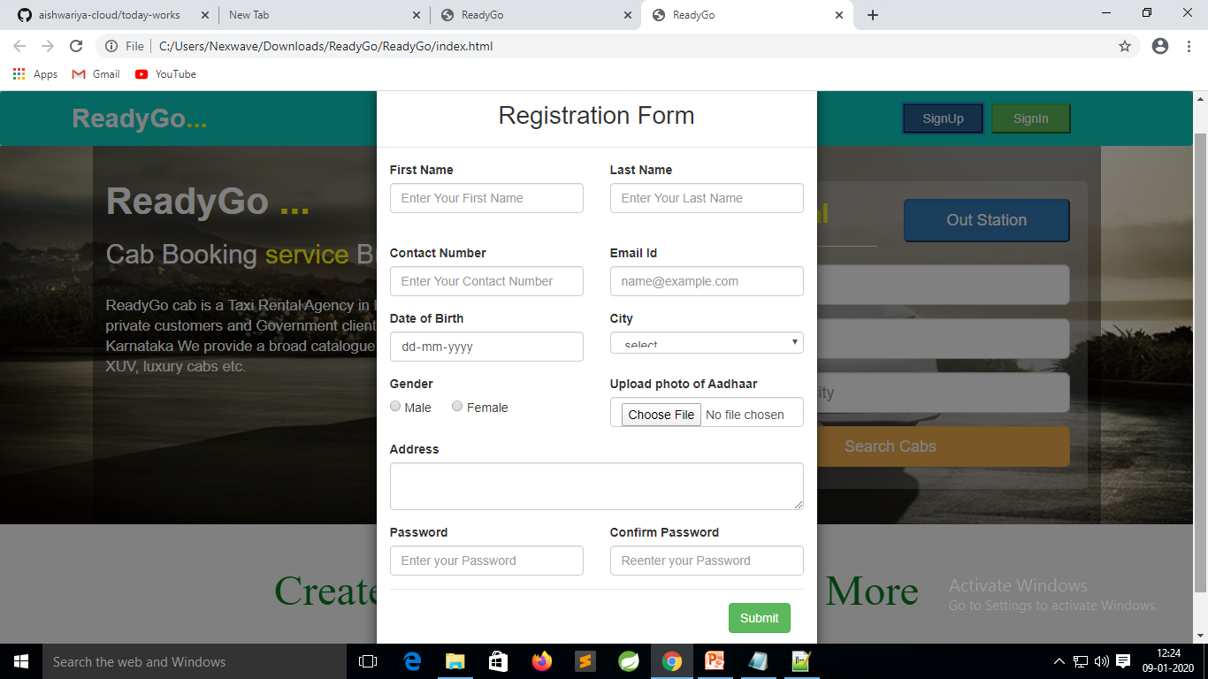
SignUp Form

Slide 11
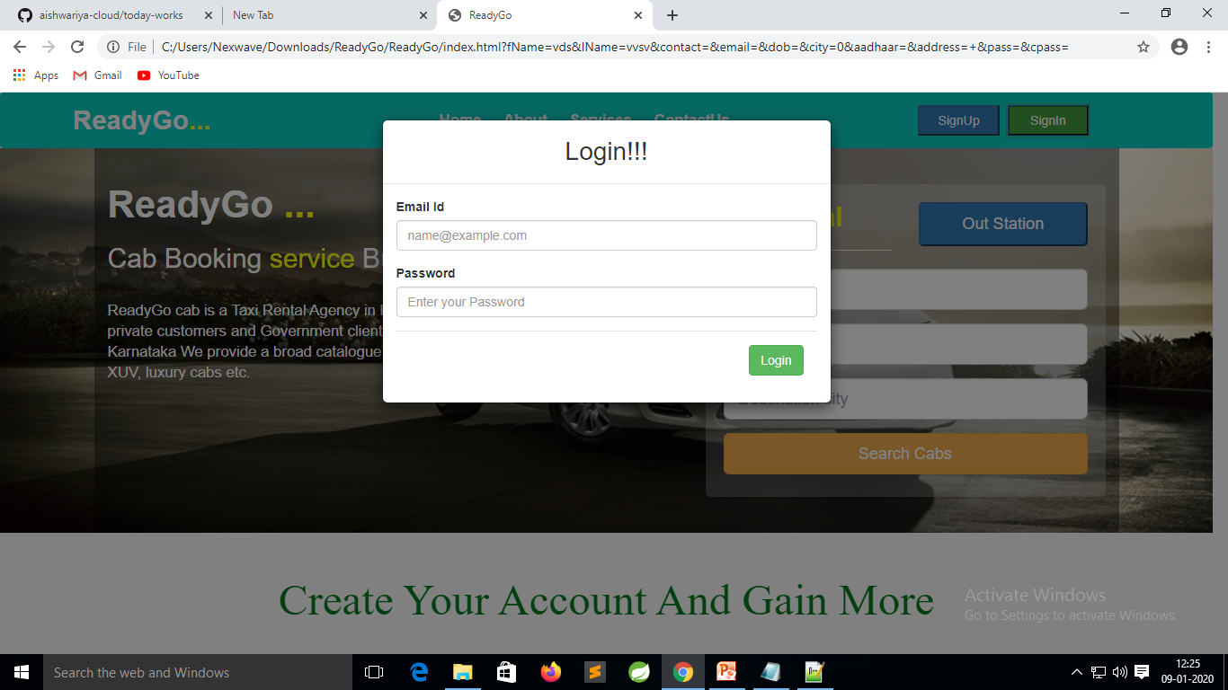
SignIn Form

Slide 12
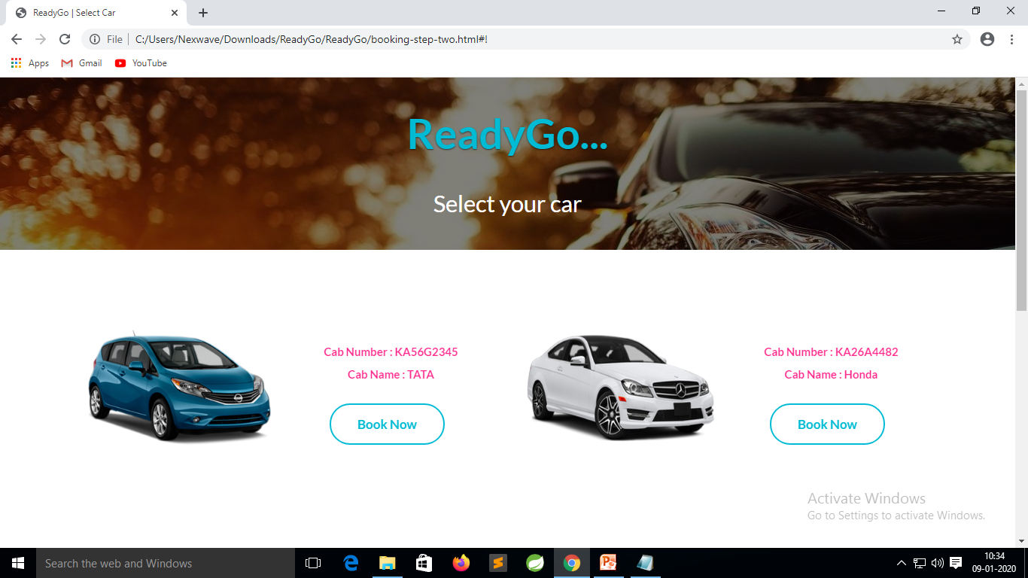
Cab Booking Form

Slide 13
