Slide 1

ReadyGo…

Slide 2

Team
Team Members:
Aakash Nagori
Aishwariya
Nandhini
Sowmiya
Zinat Parvin

Slide 3
Introduction
Purpose of ReadyGo…?
Our Features

Slide 4
Objective
Our Cab will be reach on time on the defined destination.
We are providing easy payment facility in cab i.e. by cash or by card or by net banking.

Slide 5
Scope Of The Project
This application reduces the manual operations required to maintain all the records of :
i)Users
ii) Cabs
iii)Drivers
iv)Booking history

Slide 6
Project Category
Software Requirements:
1.Sublime, VS code.
2.Spring Tool Suite 3.9 (STS).
3.Oracle 11g.

Slide 7
Project Category
Languages Used:
Front End: HTML, CSS,
Java Script, Bootstrap.
Back End: Java.
Database: Oracle 11g.

Slide 8
Project Category
Modules:
SignUp Form
SignIn Form
Drivers Registration Form
Cabs Registration Form
Cab Booking Form

Slide 9
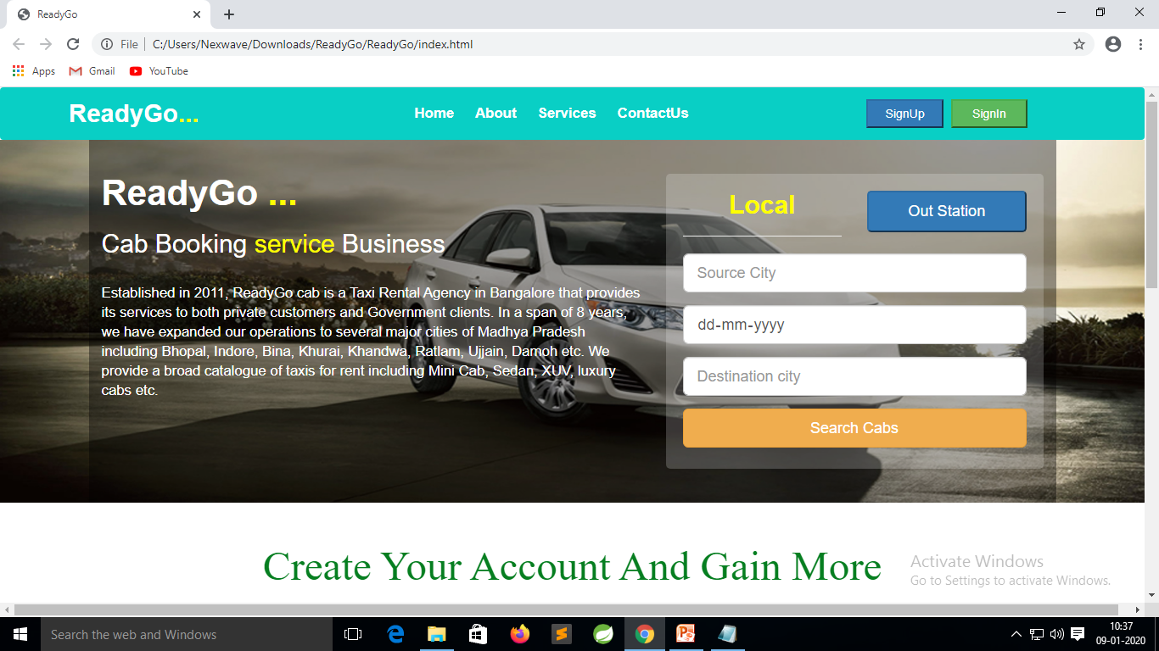
Home Page

Slide 10
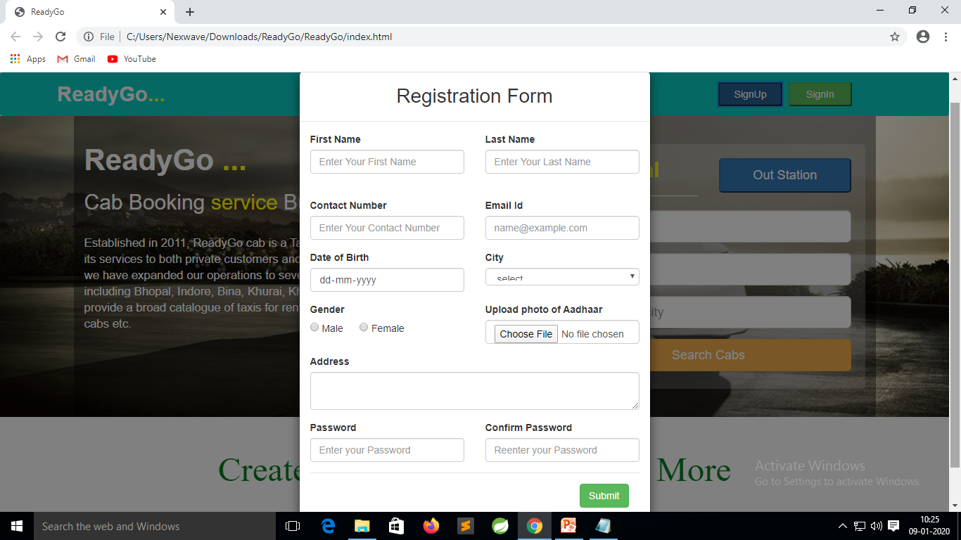
SignUp Form

Slide 11
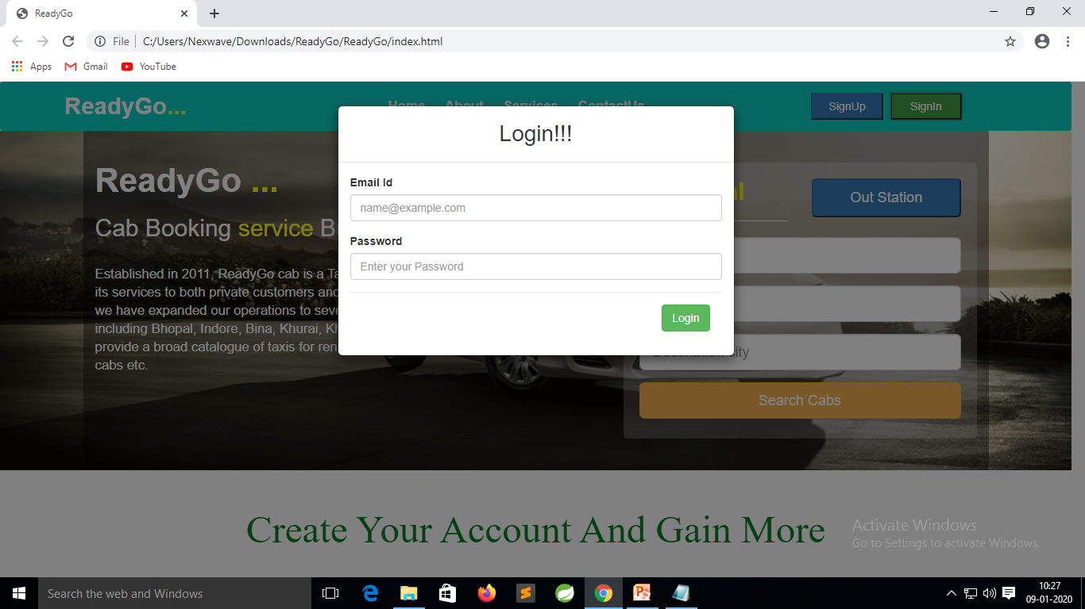
SignIn Form

Slide 12
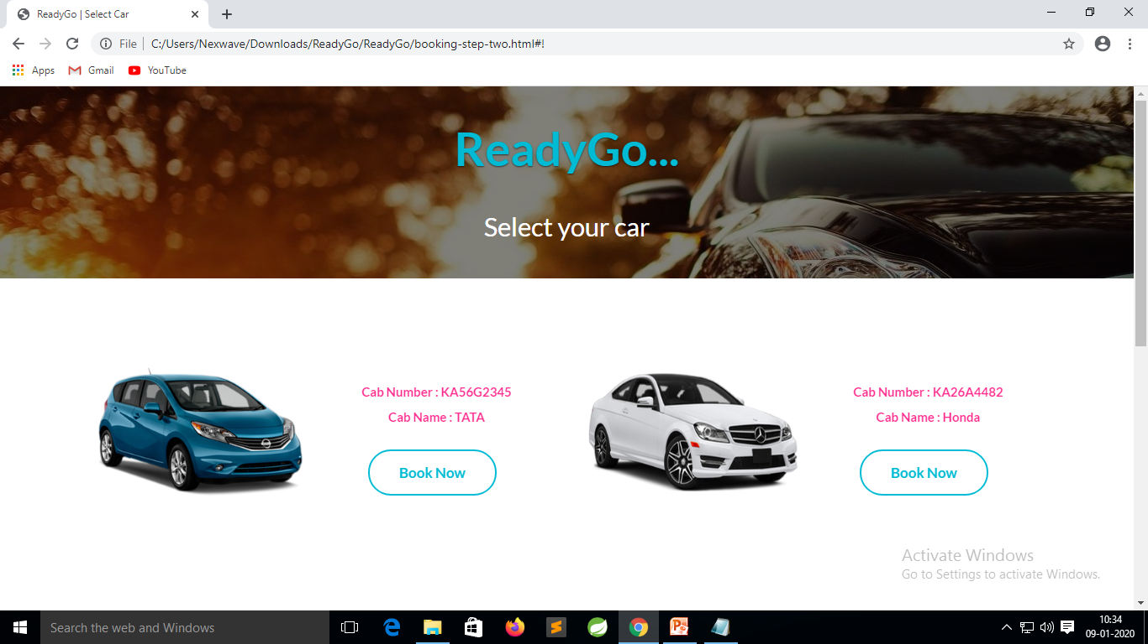
Cab Booking Form

Slide 13
