Slide 1

ALUMNI DATA PROJECT
Anisa Koni (konia@emmanuel.edu)
Lena Karaguesian(karaguesianl@emmanuel.edu)
-Under the guidance of Professor. Aishwariya Elangovan

Slide 2
Questions
Which states are the most alumni located in?
Where would it be best to hold future alumni events?

Slide 3
Project Objective
Analyze alumni distribution across the U.S. to identify optimal locations for future alumni events using R-based data visualization.

Slide 4
Dataset Overview
Dataset includes alumni location, graduation year, and state distribution.
Total records: ~16,000.
Focus: Geographic clustering of alumni.

Slide 5
Tools & Techniques
• R Programming
• Data Cleaning
• Choropleth Maps
• Distribution Analysis
• Exploratory Data Analysis (EDA)

Slide 6
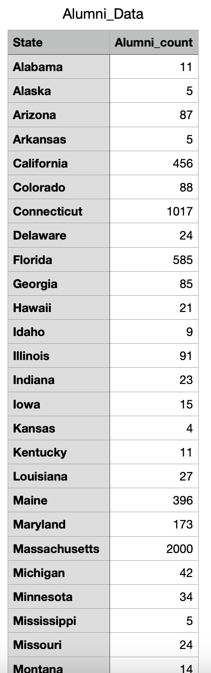
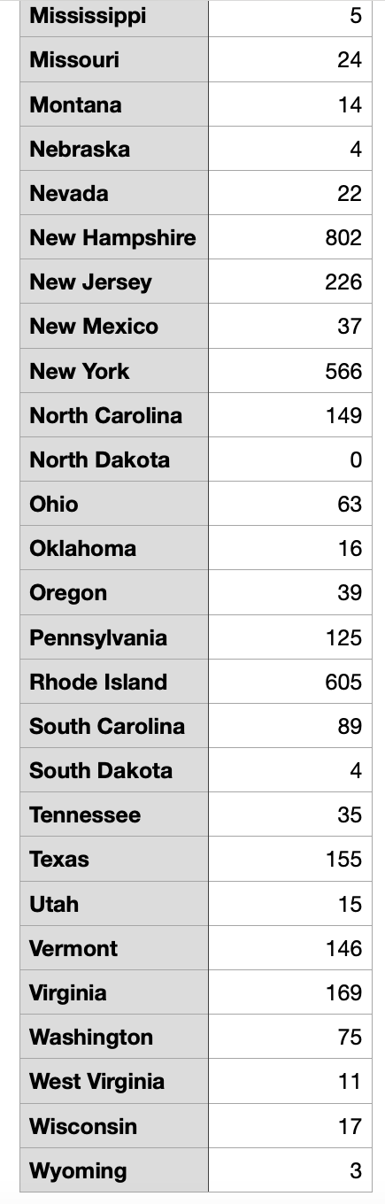
Alumni per State Data

Slide 7
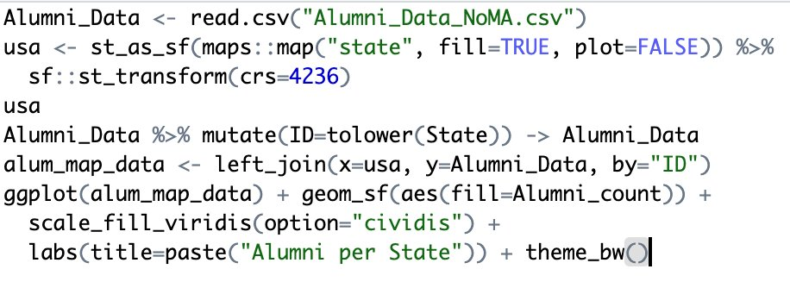
Choropleth Code using R

Slide 8
Steps
Load alumni data
Gather US map data
Join alumni and US map data
Plot alumni data on US map

Slide 9
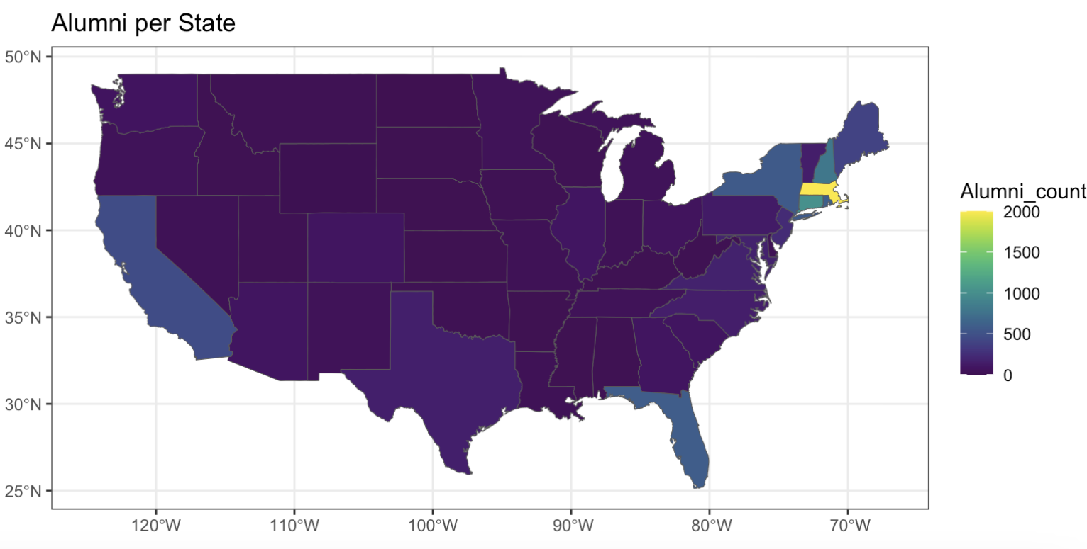
Choropleth Map

Slide 10
Map Results
Massachusetts has the highest number of alumni (about 10,000 alumni)
The following most populated states are Connecticut and New Hampshire (about 1000 alumni)
Other highly populated states are New York, Florida, and California (about 500 alumni)
Based on these results, we did an exploratory analysis of alumni in New Hampshire

Slide 11
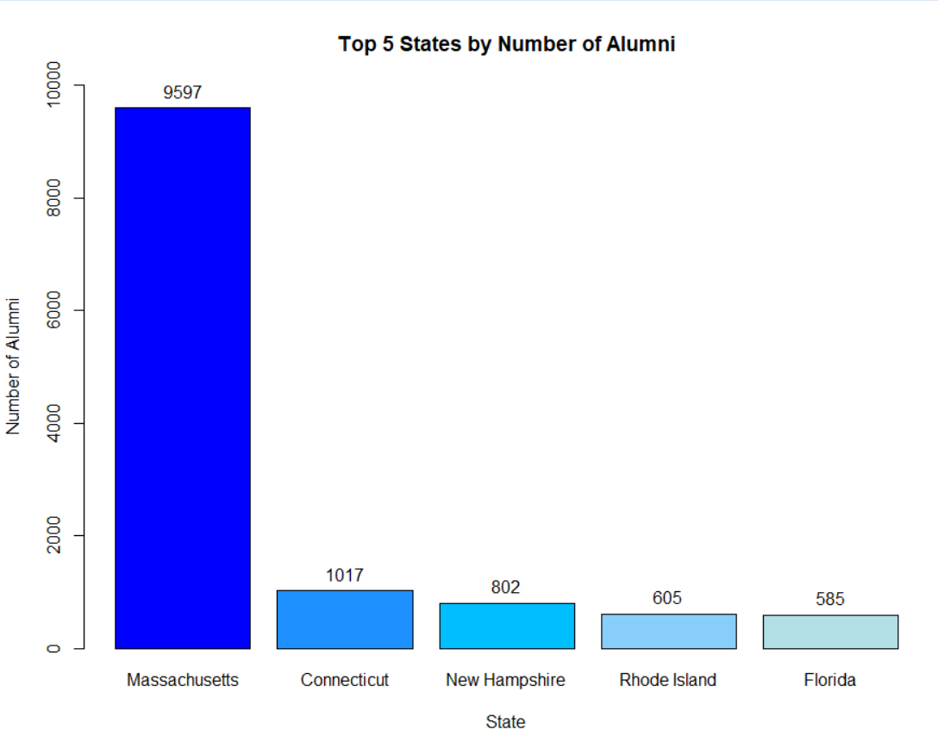
Top 5 states where alumni are located
Decided to look more into NH since there is a high population of alumni

Slide 12
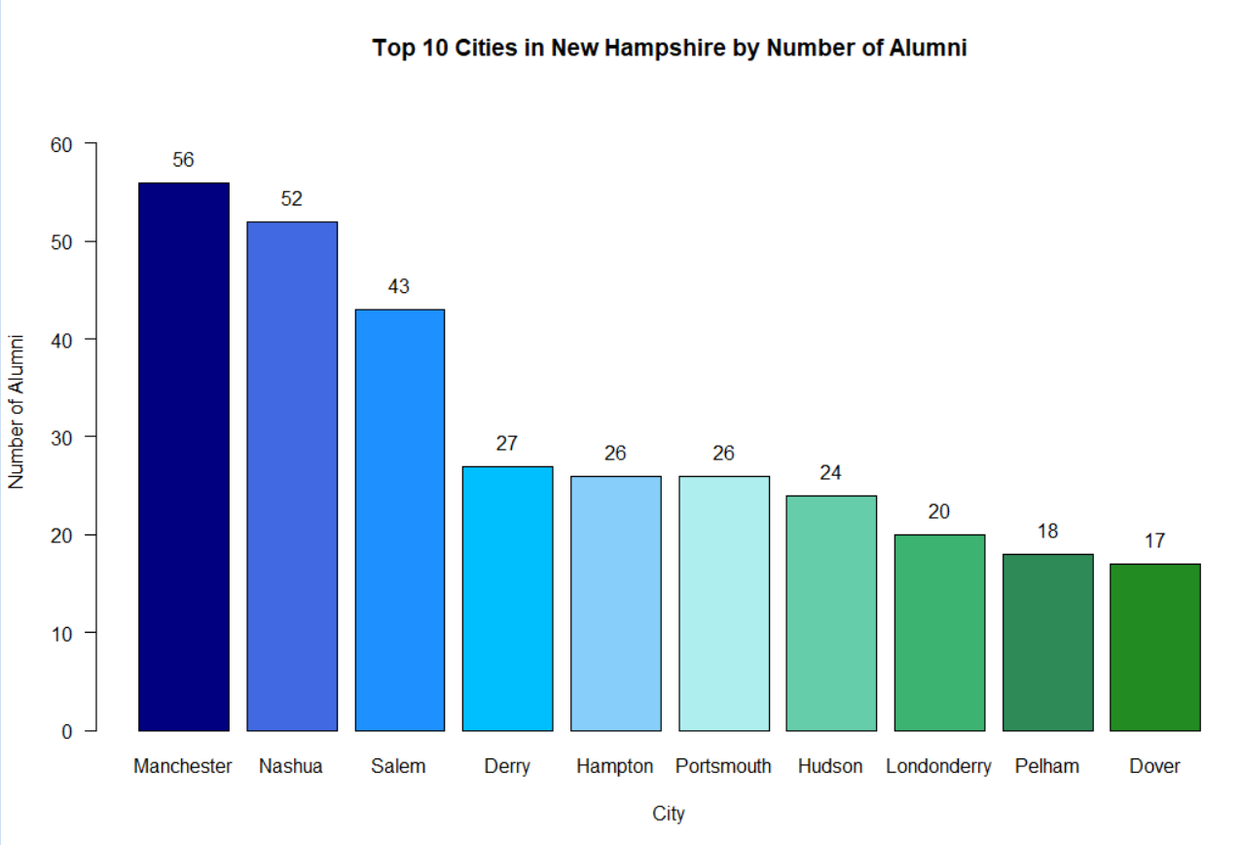
Looked at the distribution of alumni across cities in NH to see possible locations for an alumni event

Slide 13
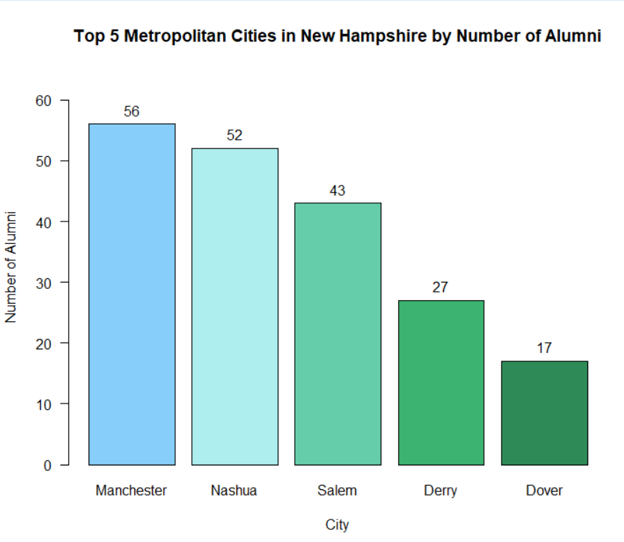
Looked at the largest cities in NH to see which city would be best to do an alumni event
The top 4 largest cities (Manchester, Nashua, Salem, Derry) are the same for the distribution of alumni

Slide 14
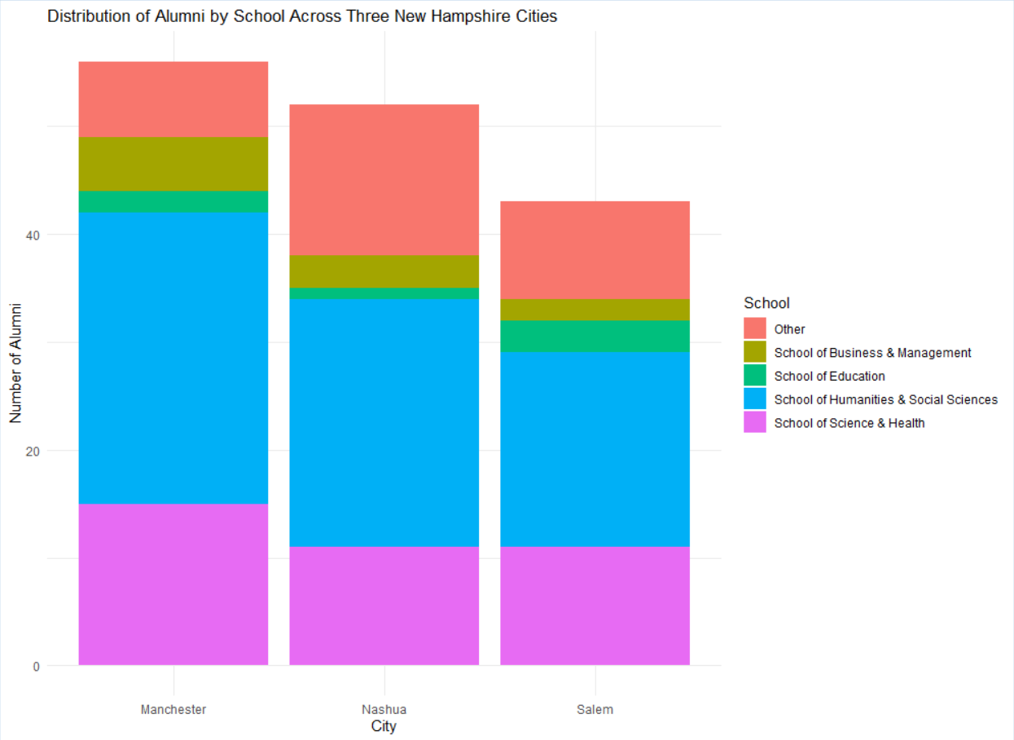
Looked at the number of alumni in each school
No school of nursing since there are no nursing majors in NH

Slide 15
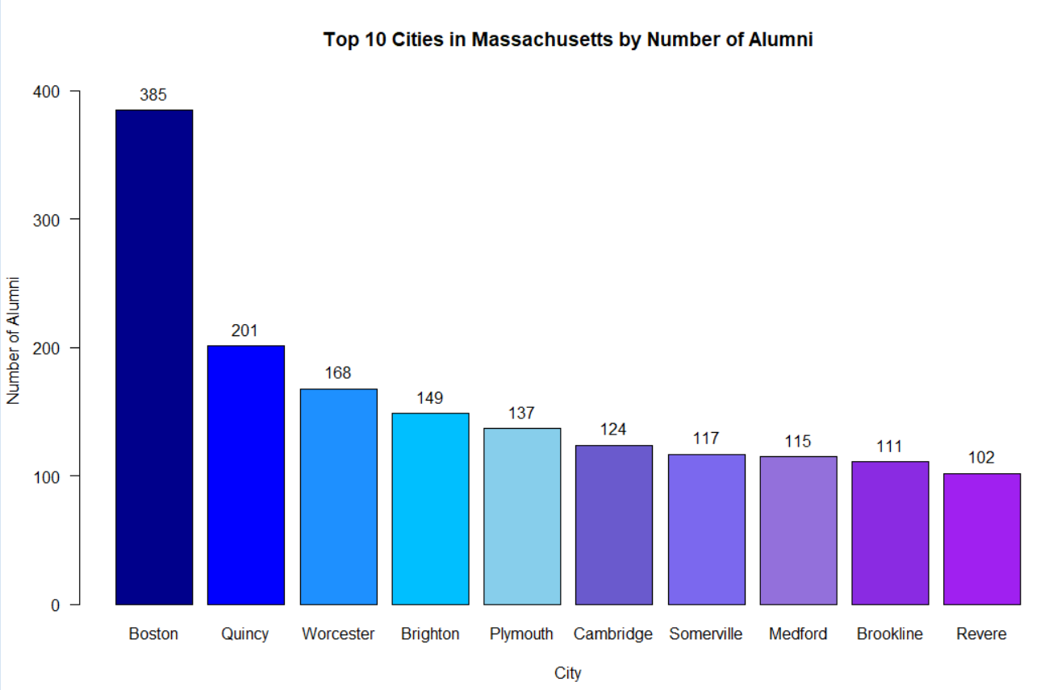
Looked at the top 10 cities in MA to see possible locations for an alumni event

Slide 16
Results
There are about 800 alumni in NH
A little under 50% of alumni in NH live in Manchester, Nashua, and Salem
A little over 50% of alumni in NH in Manchester, Nashua, and Salem have a major within the School of Humanities and Social Sciences

Slide 17
Conclusion
New Hamshire could be a possible location for an alumni event and in one of the top 3 cities which are Manchester, Nashua, and Salem
Since there are many alumni in NH with majors in the School of Humanities and Social Sciences, a targeted alumni event could be held here

