Slide 1
Dynamic Health Ledger
Team Details:
A Varun Chand (20EG105302)
P Pavan Raj (20EG105339)
S Aishwarya (20EG105345)
Project Supervisor:
Dr. T Shyam Prasad
M. Tech, PhD
Assistant Professor

Slide 2
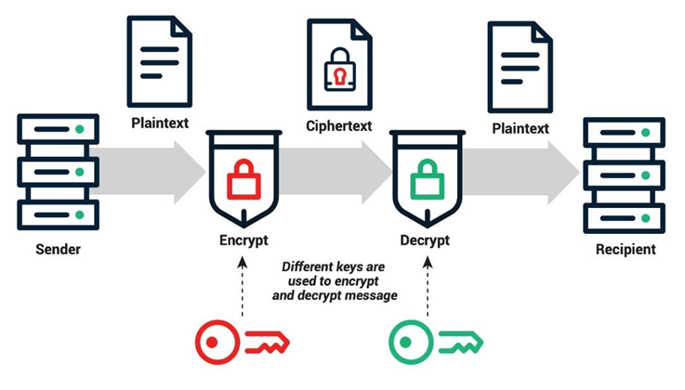
Introduction
EHRs (Electronic-Health Records) are designed to be spread out and can be managed by different groups. When patient health information is shared across different organizations, it helps doctors make better diagnoses, leading to better healthcare. The way these information systems work together is like a distributed database, where data is split and possibly copied across different computers. This allows for efficient and secure access to patient information, no matter where it's needed.
By having this distributed and replicated approach, healthcare providers can ensure that patient data is always available and up to date, improving the overall quality of care.

Slide 3
Problem Statement
Addressing the challenges in healthcare data management, our initiative focuses on leveraging RSA for secure key exchange and integrating blockchain for streamlined management of distributed health records. The project's goal is to enhance data security, accessibility, and cost-efficiency, all while prioritizing patient privacy. Through this innovative approach, we aim to establish a robust solution that transforms the landscape of healthcare data handling.
Objective
The Dynamic Health Ledger seeks to enhance the performance and efficiency of managing Electronic Health Records (EHRs) across diverse organizations. It prioritizes improving the speed and accuracy of EHR insertion, especially in scenarios involving sizable medical imaging data. The protocol aims to optimize data retrieval, minimize contention, and identify unauthorized access, all while ensuring compliance with data protection regulations.

Slide 4
Proposed Method
The Dynamic Health Ledger, employing RSA for secure key exchange and blockchain technology, holds significant promise in revolutionizing healthcare data management. This innovative approach ensures the utmost security and data integrity within the health sector, safeguarding sensitive patient information. By leveraging RSA encryption, it establishes a robust foundation for secure communication and access control, while the integration of blockchain provides an immutable ledger for transparent and auditable health record transactions. The potential for enhanced interoperability, trust, and privacy protection makes this project a valuable contribution to the future of healthcare information systems.
Access Control and Permissioning: Developing a robust access control mechanism that enforces the principle of least privilege. Where the nodes should possess specific permissions to access and validate certain records, ensuring that unauthorized nodes cannot access sensitive data.
Efficient Data Retrieval: Implementing the indexing and search mechanisms that allow for efficient retrieval of records based on specific criteria while maintaining data confidentiality.

Slide 5
Proposed Method
KEY GENERATION (USING RSA):
The RSA algorithm relies on the mathematical properties of two large prime numbers, p and q. The formula for the RSA modulus (N) is given by: N=p×q
The totient (φ) of N is calculated as: ϕ(N)=(p−1)×(q−1)
The public key (e, usually chosen as 65537 for its efficiency) and private key (d, computed using the extended Euclidean algorithm) are then determined such that: (e ×d) mod ϕ (N)=1
The public key is (N, e), and the private key is (N, d).
Key Advantages:
Tamper-Proof Database
Decentralization
Data Security and Privacy
Interoperability

Slide 6
Proposed Method Illustration
Steps:
1) Calculate value of n = p × q, where p and q are prime no.’s
2) calculate Ø(n) = (p-1) × (q-1)
3) consider d as public key such that Ø(n) and d has no common factors.
4) consider e as private key such that (e × d) mod Ø(n) = 1
5) Cipher text c = message i.e. m^{d} mod n
6) message = cipher text i.e. c^{e} mod n
Calculation
p =7, q= 11, e = 13
Use step 2 and 4 of RSA algorithm to calculate private key.
Ø(n) = (7– 1) × (11 – 1) = 6 × 10 = 60
Now,
(e × d) mod Ø(n) = 1
(13 × d) mod 60 = 1
d = 37
So, key of A = 37

Slide 7
Experiment Environment
Blockchain Framework:
blockchain framework to simulate the decentralized and distributed nature of the health ledger. Popular choices include Ethereum, Hyperledger Fabric
Smart Contracts:
Developing smart contracts to handle transactions within the blockchain. Solidity is commonly used for Ethereum.
Cryptographic Libraries:
Leverage cryptographic libraries for RSA encryption and key management.
Programming languages based on the requirements:
Solidity for smart contracts (if using Ethereum).
Python, Java, or Go for building the backend logic and APIs.
JavaScript for frontend development.

Slide 8
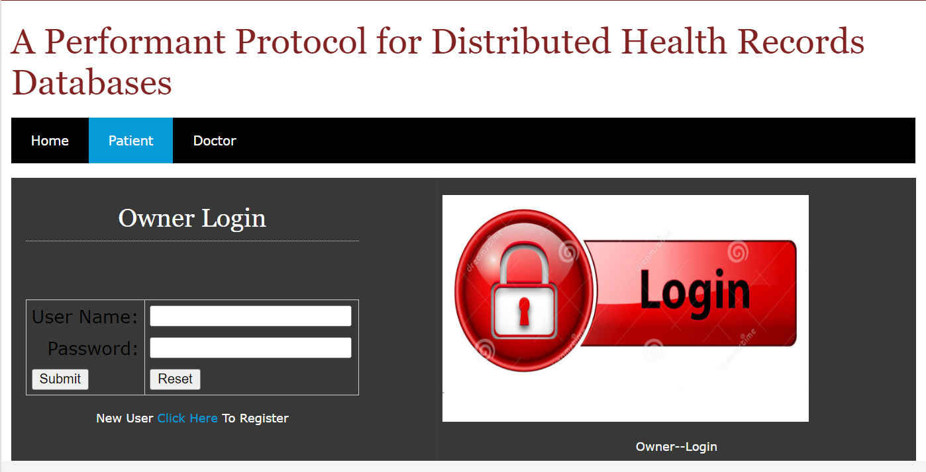
Experiment Results

Slide 9
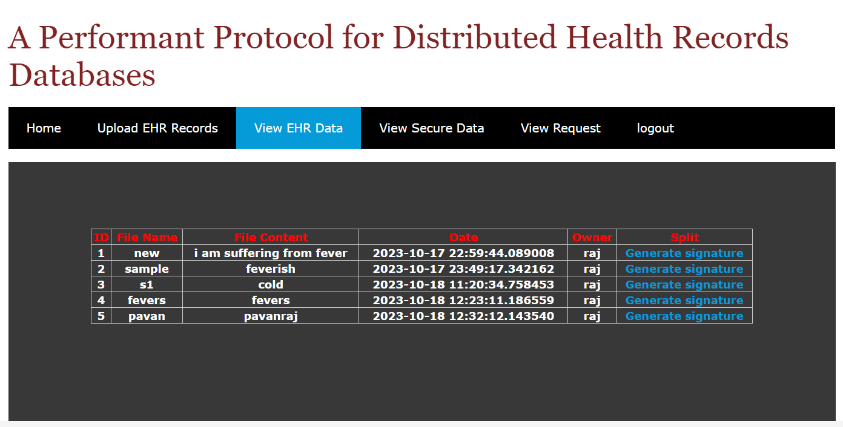
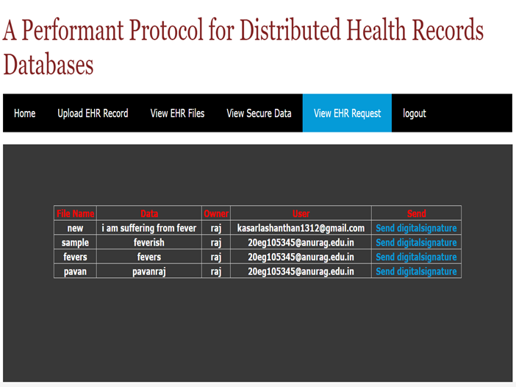
Experiment Results

Slide 10
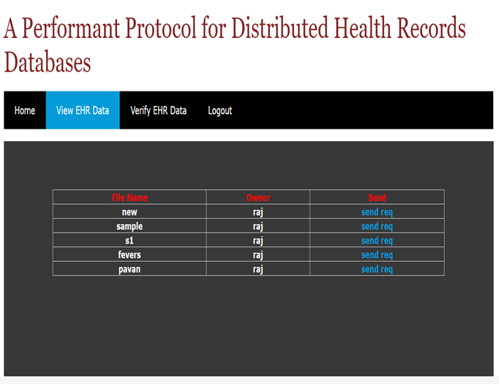
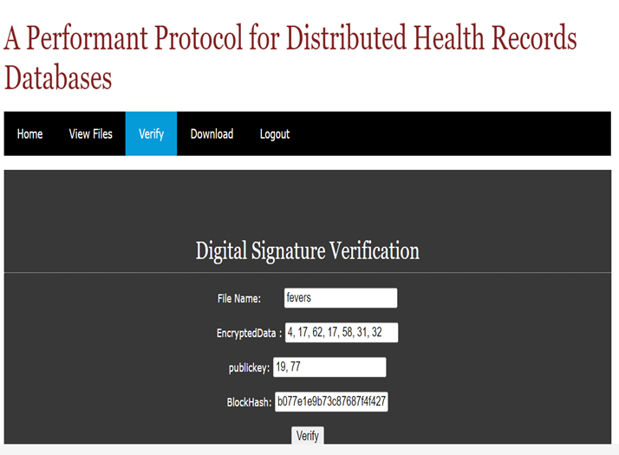
Experiment Results

Slide 11
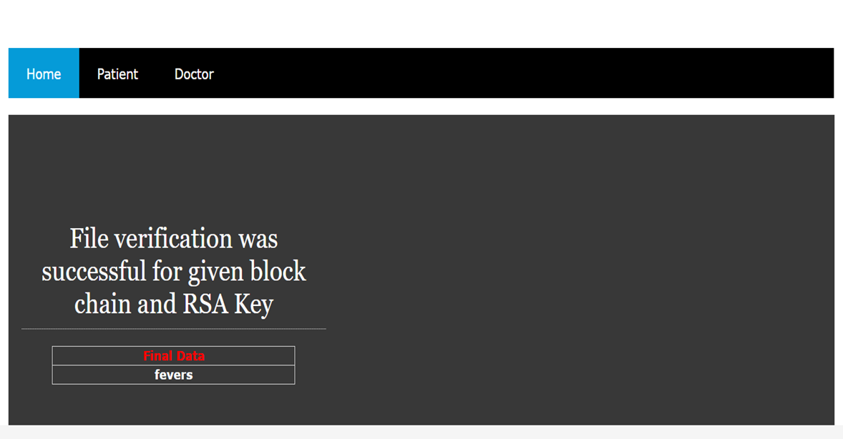
Experiment Results

Slide 12
Finding
We found that implementing the Dynamic Health Ledger with RSA for key exchange and blockchain technology was a promising approach. RSA encryption ensured secure communication by enabling a robust method for exchanging keys, safeguarding sensitive health records. The blockchain technology added an extra layer of data integrity and trust, as it provided a tamper-proof ledger for recording all transactions and changes to the health records. This combination of RSA and blockchain enhanced the security and transparency of the distributed health records database, making it a potentially effective solution for ensuring the privacy and authenticity of patient data in the healthcare sector.

Slide 13
Justification
The Dynamic Health Ledger, utilizing RSA for key exchange and blockchain, offers a robust and secure solution for managing healthcare data. RSA encryption ensures that sensitive patient information is safely exchanged between authorized parties, preventing unauthorized access. Blockchain technology, on the other hand, ensures the integrity and immutability of the health records, making it nearly impossible to tamper with or alter the data once it's stored. This protocol not only enhances data security and trust but also streamlines healthcare record management, ultimately improving patient care and data interoperability across the healthcare ecosystem. It's a pivotal step towards ensuring data privacy and the efficiency of health records in our digital age.

Slide 14
Thank you

