Slide 1
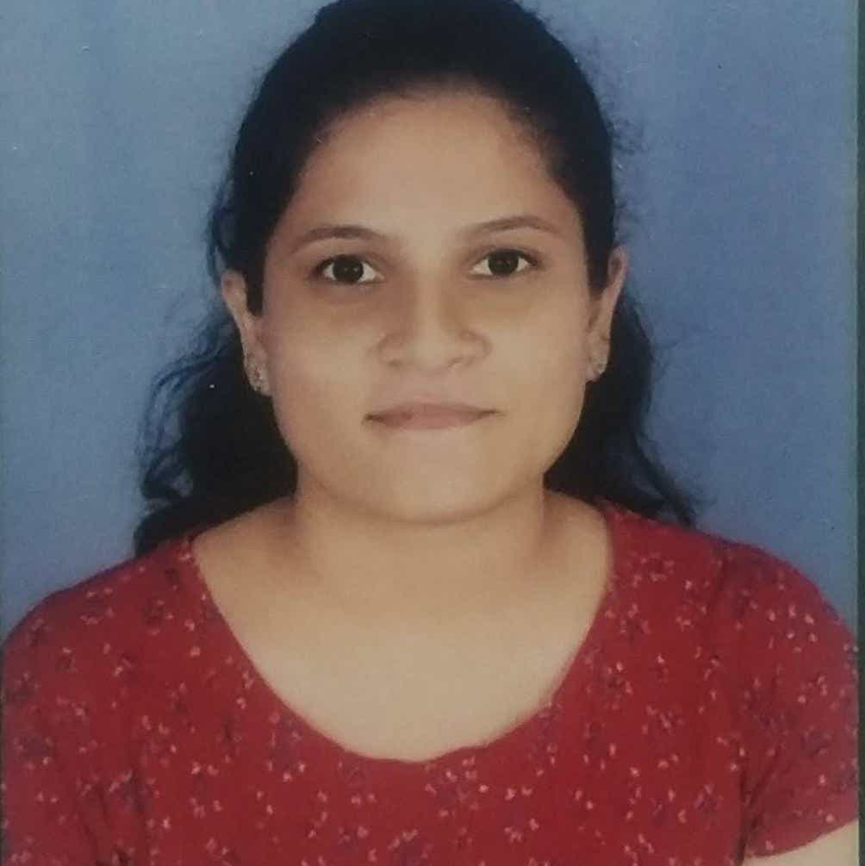
Mahanwar Aishwarya
Analyst/Software Engineer
Bachelor of Technology
Civil Engineering : 2016 – 2019
Microsoft Azure AZ-900 Fundamentals
Skills Dot Net
C#
Java
MYSQL
Backend
REST-API
Database
SQL database – MSSQL
AddOns
Github
Swagger
Postman
Additional Details
Leadership
Quick Learner
Team management
Vikrohli, Mumbai
Aishwarya.mahanwar@capgemini.com
+91 7057957259
A4
Ready to learn new technologies and implement them to further improve my knowledge.
A team player with good communication skill always ready to work for the enrichment of knowledge
Eager to work in a team of dedicated people and serve a key role in the enhancement and development of the project.
Movie Management System
Completed end to end case study of Movie Management System along with JWT authentication, Swagger and postman testing using ASP.NET Core Web API and SQL.
Az-900 Certification from Microsoft
Completed this course and having Azure certification.

