Slide 1
Death Analysis
Aishwarya Nandapurkar
avn160230

Slide 2
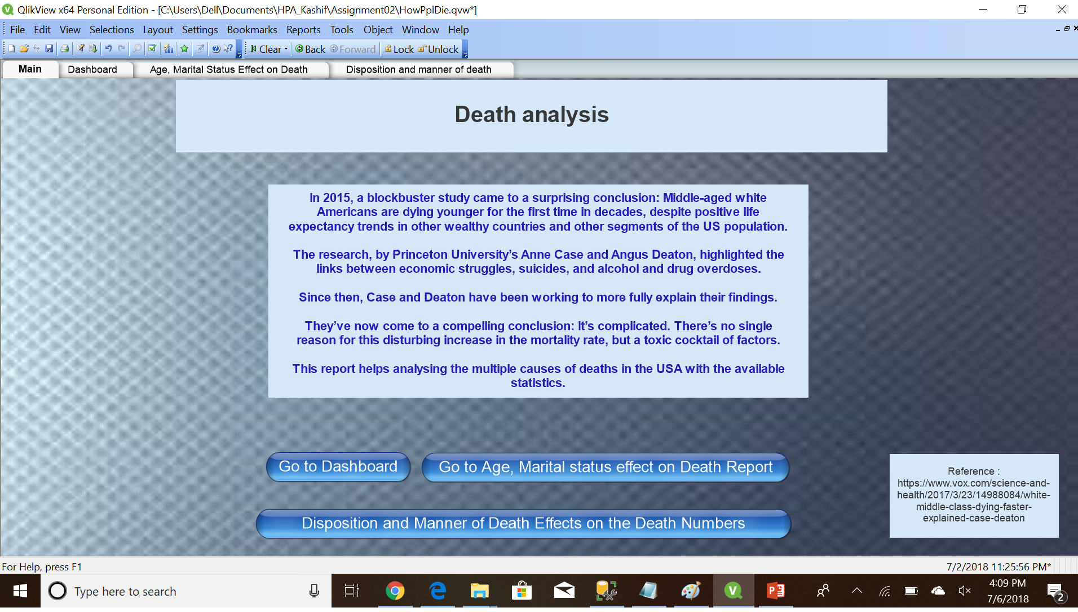
Main screen for Report

Slide 3
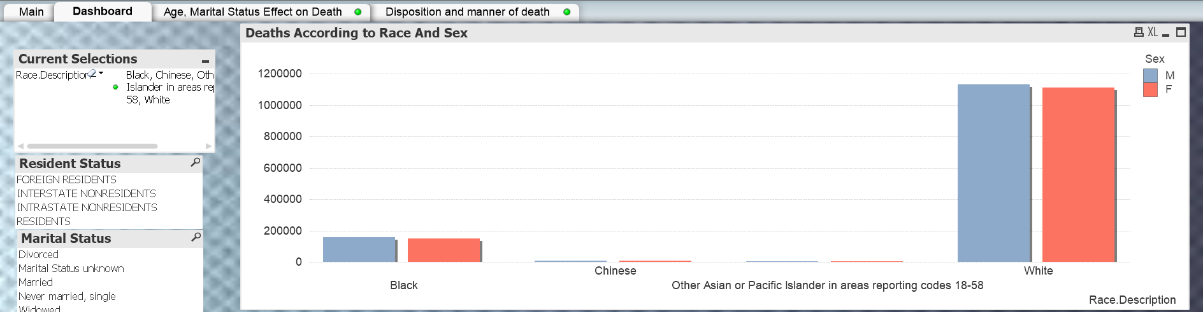
Finding 1 :
One important finding from this report is, the White race has the maximum number of Deaths as compared to any other race.

Slide 4
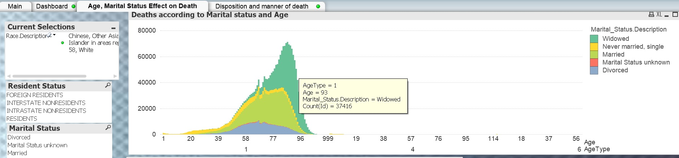
Finding : 2
Also, keeping the race filter on, filtering on all major races(according to population), we can clearly see that the Widowed people die more often as compared to people with a different marital status.

Slide 5
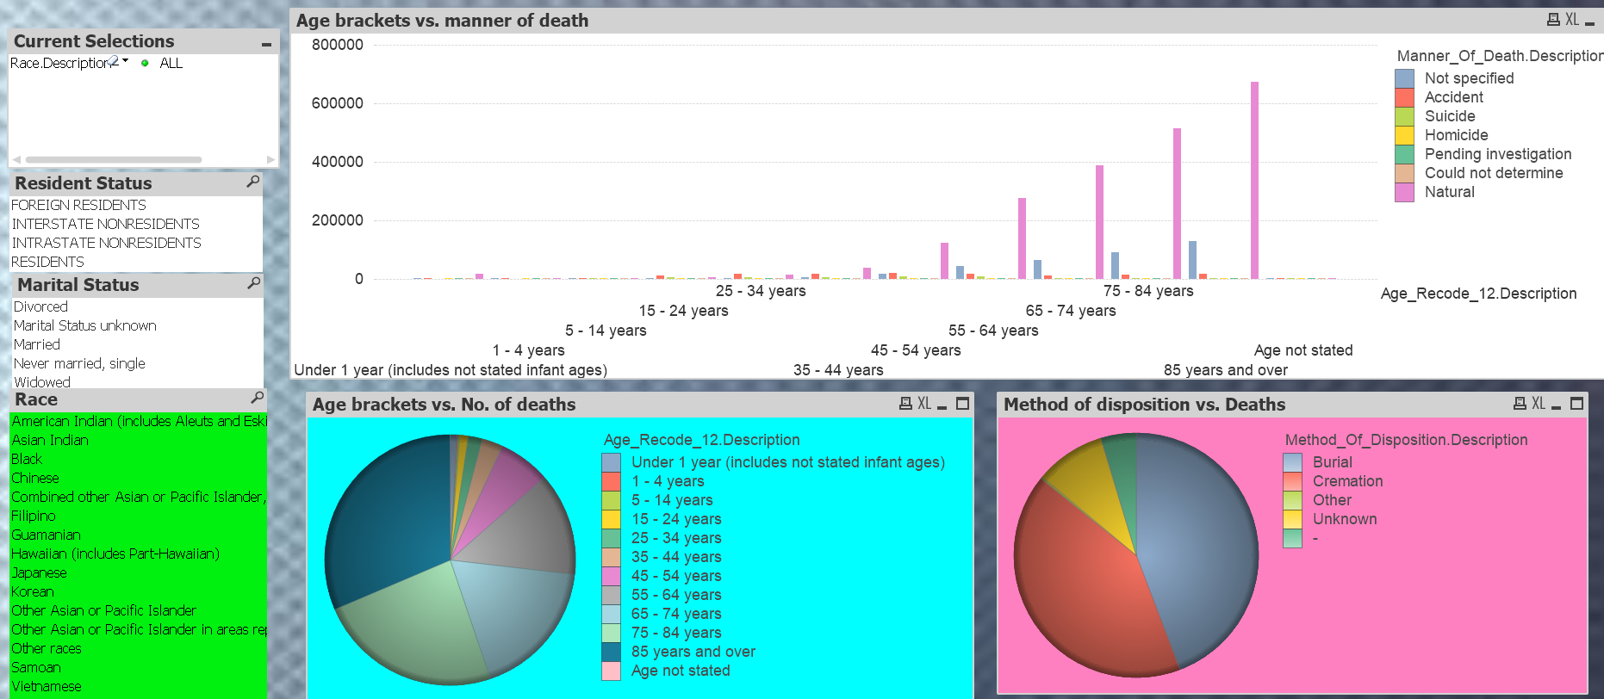
Finding 3 :
While selecting all races, we can observe that the deaths occur mostly after the age of 55 and the major reason for the same is “Natural reasons”. Also, majority of people are buried or cremated depending on race.

Slide 6
Problems
Qlikview works really well and the expressions, objects are easy to play around with but loading data onto the Qlikview file was tough.
Other than that, I liked this tool better than Tableau and Web Intelligence.

Slide 7
Recommendation According to Findings
As is visible from the finding, maximum number of deaths occur in the White race, one reason might be that their population is highest but still the difference when compared with other races is surprising. So this should be one point to go and check about.
Also, maximum deaths occur after the age range of 55. Mostly this might be because of multiple health issues, so healthcare should be improved for such people.
One more concerning finding is that Widowed people have a very high percentage of deaths as compared to other people. Surveys should be taken up for such people to know the actual reason behind this.

Slide 8
THANK YOU

