Slide 1

Insights gained from web Scraping

Slide 2
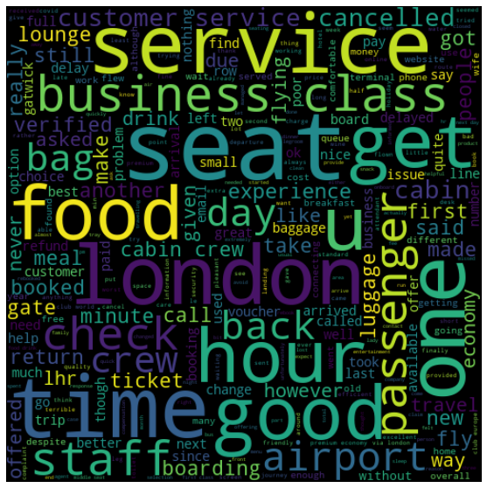
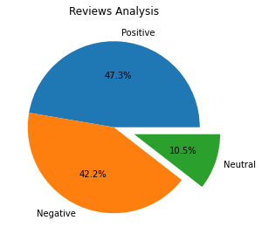
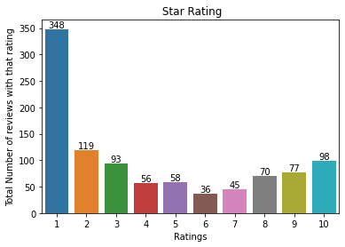
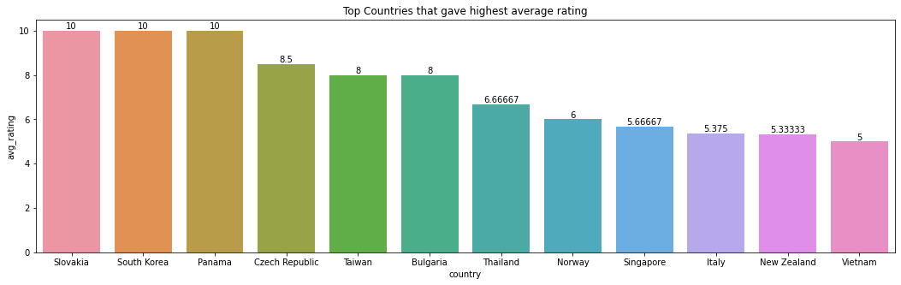
1000 reviews collected
Average Star Rating
4.16
54
countries
Based on word Cloud Analysis majority of the reviews are about time, service, food, London, seat and business class

