Slide 1
US FLIGHTS ANALYSIS WITH PYTHON
Group - 7

Slide 2
DATA SUMMARY
US domestic flights dataset for the year 2017
Source – US Bureau of Transportation
Contains approx. 6 million records with 70 columns (~2 GB)

Slide 3
DATA CLEANING
Merging data of each month together
Replacing null values with appropriate values
Changing datetimes to proper format (e.g. 1020 →10:20:00 )
Merging data with geographical coordinates

Slide 4
DATA Description
DEP_DELAY & ARR_DELAY (Departure & Arrival Delay in mins.)
Negative delay implies early departure/arrival.
CRS_ELAPSED_TIME (Computerized Reservations System) :
Elapsed Time = Airtime + Taxi In + Taxi Out
TAXI_IN : Time elapsed between wheels on and gate arrival at the destination airport
TAXI_OUT : Time elapsed between departure from origin airport gate and wheels off

Slide 5
Insight 1
Would you prefer to choose a particular airline if you knew 45% of its flights are delayed?
Probably not!?

Slide 6
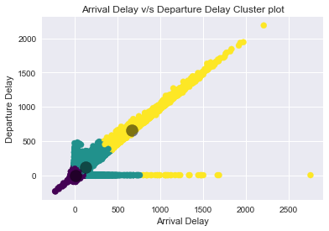
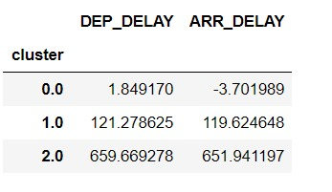
Insight 1
Using clustering, we found out that:
Even though some flights have delayed departures, they still arrive on time or in many cases even before the scheduled arrival time!
Reason?
→CRS time adjustment

Slide 7
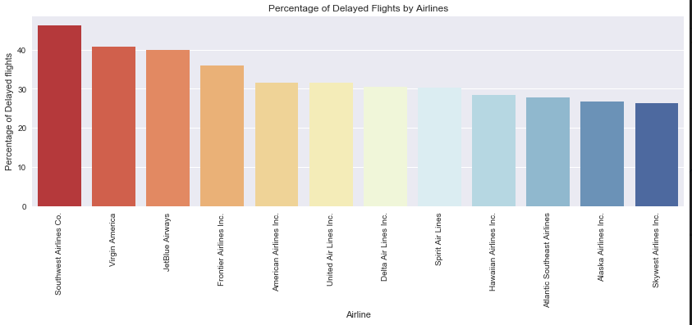
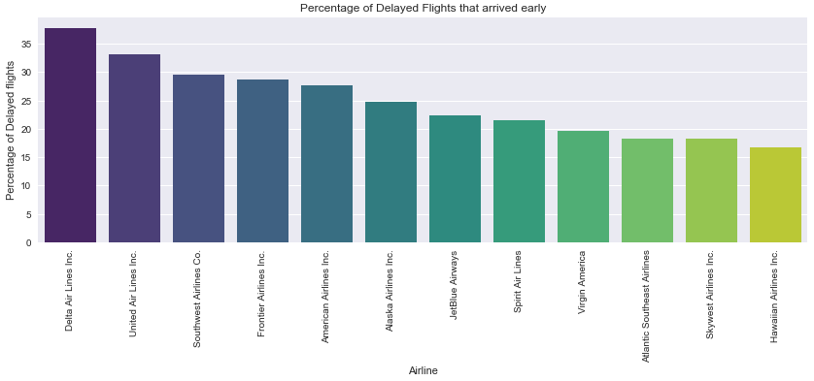
Insight 1

Slide 8
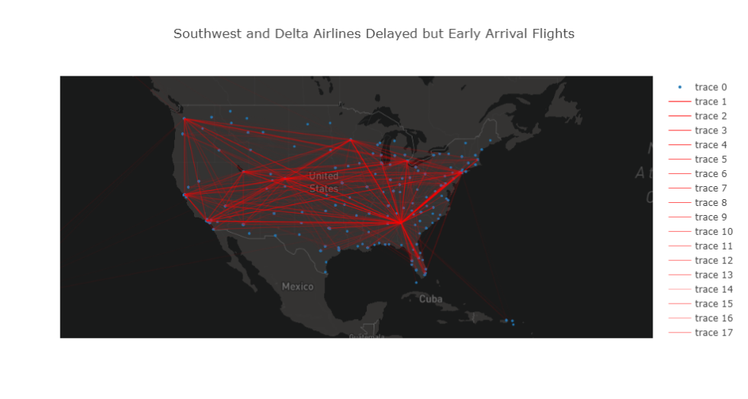

Slide 9
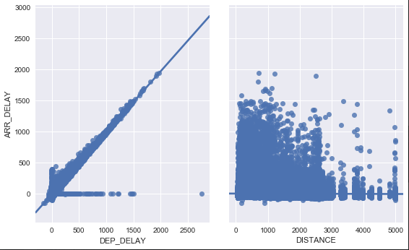
INSIGHT 2
Predicting arrival delays using regression
models.
Steps overview:
1)Used Lasso to find important attributes for prediction.
2)Trained and predicted delays using Lasso Regression Model. (MAD=4.33 mins)
3)Trained and predicted delays using Linear Regression Models. (MAD=3.80 mins)
4)Used Linear Regression Model to predict 2018 quarter 1, delays. (MAD = 3.885 mins)

Slide 10
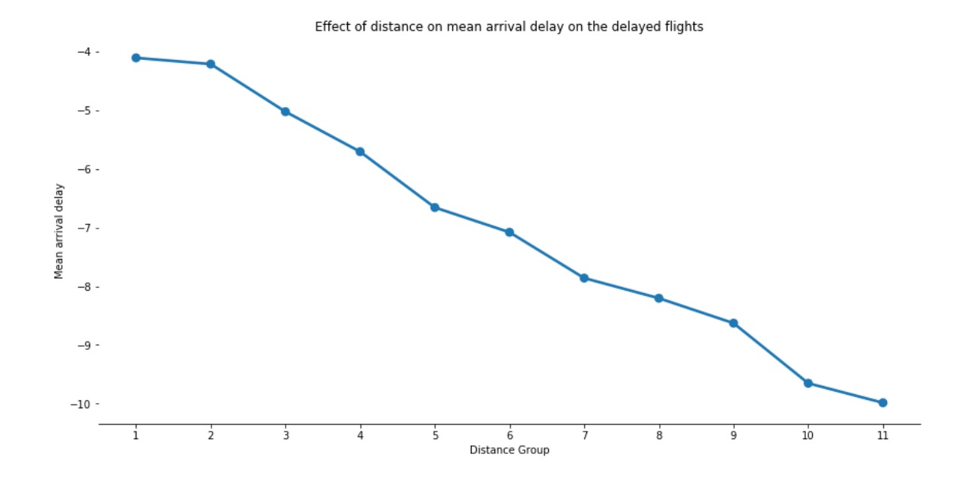
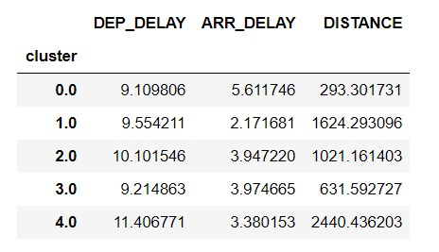
Insight 3
Shorter distance flights have comparatively more delays than longer distance flights!

Slide 11
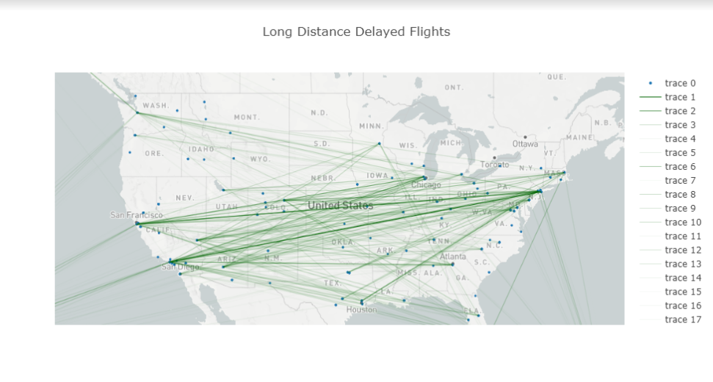

Slide 12
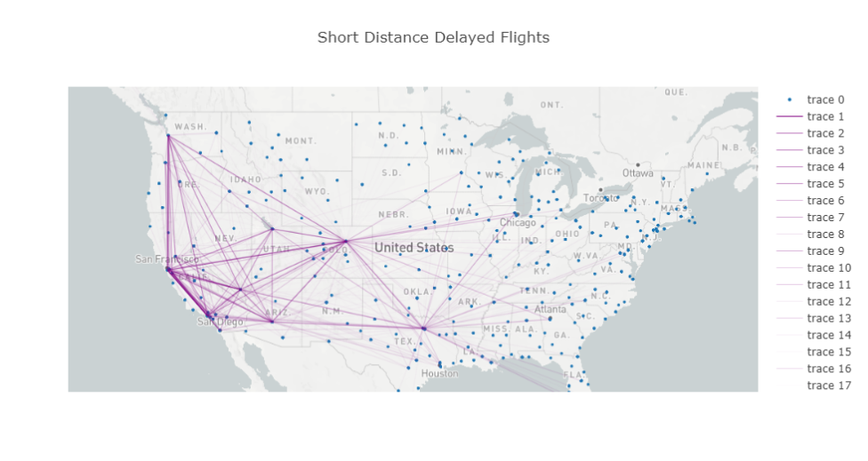

Slide 13

Just for fun!
Flights are delayed more in summers than monsoon or winters!
Causes → Low air density makes it difficult for planes to take off.
Flights are delayed more during weekdays than weekends.

Slide 14
THANK YOU!

