Slide 1
Employee Payroll Management System
228 Java SL NK Group-2

Slide 2
TEAM MEMBERS
Arvind Nair 2530280
Aishwarya V 2528926
M S Anuroop 2529591
Bhuvaneswari Mani 2528618
Jagan Koteeswaran 2529699
Narmadha Mayilraj 2529592
Rishav Ranjan 2525453
Savithasini K 2529203
Varshini S 2529982
Visalini S 2528915

Slide 3
CONTENTS
Introduction
Objective
Tools And Technologies Used
Work Flow
E-R Diagram
Features of EMP
Output screenshots
Future scope & Improvements
Conclusion

Slide 4
INTRODUCTION
Employee payroll management system is an Internet-based Java application that automates the working of a company or work center that manage and maintain records of the employees in the different department.
The proposed project “Employee Payroll Management System” has been developed to overcome the problems faced in the practicing of manual system.
The majority of the time, data security rules are stringent. Employee information is kept as private as possible, which is reflected in several degrees of administrative and access privileges. It also gives employees access to information about their salary impairments.

Slide 5
OBJECTIVE
The objective of the Employee payroll management system project is to design a scheduling system for a work center.
The supervisor holds the various activities maintain salary details ,mark attendance, and deleting the employees, and on the other hand employees view their details, view schedule and view attendance.

Slide 6
TOOLS & TECHNOLOGIES USED
Front End:
Visual Studio
Angular
HTML
CSS
BOOTSTRAP
TYPESCRIPT
Back End:
Eclipse
Spring Tool Suite
MySQL
Hibernate
Postman

Slide 7
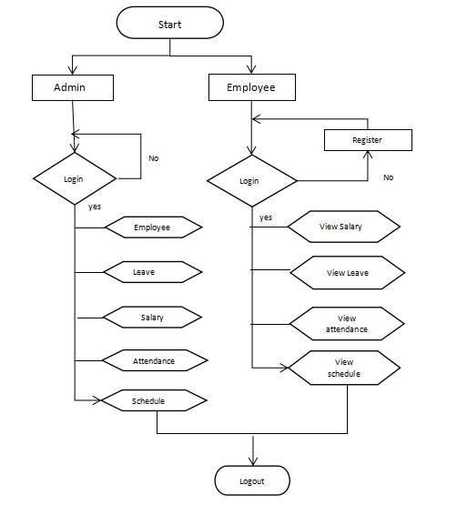
WORK FLOW

Slide 8
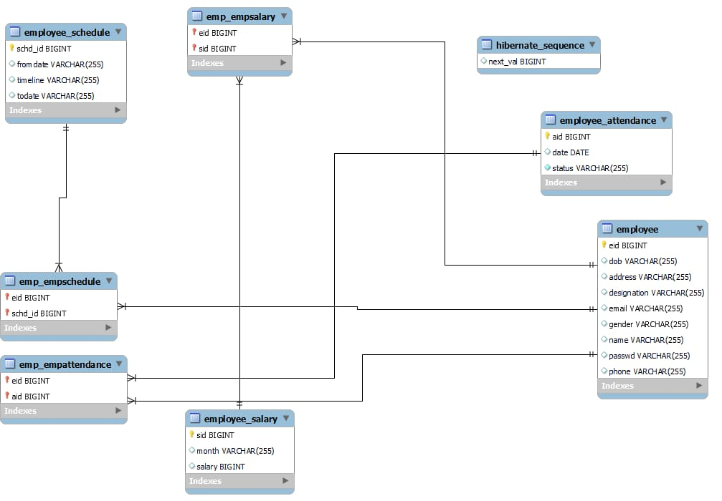
E-R DIAGRAM

Slide 9
FEATURES OF EMP
Easy to use. ​It is completely secure.
​This system is easily compatible with most of the web browsers.
​Admin can view all the records whenever necessary with ease and can add/delete various components like salary , attendance, scheduling work.
Store the end-end data of employees & Admins.

Slide 10
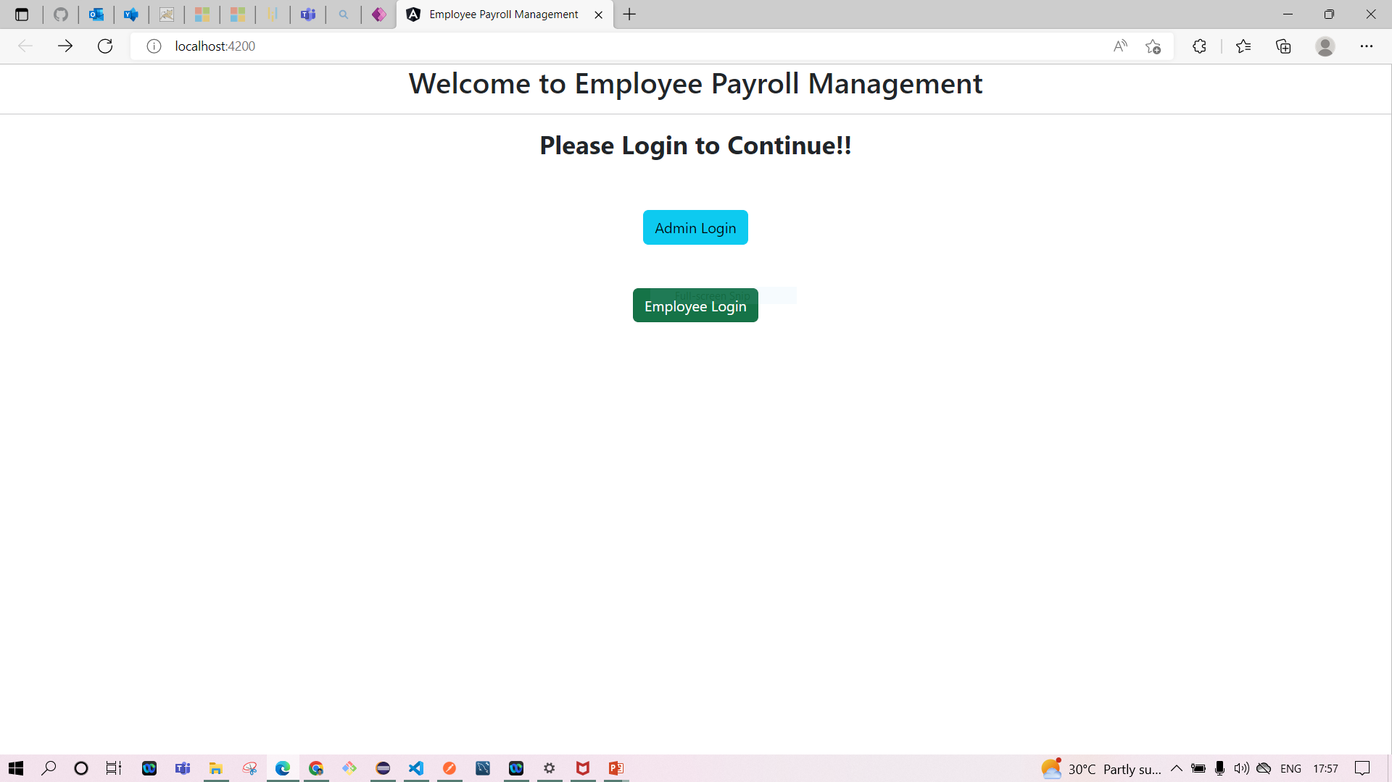
OUTPUT SCREENSHOTS
Home Page

Slide 11
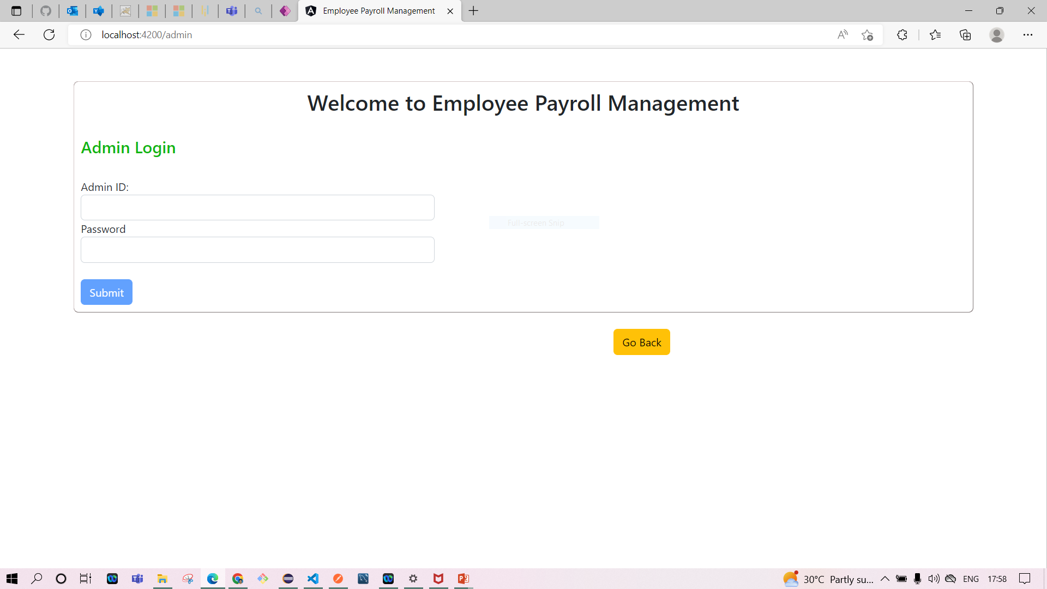
Admin Login

Slide 12
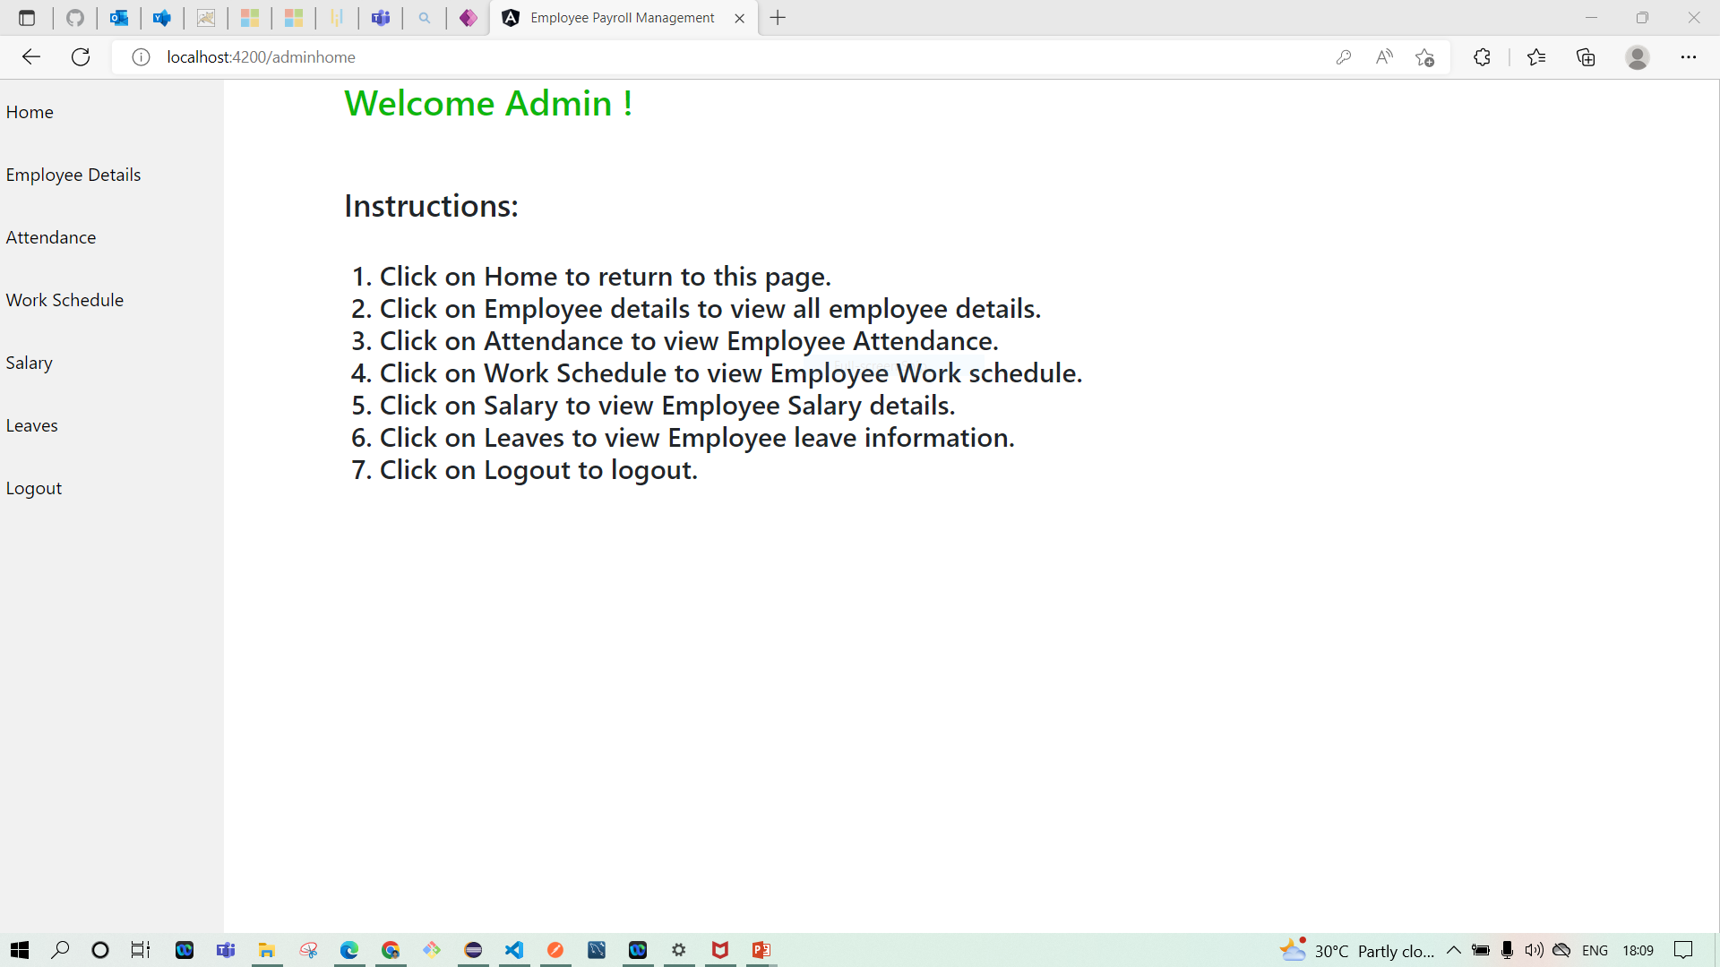
Admin Home Page

Slide 13
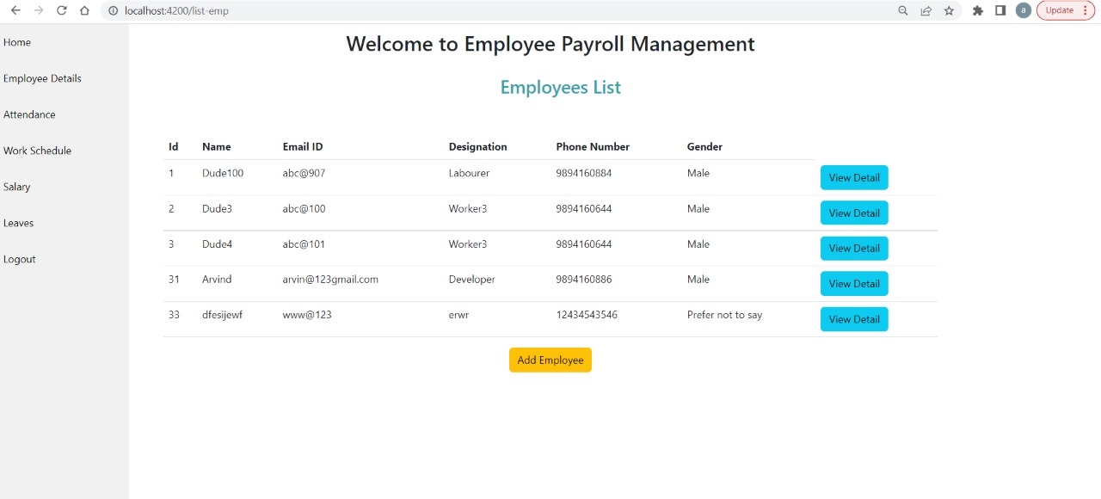
Employee’s List

Slide 14
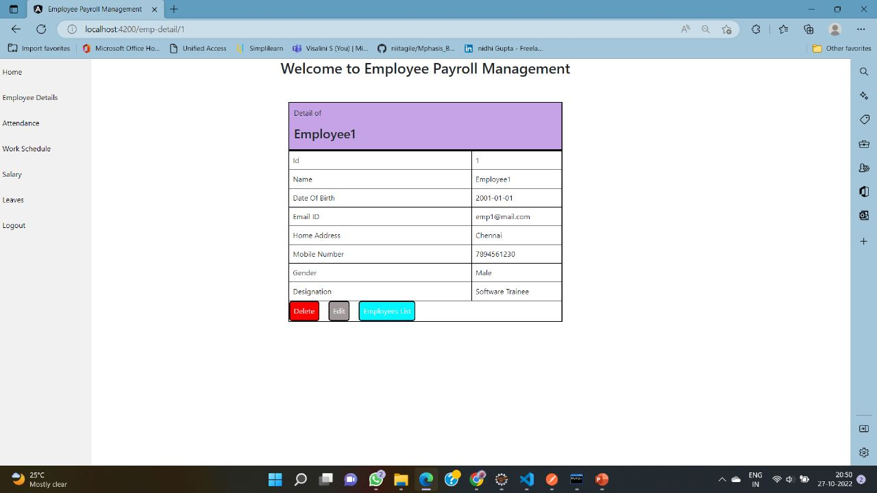
Employee Details

Slide 15
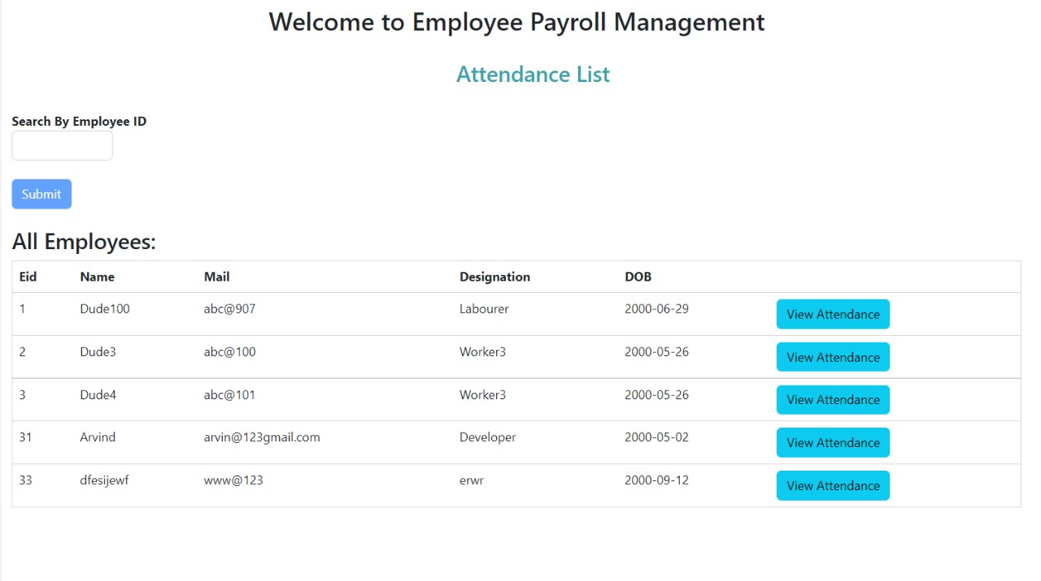
Employee’s Attendance List

Slide 17
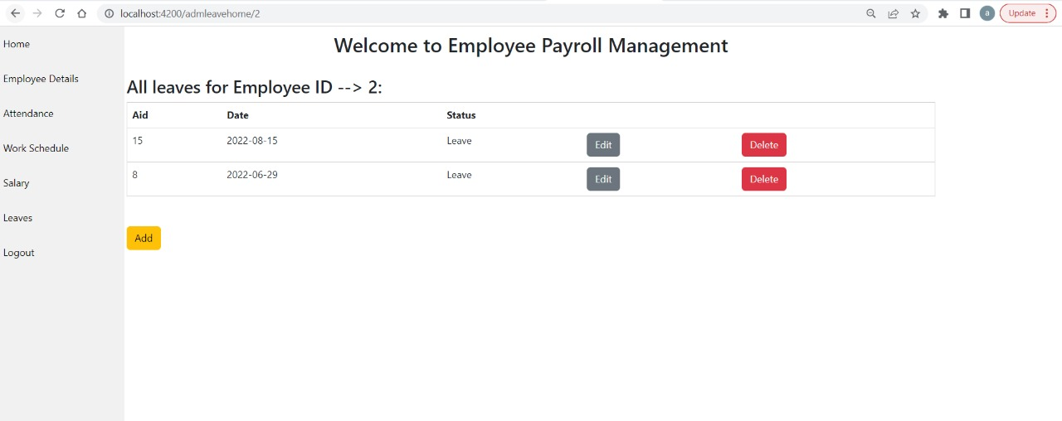
View & Edit Attendance

Slide 18
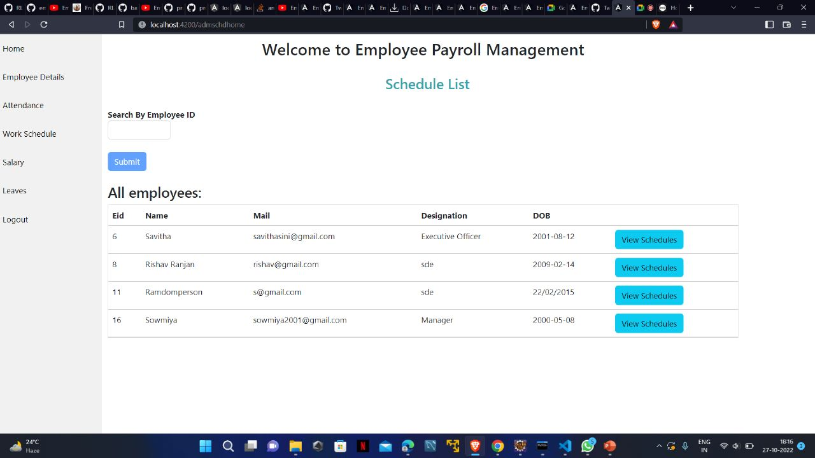
View Work Schedule of an Employee

Slide 19
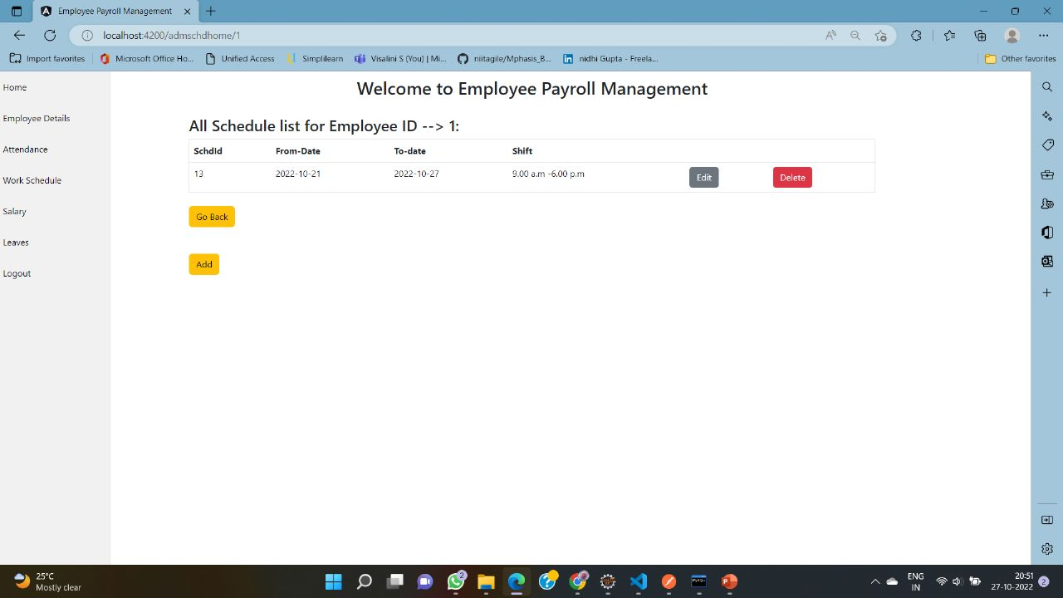
View & Edit Schedule

Slide 20
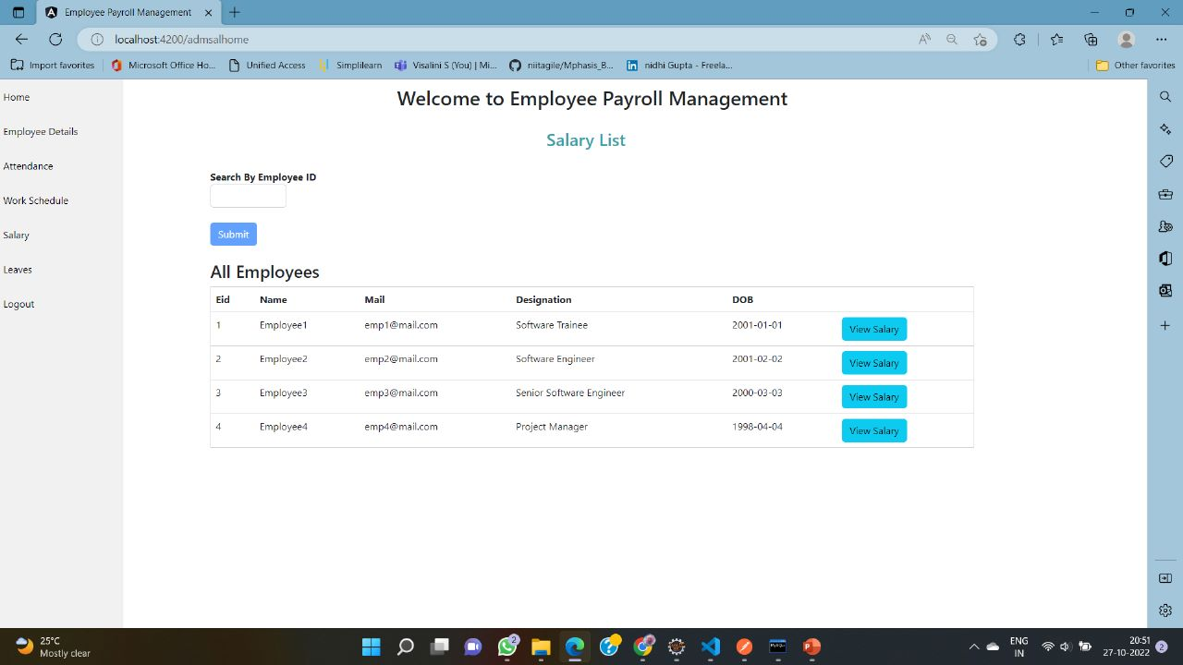
Employee’s Salary List

Slide 21
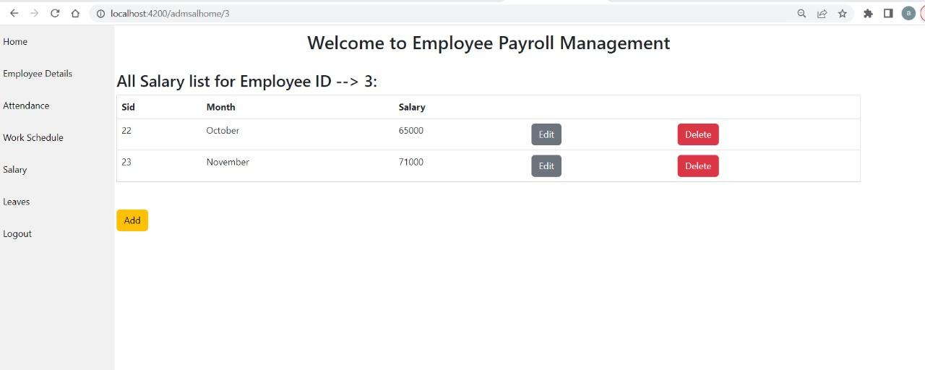
View & Edit Salary

Slide 22
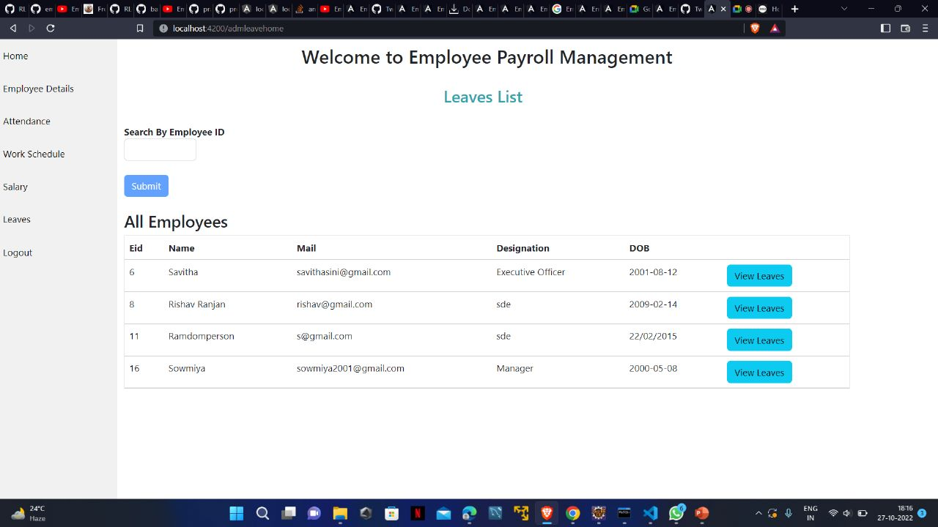
View Leavelist of an Employee

Slide 23
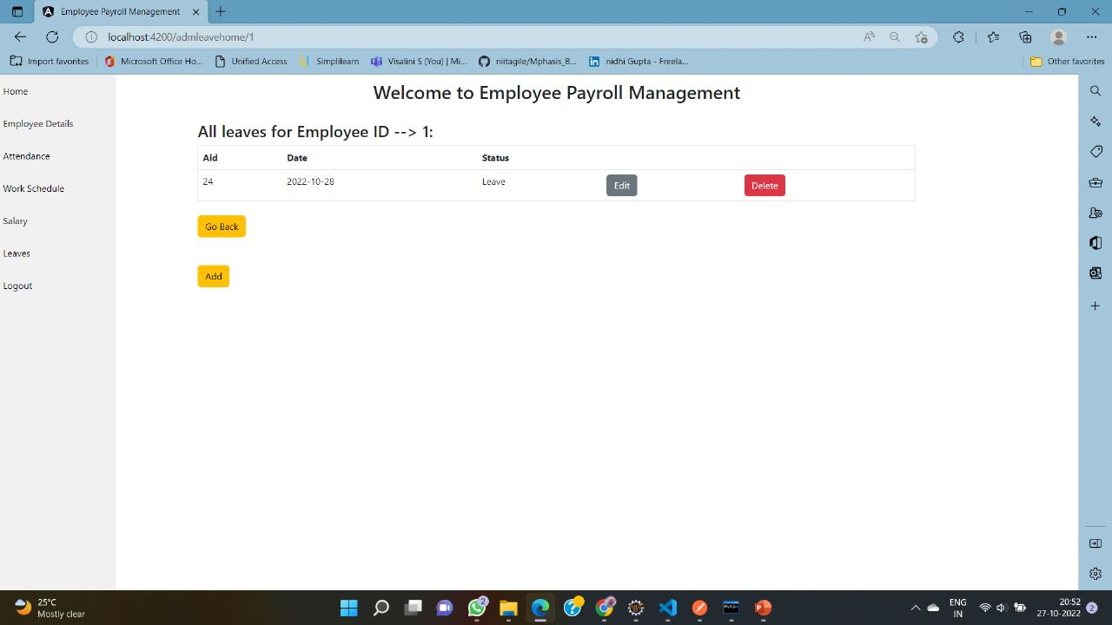
View & Edit Leaves

Slide 24
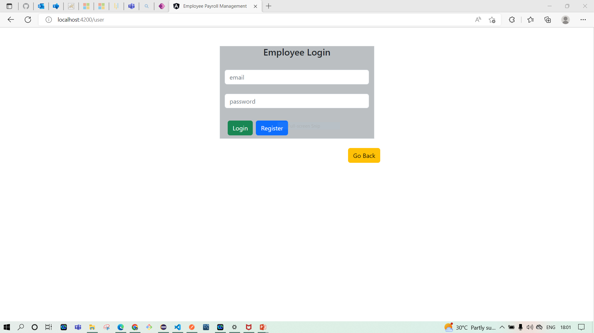
Employee Login:

Slide 25
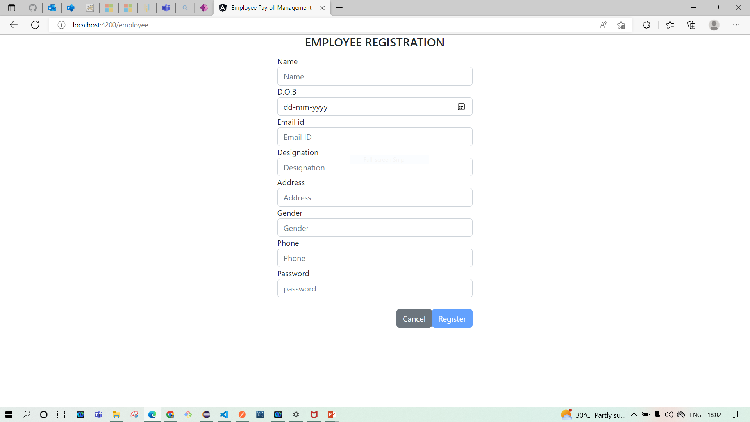
Employee’s Registration Form

Slide 26

Employee Welcome Page

Slide 27
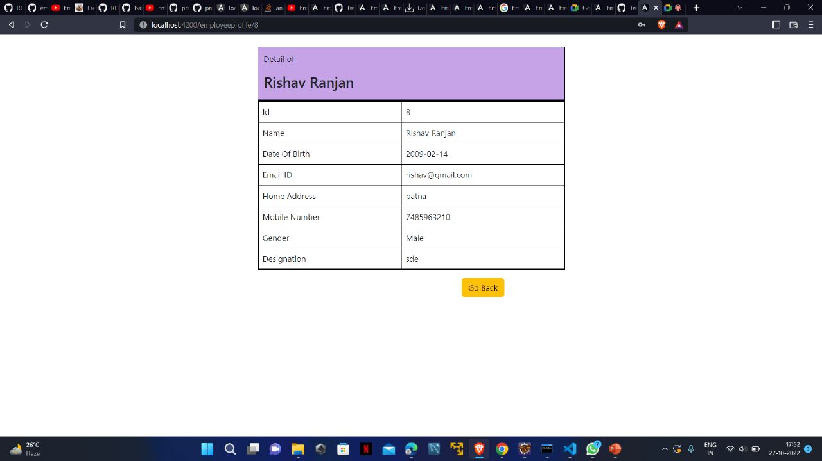
Profile Page

Slide 28
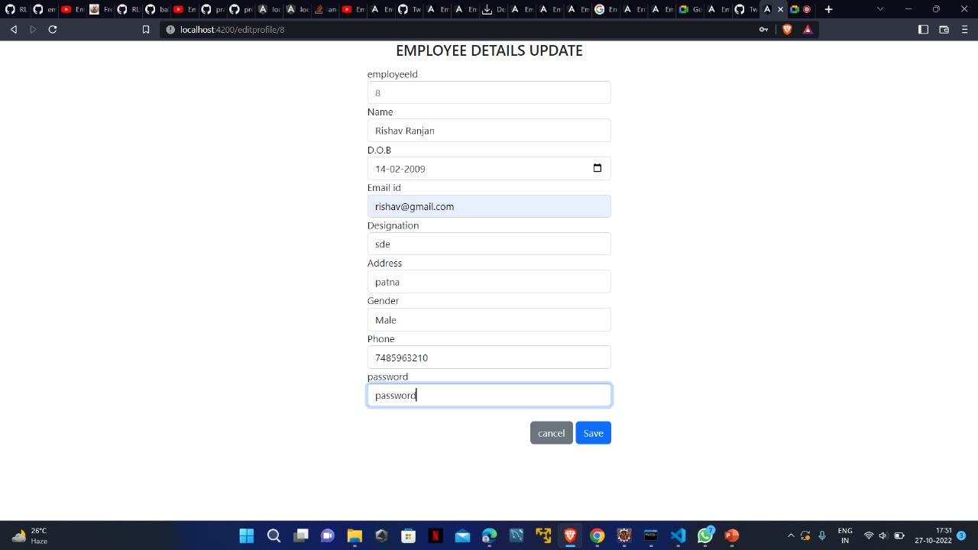
Edit Profile Page

Slide 29
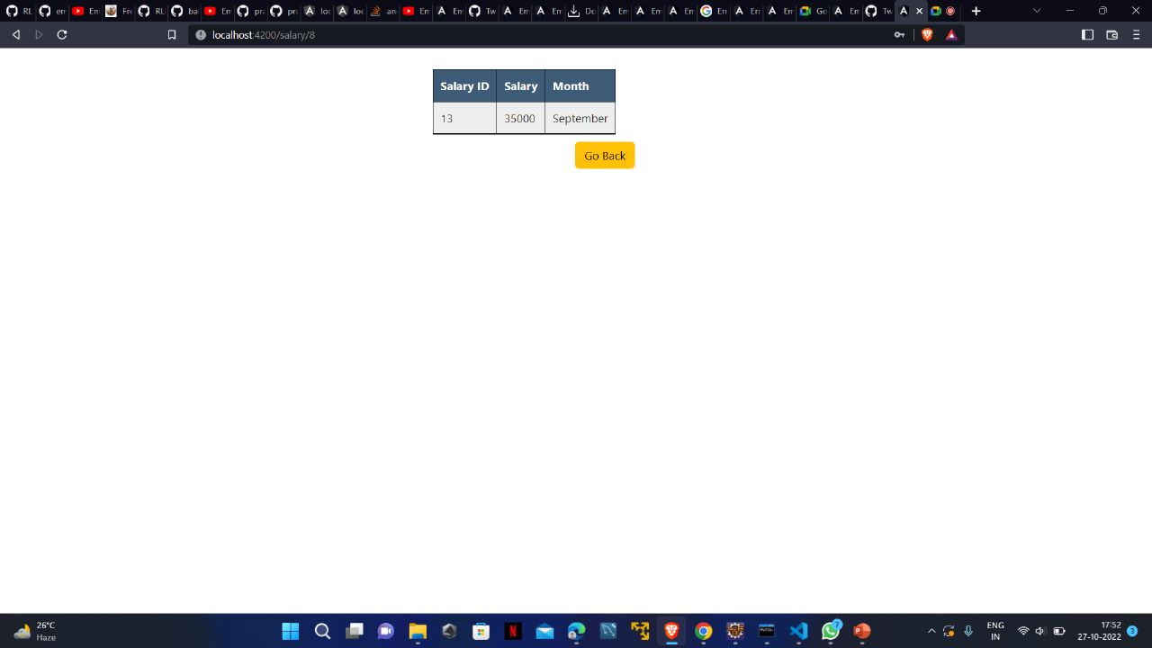
View Salary

Slide 30
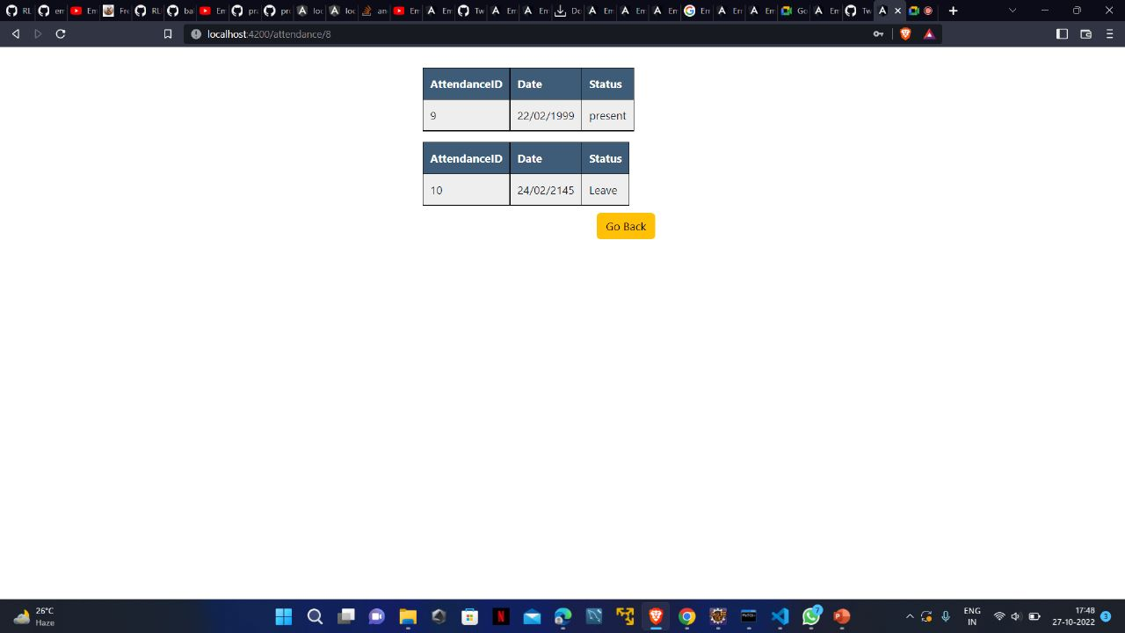
View Attendance

Slide 31
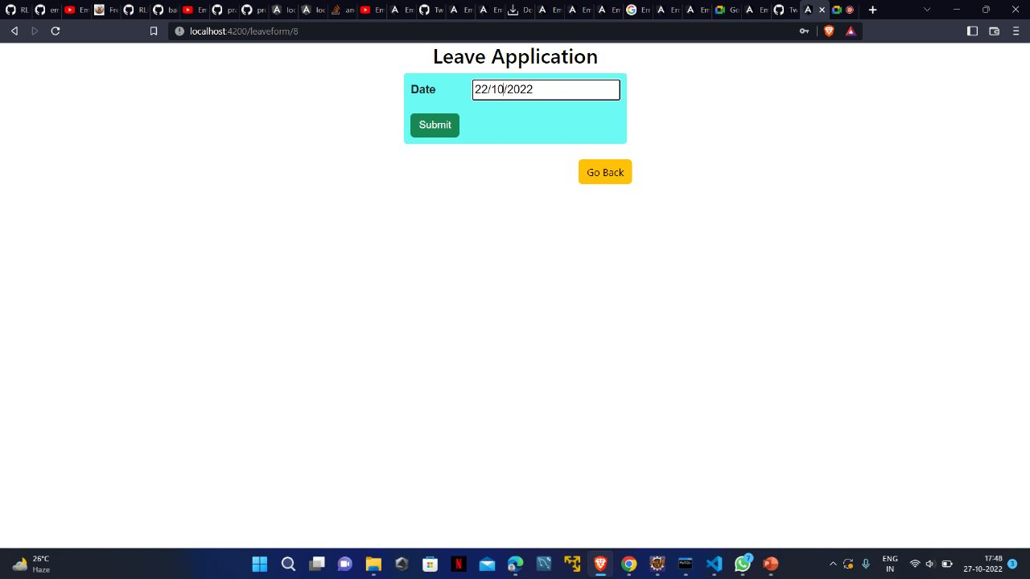
Apply Leave

Slide 32
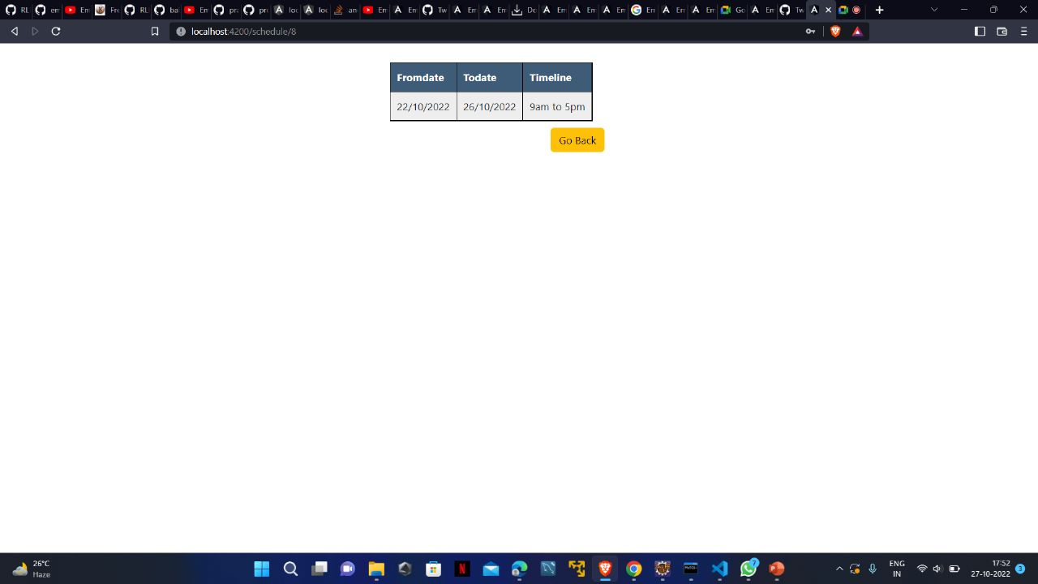
View Work Schedule

Slide 33
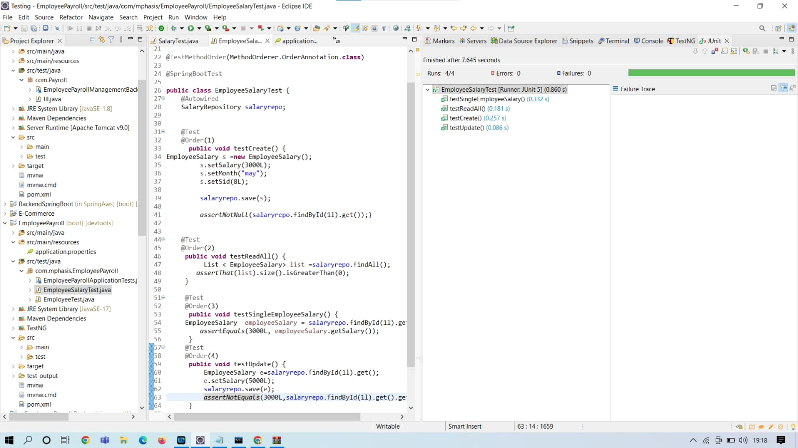
Testing(Junit)
Employee salary testcase:

Slide 34
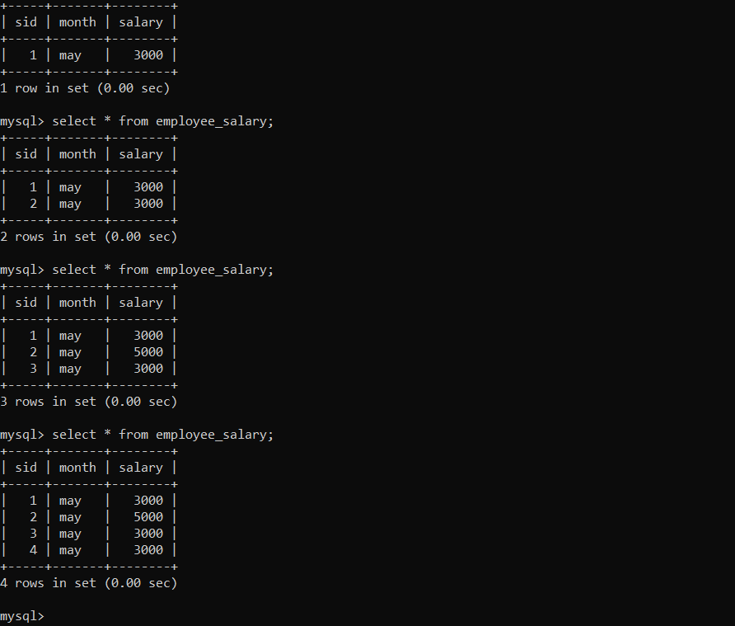
Database table:
For salary:

Slide 35
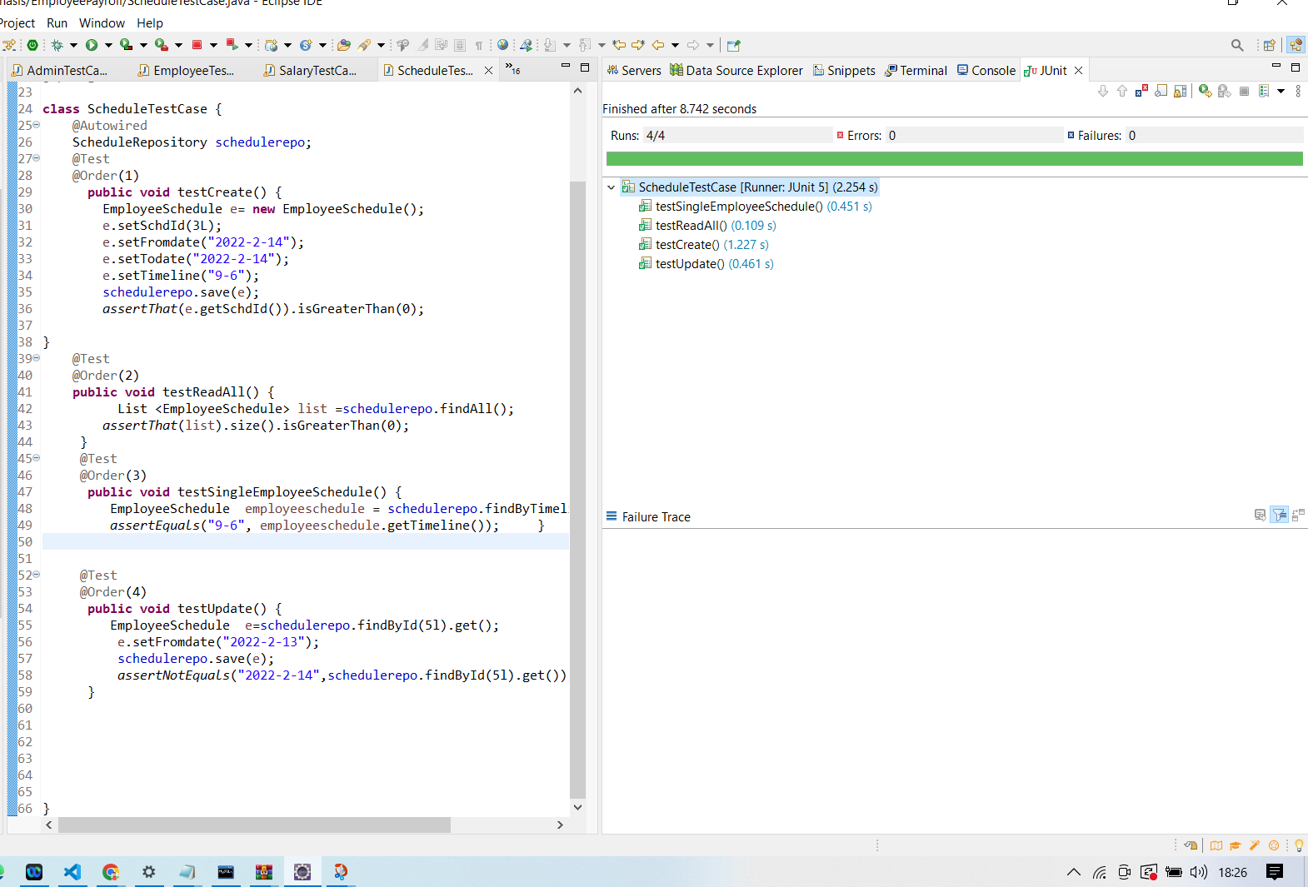
Testing(Junit)
Employee schedule testcase:

Slide 36
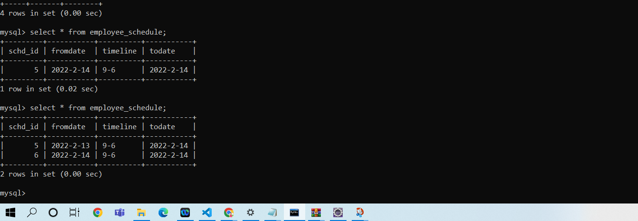
Database table:
For schedule:

Slide 37
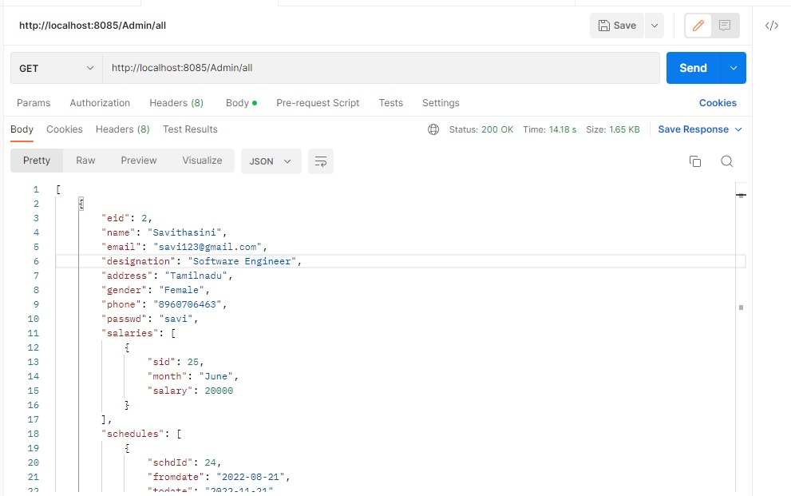
Postman
GET Method:

Slide 38
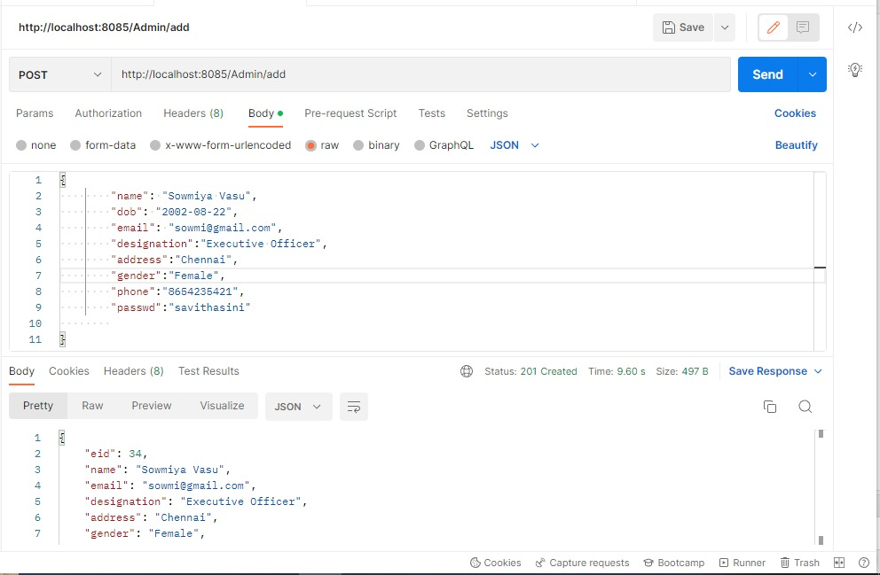
Postman
POST Method:

Slide 39
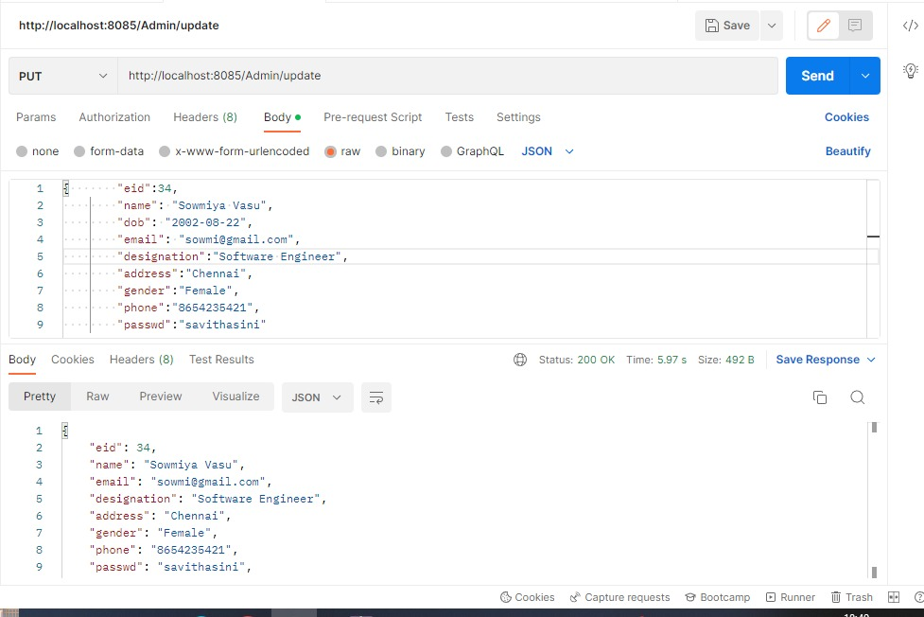
Postman
PUT Method

Slide 40
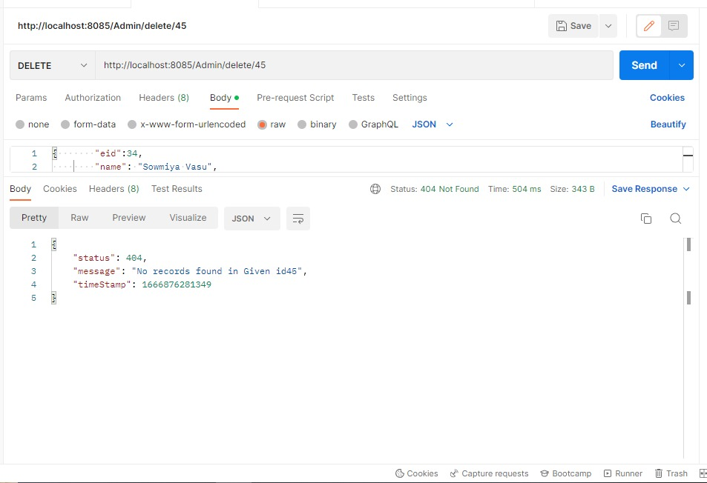
Postman
DELETE Method:

Slide 41
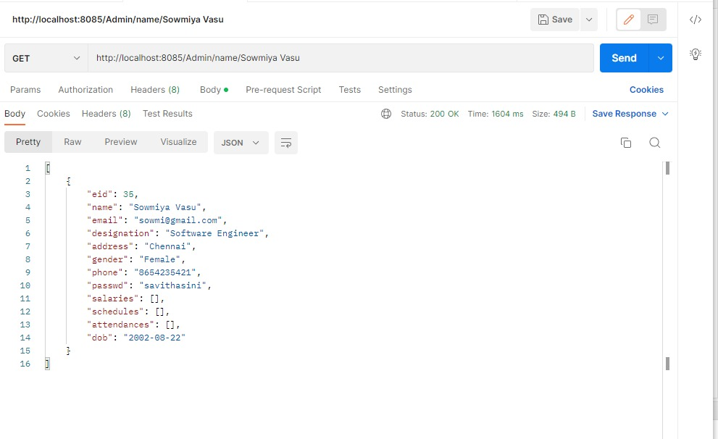
Postman
GET by Name:

Slide 42
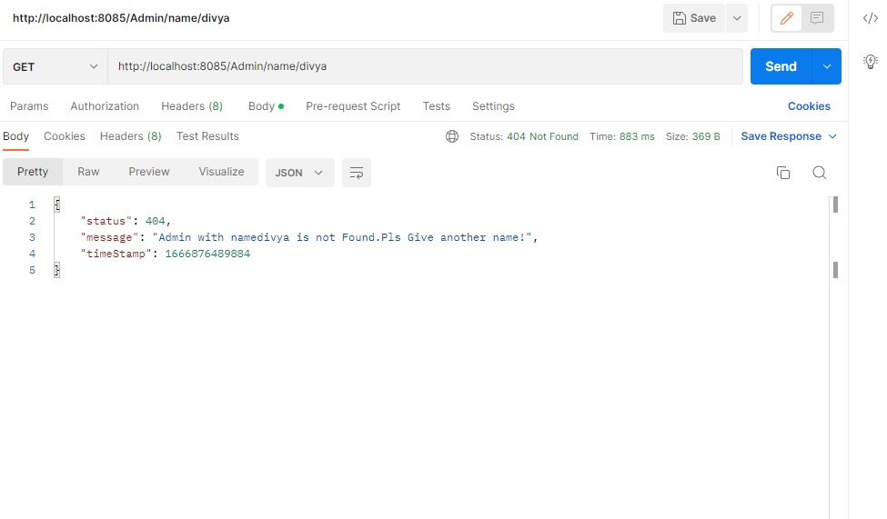
Postman
GET by Name:

Slide 43
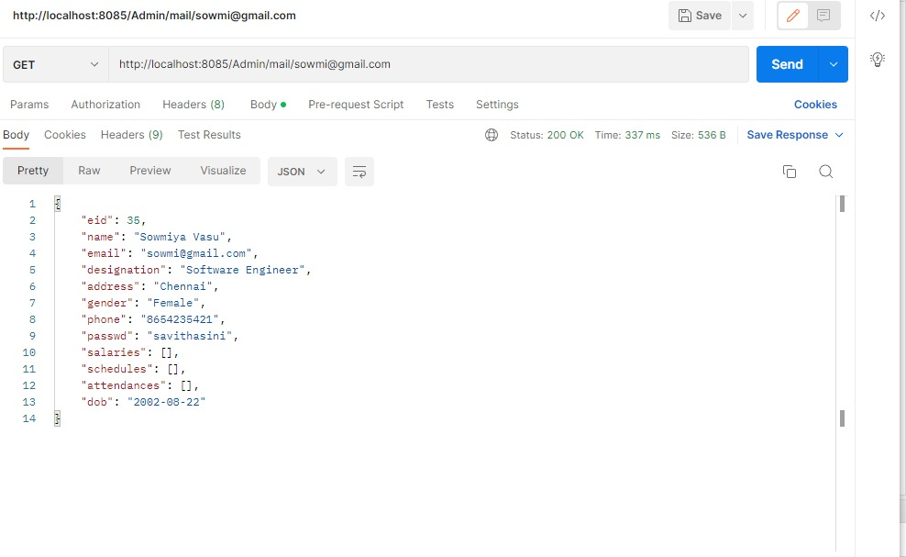
Postman
GET by Mail:

Slide 44
FUTURE SCOPE & IMPROVEMENTS
This Application works in Multiple PC’s installed on multiple Computers but sharing Same database by which users of different department can use it sitting at different locations simultaneously.
But in future we can make the Application where the database will be hosted in order to manage the all departments which will be located in different places and by keeping domain of Application as Online.

Slide 45
CONCLUSION
Payroll Management System” software developed for a company has been designed to achieve maximum efficiency and reduce the time taken to handle the Payroll activity. It is designed to replace an existing manual record system thereby reducing time taken for calculations and for storing data.
The system is strong enough to withstand regressive daily operations under conditions where the database is maintained and cleared over a certain time of span. The implementation of the system in the organization will considerably reduce data entry ,time and also provide readily calculated reports.

