Slide 1
Stack Overflow Tag Prediction
PG Project
Monsoon 2019
Guided by: Dr. Radhika Mamidi
Team Members:
Yaswanth Koravi (2018202011)
Aishwarya Shivachandra (2018202005)
Notes:
Be specific and direct in the title. Use the subtitle to give the specific context of the speech.
-The goal should be to capture the audience’s attention which can be done with a quote, a startling statistic, or fact. It is not necessary to include this attention getter on the slide.
1

Slide 2
Outline
Problem Statement
What is Stack Overflow Tag Prediction ?
Motivation
Dataset
Performance Metrics
Approach
Exploratory Data Analysis
End Results
Milestones
Notes:
Use the background points to post details that are not common knowledge, or that the audience will need to understand the context of the speech.
-Do not read these main points from the PowerPoint, instead elaborate on these points during the speech.
1

Slide 3
Problem Statement
Provided a bunch of questions, by using the text in the title and description, suggest the tags based on the content of the question posted on Stack Overflow.
This is a Multi-label Classification problem.
Notes:
Use the background points to post details that are not common knowledge, or that the audience will need to understand the context of the speech.
-Do not read these main points from the PowerPoint, instead elaborate on these points during the speech.
1

Slide 4
What is Stack Overflow Tag prediction ?
Stack Overflow is the largest, most trusted online community for developers to learn, share their programming knowledge, and build their careers. It features questions and answers on a wide range of topics in computer programming. The website serves as a platform for users to ask and answer questions, and, through membership and active participation, to vote questions and answers up or down and edit questions and answers.
A question in Stack Overflow contains three segments Title, Description and Tags. Stack Overflow predicts the tags using the text present in title and description.
Notes:
Use the background points to post details that are not common knowledge, or that the audience will need to understand the context of the speech.
-Do not read these main points from the PowerPoint, instead elaborate on these points during the speech.
1

Slide 5
Motivation
Stack Overflow features questions and answers on a wide range of technical topics. The website serves as a platform for users to ask and answer questions, to vote questions and answers up or down and edit questions and answers. Based on the type of tags assigned to questions, the most discussed topics on the site are: C#, Java, PHP, JavaScript, Android, jQuery,etc.
Stack Overflow detects that a particular user has answered a lot of questions related to a particular subject in the past and thus recognizes that he is an expert in the subject. So it raises a notification to the right people, such that they are able to answer the questions related to that subject. Stack Overflow can predict the tags using the text in title and description.
This is extremely business critical. Thus our model is most suitable for such question and answer forum related websites so that whenever a question is posted, there is high chance that it will be answered quickly if we predict the tags more accurately and the appropriate subject experts are notified for each question.
Notes:
Use the background points to post details that are not common knowledge, or that the audience will need to understand the context of the speech.
-Do not read these main points from the PowerPoint, instead elaborate on these points during the speech.
1

Slide 6
Data
Data contains 4 fields:
Id - Unique identifier for each question
Title - The question’s title
Body - The body of the question
Tags - The tags associated with the question
Size of Train.csv - 6.75GB
Number of rows in Train.csv = 60,34,195
Notes:
Use the background points to post details that are not common knowledge, or that the audience will need to understand the context of the speech.
-Do not read these main points from the PowerPoint, instead elaborate on these points during the speech.
1

Slide 7
Data Sample Point
ID: "27"
TITLE: "Is my understanding of MAKE correct?"
BODY: "<p>Taking the GNU make application as an example, when I create a makefile it is likened to a Visual Studio project file in that it contains the list of files and other items needed to compile an application. The makefile contains the path to the compiler as well as the path to all the files that could possibly be used in the compiling operation. The MAKE application reads the makefile and combines the sources into 1 file which the compiler then reads and converts into the relevant assembly/machine code.</p>
<p>The #include directive is a directive that tells the make file to:""include the contents of this file into this point of the larger file that you're making to feed to the compiler then resume with the current file"".</p><p>The MAKE application also tells the compiler where to ""emit"" the result of the compile operation once the compiling is completed. In this regard a Visual Studio .csproj file is technically a XML based makefile for a Microsoft specific MAKE application.</p><p>Is this understanding of makefiles correct?</p>"
TAGS: "visual-studio makefile gnu"
Notes:
Use the background points to post details that are not common knowledge, or that the audience will need to understand the context of the speech.
-Do not read these main points from the PowerPoint, instead elaborate on these points during the speech.
1

Slide 8
Performance Metrics
Micro-Averaged F1-Score (Mean F Score) : The F1 score can be interpreted as a weighted average of the precision and recall, where an F1 score reaches its best value at 1 and worst score at 0. The relative contribution of precision and recall to the F1 score are equal. The formula for the F1 score is:
F1 = 2 * (precision * recall) / (precision + recall)
In the multi-class and multi-label case, this is the weighted average of the F1 score of each class.
If we want to predict any of the tags we should have a high precision value i.e, we have to be really sure that the predicted tag belongs to the given question. Also, we want to have a high Recal rate, which means If the tag actually supposed to be present, we want it to be present most number of times. So mertic considered is f1 score.
Notes:
Use the background points to post details that are not common knowledge, or that the audience will need to understand the context of the speech.
-Do not read these main points from the PowerPoint, instead elaborate on these points during the speech.
1

Slide 9
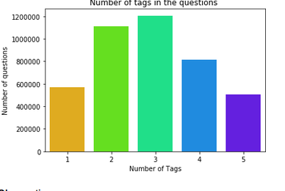
Exploratory Data Analysis- Tags analysis
Minimum number of tags per question: 1
Maximum number of tags per question: 5
Avg. number of tags per question: 2.887779
Questions with 3 tags are maximum
Fig1 :Question wise tag count
Notes:
Use the background points to post details that are not common knowledge, or that the audience will need to understand the context of the speech.
-Do not read these main points from the PowerPoint, instead elaborate on these points during the speech.
1

Slide 10
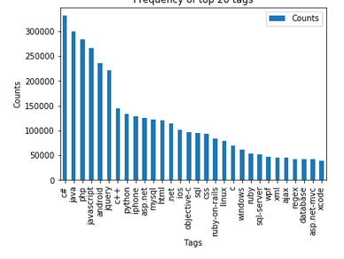
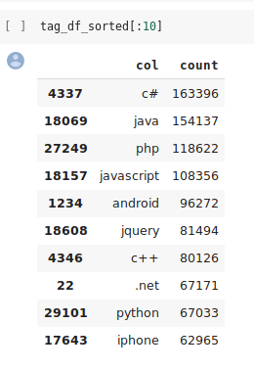
Dataset - EDA
Most frequent tags
Fig2 :Frequency of tags
Notes:
Use the background points to post details that are not common knowledge, or that the audience will need to understand the context of the speech.
-Do not read these main points from the PowerPoint, instead elaborate on these points during the speech.
1

Slide 11
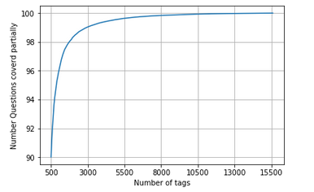
Dataset - EDA
With 5500 tags 99.041% of questions are covered.
With 500 tags 90.013% of questions are covered.
Fig5 : Number Questions covered per number of tags
Notes:
Use the background points to post details that are not common knowledge, or that the audience will need to understand the context of the speech.
-Do not read these main points from the PowerPoint, instead elaborate on these points during the speech.
1

Slide 12
Data cleaning
We cleaned the data by removing those text from the dataset that do not contribute to tag prediction:
Remove stop words.
Convert all the characters into small letters.
Use SnowballStemmer to stem the words.
Remove code snippets from the body.
Concatenate title and body into single column.
Notes:
Use the background points to post details that are not common knowledge, or that the audience will need to understand the context of the speech.
-Do not read these main points from the PowerPoint, instead elaborate on these points during the speech.
1

Slide 13
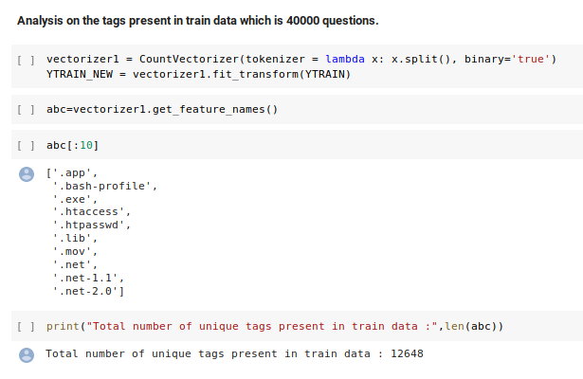
Text Pre-processing
Due to constraint on the computing power of our system, we have taken a a subset of data from Train.csv and sampled only 50,000 questions.
Then, split the given dataset using 80:20 train-validation split. Now number of rows in train data are 40,000.
Converted the text present in train data using TFIDF vectorizer with max features set as 60000 so that the maximum columns for the converted row will be 60000 .We also considered ngram range from 1-3. This technique is used to convert the text data present in train and test to numeric data.
Total number of unique tags present in train data: 12648
Notes:
Use the background points to post details that are not common knowledge, or that the audience will need to understand the context of the speech.
-Do not read these main points from the PowerPoint, instead elaborate on these points during the speech.
1

Slide 14
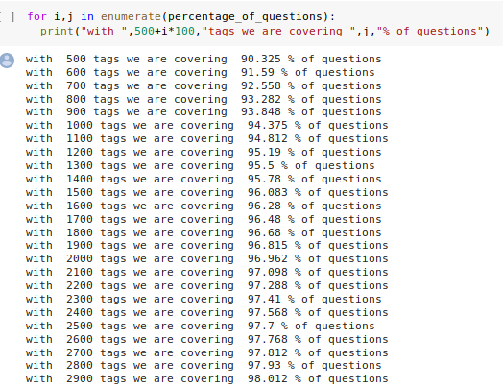
Text Pre-processing
If we consider all the tags ppresent in train data then we have to train nearly 12580 models on complete which is not computationally efficient, so we are compromising on the number tags based on the partial coverage of the questions.
Observation: By choosing top 500 tags we can cover 90% of the questions in train data.
Using bag of words technique and vocabulary as the top 500 tags choosen, we converted tags columns into sparse matrix which is suitable for modeling.
Notes:
Use the background points to post details that are not common knowledge, or that the audience will need to understand the context of the speech.
-Do not read these main points from the PowerPoint, instead elaborate on these points during the speech.
1

Slide 15
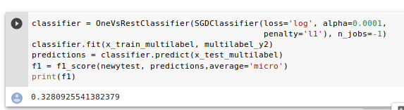
Model implementation
By using those 500 tags as the vocabulary for the training and,
by using simple logistic model with SGDClassifier using one vs rest technique,
we got an F1 score of 0.32
Notes:
Use the background points to post details that are not common knowledge, or that the audience will need to understand the context of the speech.
-Do not read these main points from the PowerPoint, instead elaborate on these points during the speech.
1

Slide 16
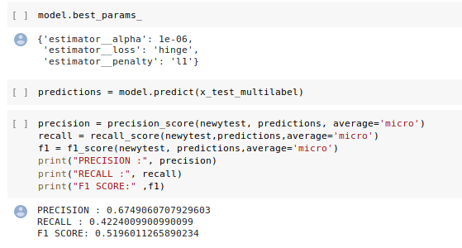
Hyper-parameter Tuning
With hyper parameter tuning on alpha and loss functions, the F1 score is further improved to 0.51
Notes:
Use the background points to post details that are not common knowledge, or that the audience will need to understand the context of the speech.
-Do not read these main points from the PowerPoint, instead elaborate on these points during the speech.
<number>

Slide 17
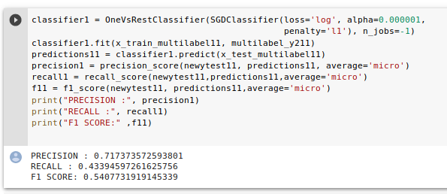
Feature Engineering
Considering the fact that title has more important than body, we gave more weightage to title.
Thus, on hyper parameter tuning for both loss function and alpha and with input as (3*title +description) the F1 score got improved to 0.54
Notes:
Use the background points to post details that are not common knowledge, or that the audience will need to understand the context of the speech.
-Do not read these main points from the PowerPoint, instead elaborate on these points during the speech.
<number>

Slide 18
Result and Conclusion
After tuning hyper-parameters ’alpha’ and loss functions, and thus obtaining highly improved F1 score, we train our model for predicting tags based on Stack Overflow questions.
Using this trained model, we developed a GUI that:
• inputs question title and description
• outputs one or more tags which are most relevant to the question
Notes:
Use the background points to post details that are not common knowledge, or that the audience will need to understand the context of the speech.
-Do not read these main points from the PowerPoint, instead elaborate on these points during the speech.
<number>

Slide 19
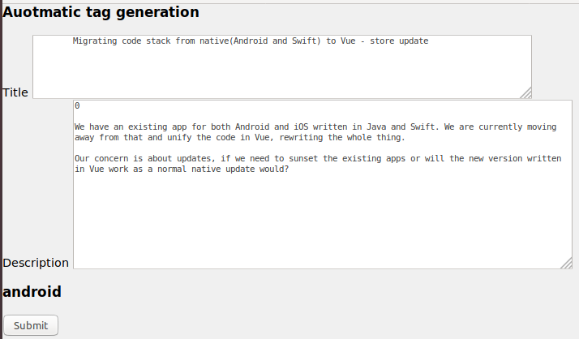
GUI sample
Title: Migrating code stack from native (Android and Swift) to Vue - store update
Description: We have an existing app for both Android and iOS written in Java and Swift. We are currently moving away from that and unify the code in Vue, rewriting the whole thing.
Our concern is about updates, if we need to sunset the existing apps or will the new version
written in Vue work as a normal native update would?
Predicted Tag: android
Notes:
Use the background points to post details that are not common knowledge, or that the audience will need to understand the context of the speech.
-Do not read these main points from the PowerPoint, instead elaborate on these points during the speech.
<number>

Slide 20

Thank You.
Thank you.
Notes:
The action step is what the audience is supposed to do or think about the topic. It should be one sentence that is written clearly and with much thought. It may also be the thesis statement restated as an action. The goal of this slide is to leave the audience with a clear message as to what they are to do or think at the end of the speech. It may be a good idea to end with a powerful quote or image.
<number>

