Slide 1
ME623 Dynamics of Machining Processes
Group No: 13
Ashok Santosh Menon - Roll No. 220103023
Aditya Singh - Roll No. 220103003
Amit - Roll No. 220103010

Slide 2
Introduction, Objectives and Methodology
Objective
This project leverages machine learning to build a robust chatter detection system using acceleration signals from the turning process.
Introduction to Chatter
Chatter is a form of self-excited vibration during machining operations such as turning, milling, or drilling. It is typically caused by the interaction between the cutting tool and the workpiece, leading to unstable cutting forces. These vibrations are often regenerative, meaning the waviness from one tool pass affects the next.
Need for Machine Learning-Based Detection
With the growing adoption of Industry 4.0, there's a shift towards:
Automated, data-driven monitoring systems
Real-time feedback for process control
Robustness across variable machining conditions

Slide 3
Introduction, Objectives and Methodology
Experimental Setup
Machine tool: Lathe/Turning machine
Work piece: Mild Steel
Cutting tool: Single-point cutting tool
Sensors: Force sensors, INVH app[accelerometer]
Methodology
Data Collection
Acceleration vs time data for three axes using BOSCH INVH app for turning process at varying spindle speed and depth of cut.
Preprocessing & Segmentation
Segmenting data into 1-second windows and sampling frequency of 407Hz
Feature Extraction
Time domain – rms, std, peak-to-peak, skew, time kurtosis
FFT – energy band ratio, dominant frequency, spectral centroid, peak count, spectral kurtosis
Semi-Automated Labelling
Use of K-means clustering to classify data into two clusters as per the features, and then labeling accordingly
Supervised Model Training
Use of Random Forest, XGboost, SVM, and KNN models for training
Combining the predictions of these models to create an Ensemble Model [Voting Classifier] to boost performance.
Evaluation & Visualization

Slide 4
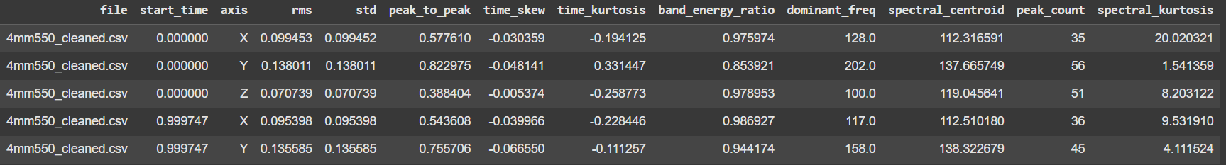
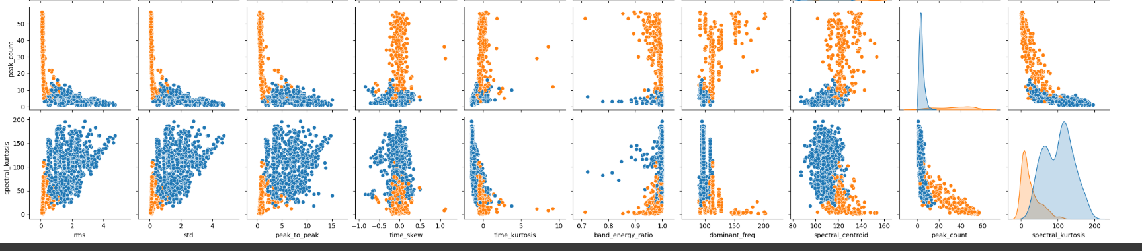
Results and Discussions
The first five rows showing the extracted features
Cluster showing the top two features and their relationship with the remaining features

Slide 5
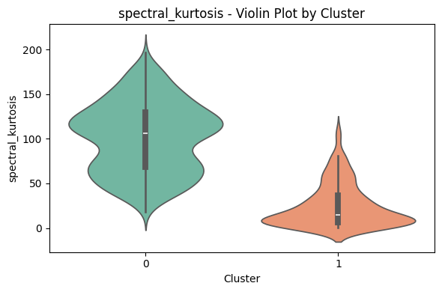
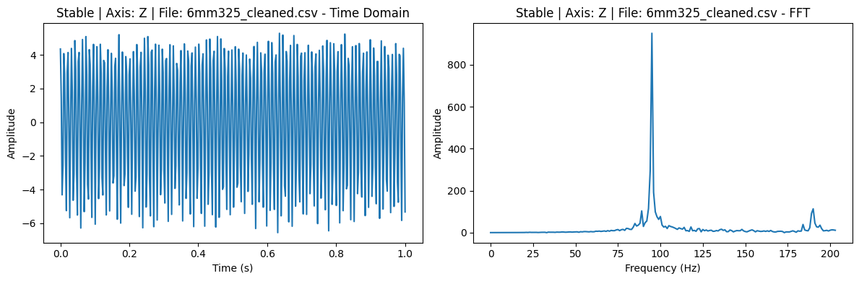
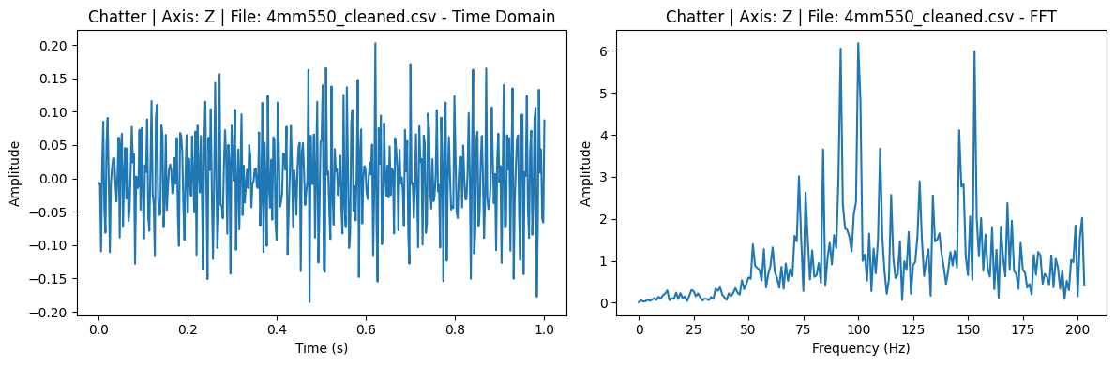
Results and Discussions
Violin plot showing the clear distinction between the two clusters

Slide 6
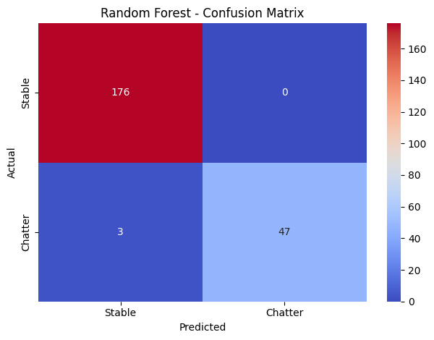
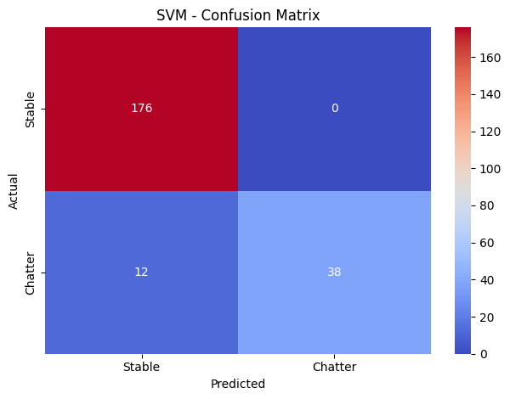
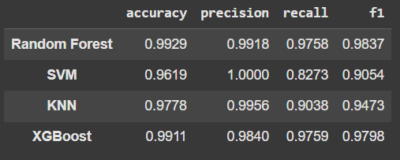

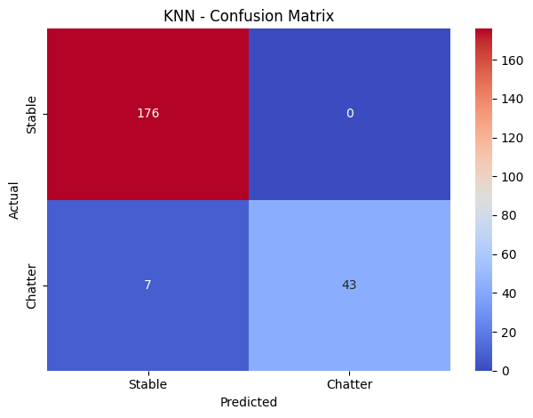
Results and Discussions
Although SVM achieved perfect precision, it underperformed in recall, indicating more false negatives, which could be critical in real-world manufacturing, where missing chatter can lead to damage.
KNN performed reasonably well but had higher variability, especially in ROC AUC, suggesting sensitivity to the feature space and sample density.
Among all the individual classifiers tested, Random Forest and XGBoost delivered the best performance with >99% accuracy, high F1-scores, and near-perfect ROC AUC (~0.9995).

Slide 7
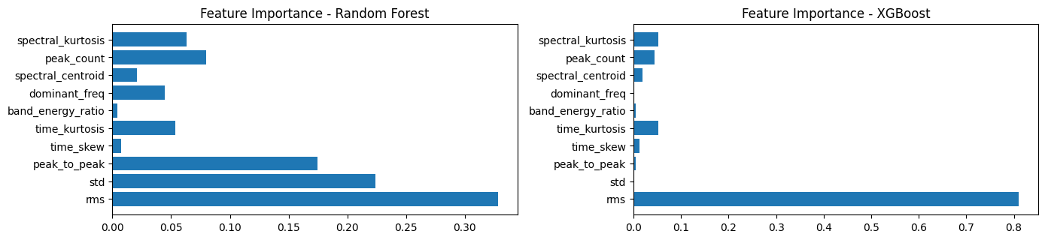
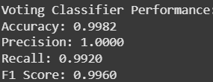
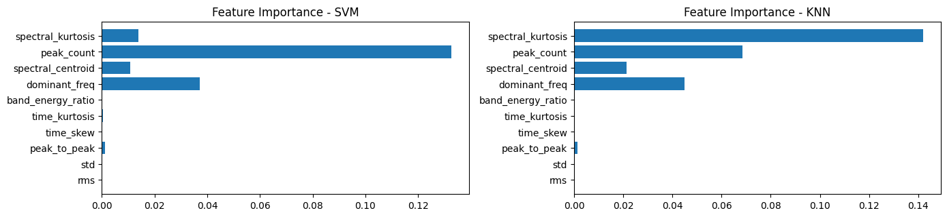
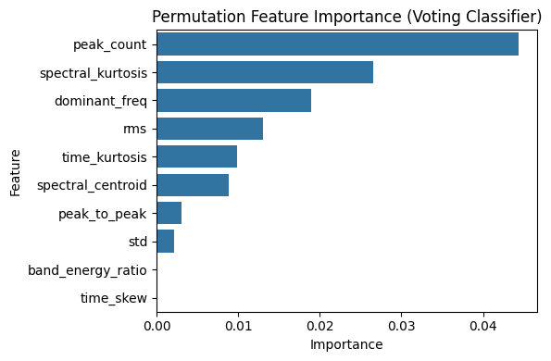
Results and Discussions
Individual feature importance for each model
Feature importance of the final ensemble model

Slide 8
Conclusions
Time Domain:
Chatter signals demonstrated a notably higher RMS, peak-to-peak amplitude, and standard deviation, highlighting the larger energy content and oscillation amplitude compared to stable cuts.
Time skewness varied, suggesting an asymmetry in signal shape, which could correspond to unbalanced or irregular force patterns during chatter
Frequency Domain:
Chatter signals exhibited:
Higher spectral kurtosis – indicative of sharp, isolated peaks in the frequency spectrum, often due to resonance or impulsive behavior.
More spectral peaks – pointing to multiple harmonic components and complex vibration modes.
Elevated band energy ratio – reflecting energy concentration in specific frequency bands typical of regenerative chatter
Model Performance:
The ensemble model consistently associated chatter with higher energy, more chaotic frequency distributions, and abrupt signal characteristics.
Chatter occurrence increases with higher depths of cut and certain spindle speeds, where machining enters unstable zones due to amplified vibrations characterized by higher energy.

